Slide 1
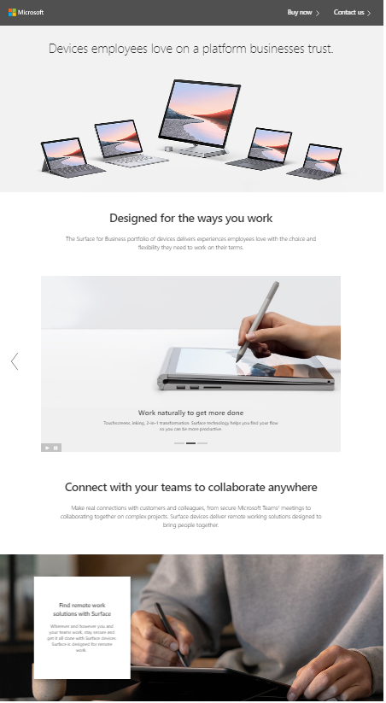
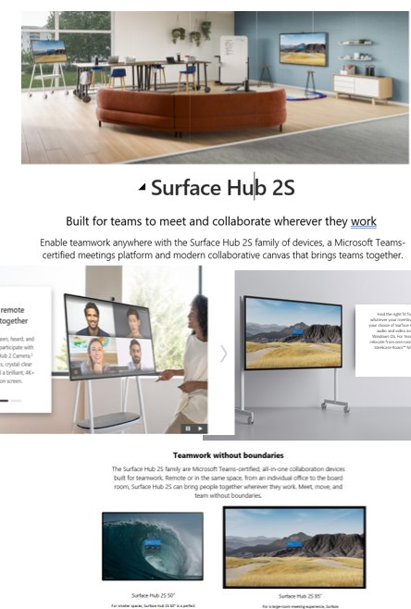
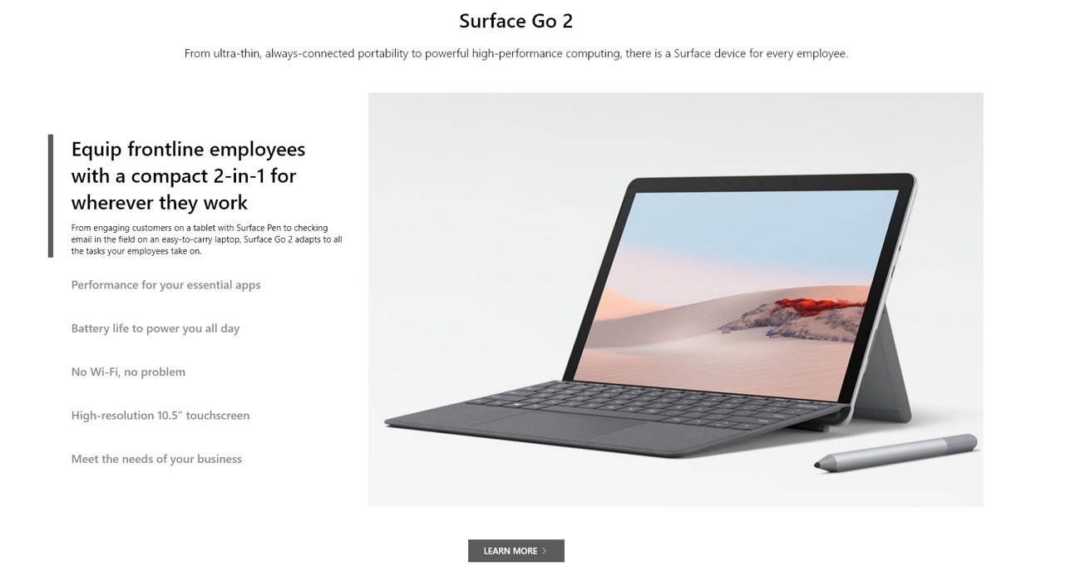
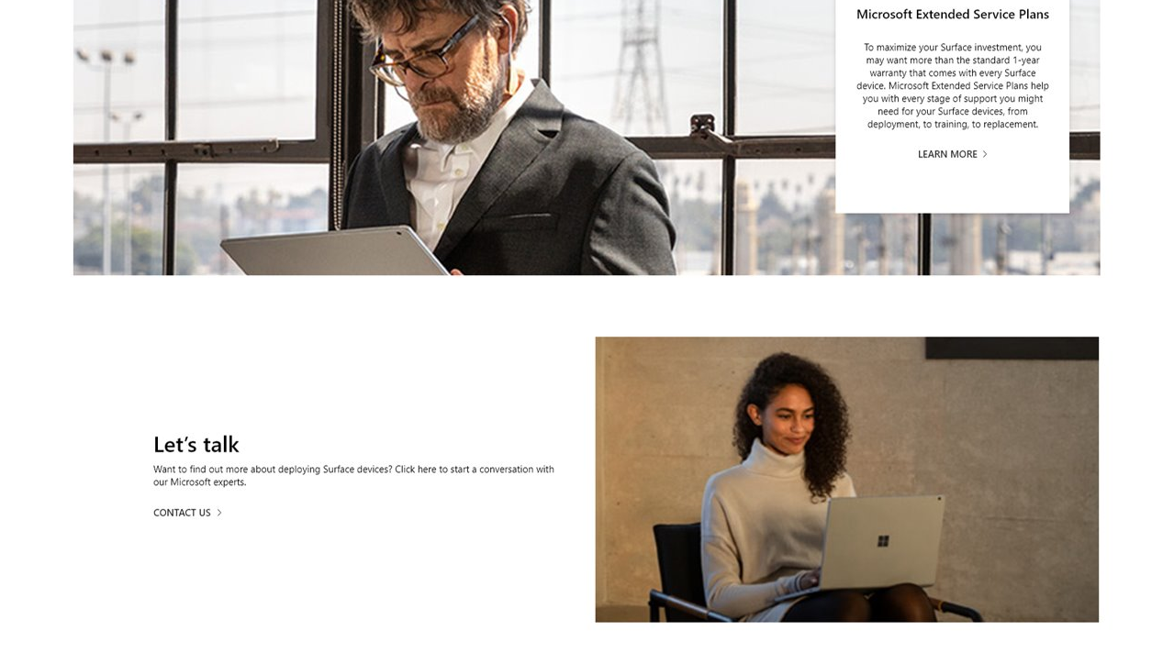
Partner Marketing Guidance - Web
Item | Description | Thumbnail | Resources
Surface on the Homepage | Surface mentioned on Reseller homepage with enough prominence that a visitor will see this. |  | Find imagery Find logos Download Authorized Reseller Badge
Surface Landing Pages Syndication | The Digital Commerce Web and Campaign Network (DCCN) is a web-based portal offering two customized Surface landing pages that easily integrate product imagery and specifications into your webpage: Surface portfolio and Surface Hub. |  | Showcase Surface on your site Go to the Microsoft DCCN home page to create an account and choose the Surface portfolio or Surface Hub landing page to integrate into your website.
Surface Product Specific Content Syndication | In partnership with Microsoft, the CNET Inline Content Syndication program provides free syndicated Surface product specific content, including Surface device images and tech specifications. |  | Showcase Surface on your site Register on the CNET portal to get started with syndicated content and receive pre-generated JavaScript code that you can apply to your product page
Web design comp | The web design comp is a visualization of web components, messaging and imagery to provide inspiration on how to build your own Surface website. |  | Find imagery by theme Devices Enable remote work Security Education

