Slide 1
Surface Commercial Digital Marketing Playbook
Guidance for digital marketing and demand gen impact for Surface Partners

Slide 2
Enabling Surface Partner Digital Marketing
Our commitment is to provide our partners with a consistent array of content and digital assets to enable more relevant marketing and customer lead gen to increase new business.
Consistency to Microsoft Campaigns
Aligned to Surface business priorities
Consistent assets & content with worldwide Surface
GTM program recommendations
Campaign aligned digital assets for both sustain and product launches
Thematic content including decks, eBooks, infographics aligned to campaign
Consistent assets & content availability to Microsoft teams
Sustain marketing assets aligned to priority business themes for Microsoft & Surface
Thought leadership content & solution content available
GTM BOMs supporting business priorities.
Core product assets including pitch decks, fact sheets, & FAQs
Digital marketing assets including email templates, flyers, social and web assets
Thought Leadership content
Recommended partner digital marketing tactics
Partner lead gen programmatic marketing program - Digital Marketing Content OnDemand
Surface and Intel co-marketing campaign – Decide what’s next

Slide 3
Recommended Partner Digital Marketing Tactics
GOOD EXECUTION
FUNDAMENTAL RECOMMENDATION
BETTER EXECUTION
ACTIVE RECOMMENDATION
BEST EXECUTION
ACCELERATE RECOMMENDATION
WEB
Surface mentioned on reseller homepage with enough prominence that a visitor will see. Use of the Authorized Surface Reseller badge.
Landing page for Surface with basic value proposition and portfolio description.
WEB
Surface on reseller homepage that links to a Surface landing page or content to learn more.
Surface landing page with content to move customer from awareness to consideration.
Surface product pages with messaging and tech specs with call to action to contact us.
WEB
Surface on reseller homepage that links to thought leadership content.
Surface landing page includes thought leadership content as lead gen.
Product pages enabled for ecommerce.
DIGITAL & RELATIONSHIP MARKETING
Use thought leadership content as lead gen. Use existing customer list. Require email details to access the content and have a short 2-3 content piece follow-up with call to action of contact me.
Use short form content (infographics and one-pagers) in emails to engage customer with a contact me call to action.
Run lead gen on affiliate networks.
DIGITAL & RELATIONSHIP MARKETING
Establish a bi-weekly blog using Digital Marketing Content OnDemand or from experts within your organization talking about the key issues facing organizations, layer in how Reseller and Surface + can help.
Hold quarterly webinar focused on Surface +. Surface + Modern Management, Surface + Security, Surface + Teams.
Use digital lead gen- emails to your customer base & run lead gen on affiliate networks.
DIGITAL & RELATIONSHIP MARKETING
Partner with Microsoft to develop a TAL (Target Account List) to use in lead gen motions.
Send follow-up email to webinar participants using thought leadership content and sign-up for future emails.
Establish device experience program as part of follow-up.
SOCIAL MARKETING & SOCIAL SELLING
Weekly posts on LinkedIn using Digital Marketing Content OnDemand to drive visitors to reseller website to learn more.
SOCIAL MARKETING & SOCIAL SELLING
2-3 posts a week on digital channels including LinkedIn and blog using social assets on the SRA portal or Digital Marketing Content OnDemand.
SOCIAL MARKETING & SOCIAL SELLING
Boost social post 1 x monthly to increase reach.

Slide 4
Digital Marketing
Content Planning & Enablement

Slide 5
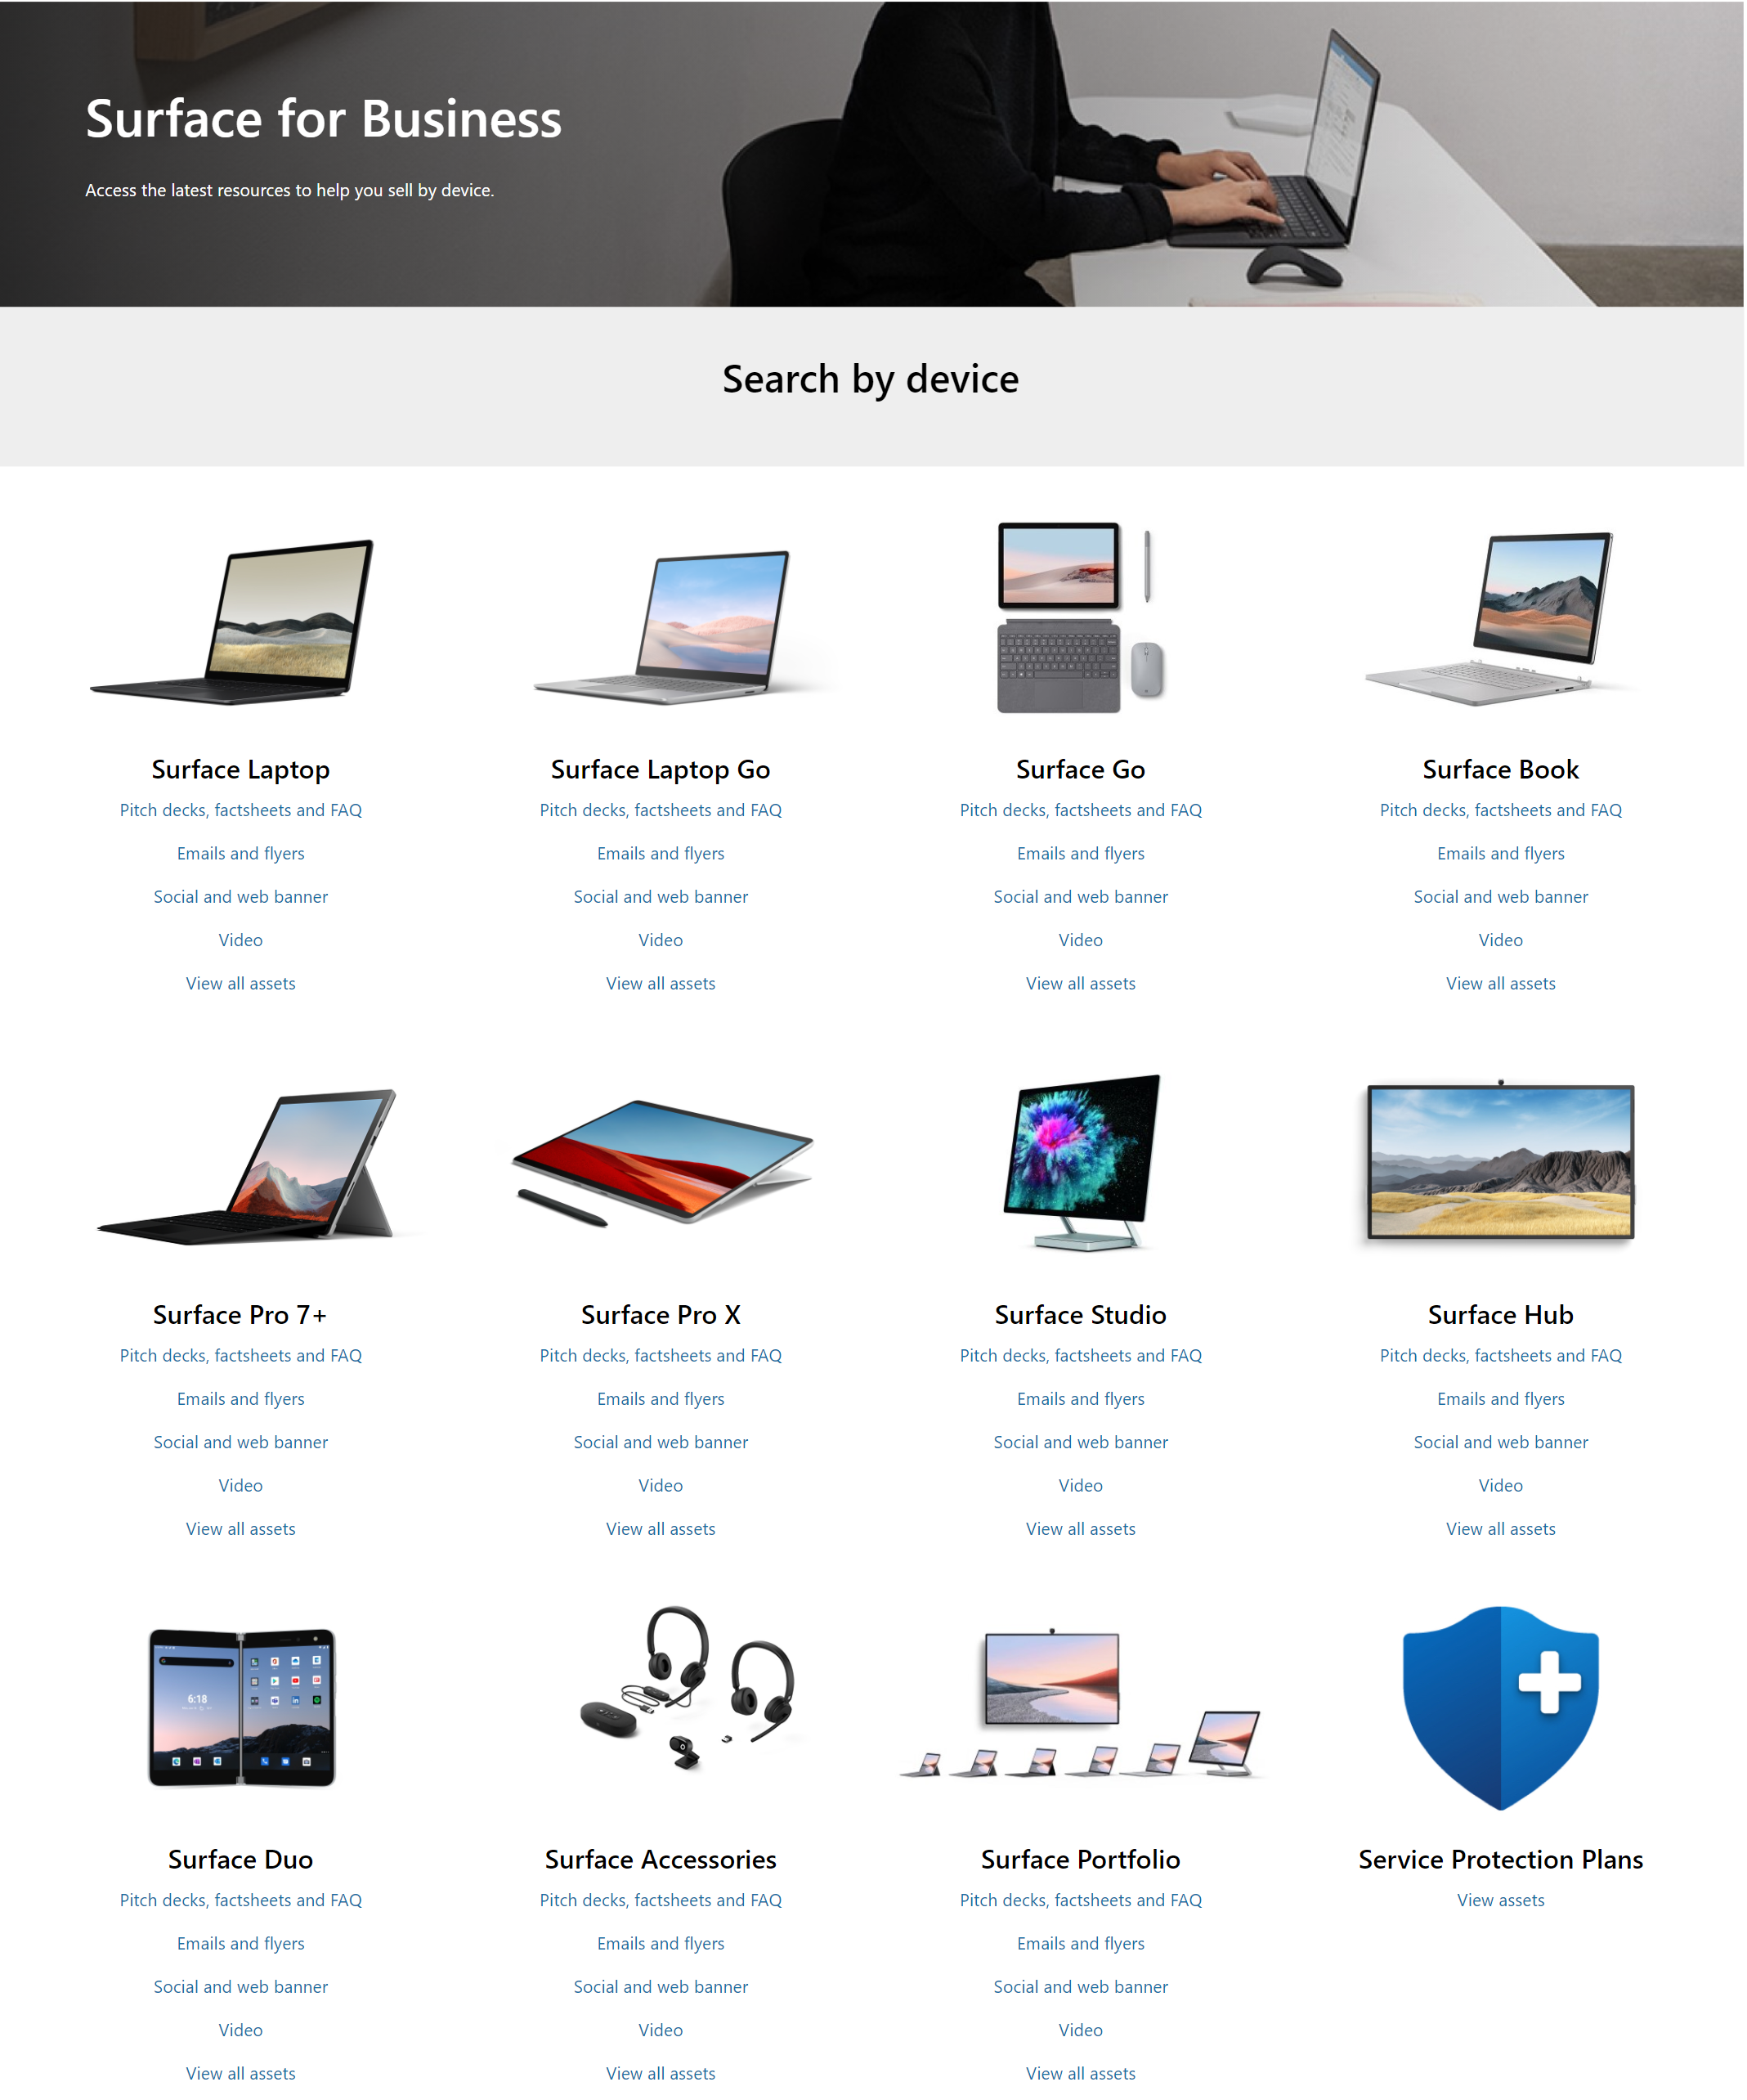
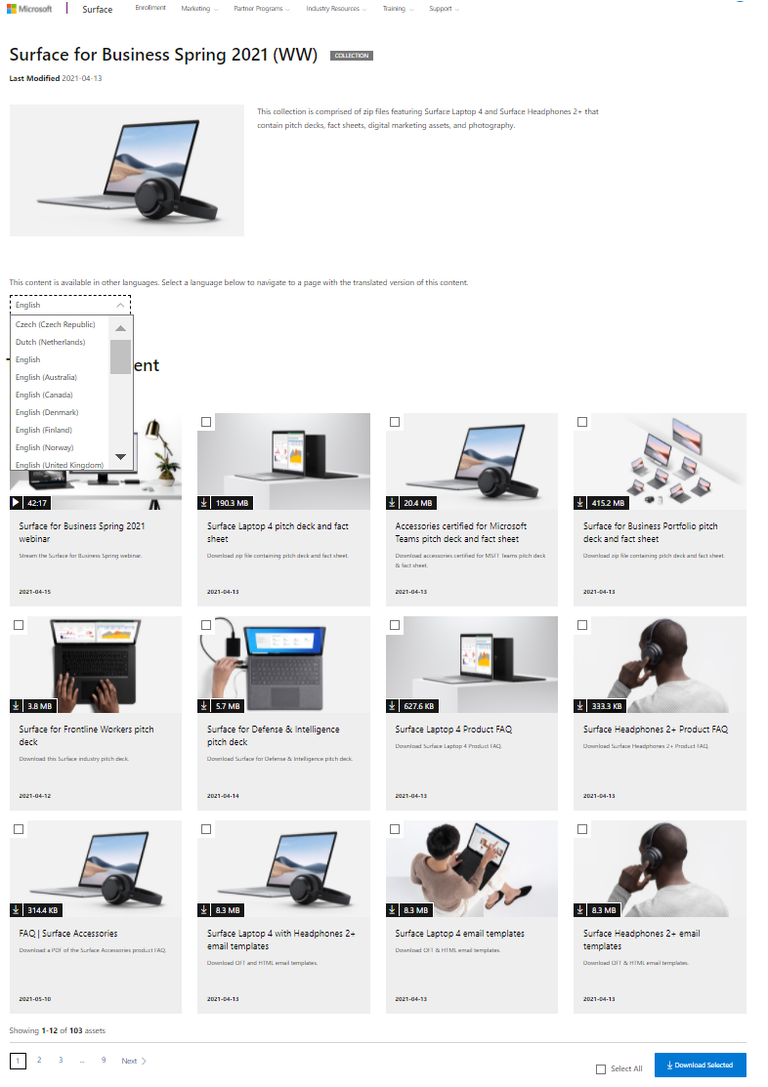
Access a variety of resources, content, and assets on the Surface Reseller Alliance (SRA) portal to grow your business.
Providing the full breath of Surface assets
Example of the digital marketing and launch assets on SRA portal
Explore the benefits of the SRA Portal
Full breadth of Surface content and assets to drive interest and push towards consideration.
Find ready-made pitch decks, fact sheets, imagery, and digital marketing assets including thought leadership lead gen assets.
Keep up with Surface news, product launches, and trainings.
Landing pages to locate assets by marketing themes

Slide 6
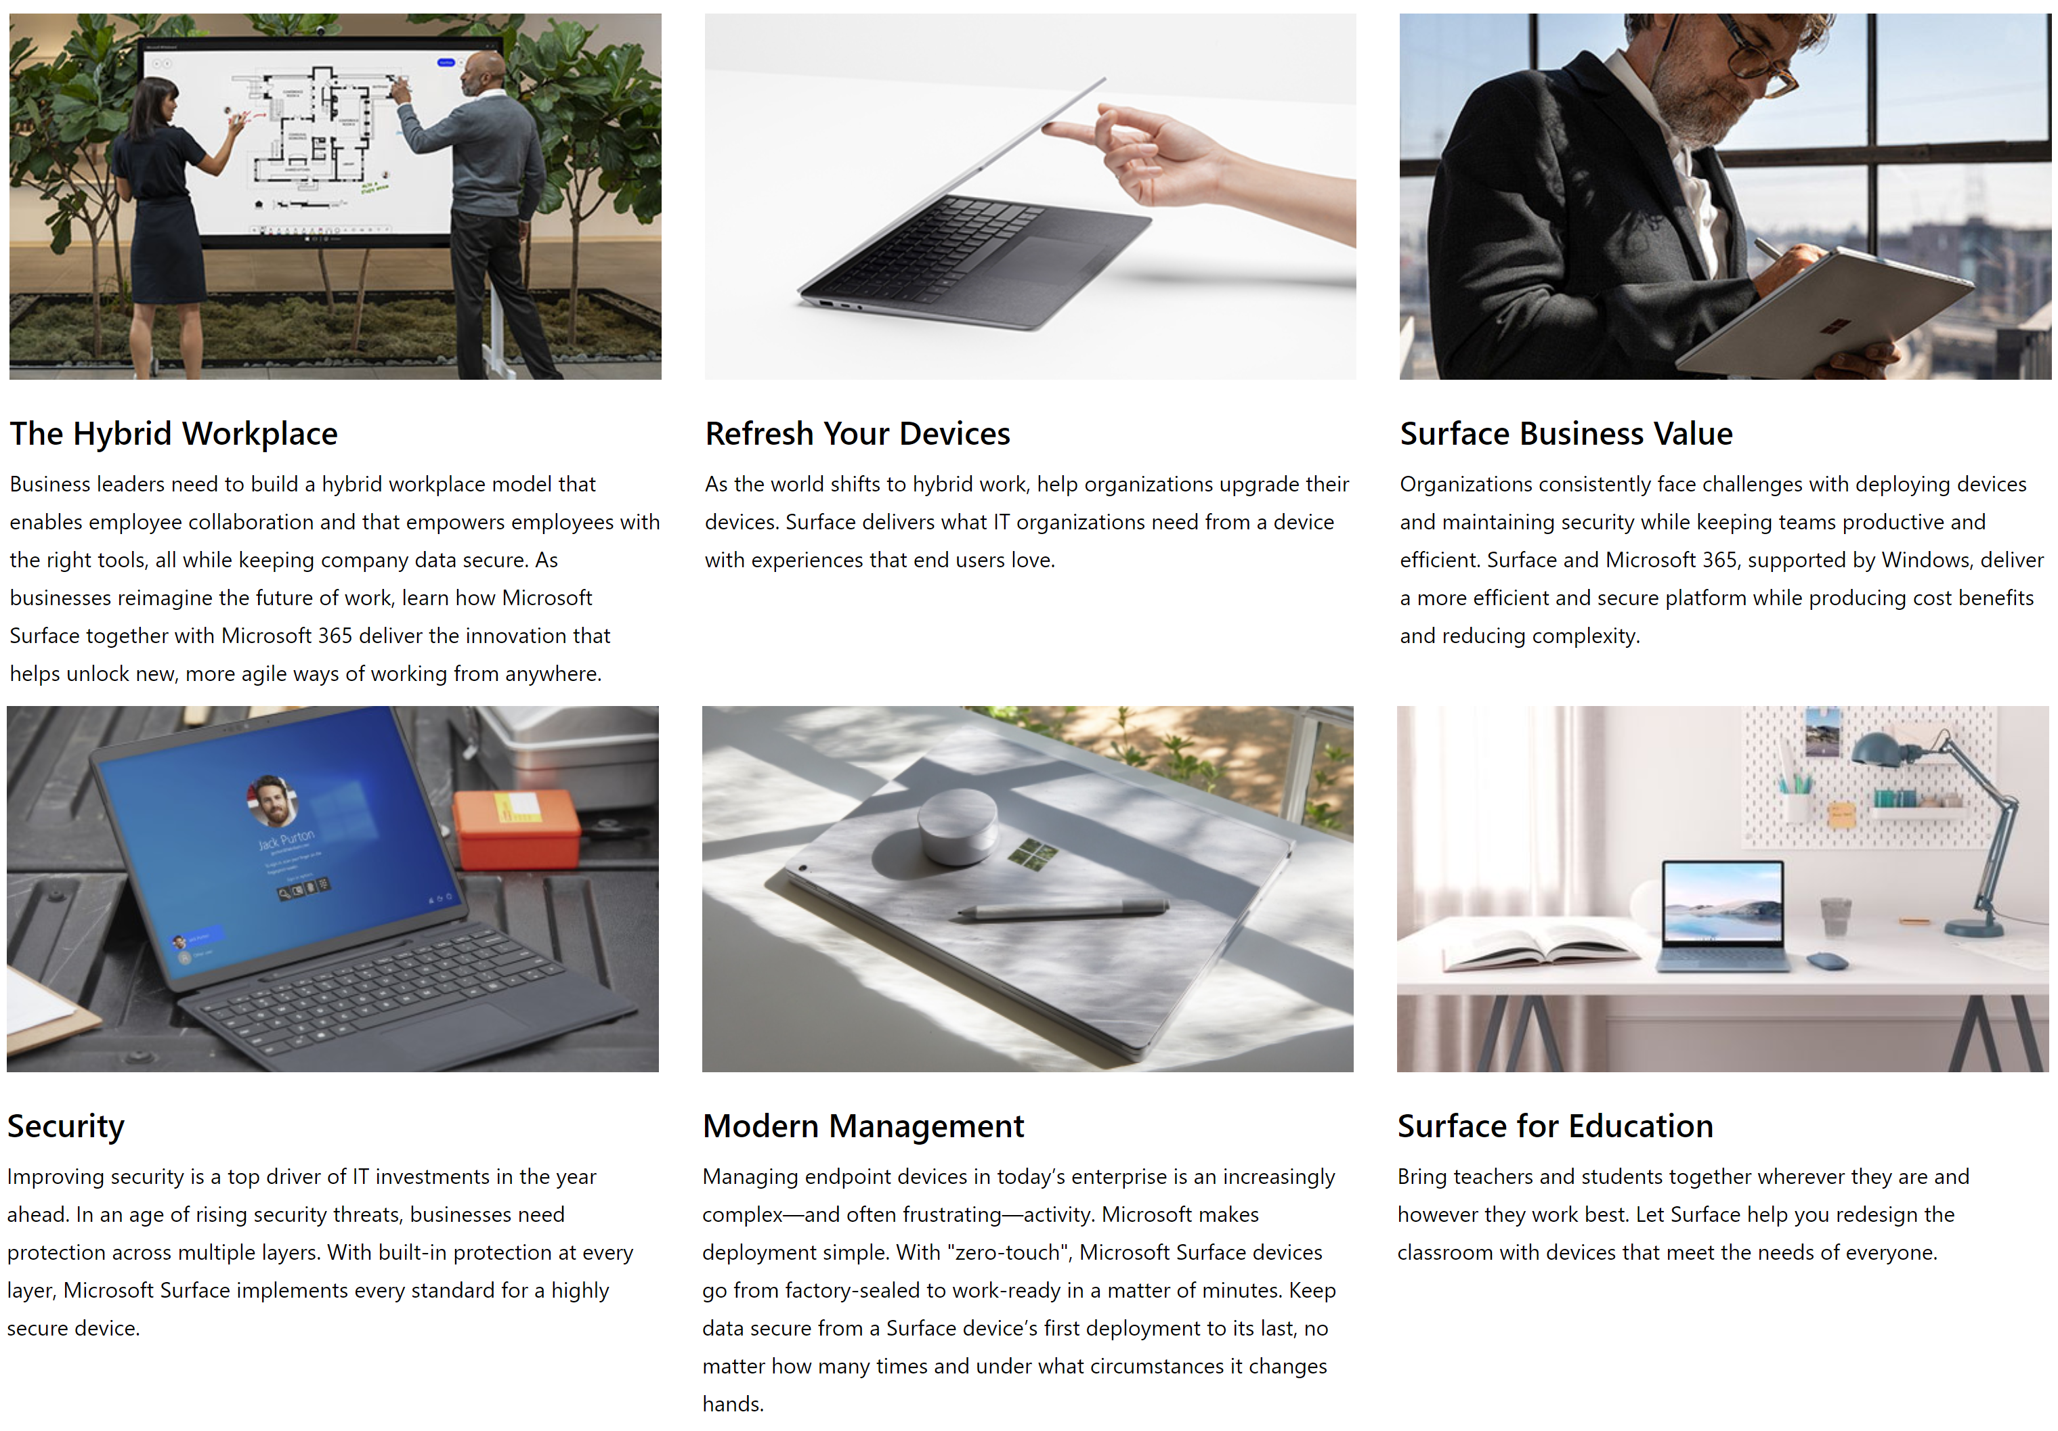
Surface Commercial Content Themes
Explore content and assets that pertain to each of our key content themes this fiscal.
Learn about the FY22 themes
Explore pitch decks, eBooks, flyers, emails, social, and imagery by each theme.
Find campaigns for your local market.
Find content related to topics of interest such as sustainability.

Slide 7
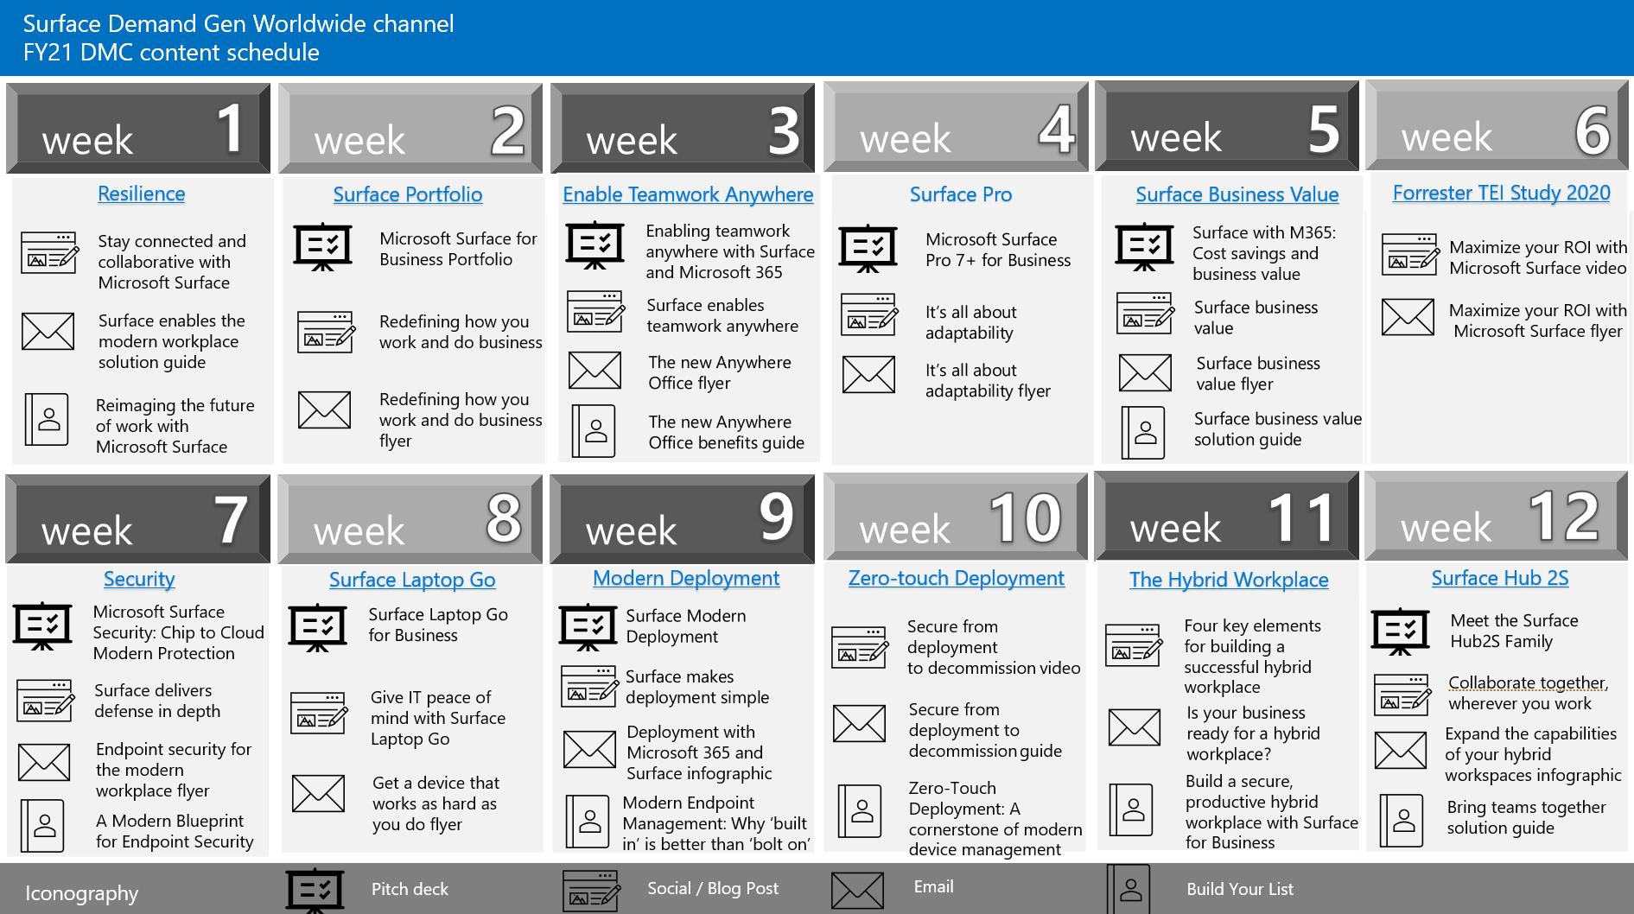
Digital Marketing Content OnDemand (DMC) is an automated marketing platform provided at no charge to Microsoft Partners that delivers comprehensive digital marketing campaigns that enable partners to efficiently execute lead gen marketing.
Programmatic Partner marketing lead gen program
Start capturing more customers
Surface WW channel 12-week calendar
Build digital presence with consistent on-line engagement.
Save time with automated posting to digital channels and co-branding with partner logo.
Generate and track leads with easy reporting.
Receive fully integrated Surface themed campaigns.

Slide 8
Define what’s next, a Surface and Intel co-marketing partner campaign is to drive consideration of Surface devices and defend against Google and Apple.
Surface + Intel co-marketing campaign
Define what’s next BOM
Assets include training and onboarding, sales enablement, demand generation, and lead nurture.
All assets reflect Surface imagery, branding, messaging and value prop.
Get started with the campaign playbook to learn more.

Slide 9
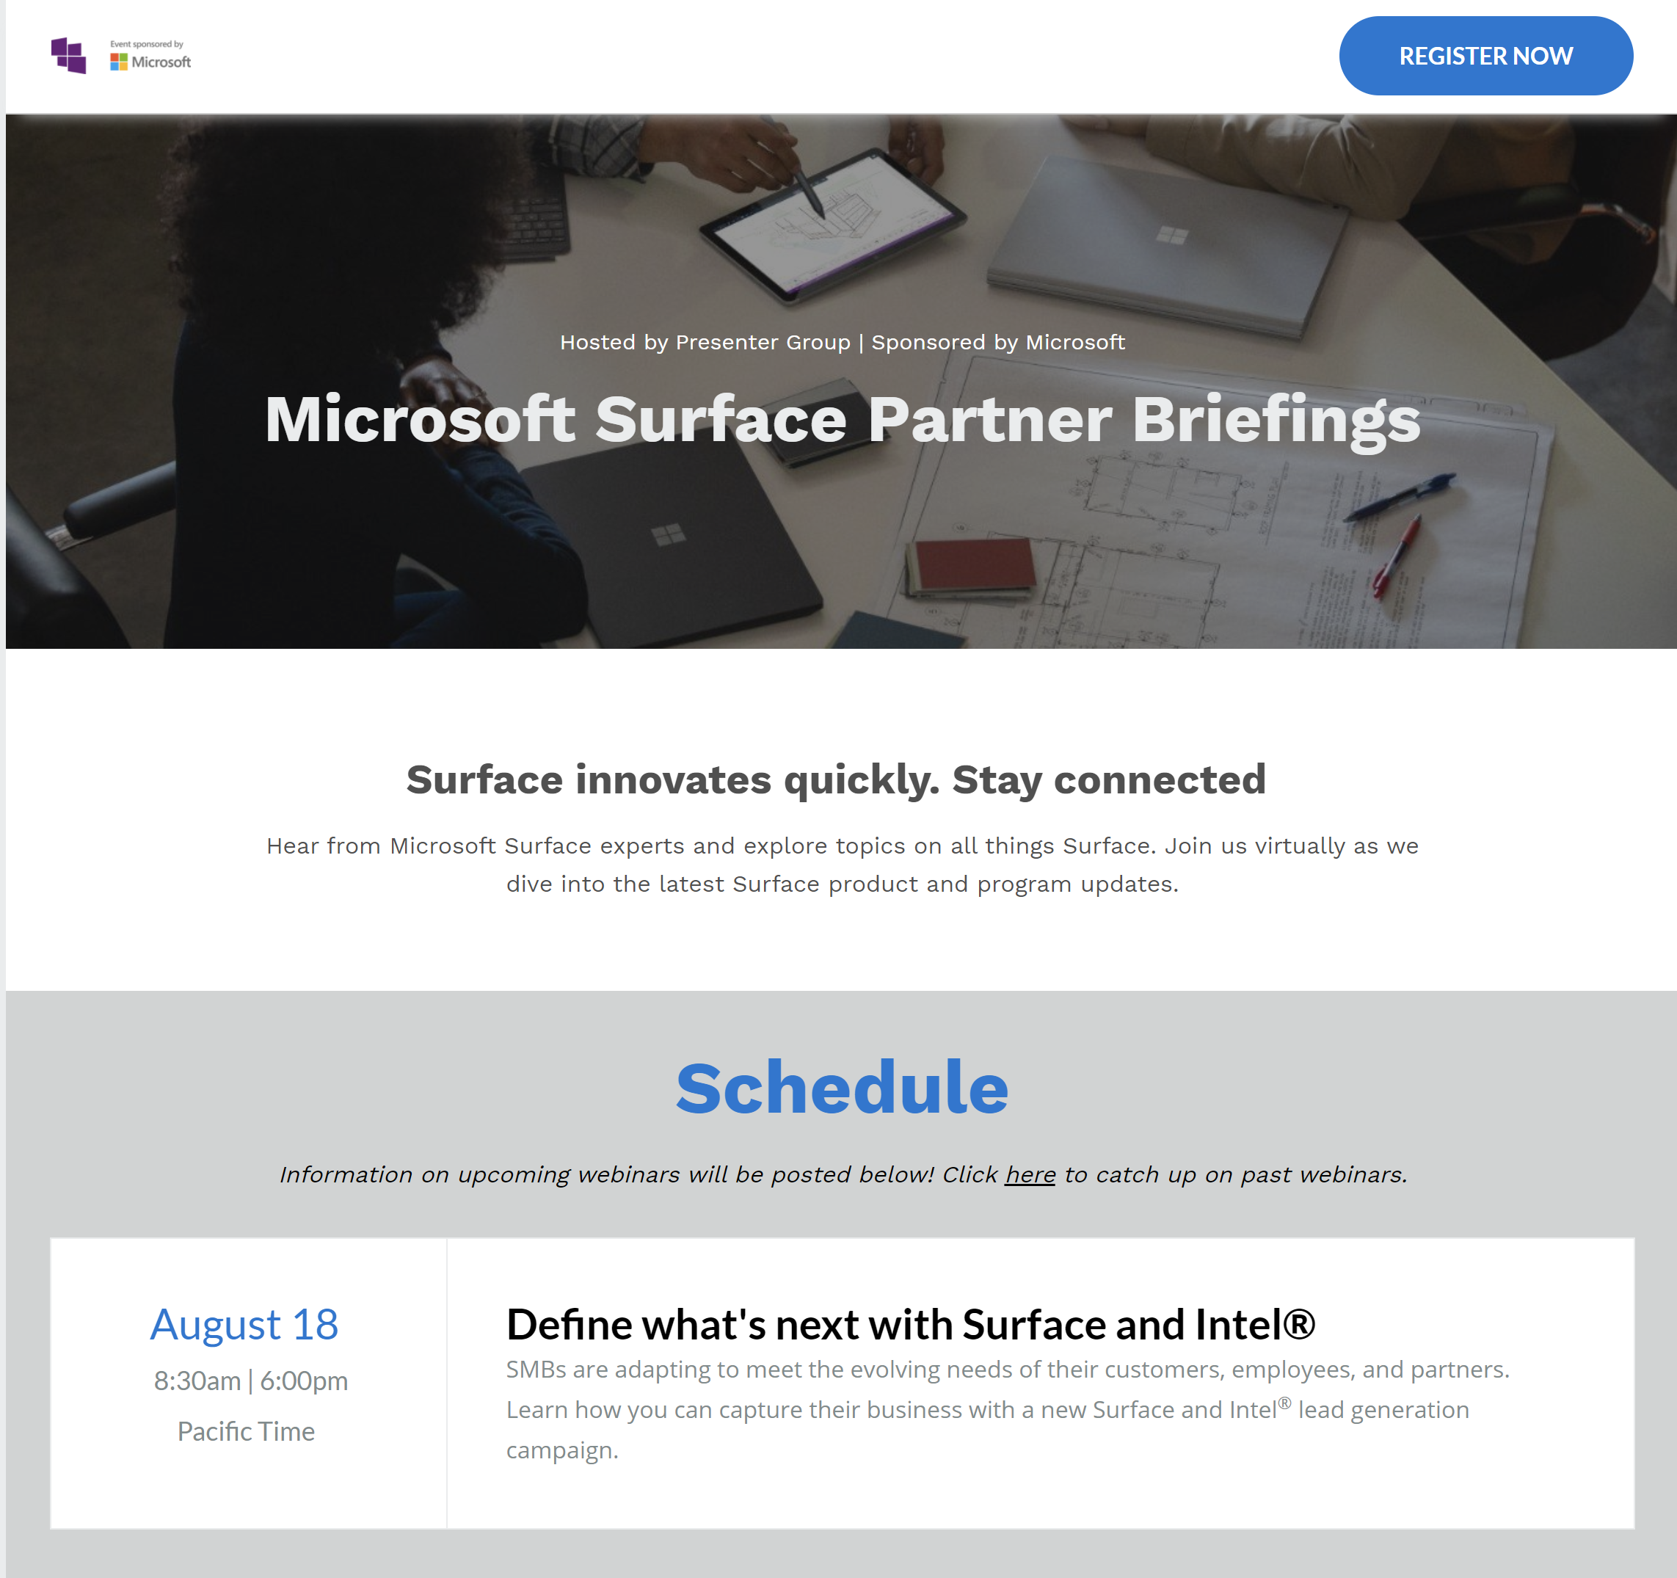
The Surface partner newsletter and webinar series provides Surface Partners with information and assets to help them effectively sell Surface and grow their business.
Stay connected with Microsoft Surface
Increase Surface Partner knowledge
Sample of the Surface newsletter and webinar series
Subscribe to receive monthly communications across product news, partner programs, offers, readiness, digital marketing, and more.
Register for the monthly partner briefings to hear from Microsoft Surface subject matter expertise.

Slide 10
Digital Marketing
Resources

Slide 11
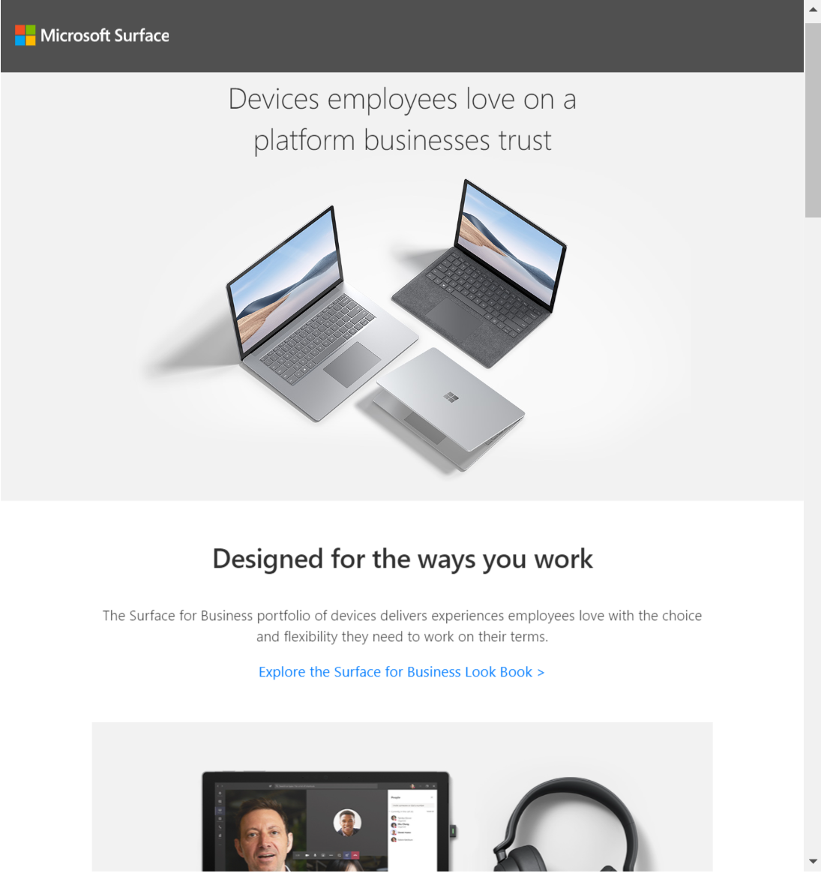
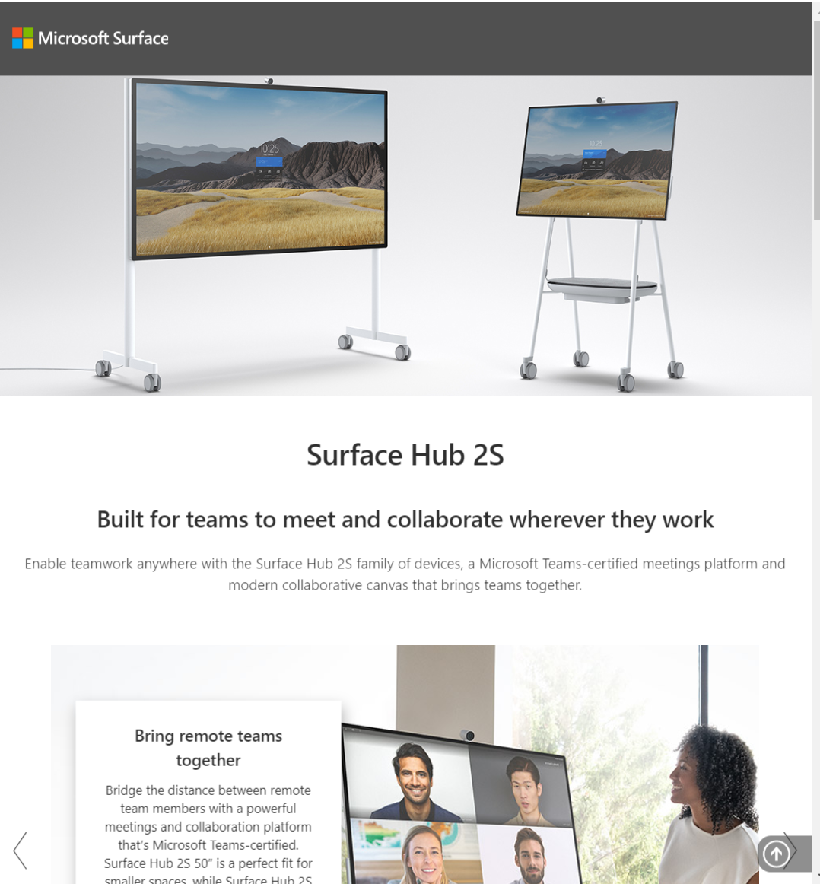
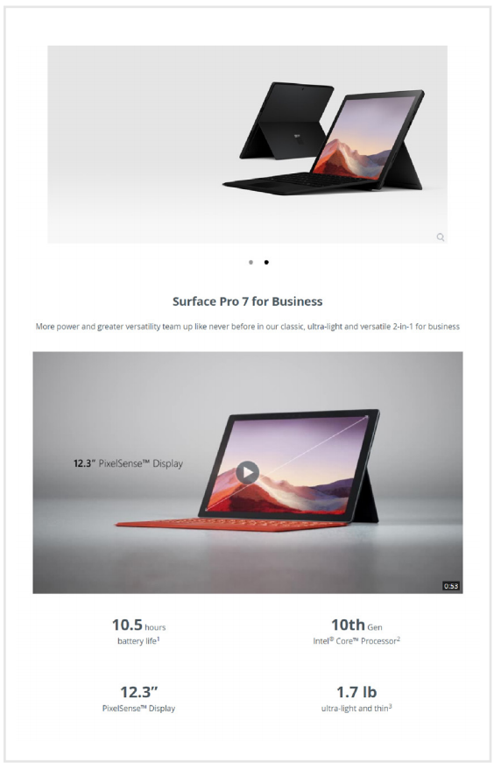
Web
Item | Description | Images | Link
Surface on the Homepage | Surface mentioned on Reseller homepage with enough prominence that a visitor will see this. |  | Product Imagery
Surface Landing Pages Syndication | The Digital Commerce Web and Campaign Network (DCCN) is a web-based portal offering two customized Surface landing pages that easily integrate product imagery and specifications into your webpage: Surface portfolio and Surface Hub. |  | Showcase Surface on your site Go to the Microsoft DCCN home page to create an account and choose the Surface portfolio or Surface Hub landing page to integrate into your website.
Surface Product Specific Content Syndication | Enhance your product pages with Surface content to educate your customers about the value of the Surface devices they’re considering. In partnership with Microsoft, the CNET Inline Content Syndication program provides free syndicated Surface product specific content, including Surface device images and tech specifications. |  | Showcase Surface on your site Register on the CNET portal to get started with syndicated content and receive pre-generated JavaScript code that you can apply to your product page

Slide 12
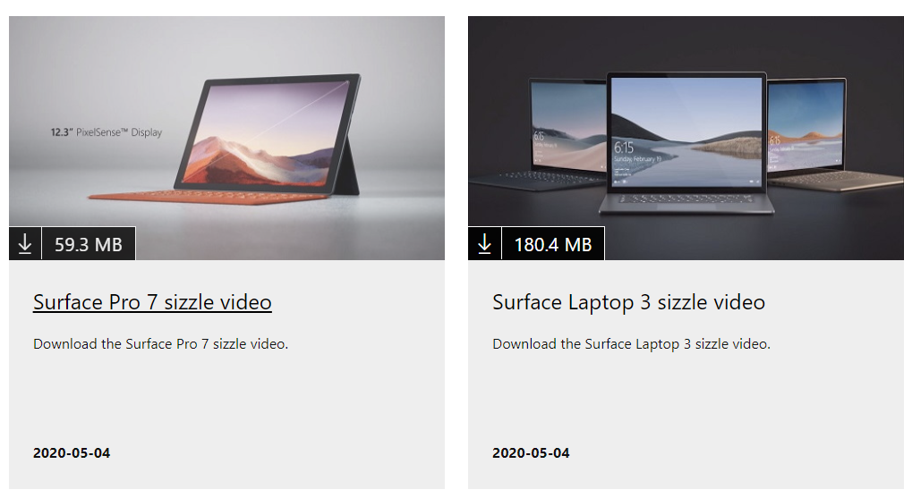
Digital Marketing
Item | Description | Images | Link
Authorized Reseller Badge | Download the Microsoft Surface Authorized Reseller badge, license and guidelines to use on web, social, and marketing materials. |  | Guidelines Badge assets and license agreement
Videos | These guidelines and assets are intended for Surface Partners when using Microsoft Surface-led videos to market Microsoft Surface products. |  | Guidance Assets Surface for Business sizzle videos Surface Hub2S sizzle videos
Customer Stories | Access library of customer stories to use as call to action on web and social. |  | Read now

Slide 13
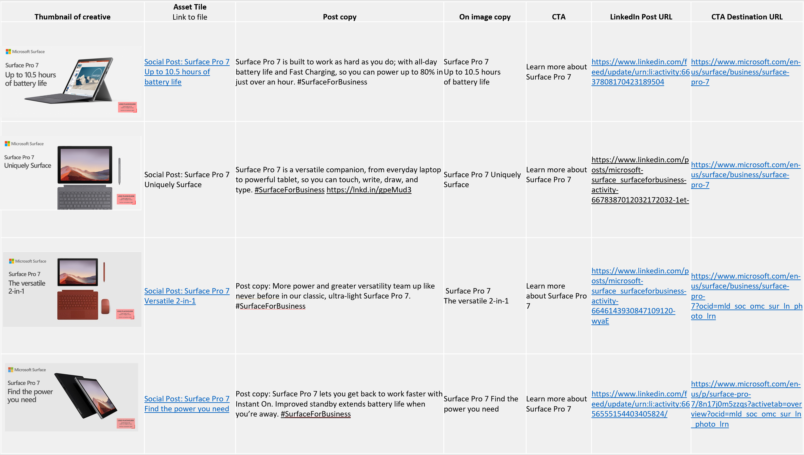
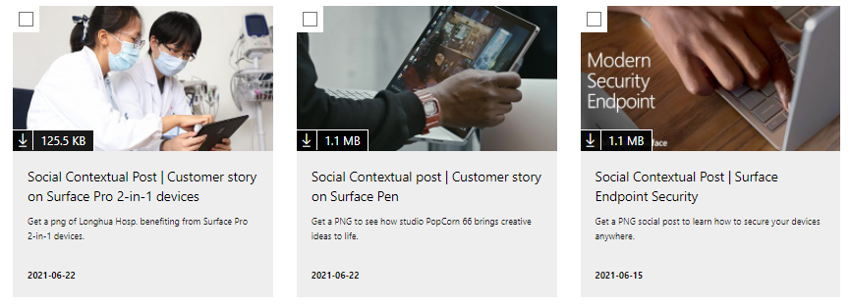
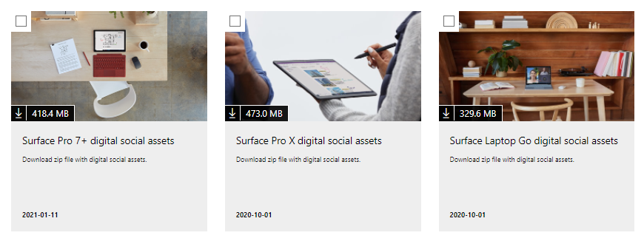
Social
Item | Description | Images | Link
How-to Guide: Social Posts | This document offers guidelines for building Surface social posts, adding your logo, and a library of examples for use. |  | Guidance
Product social assets | Social assets highlighting the features that differentiate Surface from our competitors, driving consideration for our devices. |  | Search collection
Contextual social assets | Social assets showcasing people with Surface devices and how Surface enables collaboration, productivity, and work your way. |  | View collection
Animated social assets | Explore a collection of product and contextual animated social assets. Use the animation How-to guide to learn how to build social posts using these assets. |  | View collection

Slide 14
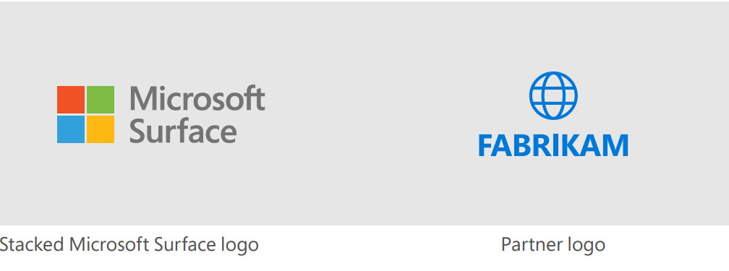
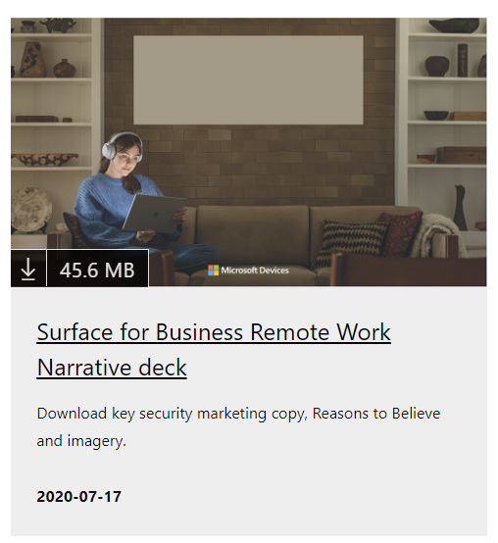
Brand and Messaging
Item | Description | Images | Link
Microsoft Partner Logo Guidelines | These guidelines cover the use of partner logos within Microsoft Surface led-materials, as well as the size relationship between logos in jointly created communications. |  | Download guidelines
Surface Narrative Decks | Download source of key marketing copy, Reasons to Believe and imagery for Education, Remote Work and Security to use in marketing campaigns. |  | Education Remote Work Security

Slide 15
Thank You

