Slide 1
Surface for Business Essentials
Protect | Manage | Support | Repair

Slide 2
Surface for Business Essentials
Customer empowered Surface solutions for business
More control
Customers gain more control over how they protect, manage, repair and maintain security of their Surface devices.
More options
The customer decides which device repair option to use to get their device back online when an issue arises.
Better value
From streamlined management, to extended protection coverage, you can lower your total device cost of ownership.
Notes:
Surface for Business Essentials is a comprehensive collection of solutions designed to empower commercial customers by providing more control, more options and better value for protecting, managing, and extending the use of their Surface devices.
More control:
When we say control, we mean the following:
Maximized productivity. Surface devices reduce downtime with in-house device repair and replacement components using step-by-step repair guidance for each repairable Surface model.
Improved device security. Self-service repair, replacement components and Drive (SSD) Retention enables customers with more control of their Surface devices.
Manage device health at scale. The Surface Management Portal and Hardware Support Portal provide end-to-end visibility and management of Surface devices to quickly identify and resolve issues that may occur.
More options:
More options refer to options for repairing or servicing your device. Benefits here include:
Maximum efficiency. You can get self-service repair with experienced in-house skilled device technicians.
Trusted in-region repair. For customers who prefer device repair by Microsoft-authorized technicians, there’s trusted in-region repair.
Customized repair solutions. ASPs can also provide tailored device repair services to meet customers unique needs.
Better value:
Better value means getting the most out of your investment in terms of lifecycle, planet impact, and more.
Device sustainability. The reduce, reuse and recover circularity model of Surface devices minimizes waste and extends the lifespan of our devices for as long as possible.
Investment protection. Enhanced protection plans and service options, provides investment protection and extends the use of Surface devices.
Reduce IT cost. The ability to centrally view and manage Surface devices across a hybrid organization helps customers reduce manual work and reduce IT costs.

Slide 3
Surface for Business Essentials
The complete built for business experience
Investment protection
Streamlined management
Optimized support
Simplified repair
Notes:
Purpose: To show how businesses can get more out of their devices with Surface for Business Essentials.
Key points:
Surface + Surface for Business Essentials provides the complete built for business experience
Surface for Business Essentials help businesses and IT reduce downtime, lower IT costs and protect Surface device investments.
Surface for Business Essentials provides comprehensive tools and resources to empower Surface customers to decide what best fits the needs of their business.

Slide 4
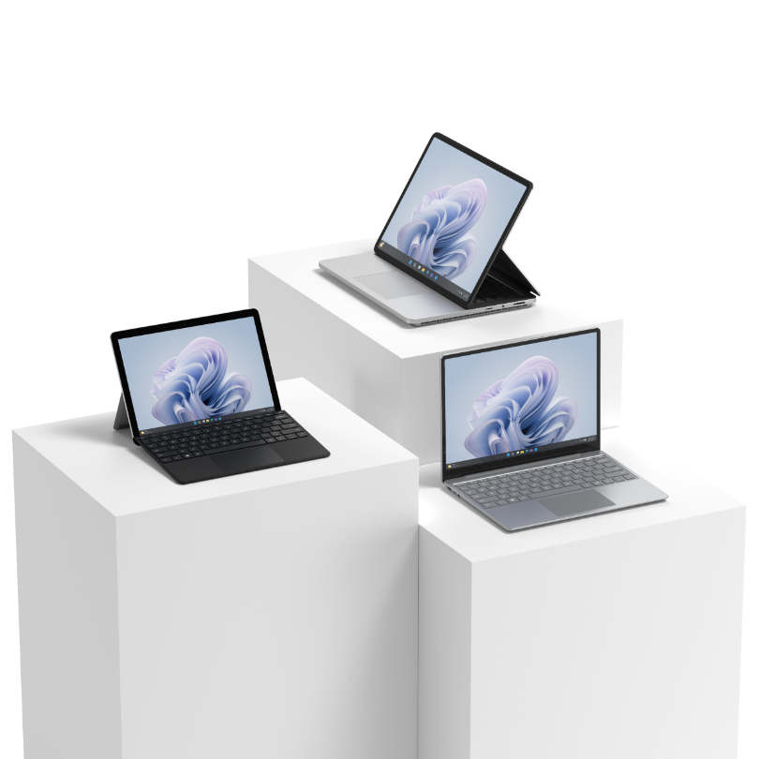
Investment protection
Each Surface device comes with a one-year Microsoft Limited Hardware Warranty¹. For customers who want to maximize and protect their Surface investments beyond the warranty they can purchase one of the available Microsoft Protection Plans².
Maximize your investment
Choose the right plan for your business
Extended support services
Notes:
Each Surface device comes with a one-year Microsoft Limited Hardware Warranty¹. For customers who want to maximize and protect their Surface investments beyond the warranty, they can purchase one of the available Microsoft Protection Plans².
Maximize your investment.
Commercial customers can maximize their Surface investments by purchasing a Microsoft Protection Plan which extends their coverage and avoids unplanned expenses.
Choose the right plan for your business.
Protection plans for Surface devices are based on business needs. Plan options include coverage for accidental damage from handling, Drive (SSD) Retention during a service event and Advanced Exchange.
Extended support services.
Businesses benefit from extended access to customer centric services and support, and ongoing access to Microsoft’s robust online Surface support articles and communities.
¹ Without prejudice to any legal (statutory) rights to which you may be entitled under your local law, Microsoft Limited Hardware Warranty covers your device or replacement component from the date of original purchase from Microsoft or an authorized reseller. Exclusions and limitations apply. Please refer to Microsoft Limited Hardware Warranty & Agreement.
² Warranty and Protection Plans vary by market. Please visit the Surface Warranty and Protection Plan page to see availability.

Slide 5
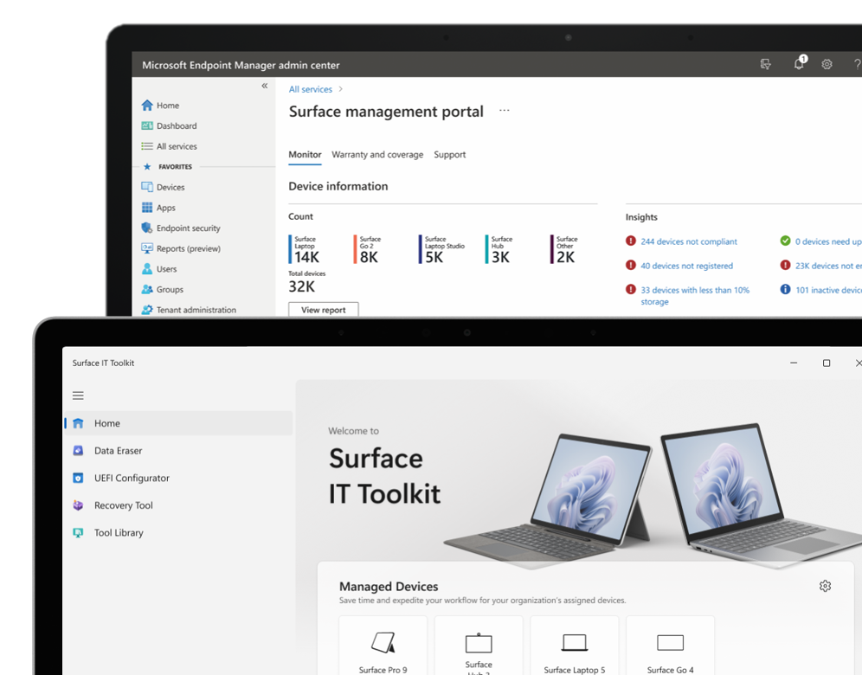
Streamlined management
Surface delivers powerful tools and management solutions that help businesses easily and efficiently control the health, apps, and functionality of their organization’s devices and streamline lifecycle management.
Manage device health at scale
Tailormade experience
More control
Notes:
Microsoft and Surface offer strategic and centralized management solutions that help businesses easily and efficiently control the health, apps, and functionality of their organization’s devices at scale and individually.
Reduce IT costs.
With one quick view, you can now access essential insights such as low device storage, non-compliant devices, inactive devices, unencrypted devices, and information of all Surface devices that require immediate action. Managing warranty and support requests are as simple as the click of a button. We have created one simplified view to highlight device status and enable faster troubleshooting.
Tailormade experience.
We reimagined an experience that would meet business needs by seamlessly managing the lifecycle of their devices. With the new feature in Surface Management Portal, customers can now stay up to date with the latest updates from the Surface engineering team, curated just for the IT audience in the enterprise space.
Optimized process.
Experience the enhanced process of creating support requests for multiple Surface devices at once. New features enable business IT to create a single request for multiple Surface devices for eligible device returns or repair needs.
Improved efficiency
IT administrators gain more convenience, control, and efficiency with the Surface IT Toolkit. An application that compiles all your essential IT tools into one place.

Slide 6
Optimized support
Surface provides several comprehensive resources and options to support customers. For more customized support, businesses can utilize a Surface Authorized Service Provider to meet their needs.
Expanded options
Troubleshoot with ease
Customized services
Notes:
Surface provides several comprehensive resources and options to support customers. For more customized support, businesses can utilize a Surface Authorized Service Provider to meet their needs.
Expanded options.
Customer-centric Surface support options. Customers decide how and what resources to leverage to service a device when an issue is identified.
Troubleshoot with ease.
The Surface Diagnostic Toolkit for Business allows IT administrators to quickly investigate, troubleshoot, and resolve hardware, software, and firmware issues with Surface devices — across a hybrid network.
Customized services.
Surface Authorized Service Providers (ASPs) perform repairs on behalf of Microsoft, have direct access to Microsoft support, and use genuine Microsoft replacement components.

Slide 7
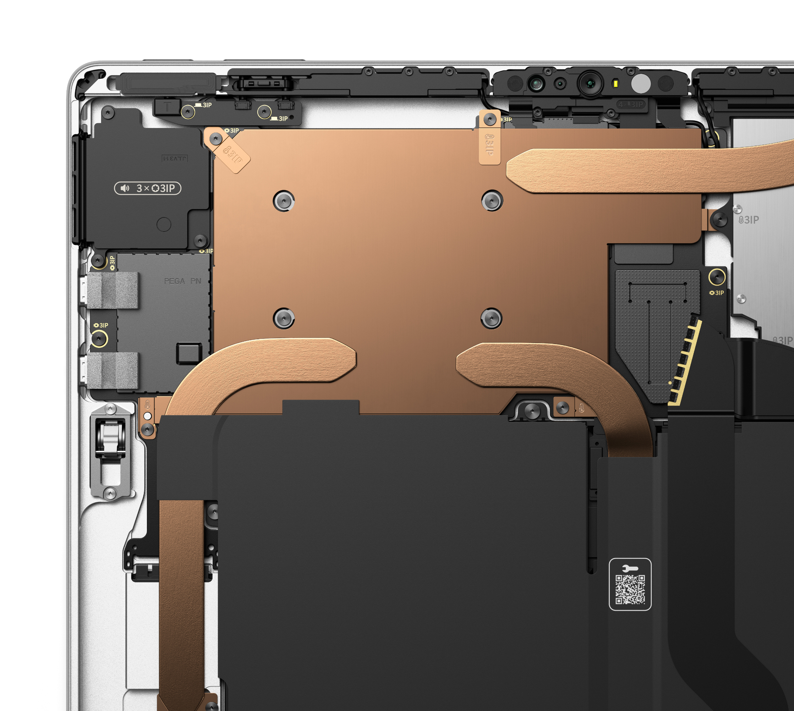
Simplified repair
²Device shown is Surface Pro 10 for Business
Microsoft’s expansion of repairable Surface devices provides businesses with more control and more options. Microsoft Surface developed a self-repair¹ model that simplifies the process so when an incident happens, a device can be brought back online quickly.
Commercial ready
Ease of repair
More secure
¹ Drive (SSD) Retention permits customers the option to retain their removable SSD during service events at no additional charge. SSD Retention is only available on Microsoft Surface devices, in which the SSD is marketed as removable per the technical specifications on the product’s description page.
² Repair markings and QR code inclusion vary by device.
Notes:
Microsoft’s expansion of repairable Surface devices provides businesses with more control and more options. Microsoft Surface developed a self-repair model that simplifies the process so when an incident happens, customers can bring a device back online quickly.
Commercial ready
Surface devices are designed for simplicity of repair and sustainability. The reduce, reuse, and recover model minimizes waste and extends the use of a customer’s device.
More secure
Microsoft’s Drive (SSD) Retention¹ means customers can retain the SSD from their Surface device during a service event, empowering customers with more control over their privacy, data, and device security.
Ease of repair
Maximize productivity and reduce downtime with comprehensive resources, easy step-by-step repair guidance, and genuine replacement components. (Replacement components have a 90-day limited warranty unless the accompanying written warranty gives a longer time. Replacement components may be new or refurbished. Replacement components are currently only available for purchase separately, independent of the warranty status of your device and repairs should only be performed by individuals who possess the knowledge and technical competence to perform complex electronic repairs. To order, see Customer self-serve repair.)

Slide 8
Customer Resources
Surface Warranty and Protection Plans
Microsoft Surface Warranty & Protection Plans
Warranty and Protection Plan Terms & Conditions
Device management resources
Surface device management tools
Surface Diagnostic Toolkit for Business
Service and Repair for Business
Surface for Business Service and Repair page
Surface repair by Microsoft Authorized Service Providers
Replacement Components
Customer self-serve repair for Surface devices
Surface for Business replacement components

Slide 9
Surface for Business Essentials
The complete built for business experience.
Protect | Manage | Support | Repair

Slide 10
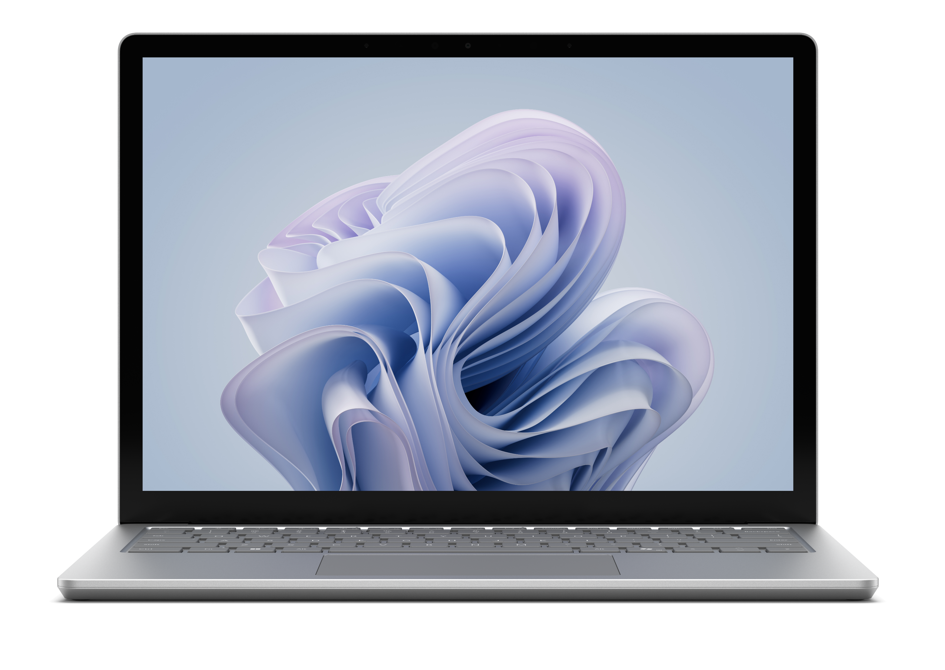
The new repairable devices from Surface
Microsoft genuine replacement components
Surface Laptop 6
Surface Pro 10
Display Assembly (including camera)
Keyboard Assembly
Removeable solid-state drive
Battery
Motherboard module (main processor and main memory)
Surface connect
Thermal module
Audio jack speakers
Touchpad
Enclosure
Feet
Touch Display Module
Removeable solid-state drive
Battery
Motherboard (including main processor and main memory)
Surface Connect
Thermal module
Microphone module
Solid-state drive door
Speakers
Enclosure (bucket)
Front camera
Rear camera
Power and volume buttons
Kickstand
Device entry kit
Notes:
Only technically inclined individuals with the knowledge, experience, and requisite tools should perform repairs in accordance with the relevant Surface Service Guide instructions.
Replacement components come with a 90-day warranty unless the accompanying written warranty gives a longer time.
Replacement components may be new or refurbished.
Replacement components are available to purchase through MS Authorized Resellers.
MS Learn: Surface for Business replacement components
Internal: Surface Post-Sales Experience (sharepoint.com)
External: Surface Repair & Replacement Parts - MS Store

Slide 11
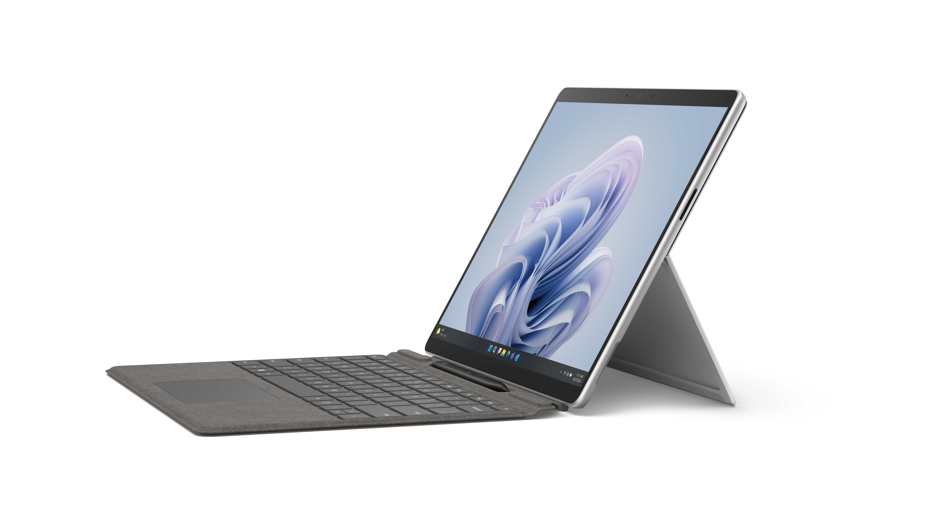
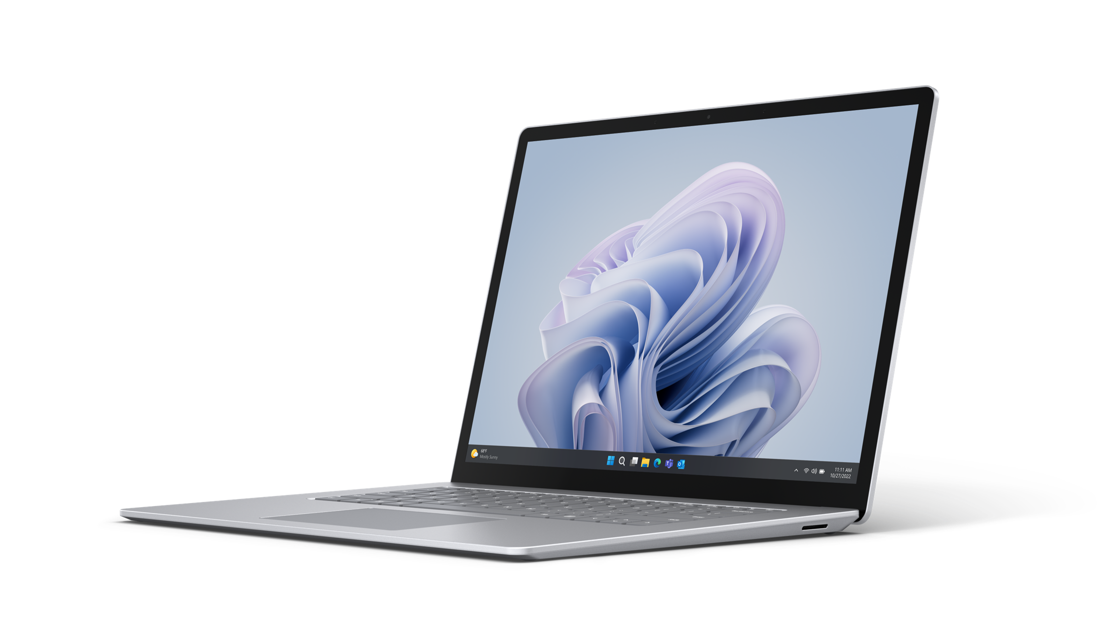
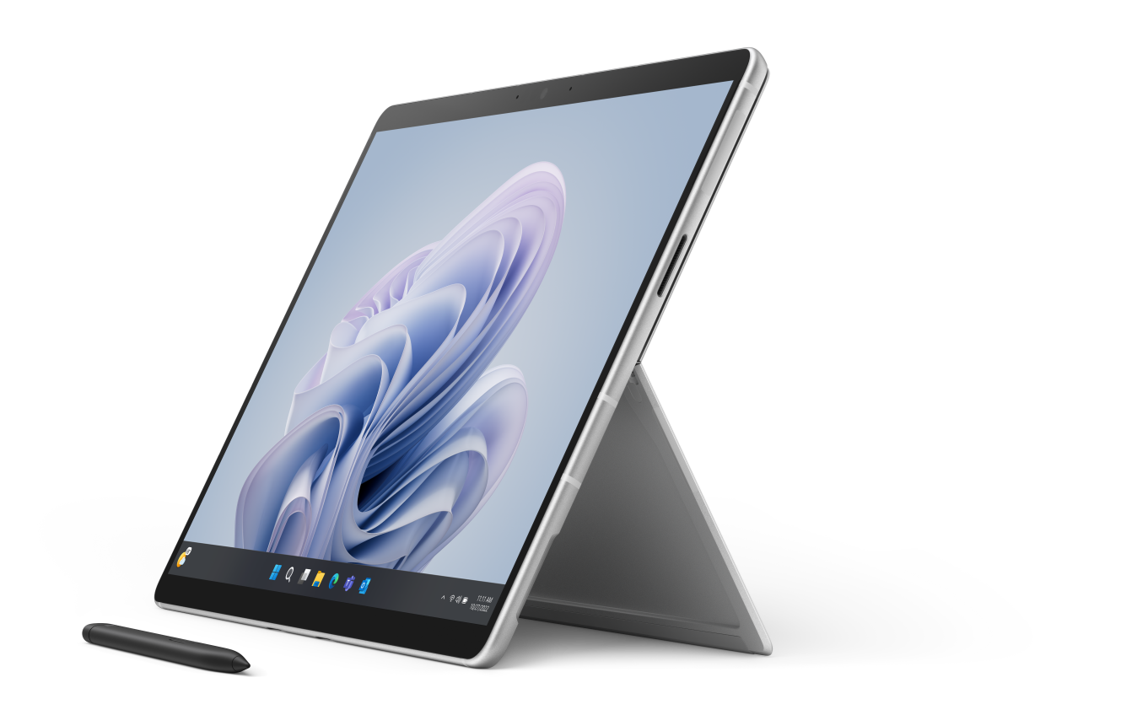
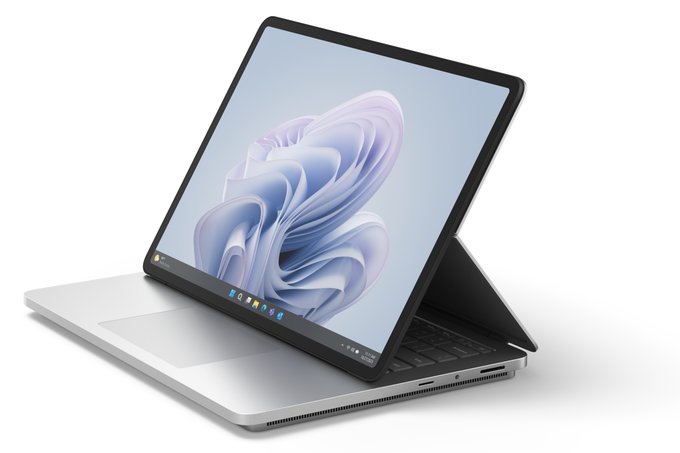
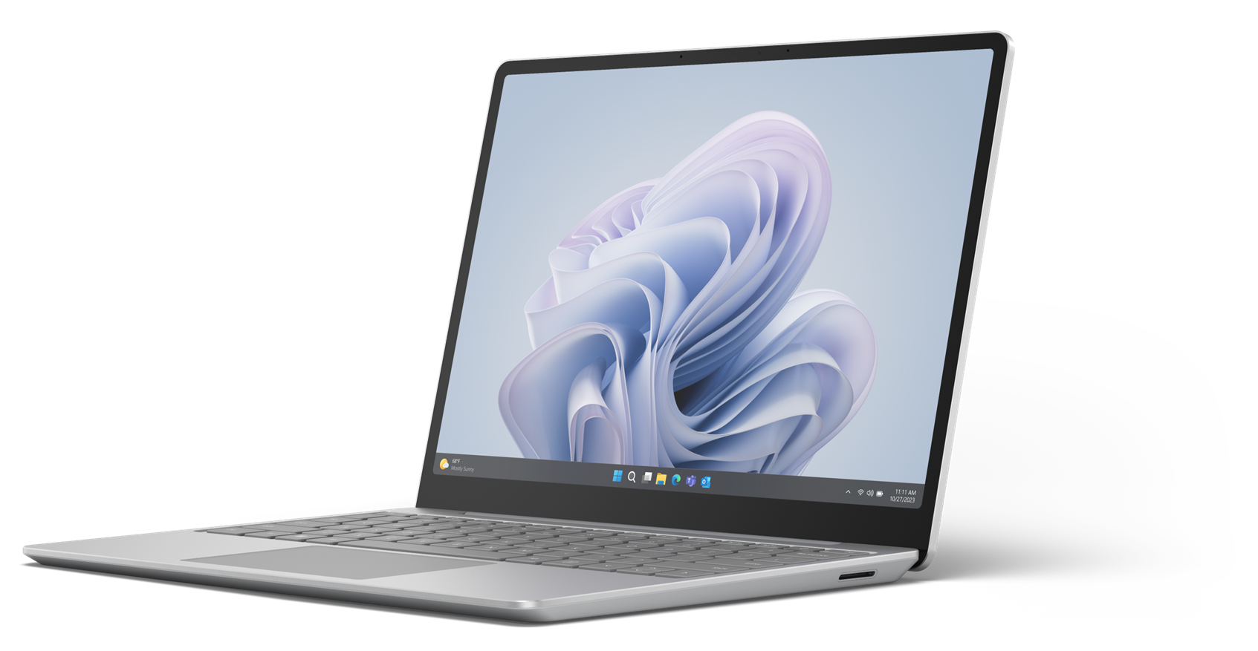
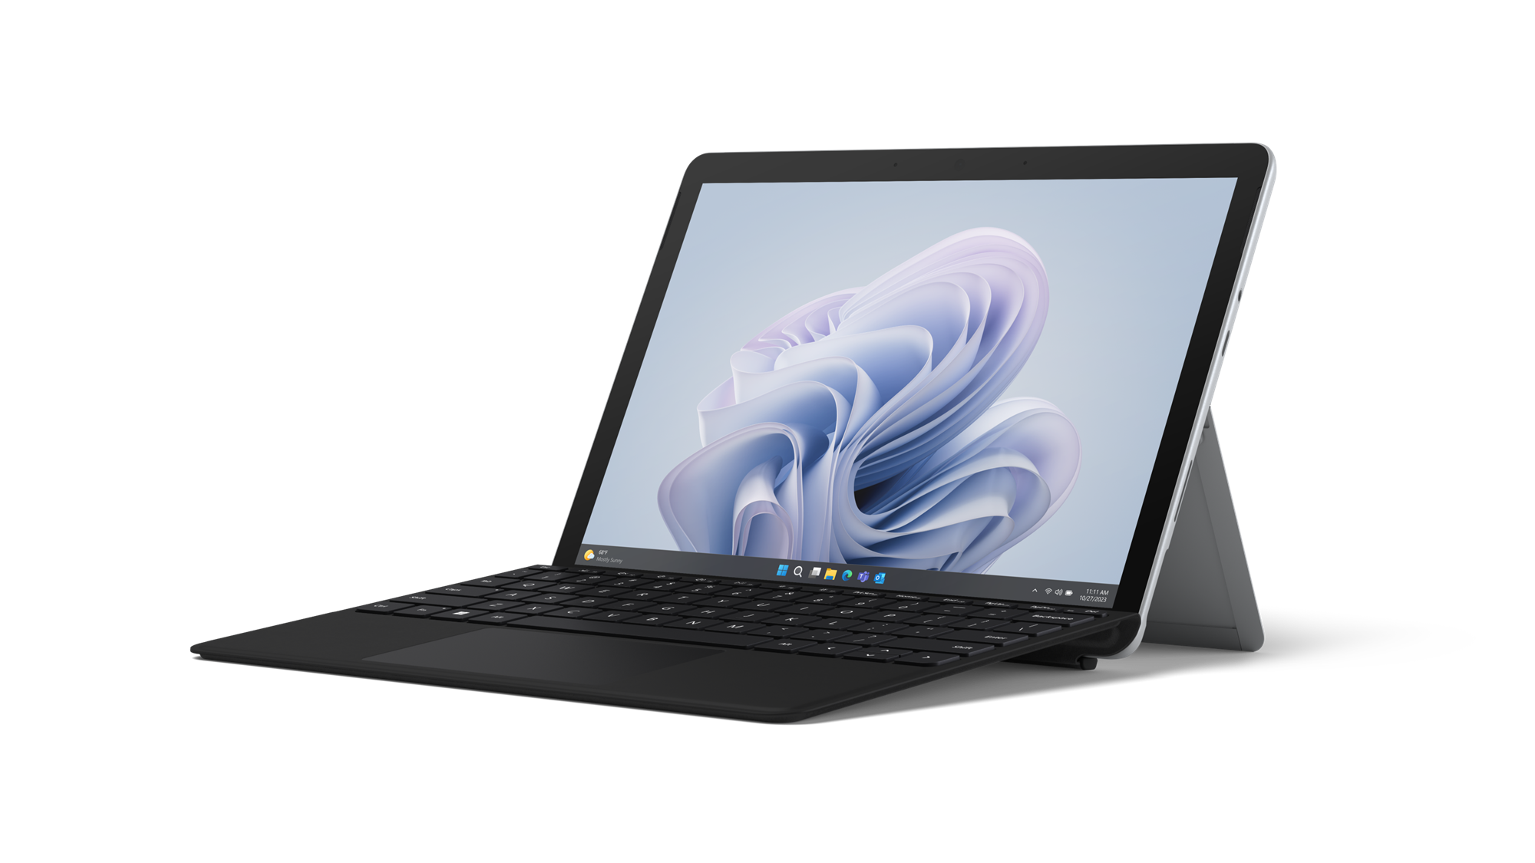
Repairable Surface Devices
Portfolio of repairable Surface devices and Microsoft genuine replacement components
Surface Laptop 5
Surface Pro 9
Surface Pro 9 with 5G
Surface Studio 2+
SSD
Display Module
Keyboard (c-cover)
Feet
Motherboard
Surface connect port (Surflink)
Battery + Bucket
Thermal module
SSD
SSD door
Kickstand
Screen (TDM)
Charge Port (Surflink)
Back cover (bucket)
Speaker
Wi-Fi Deck (Pro 9)
Battery
Thermal module
Front and rear camera
Camera deck (Pro 9 5G)
Power/volume button
Motherboard
SSD
Display Module
Thermal module
Motherboard
Feet
Internal PSU
Surface
Laptop Studio 2
Surface Laptop Go 3
Surface
Go 4
Display Assembly A/B-Cover
Keyboard Assembly C-Cover
Surflink Port
USB C
USB A
Audio Jacks
Solid State Drive
Cosmetic Plate
Non-Skid Feet
D-Bucket + Battery
Motherboard
Micro SD Reader
Display Assembly
Keyboard Assembly
rSSD (removeable solid-state drive)
Feet
Battery
Surflink Assembly
Motherboard (PCBA)
Touch Display Module
Battery (including bucket)
Motherboard (PCBA)
Front Camera
Rear Camera
IR Camera
Speakers
Hinge
Kickstand
SDXC Connector
Blade Connector

Slide 12
Warranty & Protection Plans for
Surface Laptop 6, Surface Pro 10, Surface Laptop Studio 2, Surface Laptop Go 3, and Surface Go 4
Protection plans must be purchased within 45 days of device purchase.
 | Limited Hardware Warranty | Extended Hardware Service | Extended Hardware Service Plus | Complete for Business | Complete for Business Plus
Coverage Availability | 1 year | Up to 2, 3 or 4 years | Up to 2, 3 or 4 years | Up to 2, 3 or 4 years | Up to 2, 3 or 4 years
Prepaid return shipment | ✓ | ✓ | ✓ | ✓ | ✓
Software & hardware support | ✓ | ✓ | ✓ | ✓ | ✓
Mechanical Breakdown | ✓ | ✓ | ✓ | ✓ | ✓
In-Region Repair, or Standard Exchange | ✓ | ✓ | ✓ | ✓ | ✓
Accidental Damage |  |  |  | ✓ | ✓
Drive (SSD) Retention |  |  | ✓ |  | ✓
Advanced Exchange |  |  | ✓ |  | ✓
Next Business Day Exchange |  |  | ✓ |  | ✓
NOTE:
$0 deductible on commercial warranties and protection plans.
Coverage details and entitlements are available for select commercial Surface products
Standard Exchange is the expected replacement model if In-Region Repair is unavailable.
Drive (SSD) Retention is not available for Surface Go 4. ​
Warranty and Protection Plans vary by market. Please visit the Surface Warranty and Protection Plan page to see availability.
Without prejudice to any legal (statutory) rights to which you may be entitled under your local law, Microsoft Limited Hardware Warranty covers your device for one year from the date of original purchase from Microsoft or an authorized reseller. Restrictions apply. Please refer to Microsoft Limited Hardware Warranty & Agreement.

Slide 13
Warranty & Protection Plan for
Surface Hub 3
Limited Hardware Warranty | Extended Hardware Service
Included with every Surface | Sold Separately
Duration: 1 year | Duration: Up to 2, 3, or 5 years
Starts on day of purchase | Available within 45 days of Surface device purchase
90 days of software and 1 year of hardware support | Software and hardware support
Mechanical breakdown | Mechanical breakdown
Onsite hardware service | Onsite hardware service
NOTE:
$0 deductible on commercial warranties and protection plans.
Coverage details and entitlements are available for select commercial Surface products.
Warranty and Protection Plans vary by market. Please visit the Surface Warranty and Protection Plan page to see availability.

Slide 14
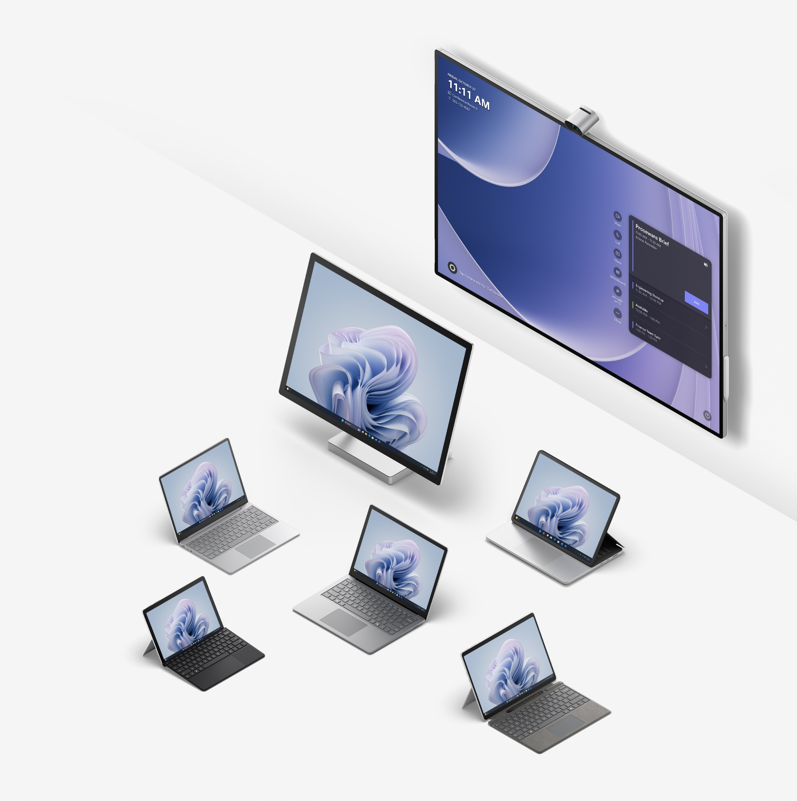
Appendix

Slide 15
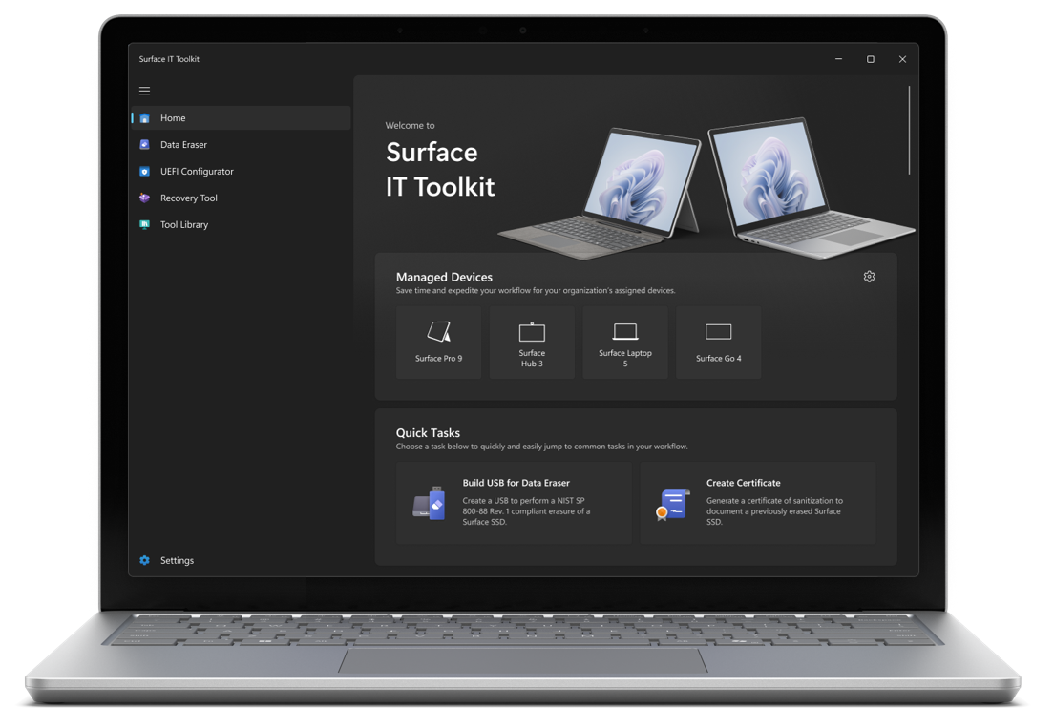
Surface IT Toolkit
A compilation of essential Surface device management tools in a single, downloadable application to provide a more efficient device management experience for IT administrators. Designed for businesses of all sizes, it delivers simplicity, improved data security, and compliance for your Surface devices.
Improved efficiency
More control
Security and resiliency
Notes:
IT administrators gain more convenience, control, and efficiency with the Surface IT Toolkit. A downloadable application that compiles all your essential Surface IT tools into one place.
Improved efficiency
Improve your IT efficiency and productivity by using a single application to access essential Surface device management tools in one place.
More control
Maintain more control over hardware and software issues through a single application, that can lockdown hardware components, securely and safely erase all data, assign digital asset tags and more.
Security and resiliency
Improve device security and resiliency with the ability to effectively control and deactivate any components at the firmware level that compromise security.

Slide 16
Customized service and repair
Microsoft’s Authorized Service Providers (ASPs) can provide a more tailored service and repair experience based on a customer’s business needs – whether on-site, remote or at the ASPs repair facility.
Benefits of ASP Surface device repair:
ASP technicians are required to take Surface device training on an on-going basis.
ASPs perform both in warranty repair services, covered by Microsoft repair warranty, and out of warranty repair of Surface devices.
ASPs can purchase genuine replacement components directly from Microsoft with reimbursements for in-warranty activities.

Slide 17
Global Availability of Microsoft Protection Plans
EHS & CfB
China
EHS & EHS+
Belgium
Egypt*
Estonia
Luxembourg
Malaysia
New Zealand
Slovenia
South Africa
South Korea
Taiwan
Vietnam*
EHS, EHS+, CfB, & CfB+
Australia
Canada
Hong Kong
India
Japan
Mexico Singapore
Thailand
United States Philippines*
EHS, EHS+, ADP, & ADP+
Austria
Bulgaria
Croatia
Cyprus*
Czech Republic
Denmark
Finland
France
Germany
Greece
Hungary
Ireland
Italy
Latvia
Lithuania
Malta
Netherlands
Norway
Poland
Portugal
Romania
Slovakia
Spain
Sweden
Switzerland
United Kingdom
*Notes:
Next Business Day service is not available in Cyprus, Egypt, Philippines and Vietnam.
Due to insurance regulations in Europe, we recommend customers work with Microsoft direct sales or a Microsoft Account manager. And for ADP and ADP+ plans in Europe please refer to the Europe pitch decks for guidance.
Fall 2023

Slide 18
Microsoft In-Region Surface Repair Facilities
Regions Served
Ivy Technology – Australia, Canada, Japan, and Poland
North America
United states
Mexico
Europe
Austria Belgium Bulgaria Cyprus Denmark Finland France Germany Hungary Ireland Italy Estonia Croatia Latvia Slovenia Spain | Luxemburg Malta Netherlands Norway Poland Portugal Romania Slovakia Sweden Switzerland United Kingdom Greece Czech Republic Lithuania
Flex Juarez, Mex
JDM 1, China
Asia
China
Japan

