Slide 1
Customer Empowered Repair Solutions

Slide 2
Topics
Surface repairability framework
Device repair options for business
Customer solutions
Warranty and Protection Plans

Slide 3
Customer empowered Surface device repair solutions
More Control
More Options
Better Value
Customers gain more control over how they manage, repair and maintain security of their Surface devices.
Customer-centric device repair options. Customers decide how to get their devices back online when issues arise.
Microsoft’s reduce, reuse, and recover model minimizes waste, and extends the use of the device.
Notes:
Built with integrity by design, many Microsoft Surface devices are now easier to repair and maintain, empowering commercial customers with more control, more options and better value while extending the use of devices.

Slide 4
Customer empowered
More Control
Maximize productivity – Reduce downtime with on-site device repair and replacement components using step-by-step repair guidance for each repairable Surface model.
Improved device security – Self-service repair, replacement components and Microsoft’s Drive (SSD) Retention¹ allow customers to have more control of device security.
Manage device health at scale – the Surface Management Portal and Hardware Support Portal provide end-to-end visibility of corporate devices to quickly identify and resolve issues that may occur.
¹ For customers with the Drive (SSD) Retention option, they can retain their removable SSD during service events at no additional charge. Drive (SSD) Retention is only available on Microsoft Surface devices, in which the SSD is marketed as removable per the technical specifications on the product’s description page.

Slide 5
Customer empowered
More Options
Maximum efficiency – Customers can do self-service repair with their experienced in-house skilled device technicians and Surface replacement components. They’re able to achieve faster resolution time and they get to keep their existing device – no need for exchange.
Trusted repair – An alternative for customers who prefer device repair at a Microsoft in-region repair facility.
Customized repair solutions – Microsoft Authorized Service Providers (ASPs) provide tailored Surface device repair services to meet customers unique needs.

Slide 6
Customer empowered
Better Value
Device sustainability – The reduce, reuse, and recover circularity model minimizes waste and extends the lifespan of our devices for as long as possible.
Investment protection – Enhanced protection plans, and device service options provide investment protection and extend the use of your Surface device.
Reduce IT Cost – Microsoft’s Surface Management Portal and Hardware Support Portal help customers reduce manual work and lower IT costs associated with device management.

Slide 7
Customer centric device repair options
Depending on business need, a customer can select either in-house self-repair, a trusted in-region repair facility or, for more customized support, use a third-party Microsoft Authorized Service Provider (ASP).
ASP Repair
Microsoft Repair
Self-repair
Customized repair services
Surface ASPs¹ are authorized by Microsoft to help resolve issues that may occur with Surface device. ASPs perform repairs on behalf of Microsoft, have direct access to Microsoft support, and use genuine Microsoft replacement components.
Trusted in-region repair
Microsoft can repair many commercial Surface devices via in-region repair facilities. If troubleshooting or diagnostics determine that your Surface device needs repair and is eligible for mail-in repair services¹, customers can ship it to Microsoft for repair and return.
Maximum efficiency
The self-service repair option helps customers maximize efficiency and maintain productivity by reducing device downtime, giving their own staff of technically inclined² individuals the ability to quickly assess and bring user devices back online.
Service and repair facilities vary by region.
Device damage caused during self-service repair will not be covered under Microsoft’s Limited Hardware Warranty or Protection Plans.
Notes:
Customers decide how to get devices back online when issues happen.
There are several ways commercial customers can obtain repair service for their Surface devices.

Slide 8
Customized service and repair
Microsoft’s Authorized Service Providers (ASPs) can provide a more tailored service and repair experience based on a customer’s business needs – whether on-site, remote or at the ASPs repair facility.
Benefits of ASP Surface device repair:
ASP technicians are required to take Surface device training on an on-going basis.
ASPs perform both in warranty repair services, covered by Microsoft repair warranty, and out of warranty repair of Surface devices.
ASPs can purchase genuine replacement components directly from Microsoft with reimbursements for in-warranty activities.

Slide 9
Trusted in-region repair
Microsoft in-region repair facilities are designed to support customers who prefer to have their Surface devices serviced and repaired¹ by Microsoft trained technicians.
Once Microsoft support determines a Surface device needs service, customers can ship their device to a Microsoft in-region repair facility² to have the device serviced and repaired.
Microsoft in-region repair reduces out-of-warranty cost for customers that need support on a Surface device that is no longer covered by Microsoft Limited Hardware Warranty or an extended protection plan.
¹ Service and repair charges may apply. ² Microsoft in-region repair is subject to availability and not available in all markets or for all devices. Please visit out-of-warranty service cost to see which countries and devices have service and repair offers.

Slide 10
Maximum efficiency with self-service repair
The self-service repair option helps customers maximize efficiency and maintain productivity by reducing device downtime, giving their own staff of technically inclined¹ individuals to quickly assess and bring user devices back online.
Microsoft’s Surface self-service repair resources:
Surface Repair Toolkit – Easily assess the health and manage your Surface devices with the Surface app and downloadable Surface Diagnostic toolkit.
Microsoft Surface Service Guides – Technically inclined teams can utilize the step-by-step repair instructions in the device specific Surface Service Guide.
Replacement components² – Surface device replacement components are available for purchase through Microsoft's authorized distributors and resellers.
¹ Device damage caused during a repair will not be covered under Microsoft’s Limited Hardware Warranty or extended protection plans.
² Replacement components have a 90-day limited warranty unless the accompanying written warranty gives a longer time. Replacement components are currently only available for purchase separately, independent of the warranty status of your device. To order, see Customer self-serve repair. Replacement components may be refurbished.

Slide 11
Improved device security
When an issue happens, repairable Surface devices bring another layer of customer control with the use of replacement components.
Microsoft’s Drive (SDD) Retention¹ means customers can retain the SSD from their Surface devices during a service event, empowering customers with more control over their privacy, data, and security.
By retaining the original drive, customers reduce public exposure of business information during repair. If a Surface removeable SSD is tampered with, the device will shut off power through cloud security.
¹ Drive (SSD) Retention permits customers the option to retain their removable SSD during service events at no additional charge. Drive (SSD) Retention is only available on Microsoft Surface devices, in which the SSD is marketed as removable per the technical specifications on the product’s description page.

Slide 12
Reduce manual work and IT costs
Microsoft’s management portals help customers reduce manual work and lower IT costs associated with device management.
Reduce IT cost – With one quick view, customers can now access essential insights and information of all Surface devices across their business. The simplified view provided by Surface Management Portal and Microsoft Hardware Portal, highlight device health and enable faster troubleshooting. All of this, and the ability to manage warranty status and support requests with a click of a button, help businesses reduce manual labor and IT costs.
Tailormade experience – Microsoft reimagined an experience that would meet customer needs in seamlessly managing the lifecycle of Surface devices. With the news feature in Surface Management Portal, customers can now stay up to date with the latest updates from the Surface engineering team, curated just for the IT audience in the enterprise space.
Optimized support process – Experience the enhanced process to create support requests for multiple Surface devices at once. The latest feature addition enables you to create a single request for multiple Surface devices for eligible device returns or repair needs.
Notes:
Reduce IT cost for the organization – With one quick view, you can now access essential insights such as low device storage, non-compliant devices, inactive devices, unencrypted devices, and information of all Surface devices that needs immediate action. Managing warranty and support requests are as simple as the click of a button. We have created one simplified view to highlight device status and enable faster troubleshooting.
Tailormade experience to meet your needs – We reimagined an experience that would meet customer needs in seamlessly managing the lifecycle of their devices. With the news feature in Surface Management Portal, customers can now stay up to date with the latest updates from the Surface engineering team, curated just for the IT audience in the enterprise space.
Optimized support process – Experience the enhanced process to create support requests for multiple Surface devices at once. The latest feature addition enables you to create a single request¹ for multiple Surface devices for eligible device returns or repair needs.

Slide 13
Microsoft Protection Plans
Each Surface device comes with a 1-year Microsoft Limited Hardware Warranty¹. For customers who want to maximize and protect their Surface investments beyond the warranty they can purchase one of the available Microsoft Protection Plans².
Warranty and Protection plan benefits:
Customer centric support for service and repair
Support tools and information to track device health at-scale, across a customer's hybrid workforce.
Ongoing access to Microsoft’s robust online Surface support articles and communities.
Additional Protection Plan options:
Accidental damage – protection from drops, spills, and cracked screens
Drive SSD retention – retain the SSD during a service event
Advanced exchange and Next business day exchange – a replacement device is shipped to customer prior to receiving the damaged device.
¹ Without prejudice to any legal (statutory) rights to which you may be entitled under your local law, Microsoft Limited Hardware Warranty covers your device or replacement component from the date of original purchase from Microsoft or an authorized reseller. Exclusions and limitations apply. Please refer to Microsoft Limited Hardware Warranty & Agreement.
² Warranty and Protection Plans vary by market. Please visit the Surface Warranty and Protection Plan page to see availability.
Notes:
The extended coverage protects their device investment and helps extend the use of their Surface devices and avoid unplanned expenses If something goes wrong, customers are covered with accidental damage protection from drops, spills, and cracked screens. With Microsoft’s Drive (SSD) Retention feature you can retain your SSD during a service event and receive your repaired device with a new SSD free of charge.
Surface continues to innovate on repairable features that help customers stay productive by allowing them to choose from our growing network of trusted Authorized Service Providers that deliver effective, safe and secure repair services.

Slide 14
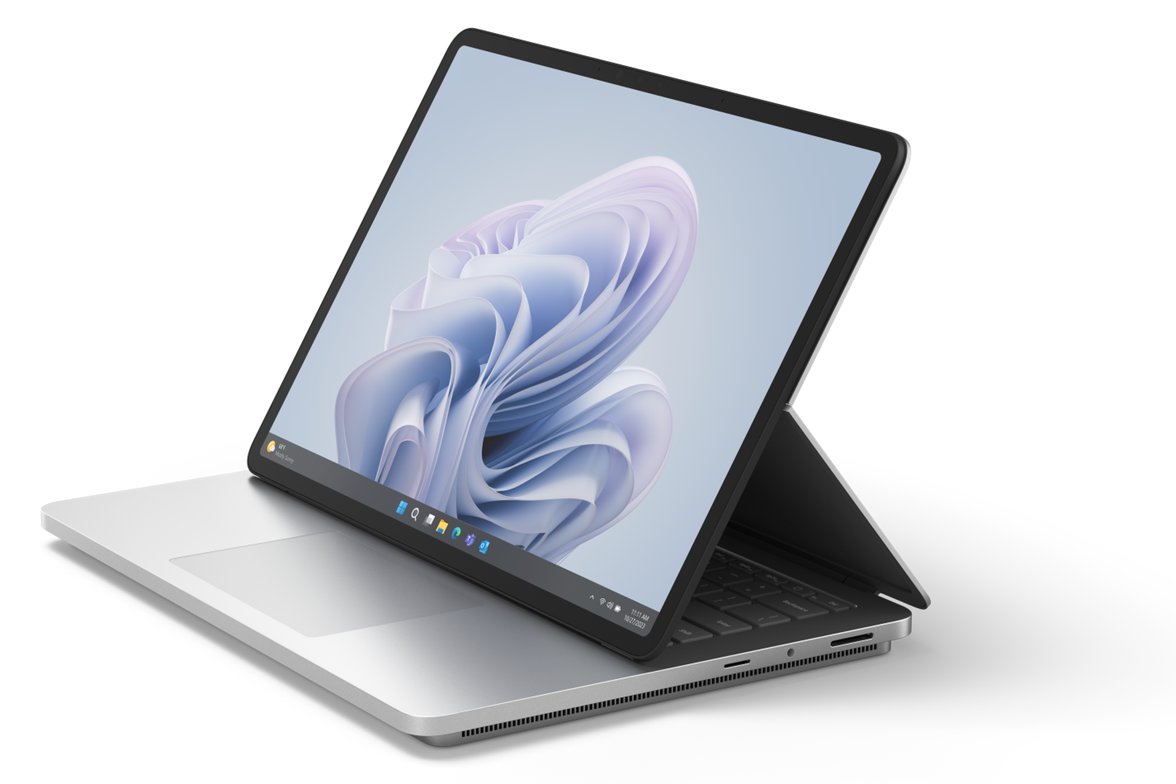
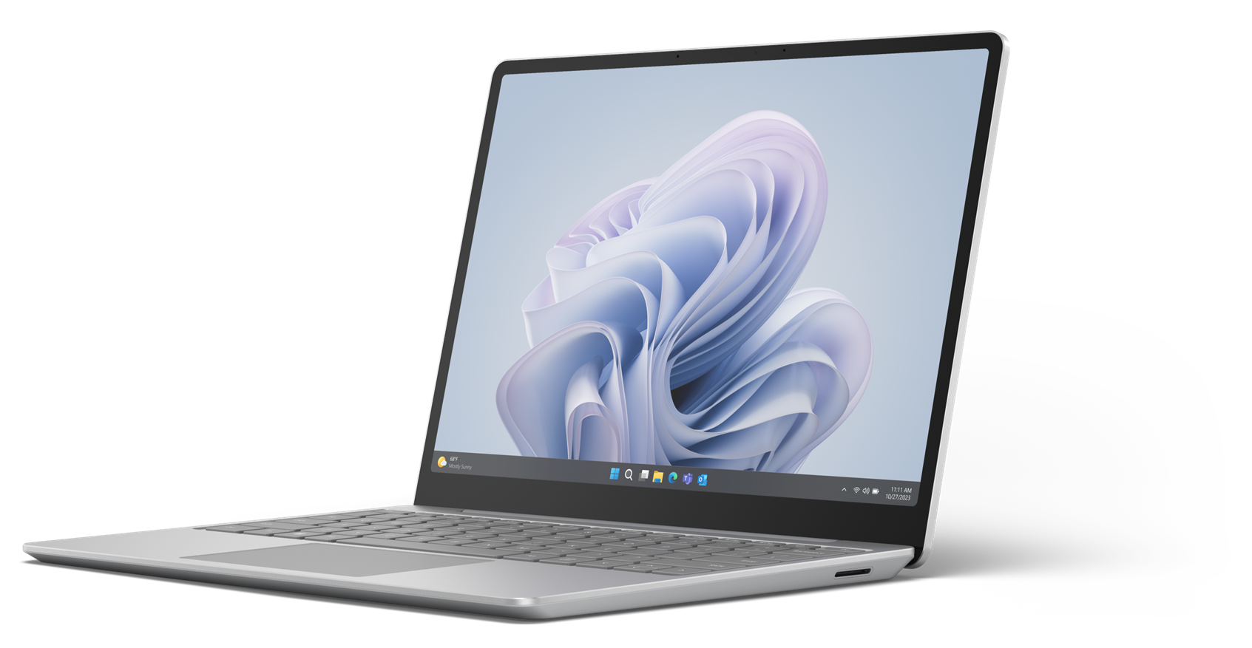
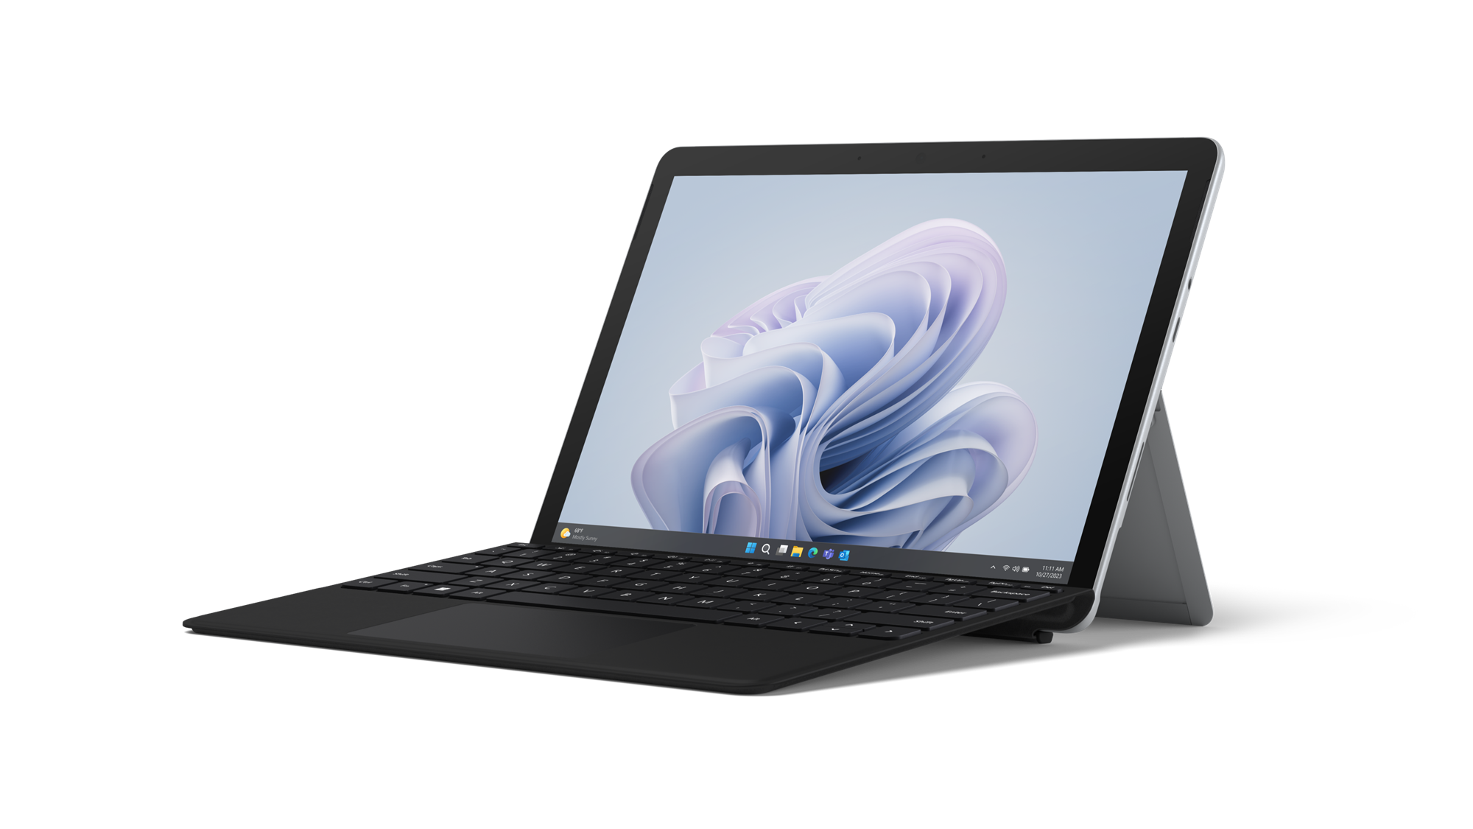
Warranty & Protection Plans for
Surface Laptop Studio 2, Surface Laptop Go 3, and Surface Go 4
Protection plans must be purchased within 45 days of device purchase.
 | Limited Hardware Warranty | Extended Hardware Service | Extended Hardware Service Plus | Complete for Business | Complete for Business Plus
Coverage Availability | 1 year | Up to 2, 3 or 4 years | Up to 2, 3 or 4 years | Up to 2, 3 or 4 years | Up to 2, 3 or 4 years
Prepaid return shipment | ✓ | ✓ | ✓ | ✓ | ✓
Software & hardware support | ✓ | ✓ | ✓ | ✓ | ✓
Mechanical Breakdown | ✓ | ✓ | ✓ | ✓ | ✓
In-Region Repair, or Standard Exchange | ✓ | ✓ | ✓ | ✓ | ✓
Accidental Damage |  |  |  | ✓ | ✓
Drive (SSD) Retention |  |  | ✓ |  | ✓
Advanced Exchange |  |  | ✓ |  | ✓
Next Business Day Exchange |  |  | ✓ |  | ✓
NOTE:
$0 deductible on commercial warranties and protection plans.
Coverage details and entitlements are available for select commercial Surface products
Standard Exchange is the expected replacement model if In-Region Repair is unavailable.
Drive (SSD) Retention is not available for Surface Go 4. ​
Warranty and Protection Plans vary by market. Please visit the Surface Warranty and Protection Plan page to see availability.

Slide 15
Customer Resources
Protect your device investment with Surface repairability and protection plans
Repair and service programs help to protect the device investment
Protection plans provide customers with extended coverage and extended device use
Protection plan coverage can be purchased at time of sale or within 45 days of device purchase.
Service and Repair for Business
Surface for Business Service and Repair page
Authorized Microsoft Reseller List - Surface Business
Surface repair by Microsoft Authorized Service Providers
Warranty and Protection Plans
Microsoft Surface Warranty & Protection Plans
Warranty and Protection Plan Terms & Conditions
Replacement Components
Customer self-serve repair for Surface devices - Surface | Microsoft Learn
Surface for Business replacement components

Slide 16
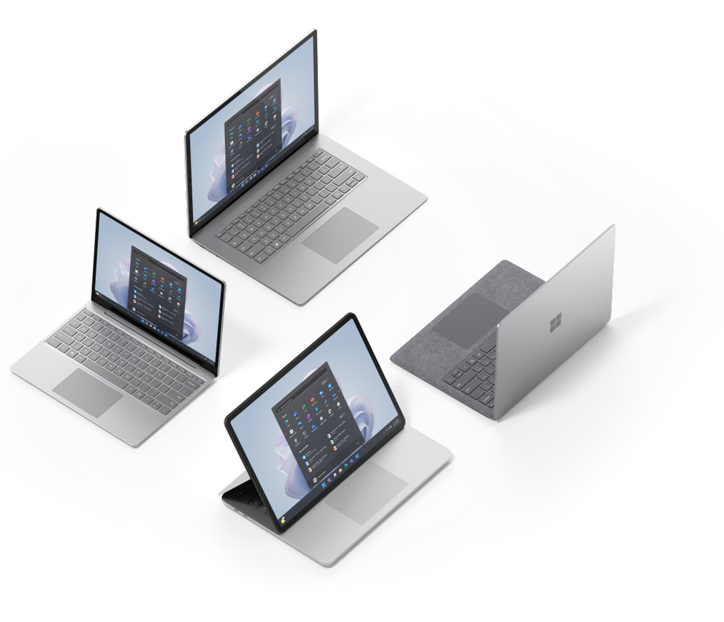
Appendix

Slide 17
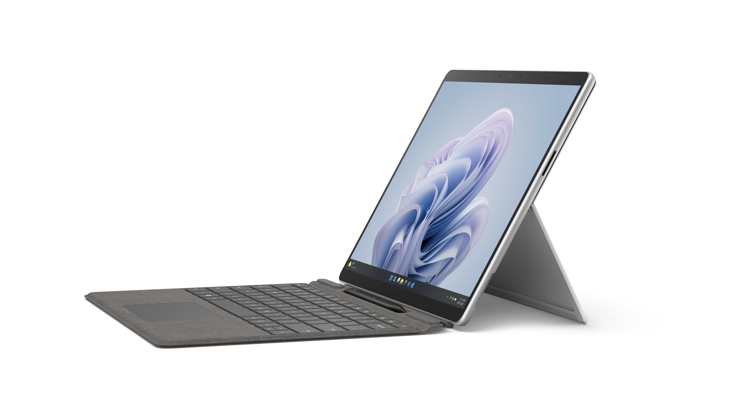
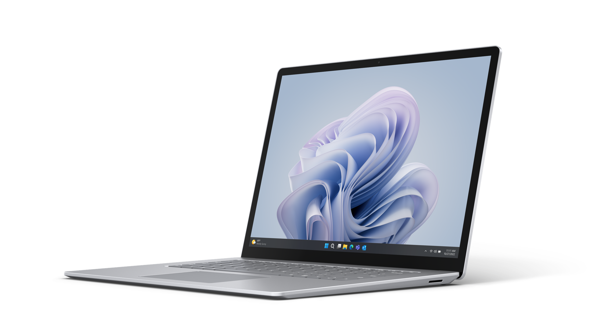
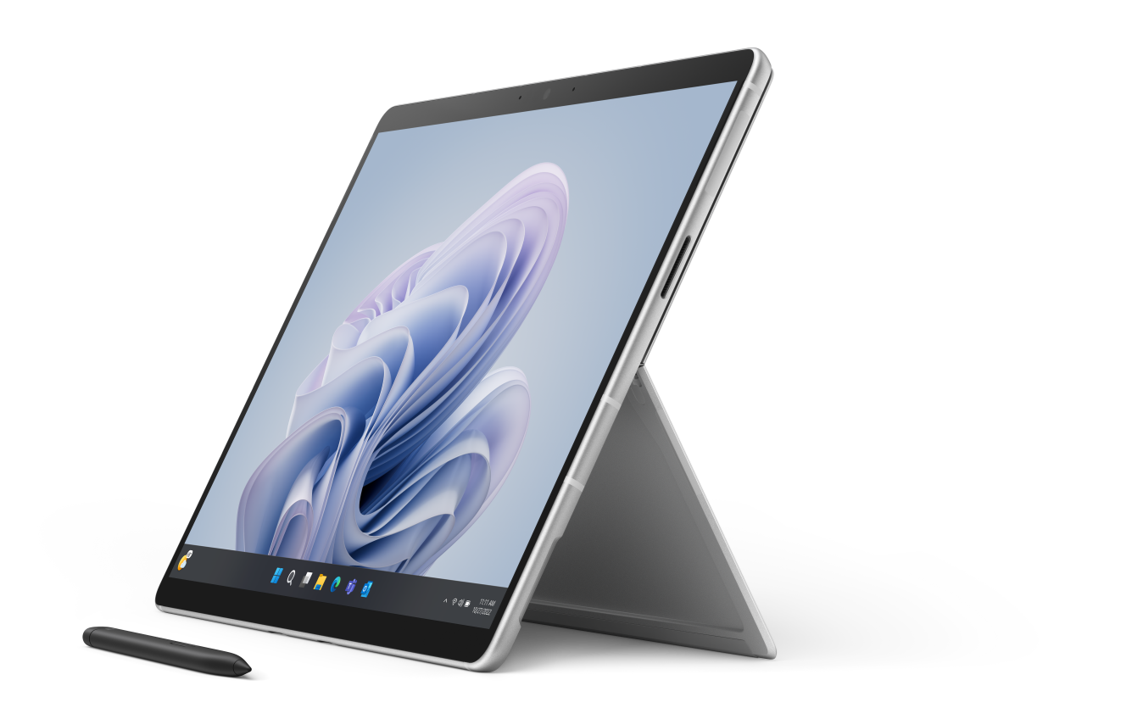
Repairable Surface Devices
Portfolio of repairable Surface devices and Microsoft genuine replacement components
Surface Laptop 5
Surface Pro 9
Surface Pro 9 with 5G
Surface Studio 2+
SSD
Display Module
Keyboard (c-cover)
Feet
Motherboard
Surface connect port (Surflink)
Battery + Bucket
Thermal module
SSD
SSD door
Kickstand
Screen (TDM)
Charge Port (Surflink)
Back cover (bucket)
Speaker
Wi-Fi Deck (Pro 9)
Battery
Thermal module
Front and rear camera
Camera deck (Pro 9 5G)
Power/volume button
Motherboard
SSD
Display Module
Thermal module
Motherboard
Feet
Internal PSU
Surface
Laptop Studio 2
Surface Laptop Go 3
Surface
Go 4
Display Assembly A/B-Cover
Keyboard Assembly C-Cover
Surflink Port
USB C
USB A
Audio Jacks
Solid State Drive
Cosmetic Plate
Non-Skid Feet
D-Bucket + Battery
Motherboard
Micro SD Reader
Display Assembly
Keyboard Assembly
rSSD (removeable solid-state drive)
Feet
Battery
Surflink Assembly
Motherboard (PCBA)
Touch Display Module
Battery (including bucket)
Motherboard (PCBA)
Front Camera
Rear Camera
IR Camera
Speakers
Hinge
Kickstand
SDXC Connector
Blade Connector

Slide 18
Microsoft In-Region Surface Repair Facilities
Ivy Technology, Poland
Regions Served
North America
United states
Mexico
Europe
Austria Belgium Bulgaria Cyprus Denmark Finland France Germany Hungary Ireland Italy Estonia Croatia Latvia Slovenia Spain | Luxemburg Malta Netherlands Norway Poland Portugal Romania Slovakia Sweden Switzerland United Kingdom Greece Czech Republic Lithuania
Flex Juarez, Mex
JDM 1, China
Asia
China
Japan

Slide 19
Global Availability of Microsoft Protection Plans
EHS & CfB
China
EHS, EHS+, ADP, & ADP+
United Kingdom
EHS, EHS+, CfB, & CfB+
Australia
Canada
Hong Kong
India
Japan
Mexico Singapore
Thailand
United States Philippines*
EHS & EHS+
Austria
Belgium
Bulgaria
Croatia
Cyprus*
Czech Republic
Denmark
Egypt*
Estonia
Finland
France
Germany
Greece
Ireland
Italy
Latvia
Lithuania
Luxembourg
Malaysia
Netherlands
New Zealand
Norway
Poland
Portugal
Slovenia
Spain
Sweden
Switzerland
S. Korea
S. Africa
Taiwan
Vietnam*
*Notes:
Next Business Day service is not available in Cyprus, Egypt, Philippines and Vietnam.
Due to insurance regulations in Europe, we recommend customers work with Microsoft direct sales Microsoft or a Microsoft Account manager. And for ADP and ADP+ plans in Europe please refer to the Europe pitch decks for guidance.
Fall FY24

