Slide 1
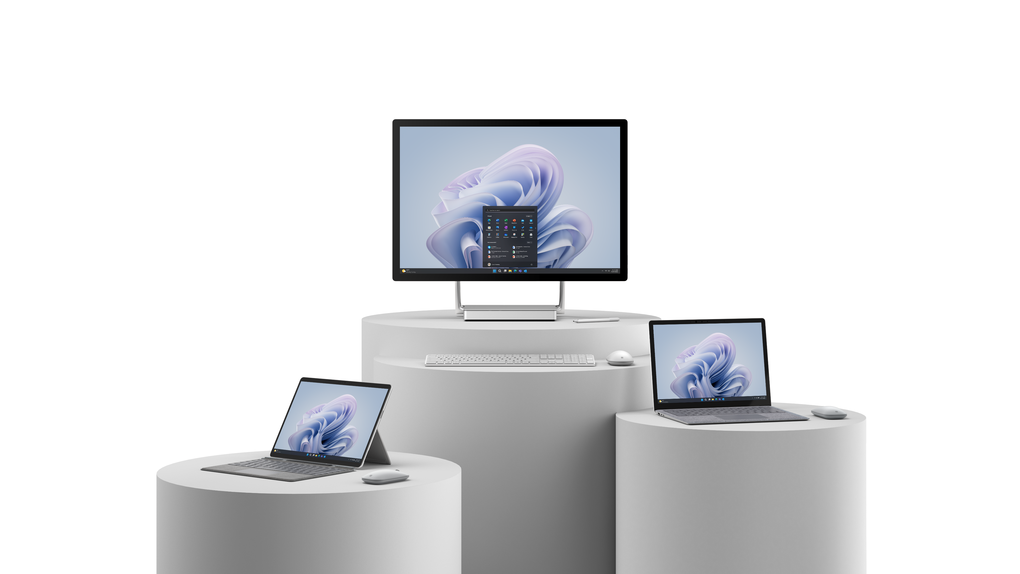
Surface Academy / Partner University Access for Surface Partners
April 2023

Slide 2
Surface Academy
Core training for Surface channel partners
http://aka.ms/SurfaceAcademy
Why important?
Core training for Surface sales success
Qualification for Surface Reseller Alliance Competency Tiers
Training content located in MS Partner University

Slide 3
Accessing MS Partner University
We recommend accessing Surface Academy content through SRA portal or via aka.ms/SurfaceAcademy
Instead of searching for Surface training within Partner University
Requires separate login from SRA Portal
Must use personal MS account
Not work account
Can create new account at https://signup.live.com/, if necessary
BUT, must associate personal MS account w/ partner ID. This is so that if you ever leave your current company, the training and assessments you have completed can be taken with you and not be tied to your expired corporate credentials

Slide 4
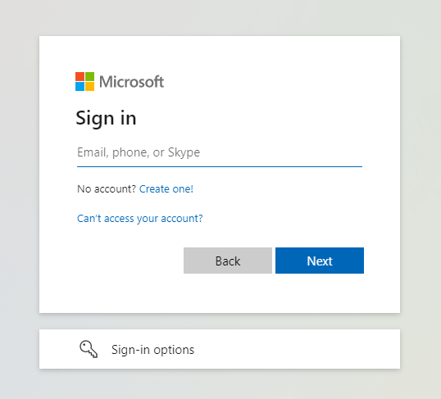
MS Partner University – Account Association
Assumes partner has migrated to MS Partner Center
Step-by-Step Process:
Step 1: Navigate to https://partner.microsoft.com/dashboard
Step 2: Enter your work account credentials
Should be the Azure Active Directory account you use to access Office 365 or other Microsoft services for your organization
Step 3: If asked, click ‘Skip tour’ if you do not want to go through the portal introduction
You can complete the tour later, if desired

Slide 5
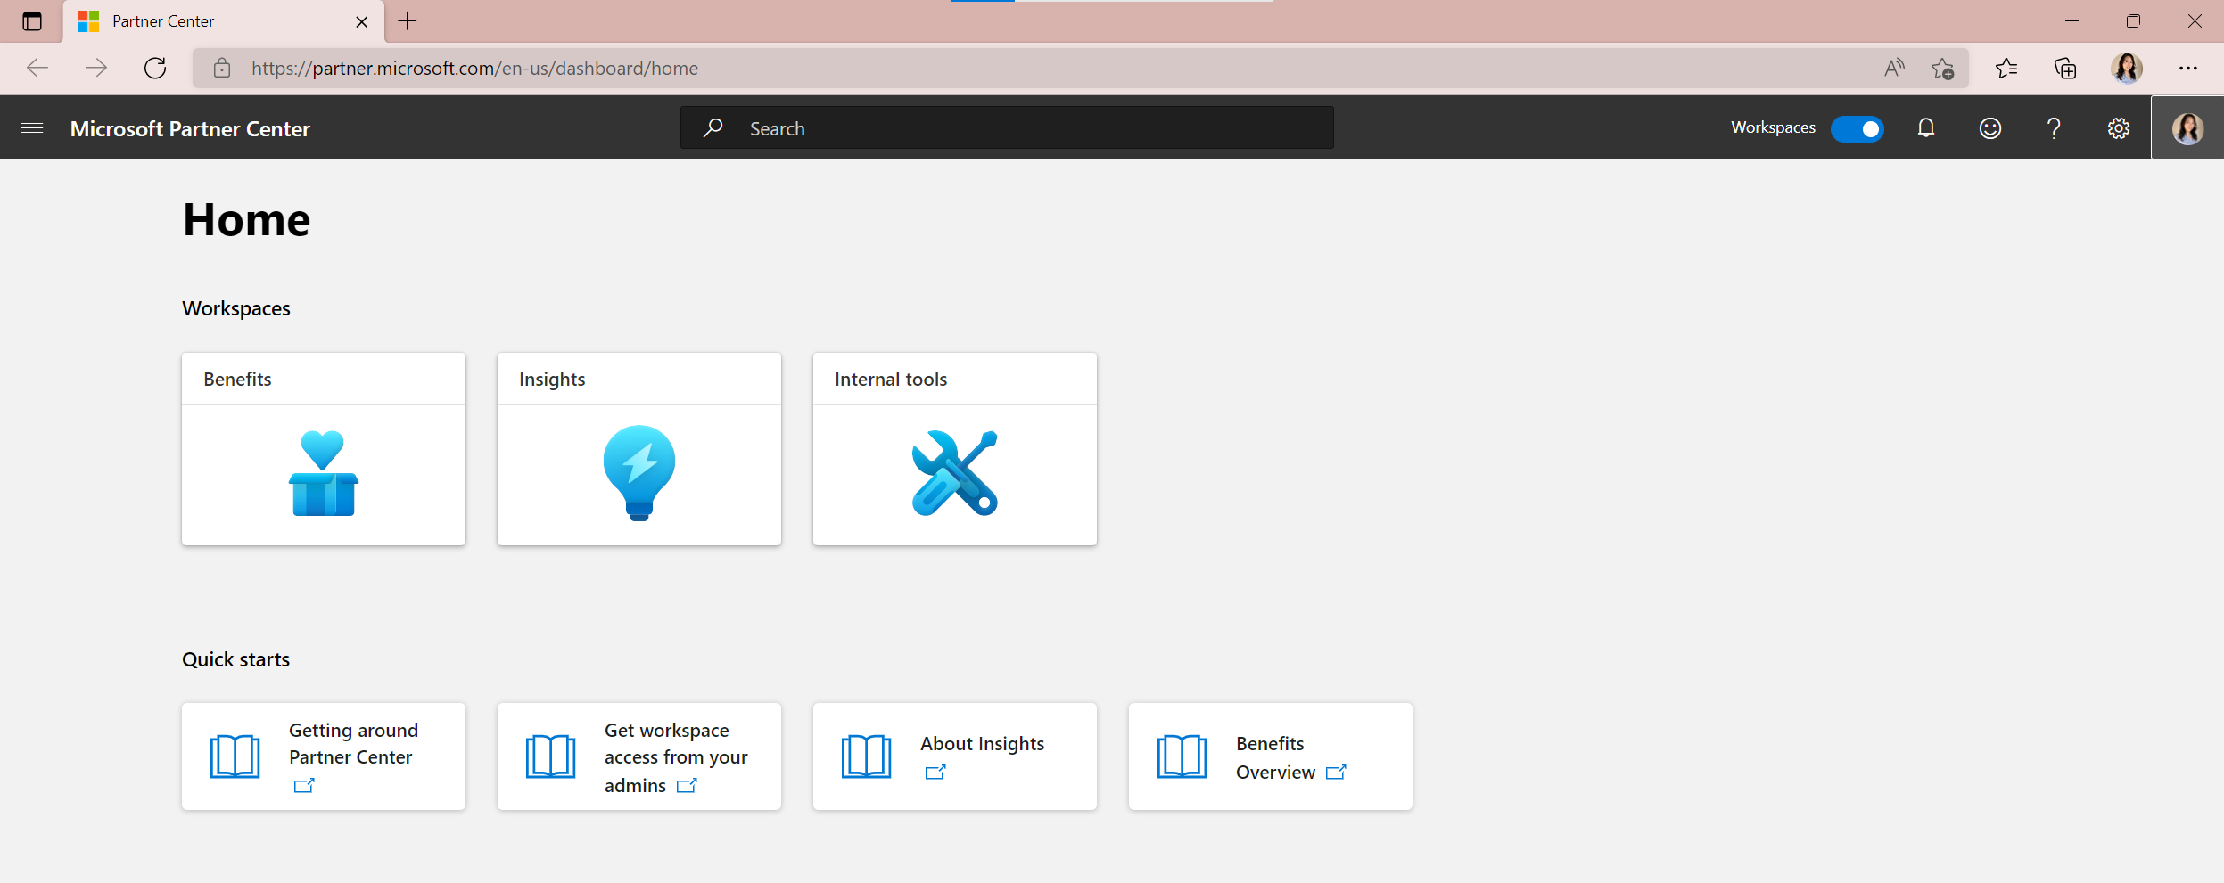
MS Partner University – Account Association
Step 4: Click the ‘your profile’ button on the right pane

Slide 6
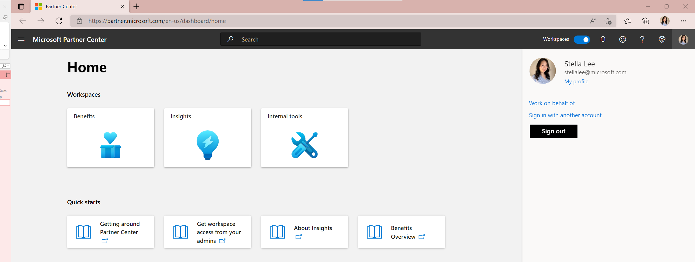
MS Partner University – Account Association
Step 5: Click ‘My Profile’
Jane Realperson J.realperson@contoso.com

Slide 7
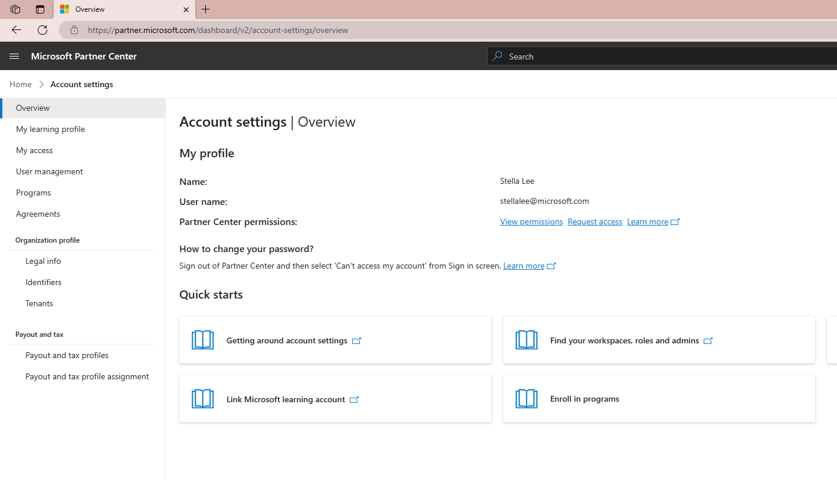
MS Partner University – Account Association
Step 6: Click ‘My Learning Profile’
Jane Realperson
J.realperson@contoso.com

Slide 8
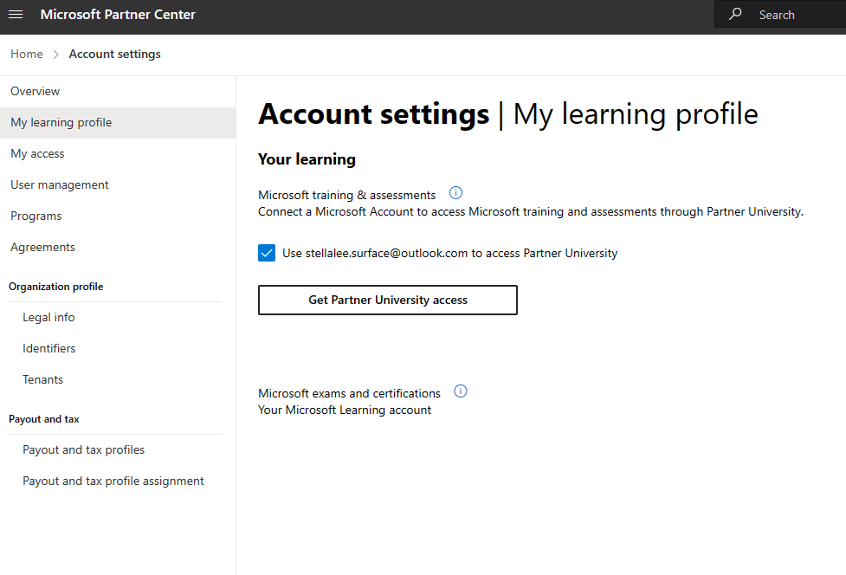
MS Partner University – Account Association
Step 6: Click ‘Get Partner University access’ under ‘Microsoft training & assessments’

Slide 9
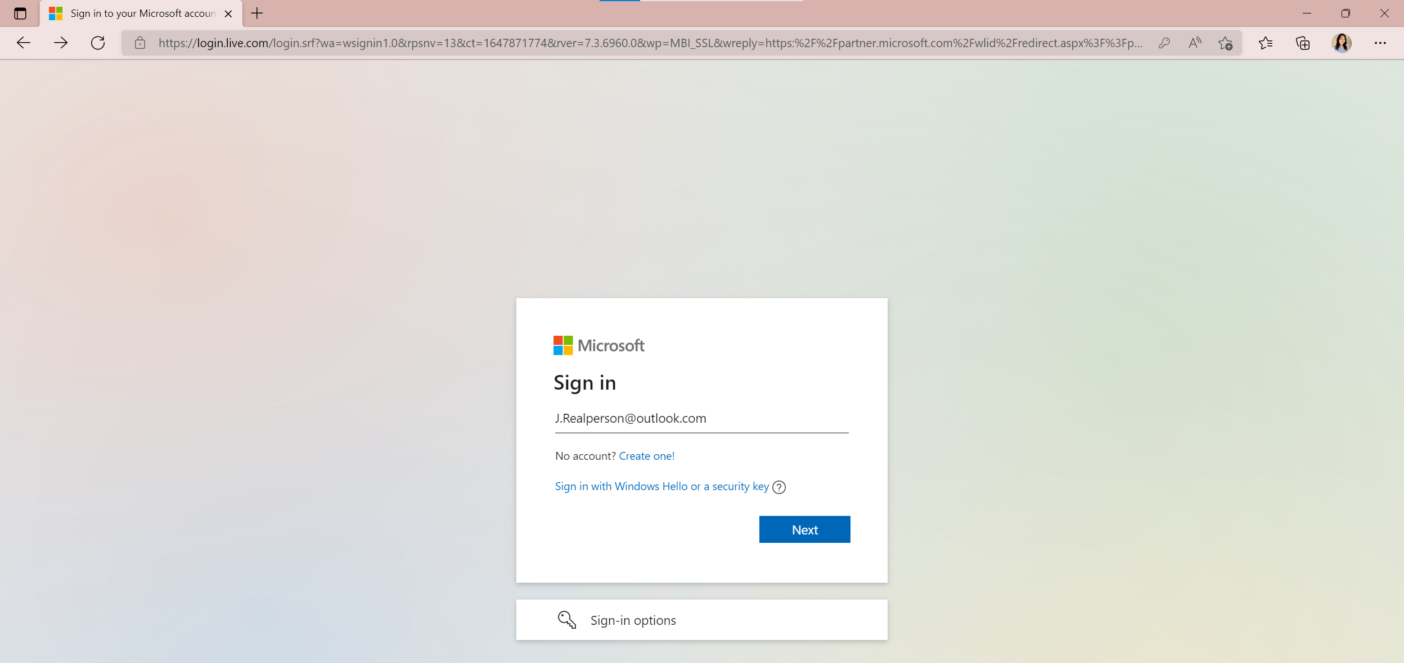
MS Partner University – Account Association
Step 7: Sign in with your personal Microsoft account (MSA)
Note: If you are an existing Partner University user, this must be the same MSA account you currently use to sign in to Partner University or other MPN sites.

Slide 10
MS Partner University
FAQ
What if partners are having trouble accessing Partner University?
First, ensure:
Partner is attempting to log into Partner University using their personal Microsoft account
Partner has successfully associated their personal Microsoft account with their organization
If still no success:
Partners can request support at partner.microsoft.com/support
Please select:
“Create a request in Partner Center”
Escalation: If no resolution, contact your Microsoft PDM

