Slide 1
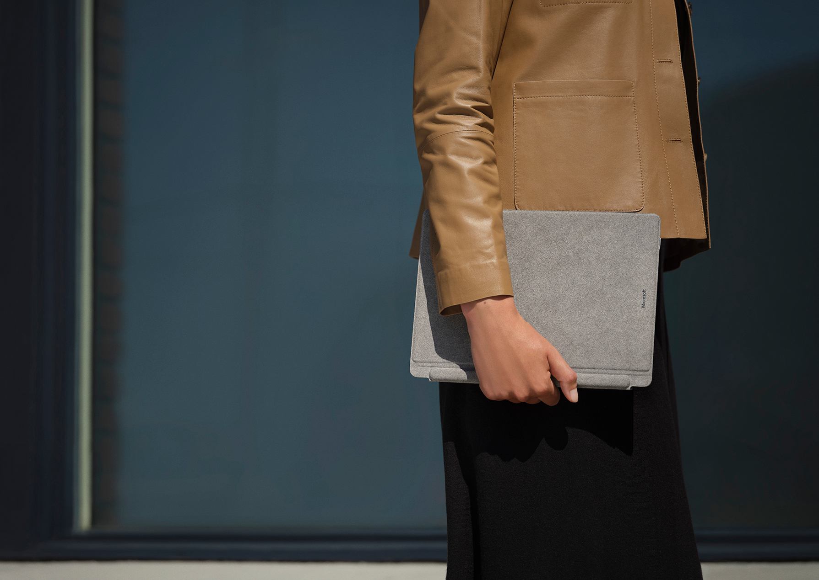
Surface Hybrid Workplace Solution Guide asset usage guidance
How to use the Surface for Business hybrid workplace assets
© 2021 Microsoft Corporation. All rights reserved. This document is provided “as-is.” Information and views expressed in this document, including URL and other Internet Web site references, may change without notice. You bear the risk of using it. This document does not provide you with any legal rights to any intellectual property in any Microsoft product. You may copy and use this document for your internal, reference purposes. https://www.microsoft.com/surface/business

Slide 2
There are: three (3) PDFs, three (3) InDesign files, and one (1) OFT and one (1) HTML.
1. Surface Hybrid Workplace Business Value Solution Guide
Objective: The intention of the guide is to explain to prospective customers and purchase influencers how Surface for Business addresses the challenges of trying to keep employees productive, collaborative, and secure in a hybrid workplace.
File Format: PDF and InDesign​. You will need Adobe InDesign to edit the static image file and flow localized copy through.​​
2. Surface Hybrid Workplace Business Value Solution Guide Flyer
Objective: The flyer provides prospective customers and purchase influencers a brief overview of the benefits of Surface for Business in a hybrid work environment.
File Format: PDF and InDesign​. You will need Adobe InDesign to edit the static image file and flow localized copy through.​​
3. Surface Hybrid Workplace Business Value Solution Guide Email Template
Objective: The intention of the email is to provide direct outreach to customers.
File Format: OFT​: You will need Microsoft Outlook to edit to flow localized copy through. HTML: You will need to follow your usual procedures edit and use HTML content in non-Outlook email clients.
Notes:
Design team and/or agency should take the copy document marked with EN-US, then copy, localize, and flow that copy into the final design assets.
​​

Slide 3
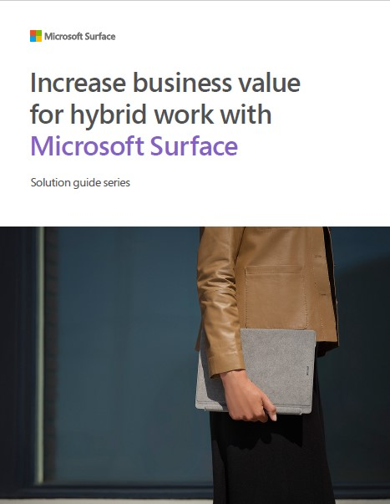
Asset Location + Title | Surface_Surface-devices-solution-guide_solutionguide_110321.zip
Thumbnail | File Type | Copy
 | PDF InDesign | Title: Increase business value for hybrid work with Microsoft Surface CTAs: Read the study “Maximizing Your ROI From Microsoft 365 Enterprise With Microsoft Surface.” Learn more about Surface for Business.

Slide 4
Asset Location + Title | SurfaceHybridSG-Flyer_110121.pdf
Thumbnail | File Type | Copy
 | PDF InDesign | Title: Enhance your hybrid work strategy with Surface for Business Subtitle: The emerging hybrid workplace brings new challenges for organizations’ IT teams. Overcome them with Surface for Business. In our solution guide, “Increase business value for hybrid work with Microsoft Surface,” find out how to: Increase engagement: Keeping employees engaged and productive can be more difficult in a hybrid workplace. Manage devices: Hybrid workplaces demand more flexible and secure device solutions. Mitigate risk: With employees working from anywhere, organizations face new security risks. Overcome these hybrid workplace challenges with Surface for Business. CTAs: Read all about it in our solution guide. Learn more about Surface for Business.

Slide 5
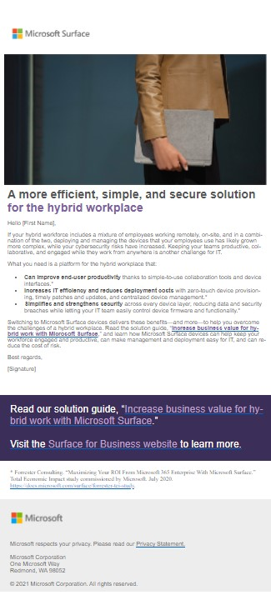
Asset Location + Title | SurfaceBusinessValue-SolutionGuide_Email_110121.oft SurfaceBusinessValue-SolutionGuide_Email_110121.html
Thumbnail | File Type | Copy
 | OFT HTML | Subject line: Modernize your hybrid workplace with simple, flexible, and secure devices A more efficient, simple, and secure solution for the hybrid workplace Hello [First Name], If your hybrid workforce includes a mixture of employees working remotely, on-site, and in a combination of the two, deploying and managing the devices that your employees use has likely grown more complex, while your cybersecurity risks have increased. Keeping your teams productive, collaborative, and engaged while they work from anywhere is another challenge for IT. What you need is a platform for the hybrid workplace that: Can improve end-user productivity thanks to simple-to-use collaboration tools and device interfaces. Increases IT efficiency and reduces deployment costs with zero-touch device provisioning, timely patches and updates, and centralized device management. Simplifies and strengthens security across every device layer, reducing data and security breaches while letting your IT team easily control device firmware and functionality. Switching to Microsoft Surface devices delivers these benefits—and more—to help you overcome the challenges of a hybrid workplace. Switching to Surface and Microsoft 365, supported by Windows, delivers a more efficient and secure platform for the hybrid workplace while reducing costs and complexity, helping you overcome the challenges of a hybrid workplace. Read the solution guide, “Increase business value for hybrid work with Microsoft Surface,” and learn how Microsoft Surface devices can help keep your workforce engaged and productive, can make management and deployment easy for IT, and can reduce the cost of risk. Best regards, [Signature] CTAs: Read our solution guide, “Increase business value for hybrid work with Microsoft Surface.” Visit the Surface for Business website to learn more.

Slide 6
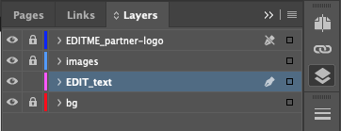
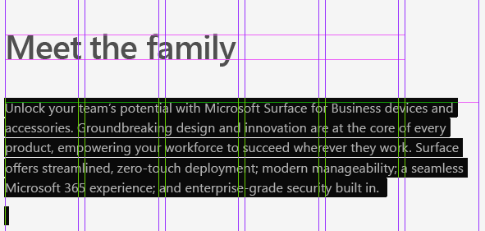
Step-by-step instructions on
how to flow localized copy in InDesign
Open Layers panel and make sure that “EDIT_text” layer is unlocked. Lock all other layers by clicking on the box to the immediate left of the layer name.
Double-click into the text box or hit “T” and click in the text box to edit the text. Copy + paste from another document or edit directly in InDesign.
Double-check the details:
Run spell-check. Double-click into the text box and select all. Right click > Spelling > Spell Check. Choose whether to Skip, to change to a Suggested Correction, add to User Dictionary, or Ignore.
Check footnotes. Check that all references to footnotes use a superscript style. To change numbers from regular to superscript, highlight the number and hover over it. A superscript option will appear. Alternatively, open Window > Type & Tables > Glyphs and make the change in the Glyphs panel.

Slide 7
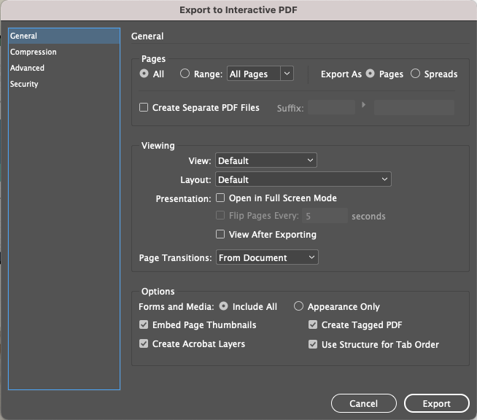
Best practices for exporting a PDF from InDesign
Export the PDF: File > Export > Export As.
Name the file and determine your save location. Under Format, select Adobe PDF (interactive).
In the Export Adobe PDF dialog box, set any options, then click Export to output the PDF.

Slide 8
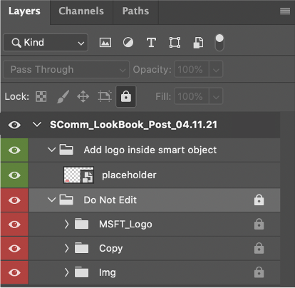
Step-by-step instructions on
how to flow localized copy into static images in Photoshop
Inside each PSD file, you will find 2 main folders at the layers panel.
Partner logo placeholder.
Delete or hide this layer group if your post does not include a partner logo.
In order to edit the copy, you must first unlock this layer group by clicking the lock icon at the right.
Open each PSD file. Click the lock icon in the layers panel to make all elements editable.
Copy the localized title from the approved document.
Select the current title in Photoshop using the Text tool and replace it by pasting in the localized copy (Edit > Paste).
Repeat steps 2 & 3 to update the subtitle or additional copy elements.
Export the updated image. See previous slide for export specifications.

Slide 9
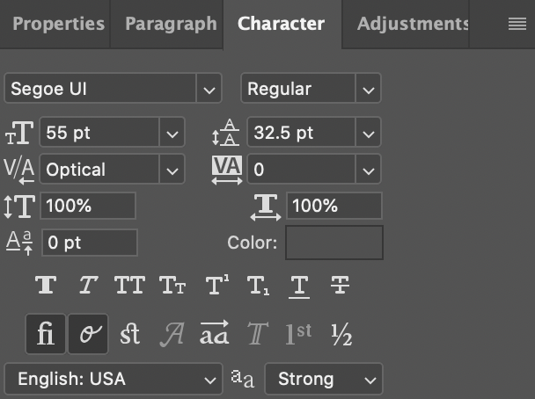
Best practices for managing text in Photoshop
Open the character panel to view properties such as font size, font style, color and tracking.
(Window > Character)
All of these properties should remain intact. The only exception occurs if type size needs to be reduced to accommodate longer words in other languages.
Copy checklist
Before you’re ready to post, please verify the following:
On-image copy: Fonts, font sizes and styles must not be modified when pasting in the localized copy.
Post copy is kept under 150 characters.
The hashtag #SurfaceForBusiness is used after the final sentence and isn’t incorporated into the statement; it stands alone.

Slide 10
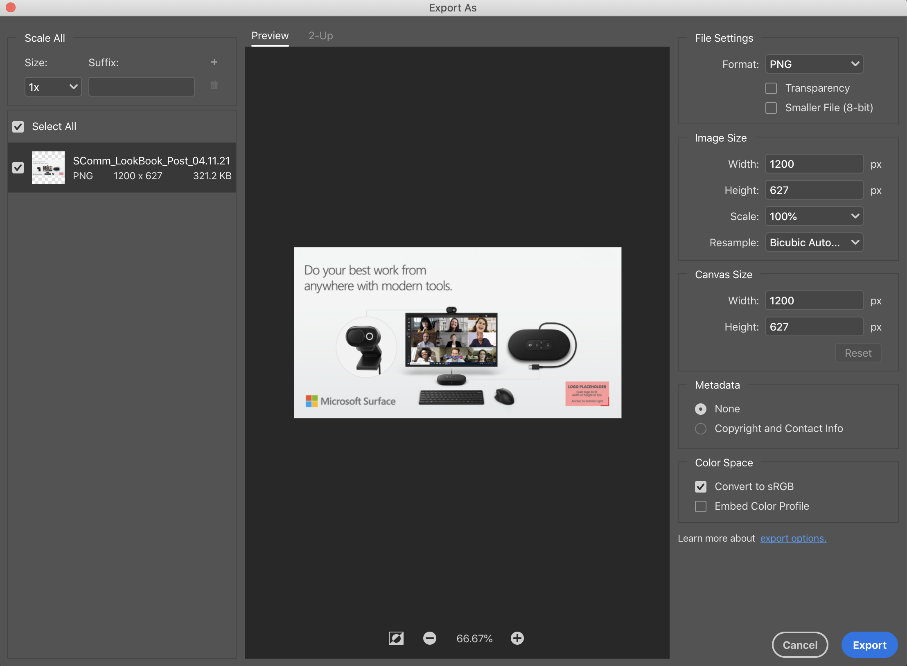
Best practices for exporting static images from Photoshop
Export the image: File > Export > Export As.
File format: PNG. No transparency.
Scale: 100%
Size: 1200x627 pixels
Metadata: None
Convert to sRGB
Image checklist
Before you’re ready to post, please verify the following:
Your partner logo is positioned according to the placeholder guides.
The logo is accessible and has enough contrast against the light grey background.
On-image copy can only be modified for localization purposes.
All other design elements must not be moved or altered in any way.

Slide 11
Step-by-step instructions on how to edit the OFT email
Choose the OFT file from the eMail templates folder.
Use -PV-1 if you need to add links to the CTA section.
Use -PV-2 if you also need to add a logo.
Add the name of the recipient in the opening, in the area marked [First Name].
Add your name and signature/email address to in the closing statement of the email, in the area marked [Signature].
Add your logo into the email where indicated, if using PV-2
Step-by-step instructions on how to edit the HTML file
Download the .html file to your device. ​
Find the file in your file explorer. Right-click it, look for the option to Open with... and then select your favorite browser from the options presented.​ ​
In the browser window, press CTRL + A to select all. Then paste it into the body of a new email. ​
Add the name of the recipient in the opening, in the area marked [First Name].​ ​
Add your name and signature/email address to in the closing statement of the email, in the area marked [Signature].​ ​
Add your logo into the email.​ indicated, if using PV-2.

Slide 12
Microsoft co-branding guidelines Partner logo minimum size and relationship
Horizontal logo
Partner logo should be no less than 16px high and should not exceed more than the height of the horizontal Microsoft Surface logo.
Stacked logo
Partner logo should be no less than 16px high and should not exceed more than 1 symbol square higher than the stacked Microsoft Surface logo.
Note: Padding on ALL banners follows the horizontal logo rules at 16px.
Clear space
Clear space is the minimum distance between partner logo lockups and other visual or verbal elements, as well as the edge of a product.
Minimum clear space surrounding the lockup is equivalent to one 16px symbol of the horizontal Microsoft Surface logo.

