Slide 1
How to use this presentation
This pitch deck is a presentation tool that explores the features, benefits, and the motivations behind many attributes of Surface Hub 2S.
Along with the information highlighted
in the main slides, you’ll also find additional information in the speaker notes.
This presentation is divided into four sections:
Section 1: The Microsoft Surface portfolio
This section introduces current trends concerning the needs of the modern workplace and presents the Surface portfolio as a solution to those needs.
Section 2: Surface Hub 2S overview: The ultimate teaming device
This section introduces the three messaging pillars that characterize the value of Surface Hub 2S. This section will demonstrate the value of Surface Hub 2S in the context of each messaging pillar and showcase the benefit-rich features that comprise the pillar.
    Teamwork anywhere
    Bring remote teams together
    Fluid team collaboration
Section 3: Appendix
This section provides additional Surface Hub 2S details including technical specifications, features accessories, warranty information, etc.
Notes:
Note: Relevant disclaimers are included in the slide notes throughout this presentation.

Slide 2
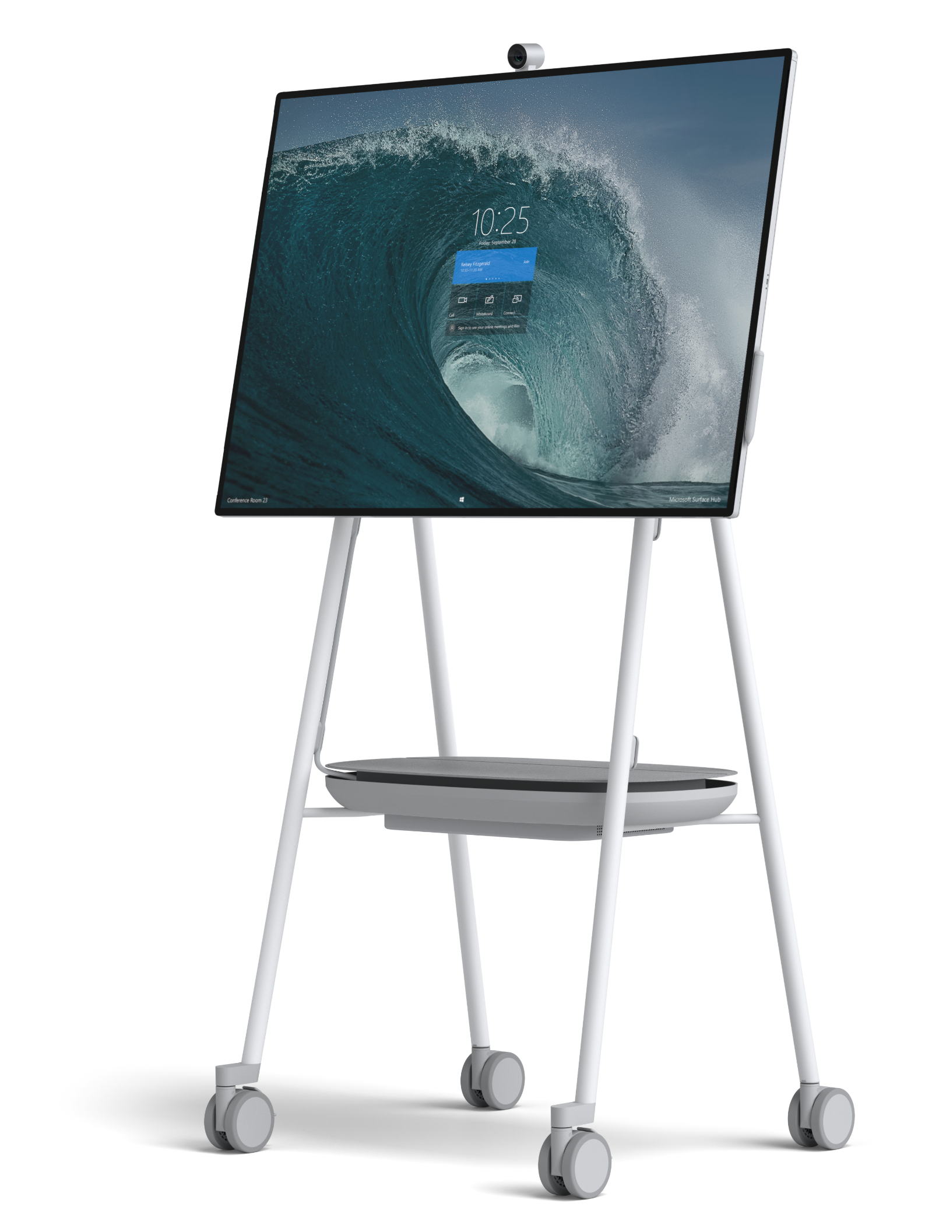

Introducing Surface Hub 2S
Teamwork without boundaries

Slide 3

A modern workplace is emerging
Collaboration is key
More than 50% of the work done today is accomplished through collaboration¹
Rise in remote working
70% of professionals work somewhere other than the office at least one day a week²
Workspace evolution
“Empowered offices” – in which workers choose their office conditions – can increase productivity by +25%³
*Steelcase Roam™ Mobile Stand and APC™ Charge Mobile Battery sold separately.
Notes:
*Steelcase Roam™ Mobile Stand and APC™ Charge Mobile Battery sold separately.
¹Inc.com. “7 Best Solutions to Increase Collaboration That Are Often Overlooked.” September 2018.
²International Workplace Group (IWG), IWG Workplace Survey 2018
³NYT, “Don’t Get Too Comfortable in that Desk”, Oct 2017

Slide 4
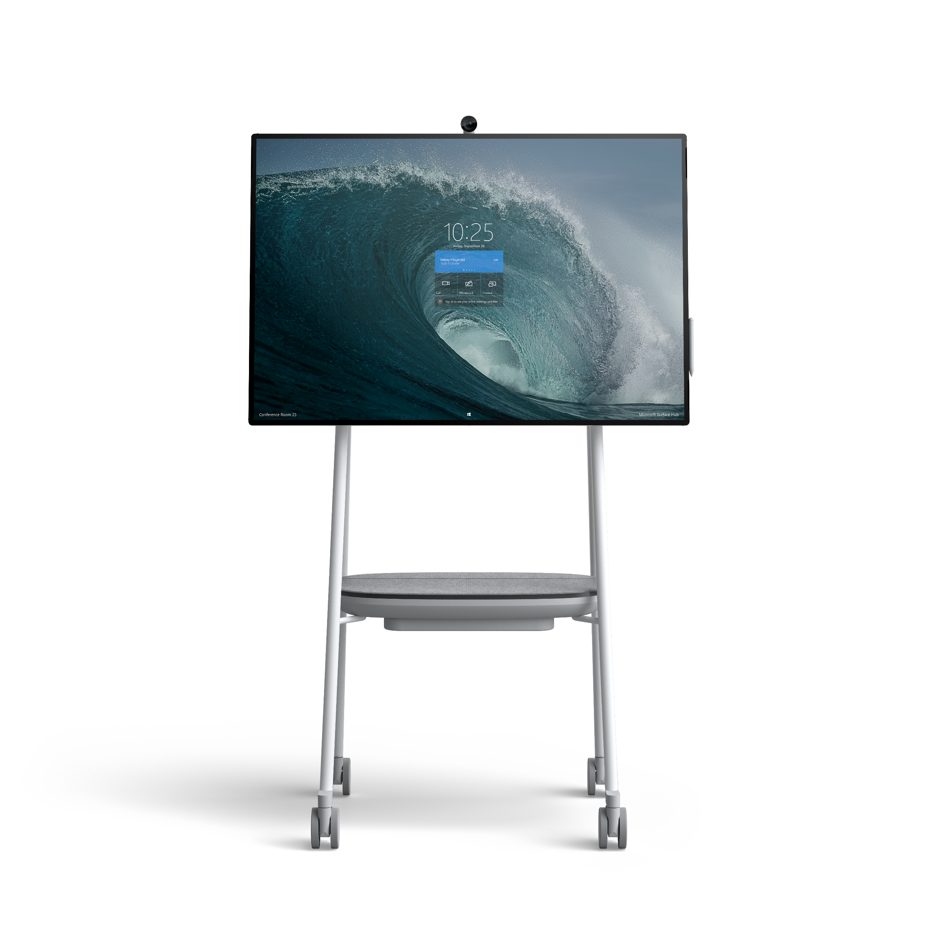
Meet Surface Hub 2S
Teamwork without boundaries
Sleek, slim design with the thinnest edge and bezel of any device in its class¹
A brilliant 4K+ screen, 4K camera, and enhanced speakers and mics
A great platform for Microsoft Teams² and Skype for Business²
Next level brainstorming with Microsoft Whiteboard, a persistent digital canvas
Sign in to access OneDrive files or project content wirelessly with Miracast
Interact naturally with Surface Hub 2 Pen³ and touch functionality
Fully integrated Windows 10 device— natively run must-have Microsoft and third-party apps
Experience mobile, cordless teamwork with Steelcase Roam™ Mobile Stand and APC™ Charge Mobile Battery⁴
Surface Hub 2S has not yet been authorized under U.S. Federal Communications Commission (FCC) rules; actual sale and delivery is contingent on compliance with applicable FCC requirements.
Notes:
¹Comparison by Microsoft of Surface Hub 2S to all other devices within the Futuresource-defined Integrated Unified Communications Displays category (integrated solutions incorporating video, content and audio conferencing features with a display providing an end to end hardware and platform solution, optimized to support a specific UC platform), as of April 2019.
²Software license required for some features. Sold separately.
³One (1) Surface Hub 2 Pen and one (1) Surface Hub 2 Camera included with Surface Hub 2S. Additional accessories sold separately.
⁴Steelcase Roam™ Mobile Stand, Steelcase Roam™ Wall Mount, and APC™ Charge Mobile Battery sold separately.
Please use the applicable compliance requirements and certs for your market only.
Australia: Surface Hub 2S has not yet been authorized under ACMA rules; actual sale and delivery is contingent on compliance with applicable ACMA requirements.
Launch Countries in the EU/Common Market: “Surface Hub 2S has not yet been authorized under Directive 2014/53/EU; actual sale and delivery is contingent on compliance with applicable Directive 2014/53/EU requirements
Countries: Austria, Belgium, Denmark, Finland, France, Germany, Ireland, Italy, Luxembourg, Netherlands, Norway, Portugal, Spain, Sweden, Switzerland, UK
Hong Kong, Japan, Qatar, UAE: Surface Hub 2S coming in 2019; Pre-release products shown; products and features subject to change, and may vary by country/region.
New Zealand: Surface Hub 2S has not yet been authorized under Radio Spectrum Management rules; actual sale and delivery is contingent on compliance with applicable Radio Spectrum Management requirements.
United States: Surface Hub 2S has not yet been authorized under U.S. Federal Communications Commission (FCC) rules; actual sale and delivery is contingent on compliance with applicable FCC requirements.
Canada and Singapore: Surface Hub 2S coming in 2019; Pre-release products shown; products and features subject to regulatory certification/approval, may change, and may vary by country/region.

Slide 5
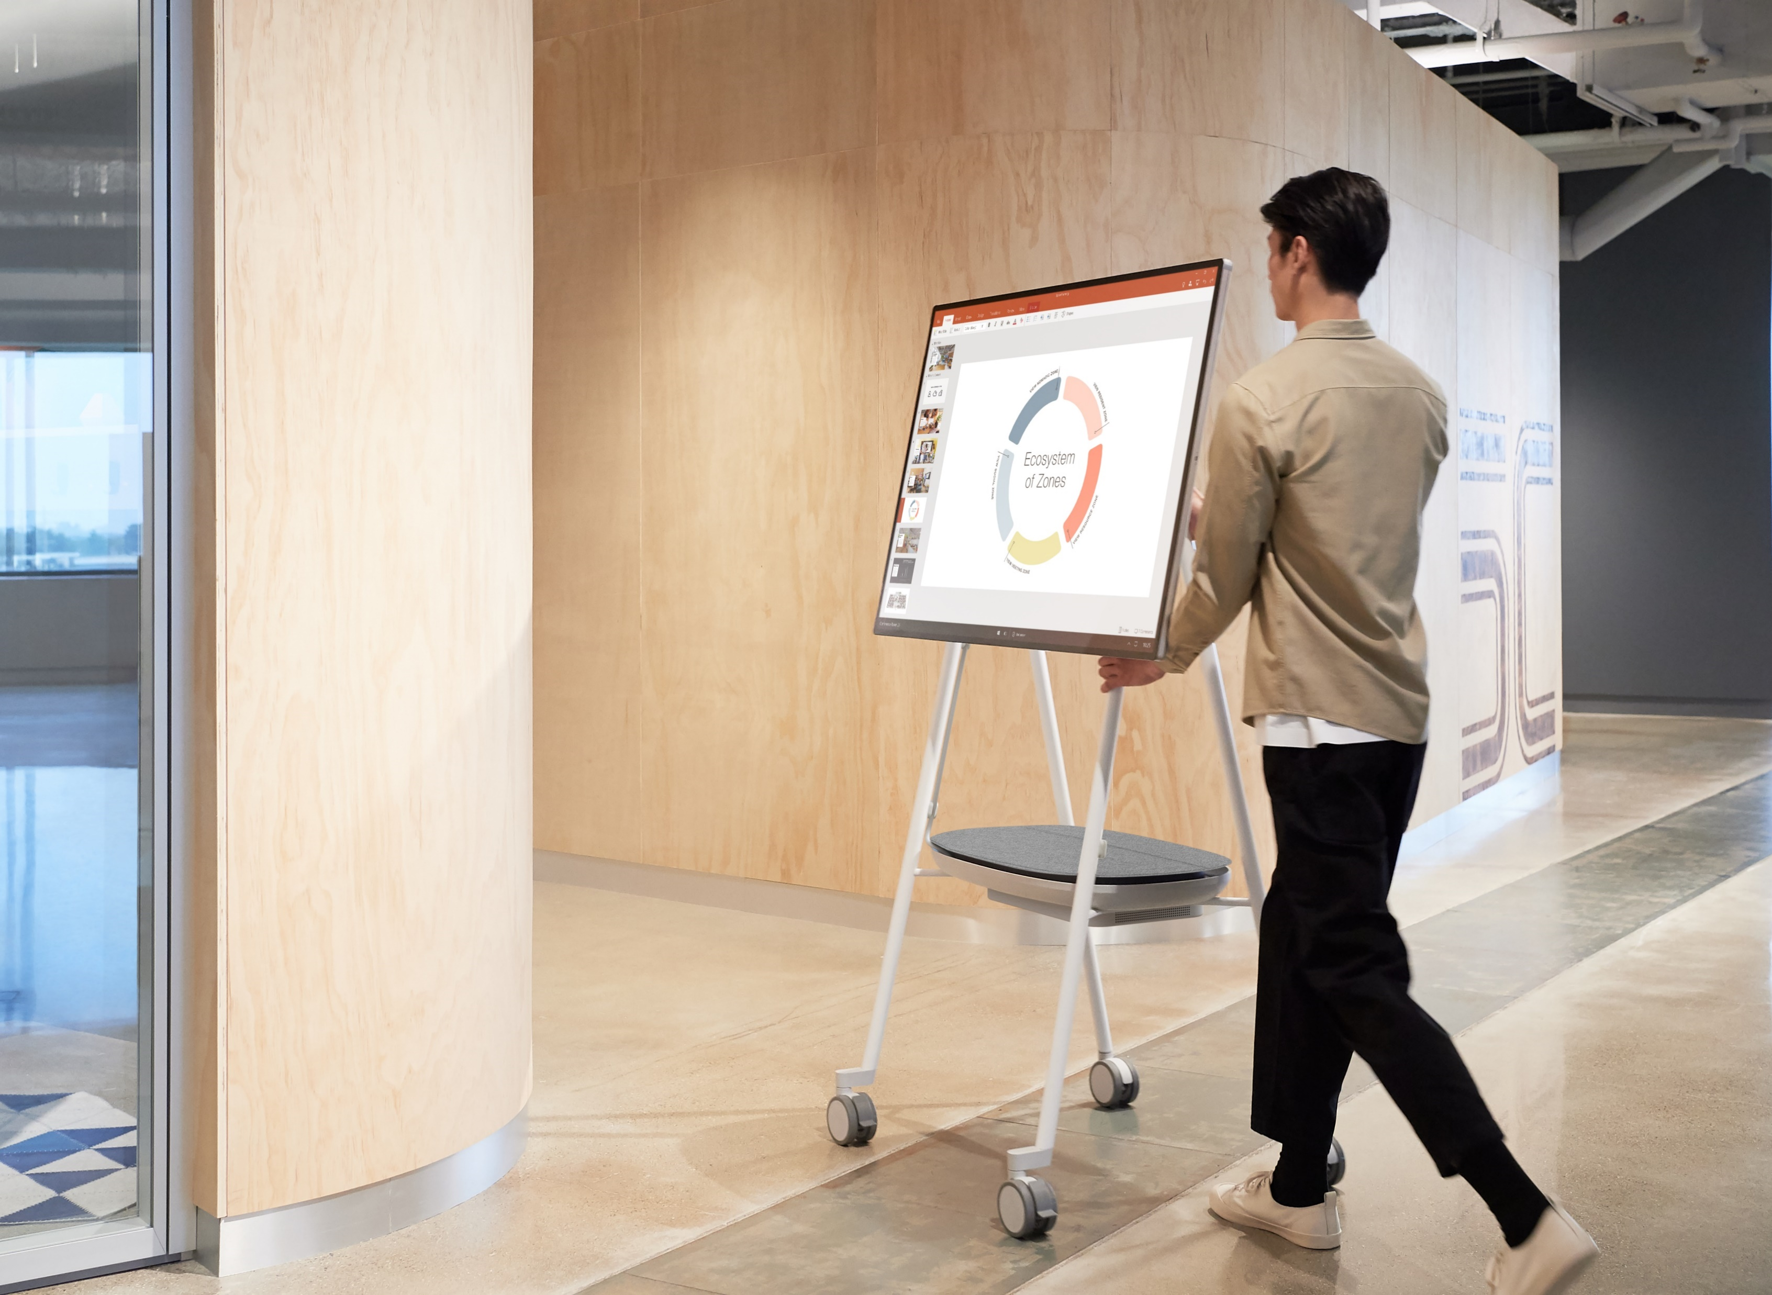
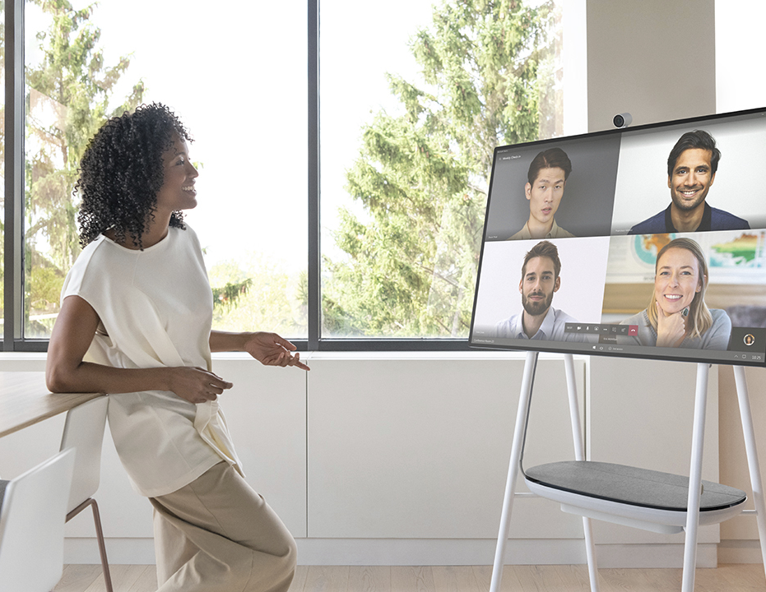

Surface Hub 2S
The ultimate teaming device
Teamwork anywhere
Bring remote teams together
Fluid team collaboration
Notes:
¹Steelcase Roam™ Mobile Stand, Steelcase Roam™ Wall Mount, and APC™ Charge Mobile Battery sold separately.

Slide 6

Teamwork anywhere
Empower teams to collaborate whenever and wherever their ideas strike. Surface Hub 2S is thin and lightweight, and enables mobile, cordless,¹ uninterrupted teamwork. Turn any space into a teamwork space.
Notes:
¹Steelcase Roam™ Mobile Stand, Steelcase Roam™ Wall Mount, and APC™ Charge Mobile Battery sold separately.

Slide 7
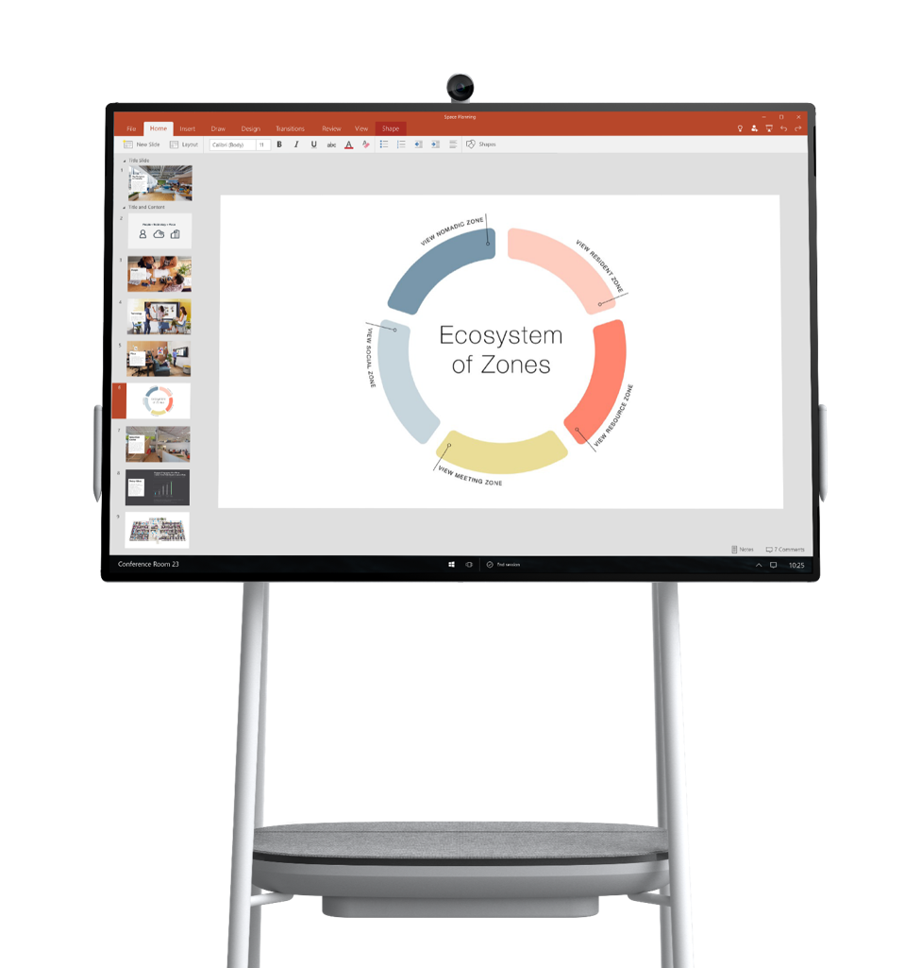
15 mm bezels
Teamwork anywhere
Move collaboration anywhere with Surface Hub 2S. At just 61.6 lbs. (28 kg), it’s 40% lighter than before.¹
Experience mobile, cordless, uninterrupted team collaboration that moves with you with the Steelcase Roam™ Mobile Stand and APC™ Charge Mobile Battery.²
Enhance any workspace with a sleek, modern design and thinnest edge and smallest bezels of any device in its class.³
Under 30 kg
Mobile and cordless
Notes:
¹Weight excludes stand and mobile battery. Compared with a 55" Microsoft Surface Hub.
²Steelcase Roam™ Mobile Stand, Steelcase Roam™ Wall Mount, and APC™ Charge Mobile Battery sold separately.
³Comparison by Microsoft of Surface Hub 2S to all other devices within the Futuresource-defined Integrated Unified Communications Displays category (integrated solutions incorporating video, content and audio conferencing features with a display providing an end to end hardware and platform solution, optimized to support a specific UC platform), as of April 2019.

Slide 8
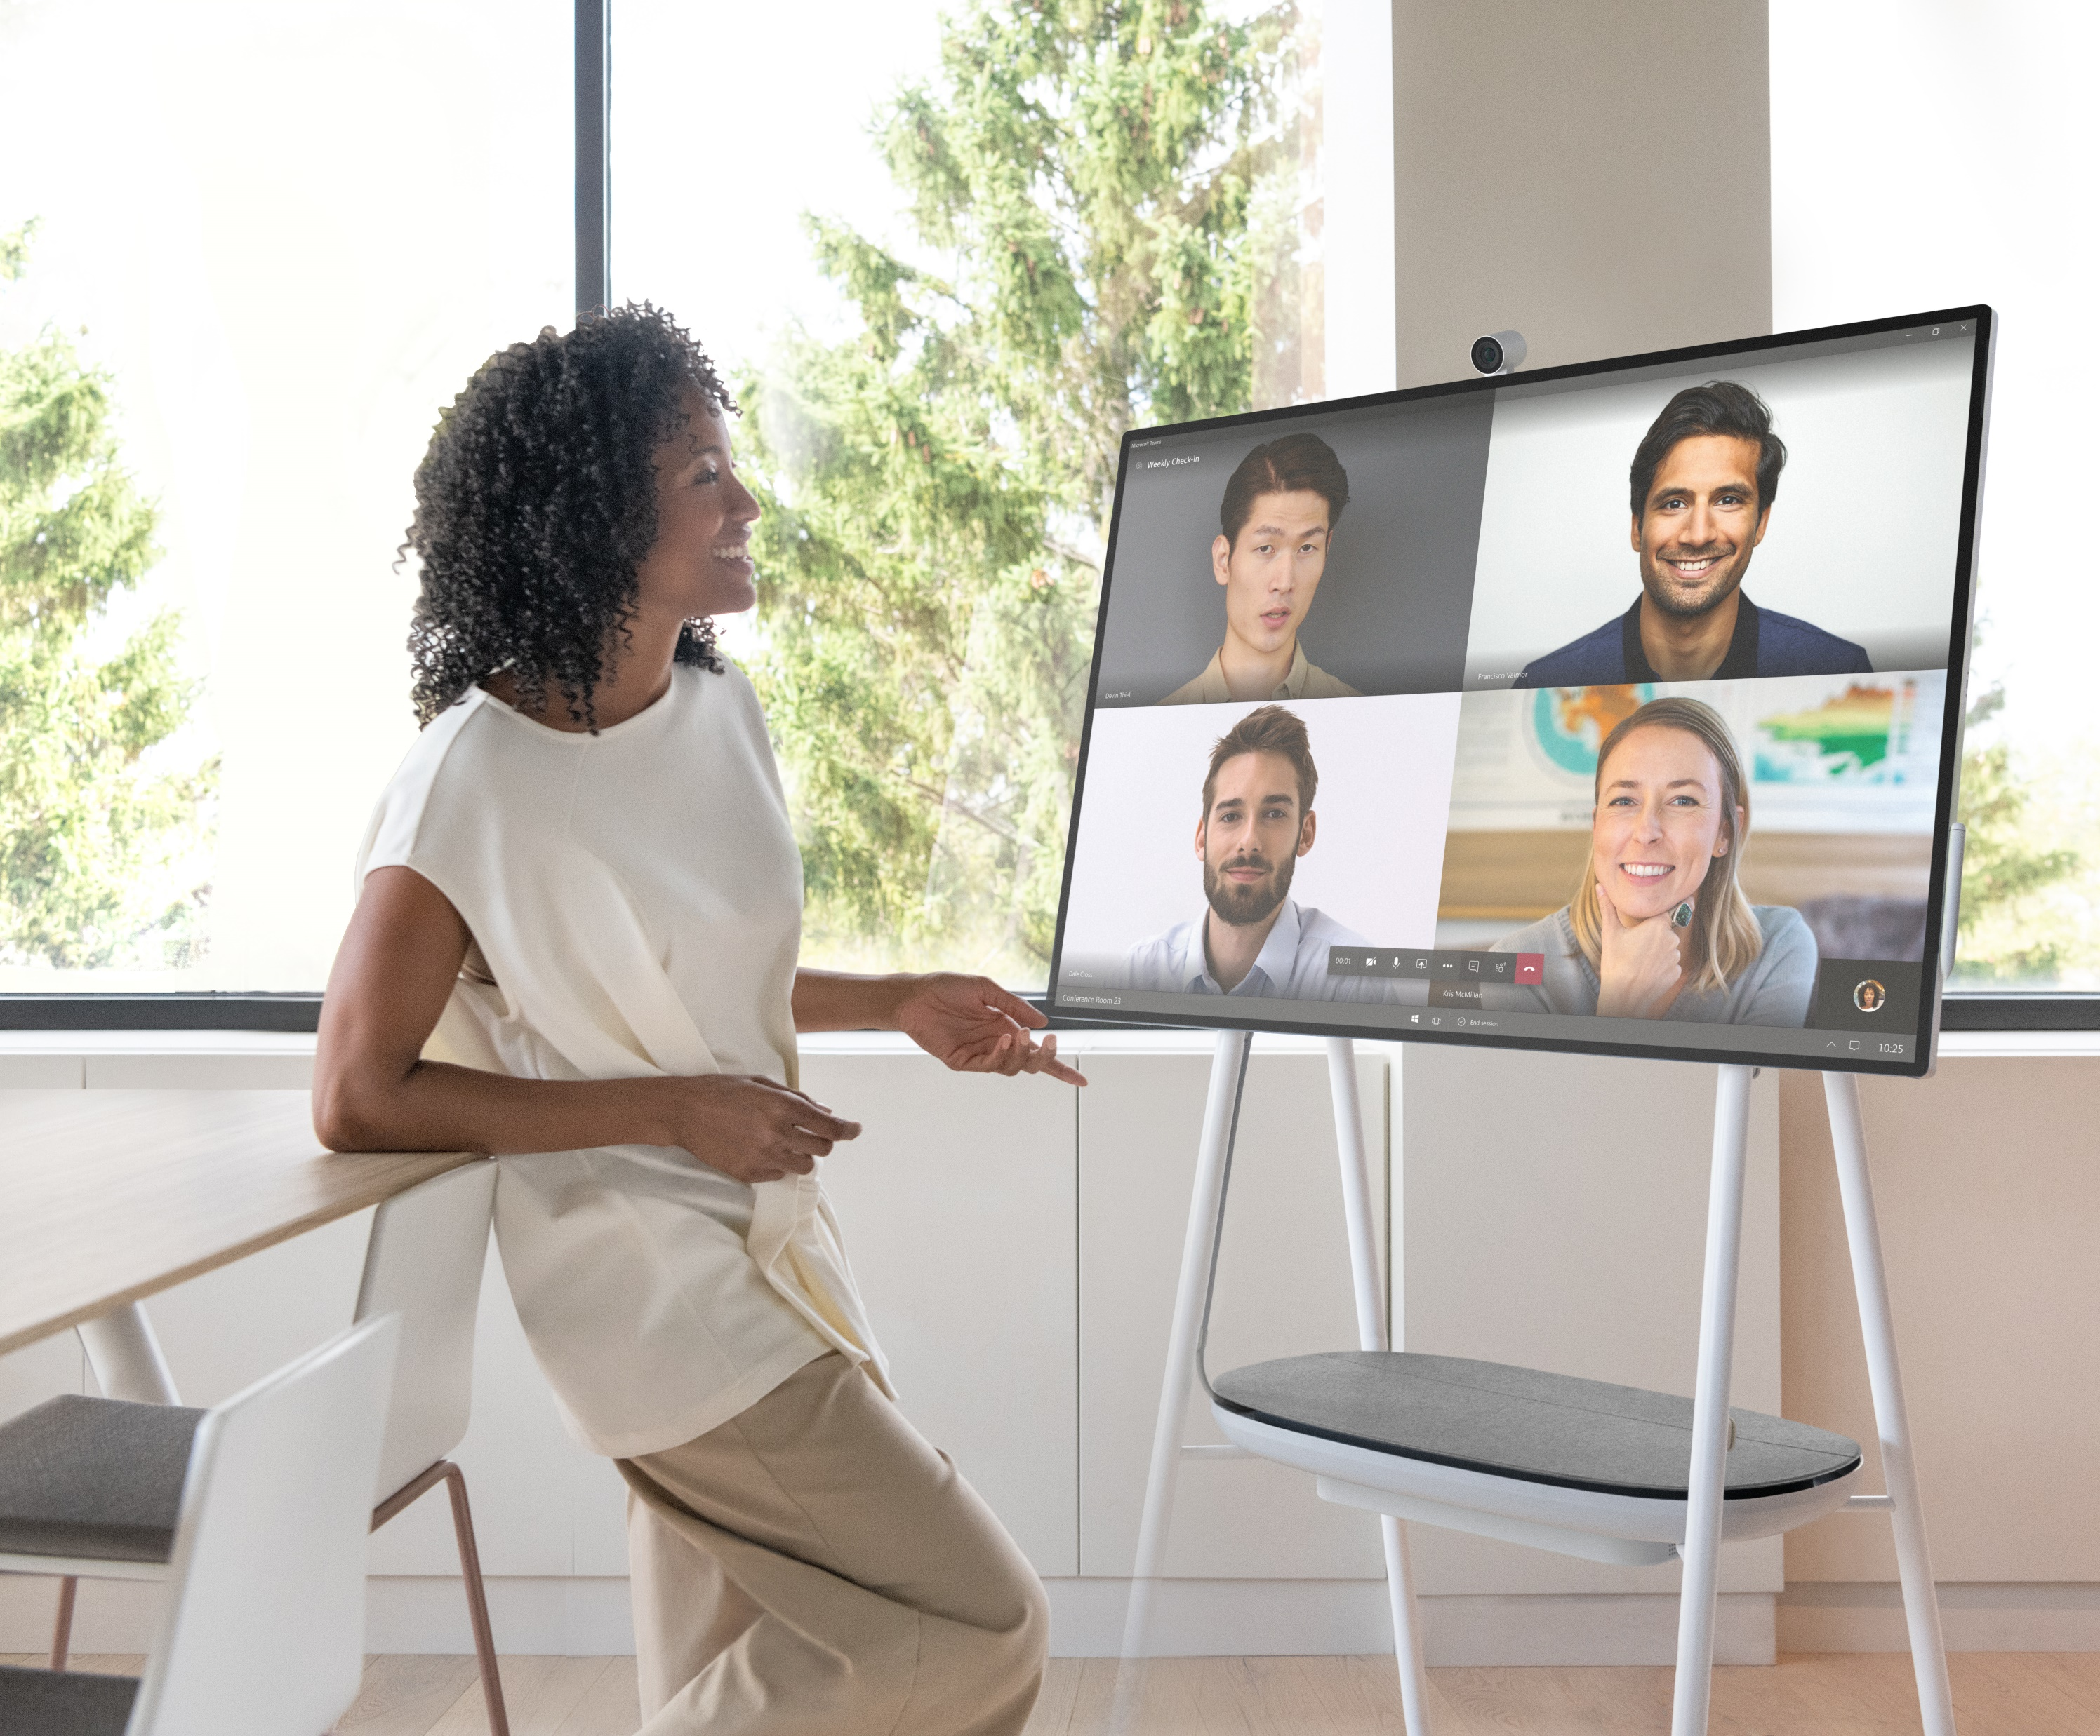
Bring remote teams together
Be seen, be heard, and actively participate in the group discussion with best-in-class technology. Remote meetings and ad-hoc calls run seamlessly with Microsoft Teams¹ or Skype for Business.¹
Notes:
¹Software license required for some features. Sold separately.
*Steelcase Roam™ Mobile Stand and APC™ Charge Mobile Battery sold separately.

Slide 9
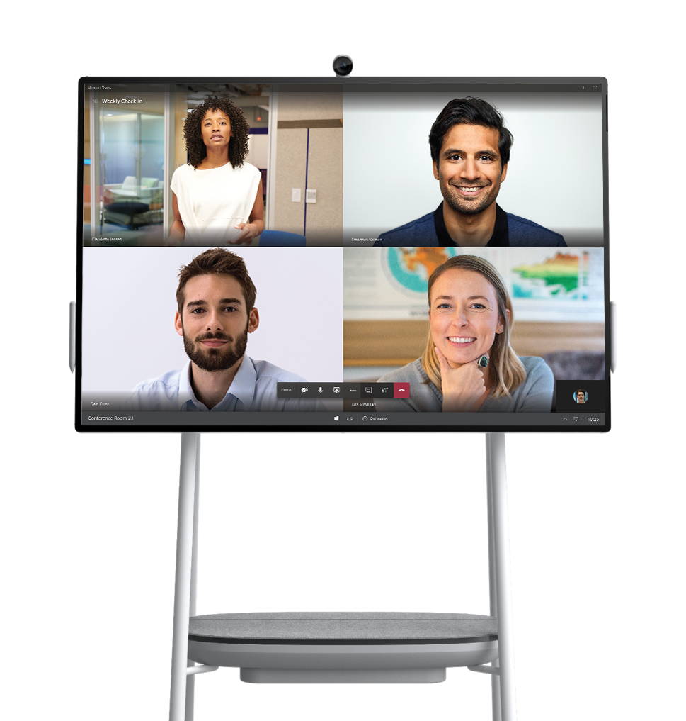
Surface Hub 2 Camera
Bring remote teams together
Engage remote teams with the Surface Hub 2 Camera,¹ far-field mics, and crystal clear speakers.
Videos look clear and crisp on a brilliant, 4K+ screen with the highest resolution and best graphics performance in its class.²
Run remote meetings and make ad-hoc calls seamlessly with Microsoft Teams³ or Skype for Business.³
4K+ screen
Microsoft Teams for Surface Hub
Notes:
¹One (1) Surface Hub 2 Pen and one (1) Surface Hub 2 Camera included with Surface Hub 2S. Additional accessories sold separately.
²Comparison by Microsoft of Surface Hub 2S to all other devices within the Futuresource-defined Integrated Unified Communications Displays category (integrated solutions incorporating video, content and audio conferencing features with a display providing an end to end hardware and platform solution, optimized to support a specific UC platform), as of April 2019.
³Software license required for some features. Sold separately.
*Steelcase Roam™ Mobile Stand and APC™ Charge Mobile Battery sold separately.

Slide 10
Fluid team collaboration
Everything you need at your fingertips. Interact naturally with Surface Hub 2 Pen¹ and touch. Use Microsoft Whiteboard and leading industry apps to keep teams in their flow. Access and share content easily from one device.
Notes:
¹One (1) Surface Hub 2 Pen and one (1) Surface Hub 2 Camera included with Surface Hub 2S. Additional accessories sold separately.
*Steelcase Roam™ Mobile Stand and APC™ Charge Mobile Battery sold separately.

Slide 11
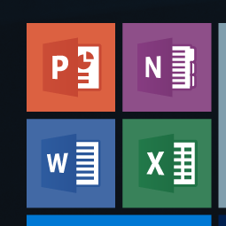
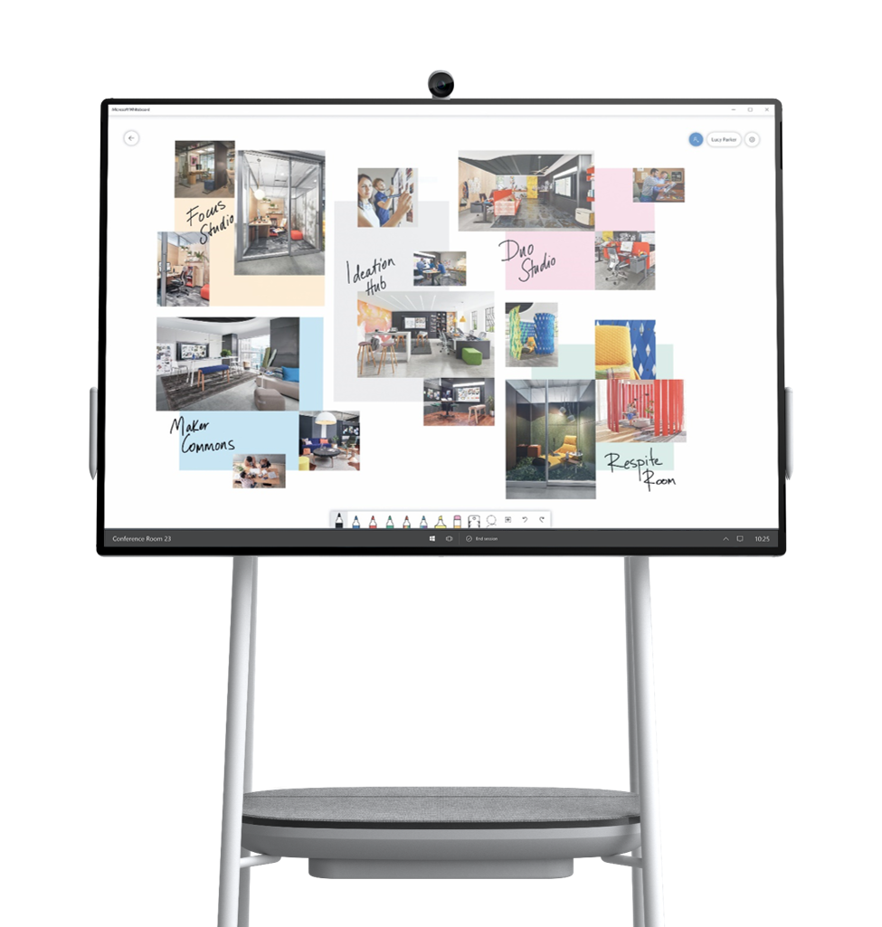
Microsoft Whiteboard
Office 365 apps
Fluid team collaboration
Interact naturally with Surface Hub 2 Pen¹ and touch, and
sign in to Surface Hub 2S to grab your OneDrive files or
project wirelessly with Miracast.
Take team brainstorms to the next level with
Microsoft Whiteboard, a persistent digital canvas that teams
can contribute to anytime, anywhere—across devices.
Use the apps you need—take advantage of native integration with Office 365,² Edge, and leading third-party apps.³
Surface Hub 2 Pen
Industry apps like Drawboard BullClip²
Notes:
¹One (1) Surface Hub 2 Pen and one (1) Surface Hub 2 Camera included with Surface Hub 2S. Additional accessories sold separately.
²Software license required for some features. Sold separately.
³Third-party apps sold separately.
*Steelcase Roam™ Mobile Stand and APC™ Charge Mobile Battery sold separately.

Slide 12
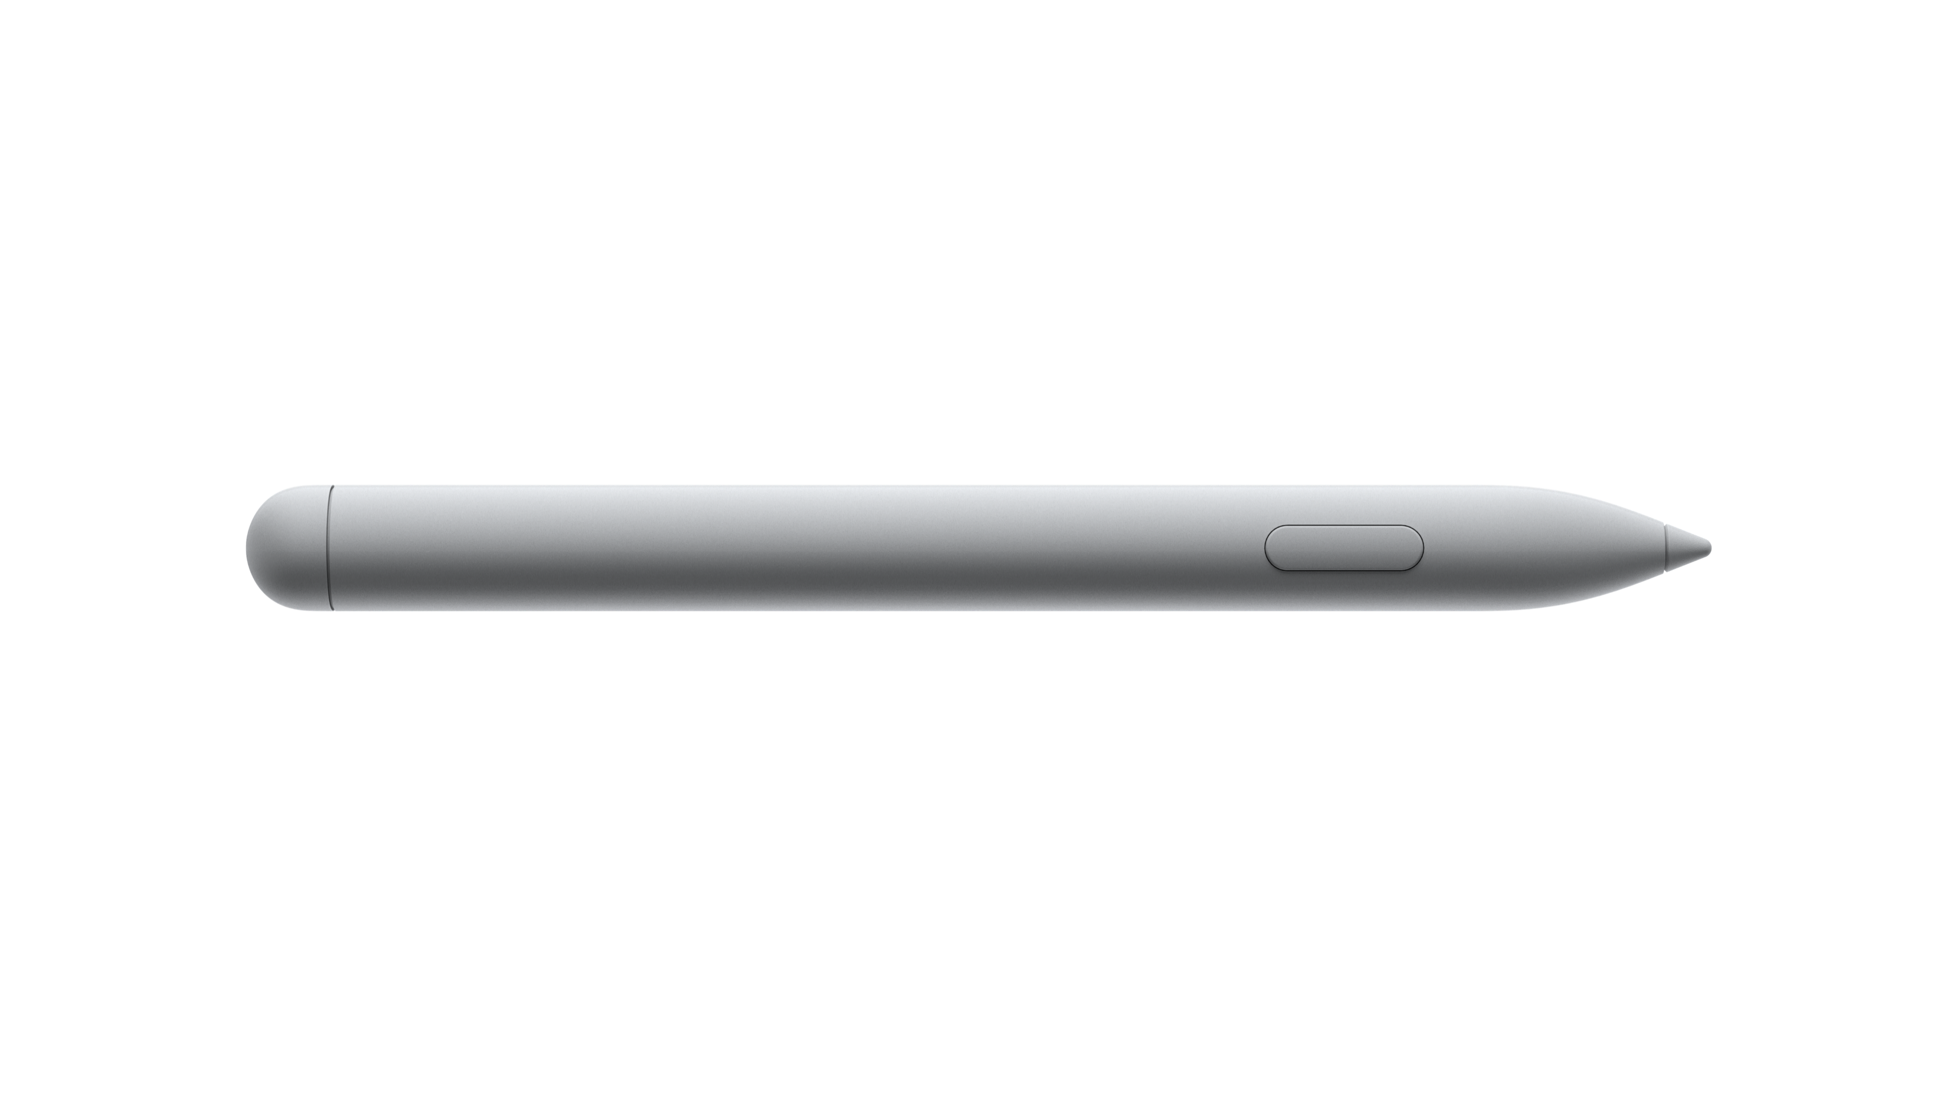
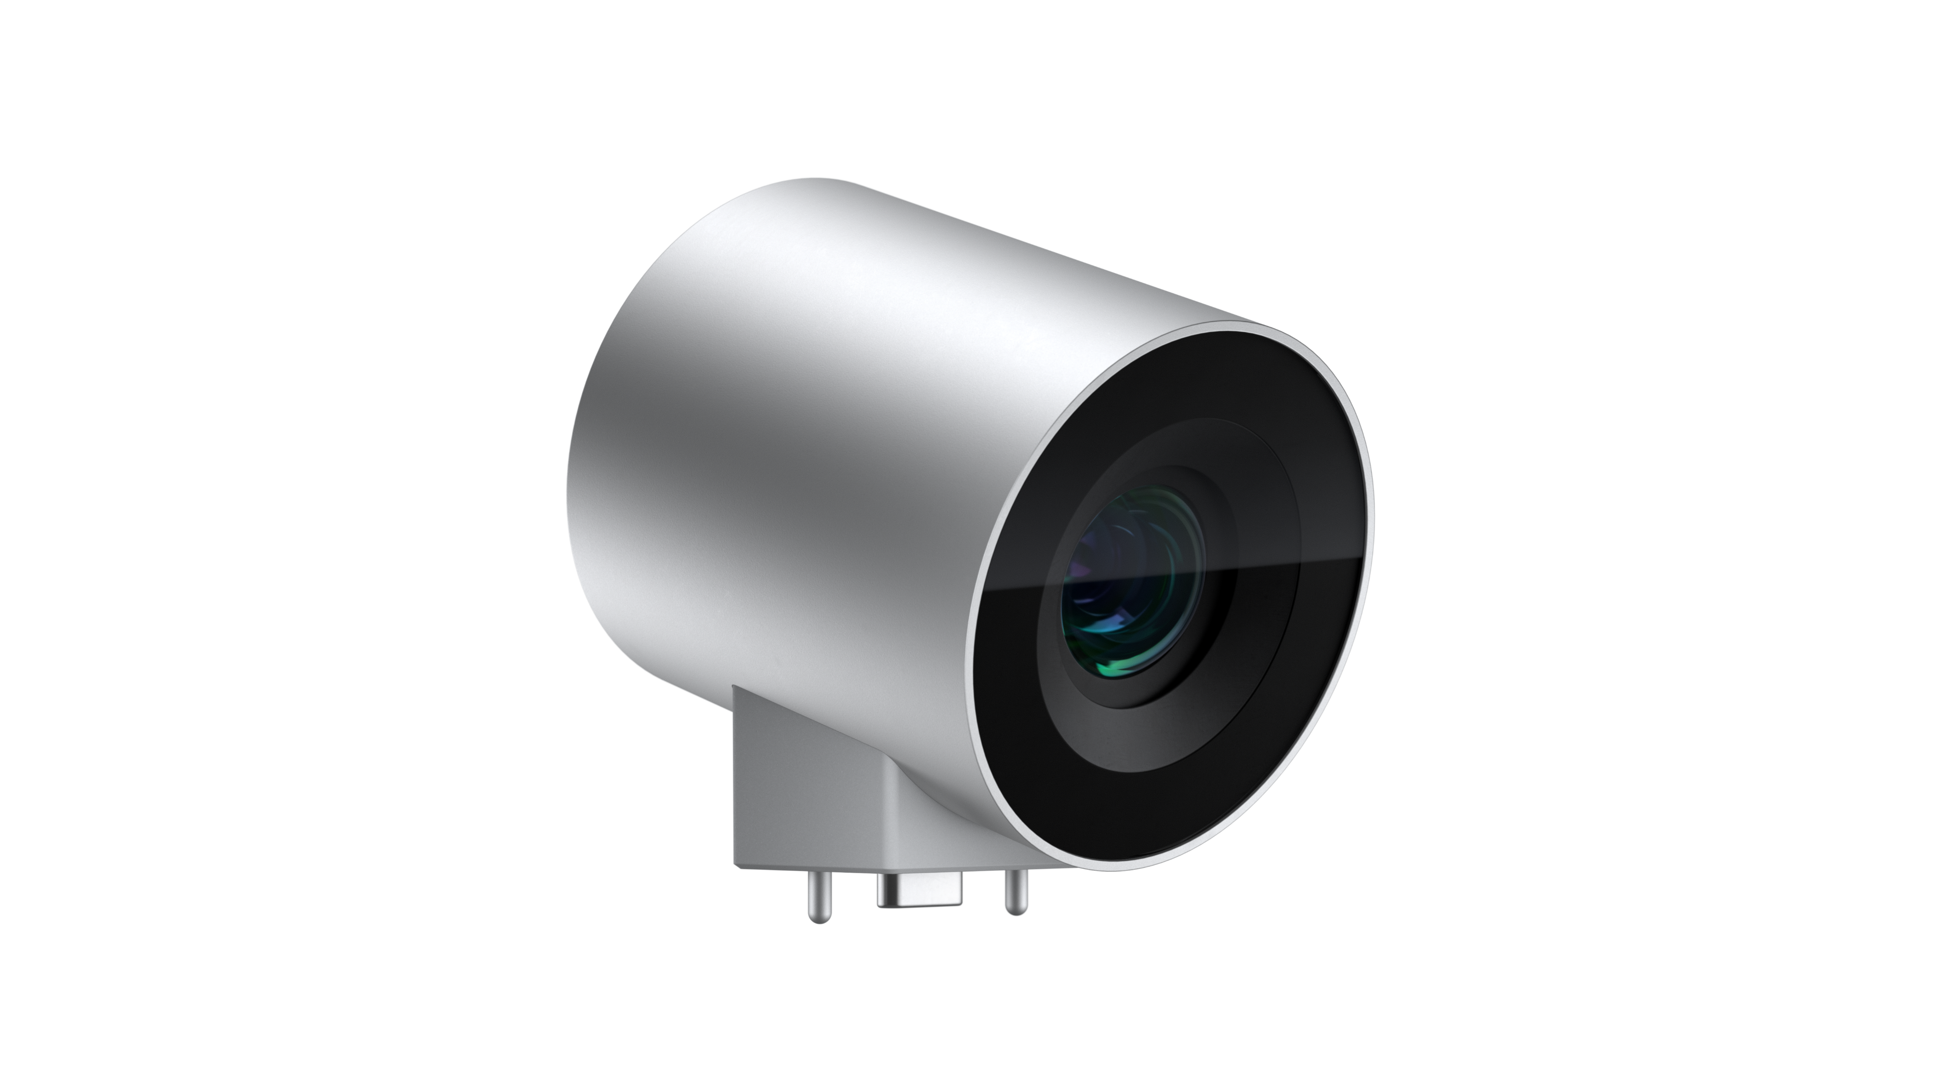
Surface Hub 2S accessories
Surface Hub 2 Pen*
Write fast and precise with the new Surface Hub 2 Pen. Enjoy a natural writing experience with highly responsive touch and inking capabilities.
Surface Hub 2 Camera*
See every detail in crystal clarity with the new Surface Hub 2 Camera.
With 4K resolution and wide angle lens, meetings come to life right before your eyes.
Notes:
*One (1) Surface Hub 2 Pen and one (1) Surface Hub 2 Camera included with Surface Hub 2S. Additional accessories sold separately.

Slide 13
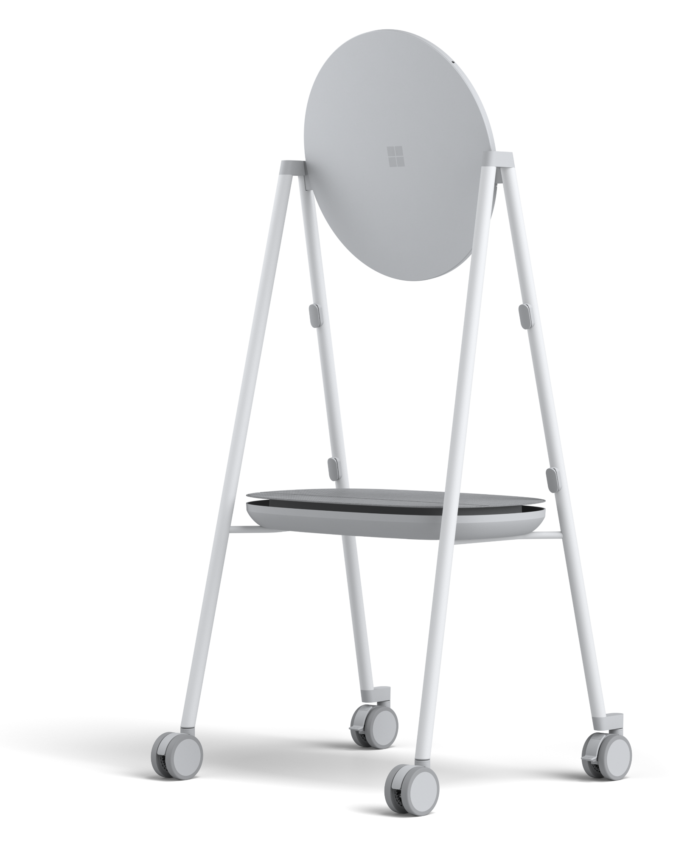
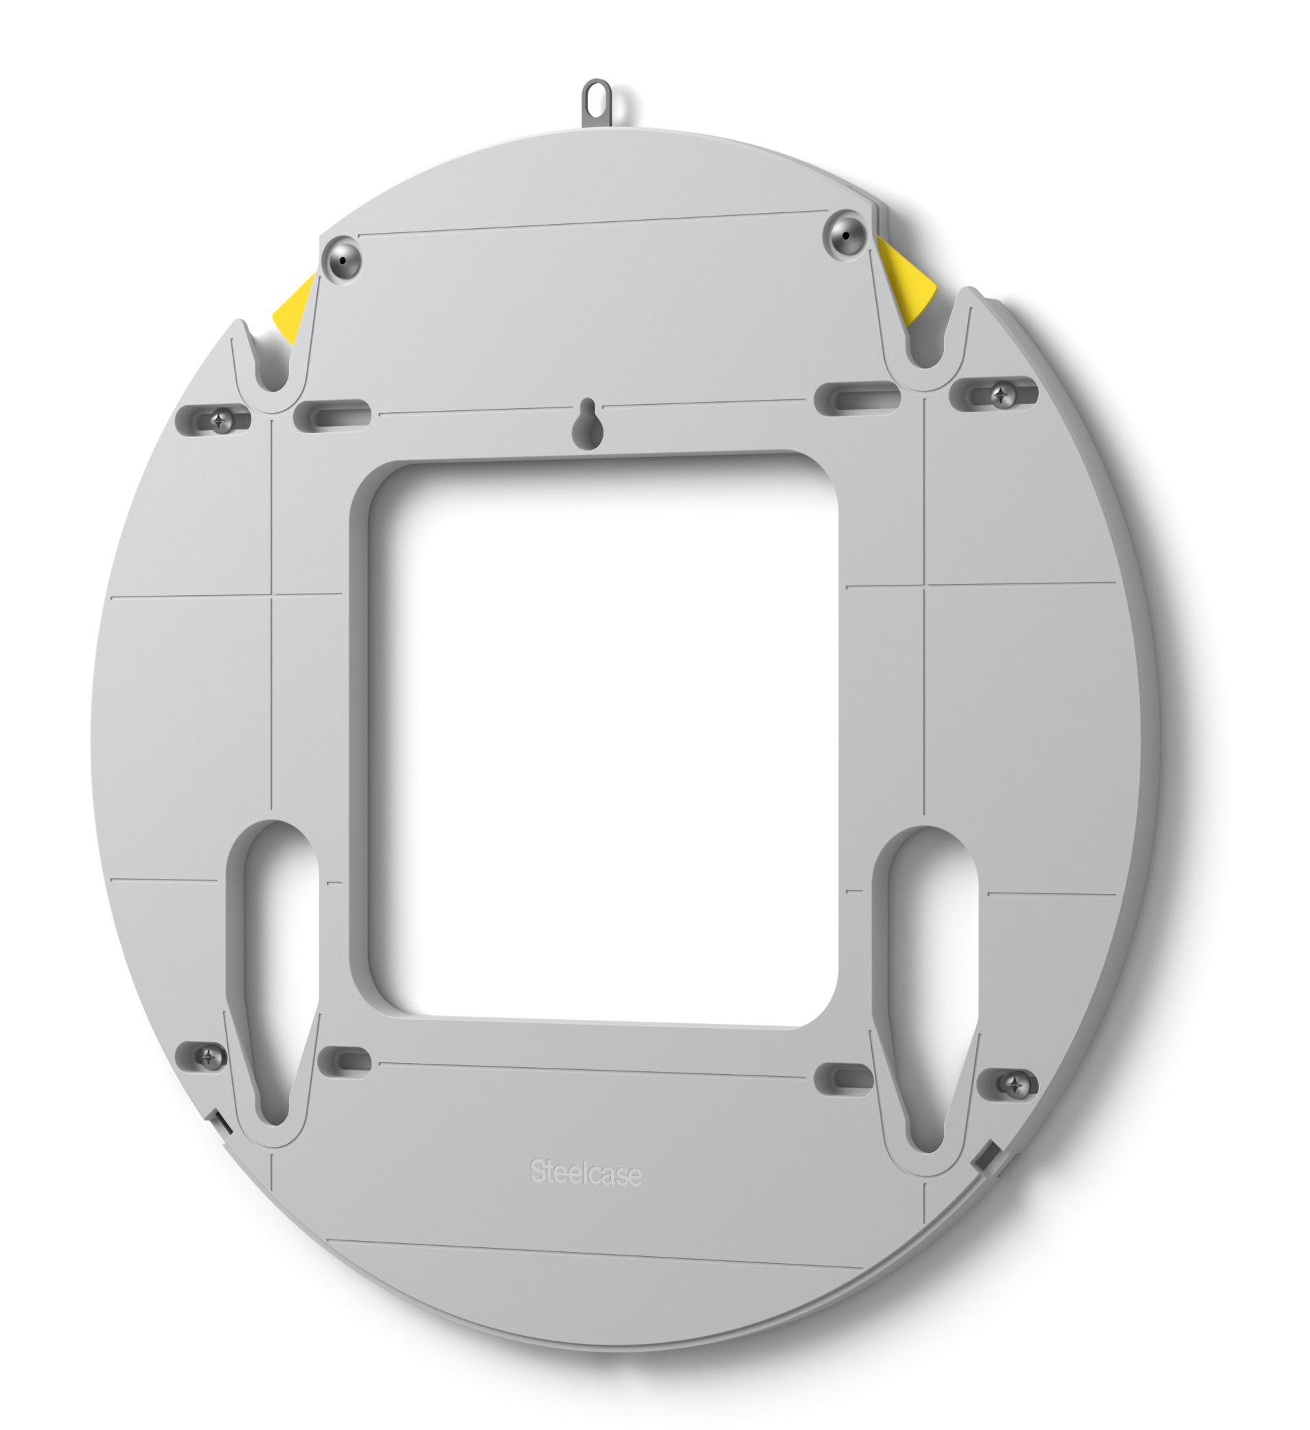
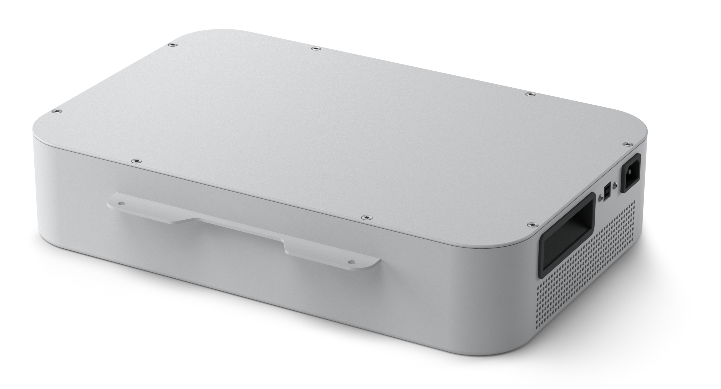
Partner accessories designed for Surface Hub 2S
Developed in partnership to deliver mobile, unplugged, uninterrupted teamwork
Steelcase Roam™ Mobile Stand*
www.steelcase.com/roam
Steelcase Roam™ mobile stands free teams to collaborate anywhere.
Steelcase Roam™ Wall Mount*
www.steelcase.com/roam
Steelcase Roam™ wall mount is ultra thin and easy to install.
APC™ Charge Mobile Battery*
www.apc.com
Designed to power Surface Hub 2S, the APC™ Charge lithium-ion battery system enables true mobility. Unplug without losing your team’s creative momentum.
Notes:
*Sold separately.
APC Charge Mobile Battery direct link: https://www.apc.com/us/en/campaign/apc-charge-mobile-battery-for-microsoft-surface-hub-2.jsp

Slide 14
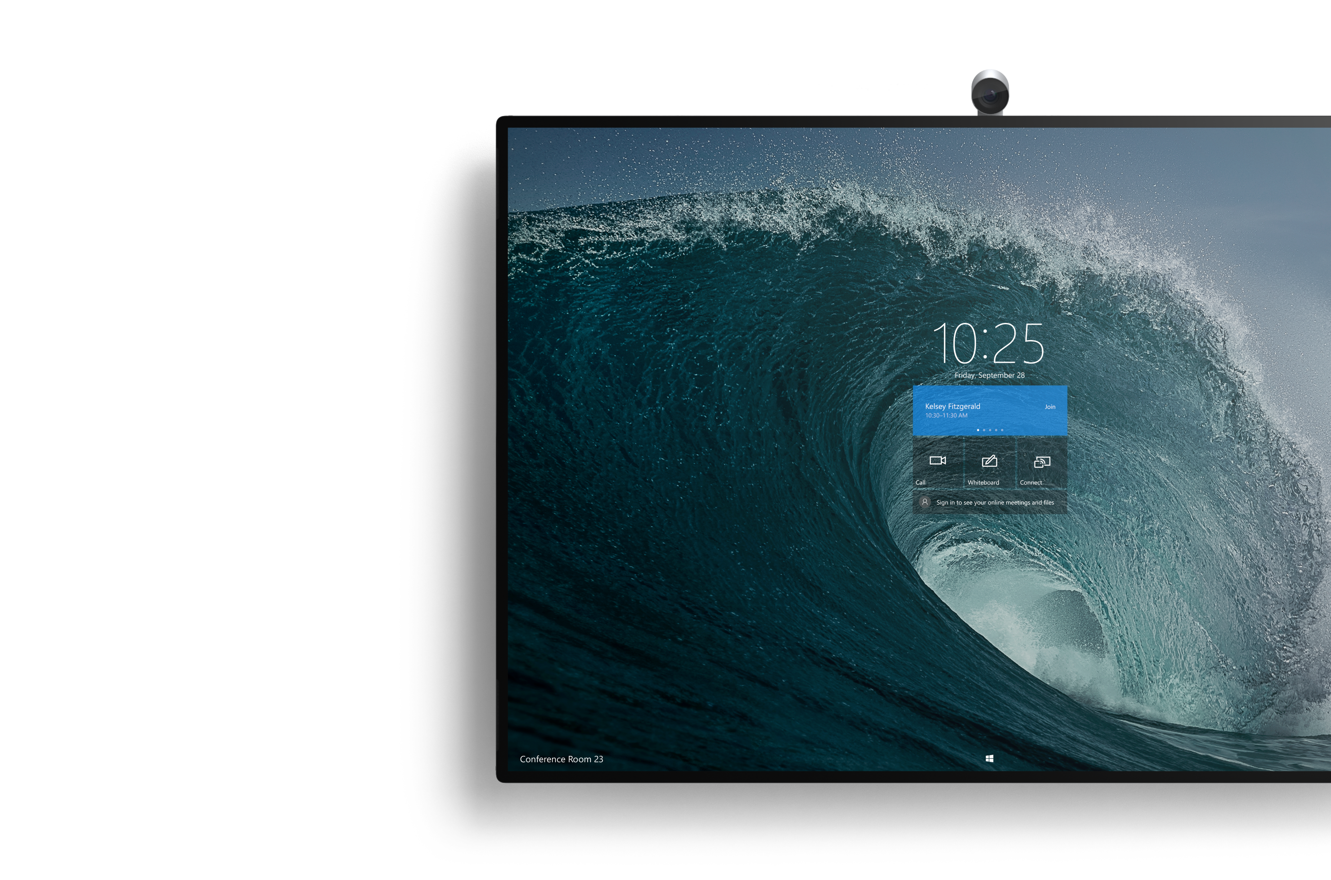
Next steps
<Insert call to action #1>
<Insert call to action #2>
<Insert call to action #3>

Slide 15
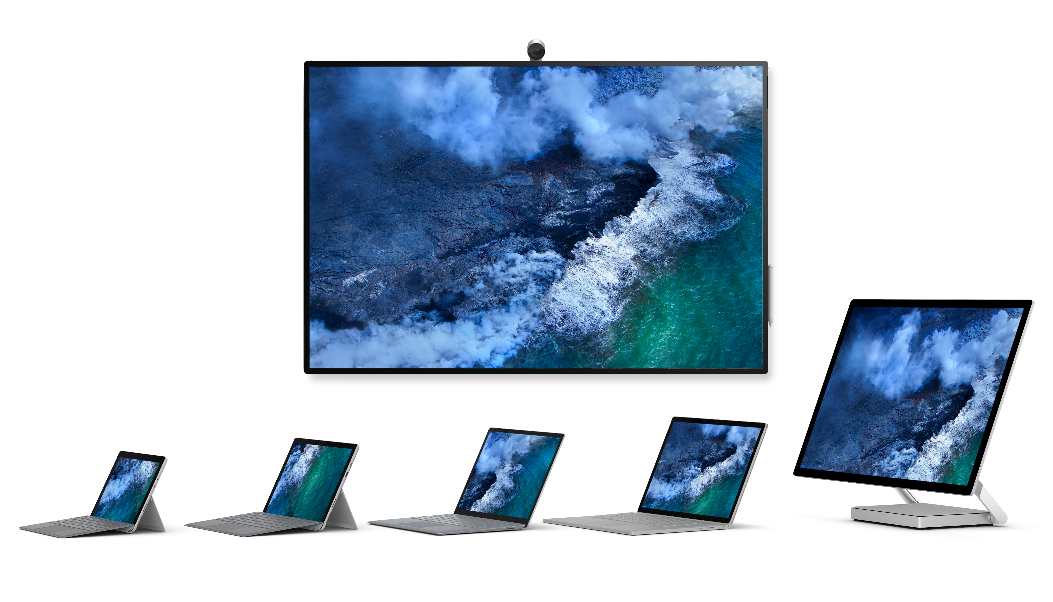
Microsoft Surface
Designed for the modern workplace
Learn more at www.microsoft.com/surface/business

Slide 16
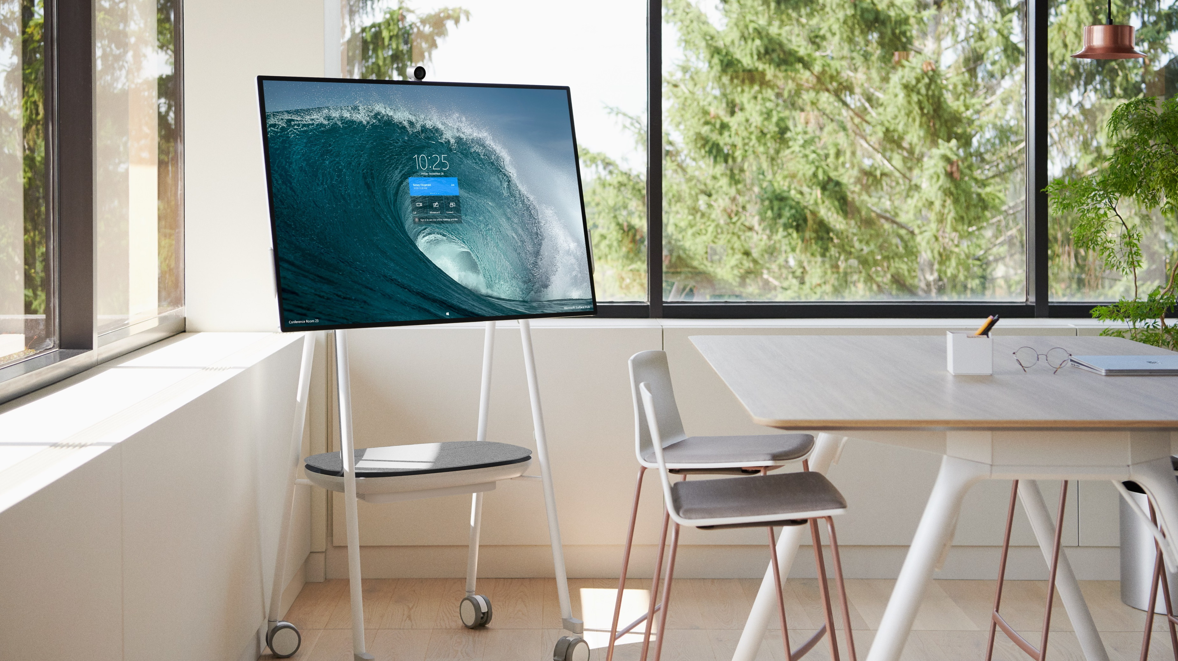
Appendix
Notes:
*Steelcase Roam™ Mobile Stand and APC™ Charge Mobile Battery sold separately.

Slide 17
Surface Hub 2S technical specifications
Dimensions | 29.2” x 43.2” x 3.0” (741 mm x 1097 mm x 76 mm)
Weight | 61.6 lbs. (28 kg)
Resolution | 3840 x 2560
Display | PixelSense™ Display, 3:2 aspect ratio, 10-bit color, 15.5 mm border, anti-glare, IPS LCD
Compute | Quad-core 8th Generation Intel® Core™ i5 processor, 8GB RAM, 128GB SSD¹
Graphics | Intel® UHD 620
Wireless | Wi-Fi 5 (IEEE 802.11 a/b/g/n/ac compatible) Bluetooth Wireless 4.1 technology Miracast Display
Connections | USB-A Mini-DisplayPort Video Output RJ45 Gigabit Ethernet HDMI Video Input USB-C™ with DisplayPort Input (4) USB-C™ (on display)
Sensors | Doppler occupancy sensor Accelerometer Gyroscope
Audio/Video | Full range front facing 3-way stereo speakers Full band 8-element MEMS microphone array Microsoft Surface Hub 2 Camera, 4K, USB-C™ connection, 90 degree HFOV
Pen | Microsoft Surface Hub 2 Pen (active)
Software | Windows 10 Microsoft Teams for Surface Hub² Skype for Business² Microsoft Whiteboard Microsoft Office (Mobile) Microsoft Power BI²
Exterior | Casing: Precision machined aluminum with mineral-composite resin Color: Platinum Physical Buttons: Power, Volume, Source
What’s in the box | (1) Surface Hub 2S (1) Surface Hub 2 Pen (1) Surface Hub 2 Camera 3m AC Power Cable Quick Start Guide
Warranty | 1-year limited hardware warranty
Learn more at https://www.microsoft.com/surface/business/surface-hub-2
Notes:
¹System software uses significant storage space. Available storage is subject to change based on system software updates and apps usage. 1 GB= 1 billion bytes. See Surface.com/Storage for more details.
²Software license required for some features. Sold separately.

Slide 18
Surface Hub 2 Pen technical specifications
Surface Hub 2 Camera technical specifications
Dimensions | 5.94” x 0.64” x 0.56” (151 mm x 16.3 mm x 14.3 mm)
Weight | 0.09 lbs. (41 g)
Buttons | Barrel button and tail eraser
Color | Grey
Connector type | Bluetooth 4.0
Compatibility | Surface Hub 2S Surface Book 2¹ Surface Book Surface Studio 2¹ Surface Studio¹ Surface Laptop Surface Go Surface Go with LTE Advanced Surface Pro 6¹ Surface Pro (5th Gen)¹ Surface Pro (5th Gen with LTE Advanced¹ Surface Pro 4 Surface Pro 3 Surface 3
Dimensions | 2.26” x 2.18” x 1.65” (57.5 mm x 55.3 mm x 42 mm)
Weight | 0.19 lbs. (88.01 g)
Connection | USB-C™ (with magnetic attach)
Resolution | 4K
Field of View | 90 degree HFOV
Imaging Features | Anti-flicker Face based auto exposure Up to 30 frames per second
Learn more at https://www.microsoft.com/surface/business/surface-hub-2
Notes:
¹Tilt functionality is currently available.

Slide 19
Microsoft Service Offerings for Surface Hub 2S
 | Worldwide Hardware Warranty | Worldwide Extended Hardware Service
Extended Hardware Service | NA
Accidental Damage |  | No
Coverage Duration | 1Y | 2Y and 3Y options; no 5Y option
Number of repairs | At Microsoft discretion repair or replace | 3
Number of replacements |  | 1
Limit of liability |  | Up to original purchase price
In Box Accessories
Standard Exchange
Advanced Exchange | No | As needed, through CSS
In Person Repair/Replace
Concierge | NA | Live online and video training
Software support | 90 days | Through coverage duration
Renewable | NA | No
Out of warranty paid offers

