Slide 1
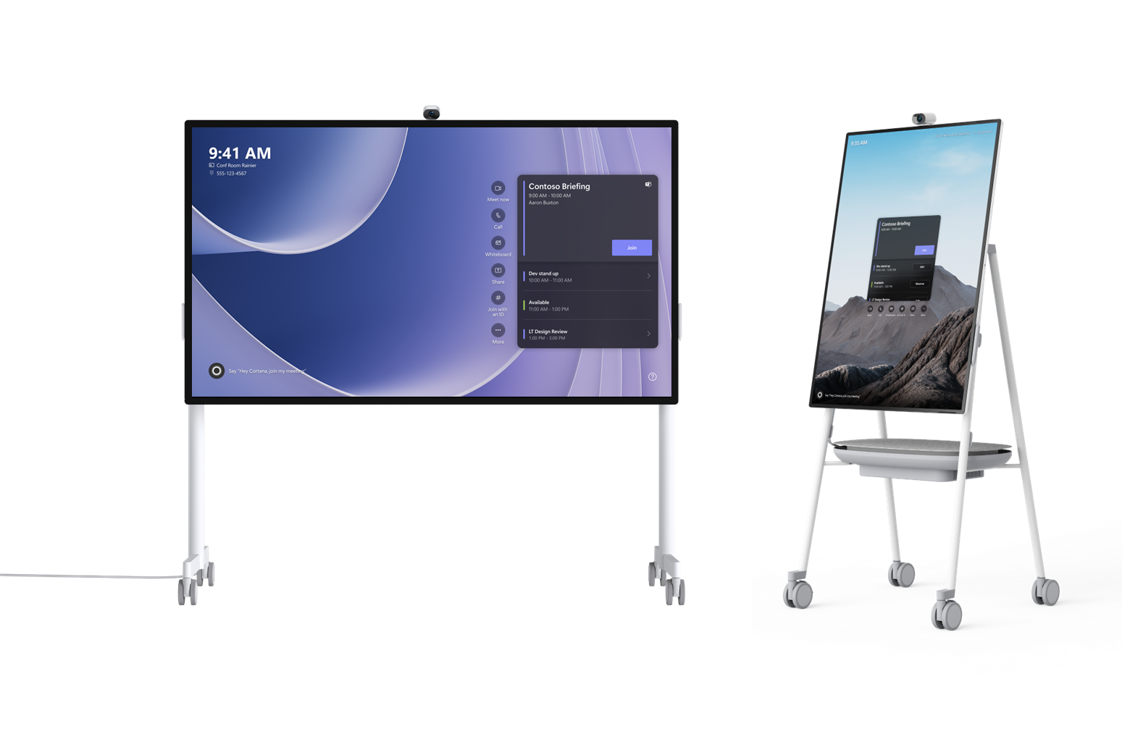
Surface Hub 2S Global Recycling Program

Slide 2
Surface Hub 2S Global Recycling Program
Who it’s for
What’s the outcome
Program benefits
What products apply
How to access
The program is for owners of Surface Hub 2S cartridge(s) who have upgraded to the Surface Hub 3 Pack.
Microsoft’s logistics and recycle partners receive, sort and recycle electronic waste. Request a pre-paid shipping label for a box of up to 18 cartridges at a time and have the shipment sent to our logistics provider; we will handle the rest.
The recycling program alleviates expensive private e-waste disposal services customers purchase that are unfamiliar with the product composition and the status of any global data retention requirements. Microsoft has pre-filed all the material information to make recycling seamless.
The Surface Hub 2S cartridge can be recycled through this program when the customer has reached end-of-life or use of the device.
To recycle your Surface Hub 2S cartridge, visit the Microsoft Docs Recycle page and click "Surface Hub 2S Recycle Program."
Learn more about Microsoft’s end-of-life management and recycling programs, and our approach to sustainability at this link: https://www.microsoft.com/en-us/legal/compliance/recycling
TES maintains the following certifications: Sustainable Electronics Recycling International (SERI) R2 and R2v3, ISO 9001, ISO 14001, ISO 27001, ISO 45001:2018 and TAPA.

