Slide 1
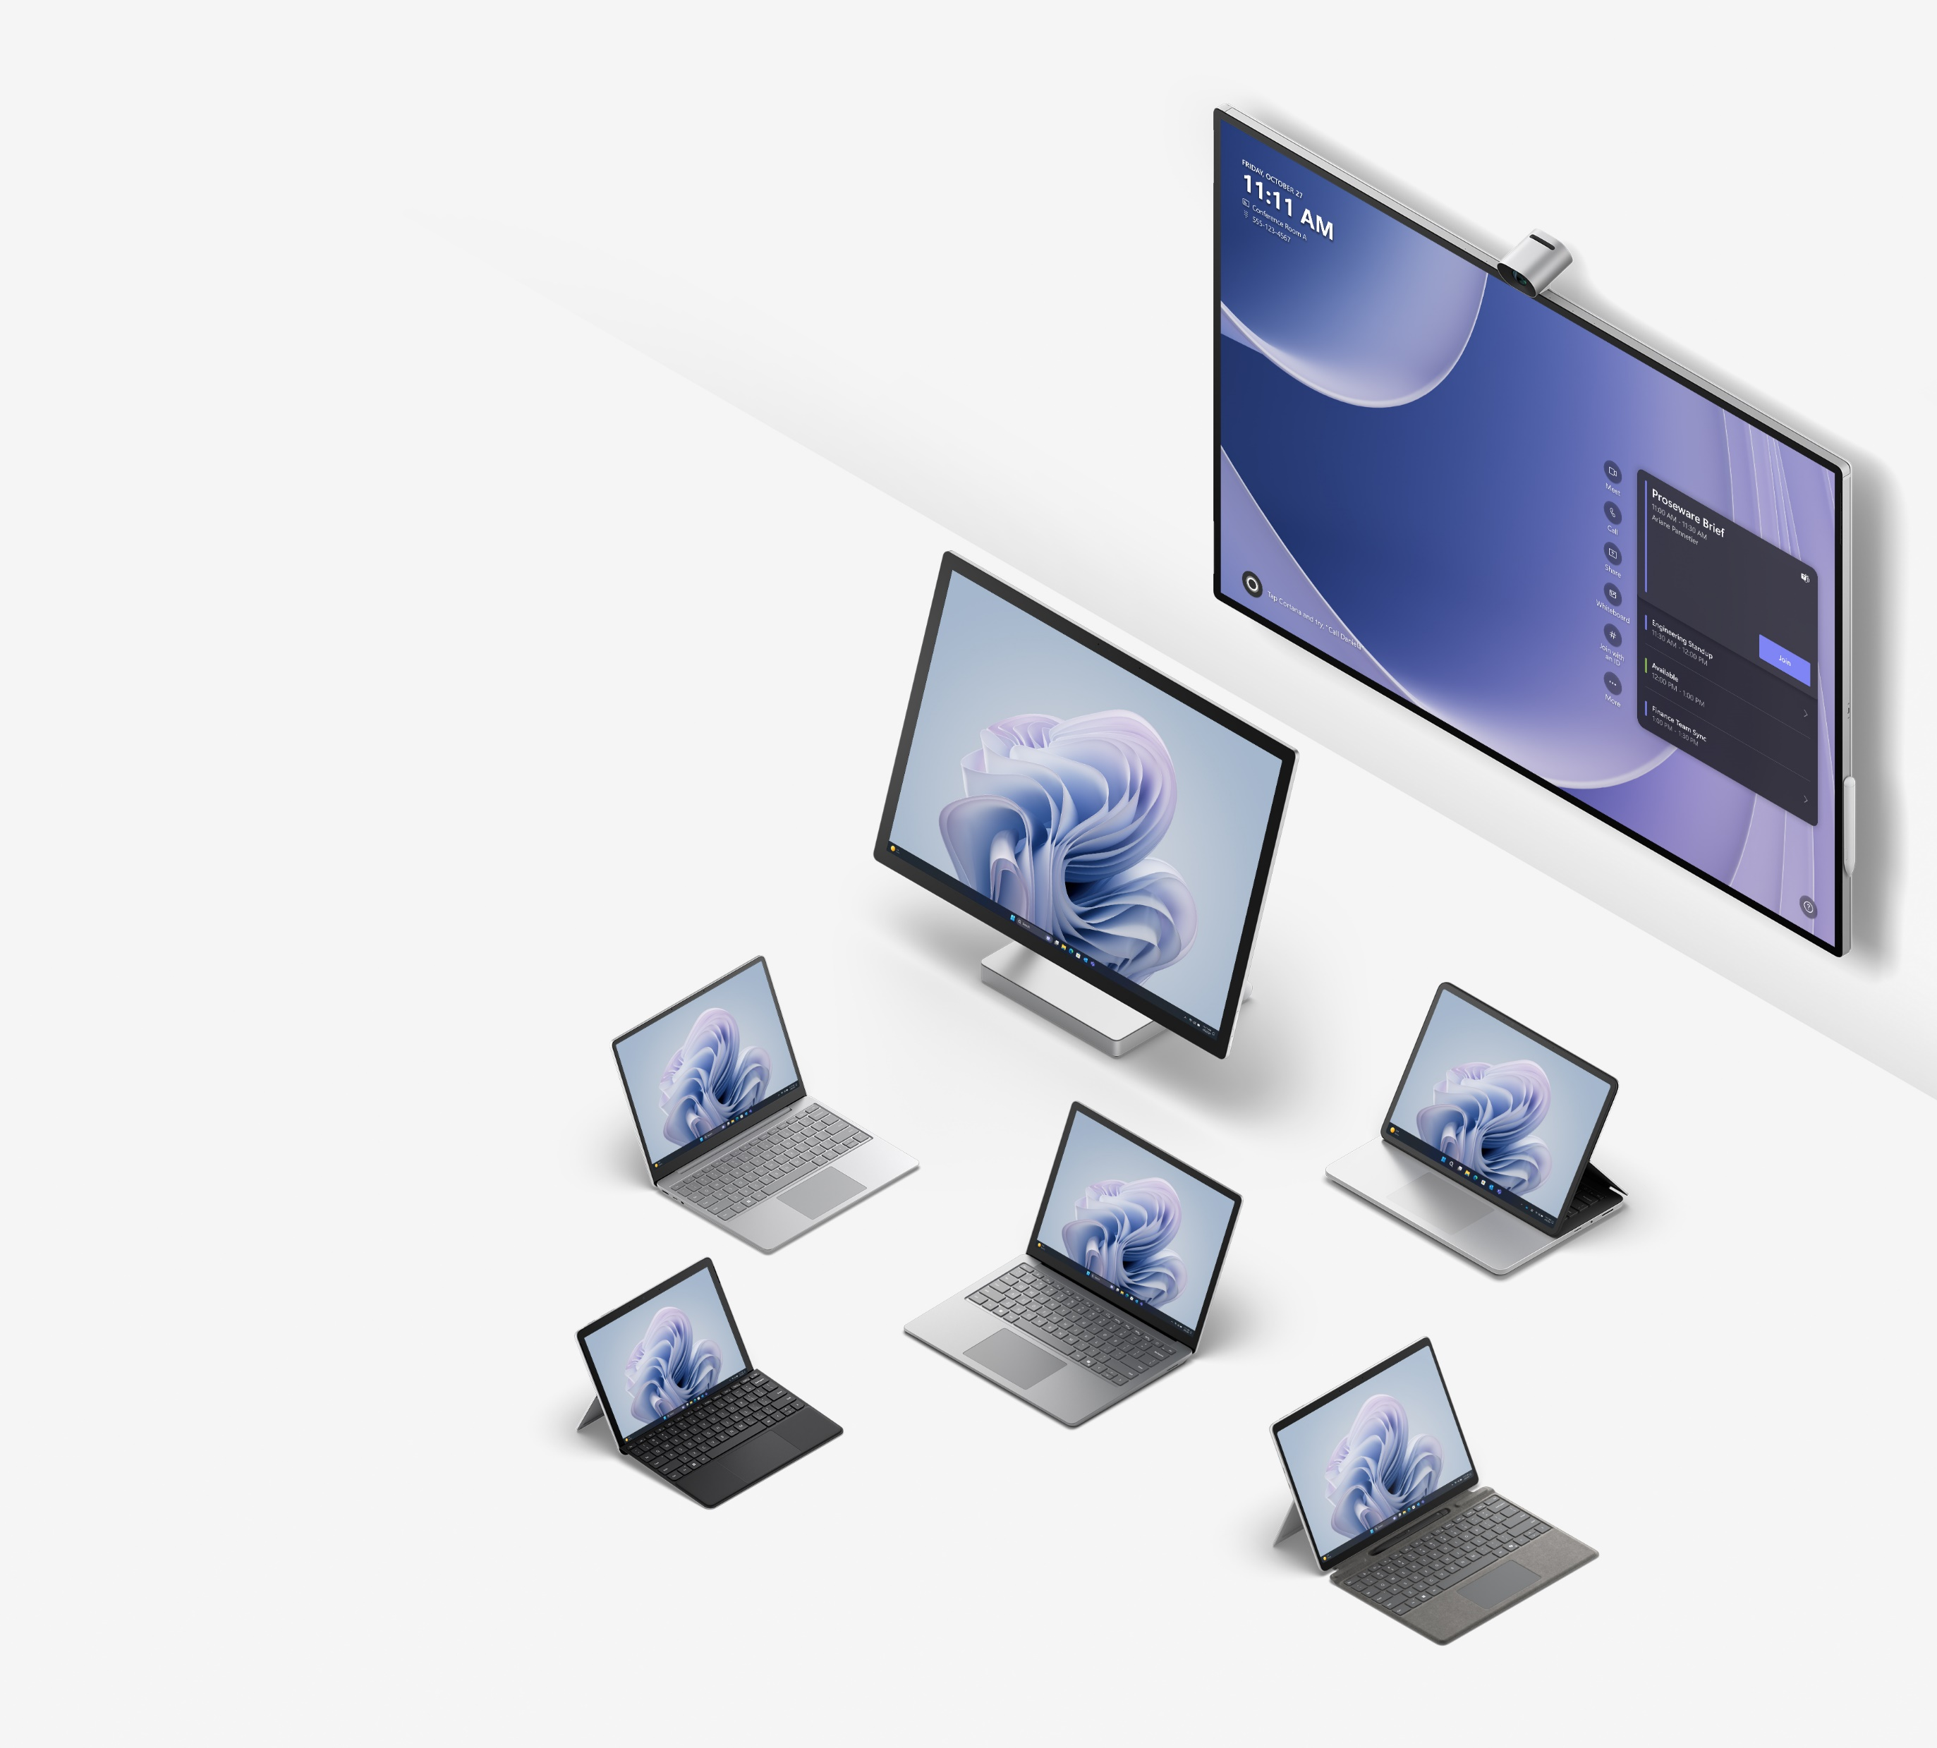
Surface for Business FY24 Spring Launch Assets
English Worldwide

Slide 2
Table of contents
01
02
03
04
05
06
Portfolio
Surface Pro 10
Surface Laptop 6
Adaptive Accessories
Designed for Surface
Surface for Business Essentials

Slide 3
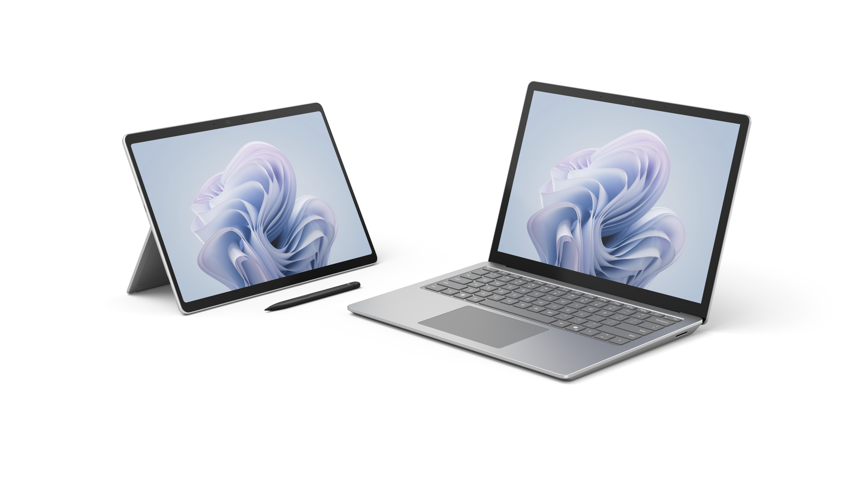
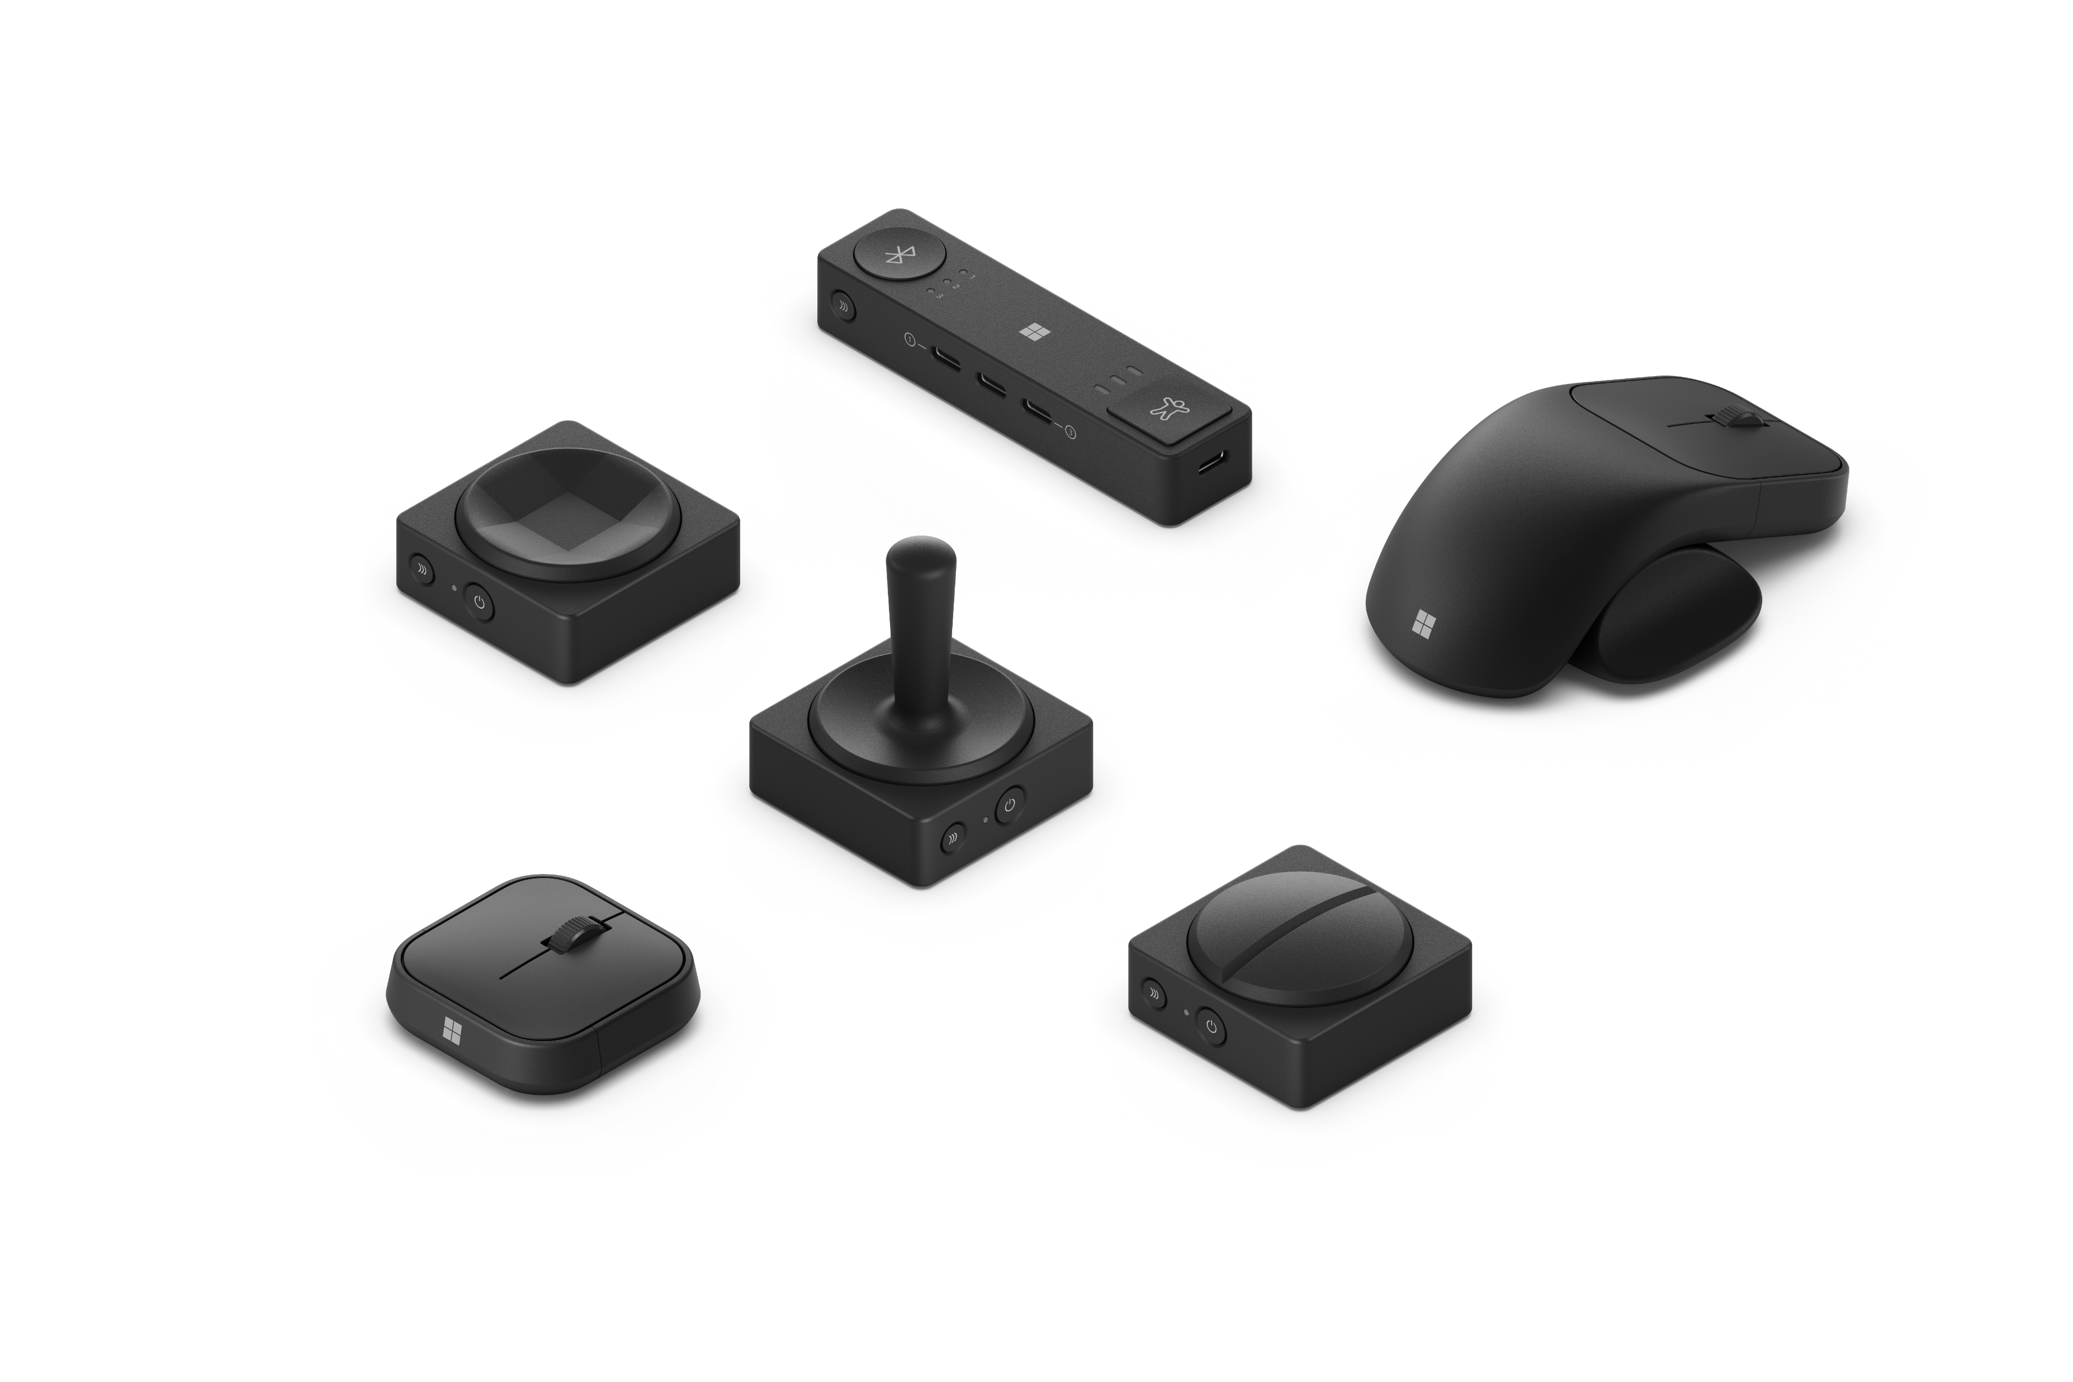
ASSETS
Surface Portfolio
March 2024
Digital Events
Advancing the New Era of Work with Copilot
Blogs
Advancing the New Era of Work with Copilot, Windows, and Surface
Introducing Surface Pro 10 & Surface Laptop 6: AI PCs Built for Business
Introducing Surface Pro 10 for Business and Surface Laptop 6 for Business
MS Docs: NFC Support in Surface Pro 10 for Business
Pitch Decks
Surface for Business, Spring 2024
Get AI Ready with Surface for Business
Surface for Business Customer Presentation
Surface for Business Tech Deck
Surface for Business Lookbook
Seller Slide - What's new for Spring 2024
Flyer Surface for Business & Copilot Key
Email Templates
Social
Pro 10 & Laptop 6
Copilot Key
Event invite
Display Banner | Pro 10 & Laptop 6
Teams Background
YouTube Videos
Meet Surface Pro 10 and Surface Laptop 6 for Business
Introducing Microsoft Surface Pro 10 and Surface Laptop 6
Expert Zone Spring 2024 Launch Mission; Solution ExpertPath
Portfolio Collection *renderings and contextual images in collection

Slide 4
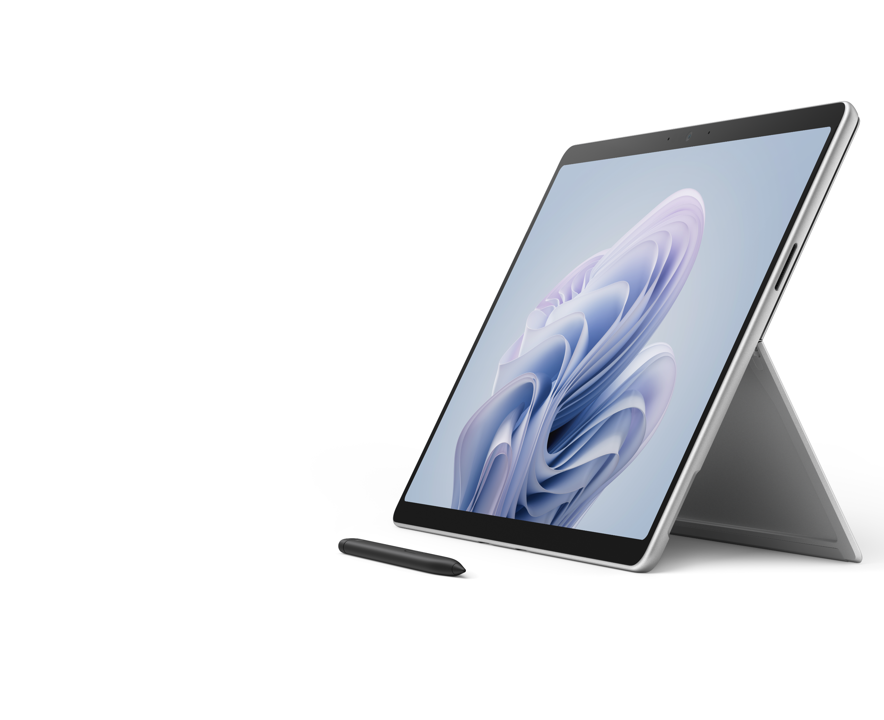
ASSETS
Surface Pro 10 for Business
FAQ
Factsheet
Seller Slides
Pro 10 Desktop Scenario
Pro Portfolio
Display Banners
Pro 10
Pro Portfolio
Explore Surface
ExpertZone: Intro Surface Pro 10
Surface Pro 9 Collection
*renderings and contextual images in collection
The versatility to create.
The power to perform.
Surface Pro 10 blurs the boundary between hardware and software for peak performance in a secured, lightweight device that adapts to any work style.

Slide 5
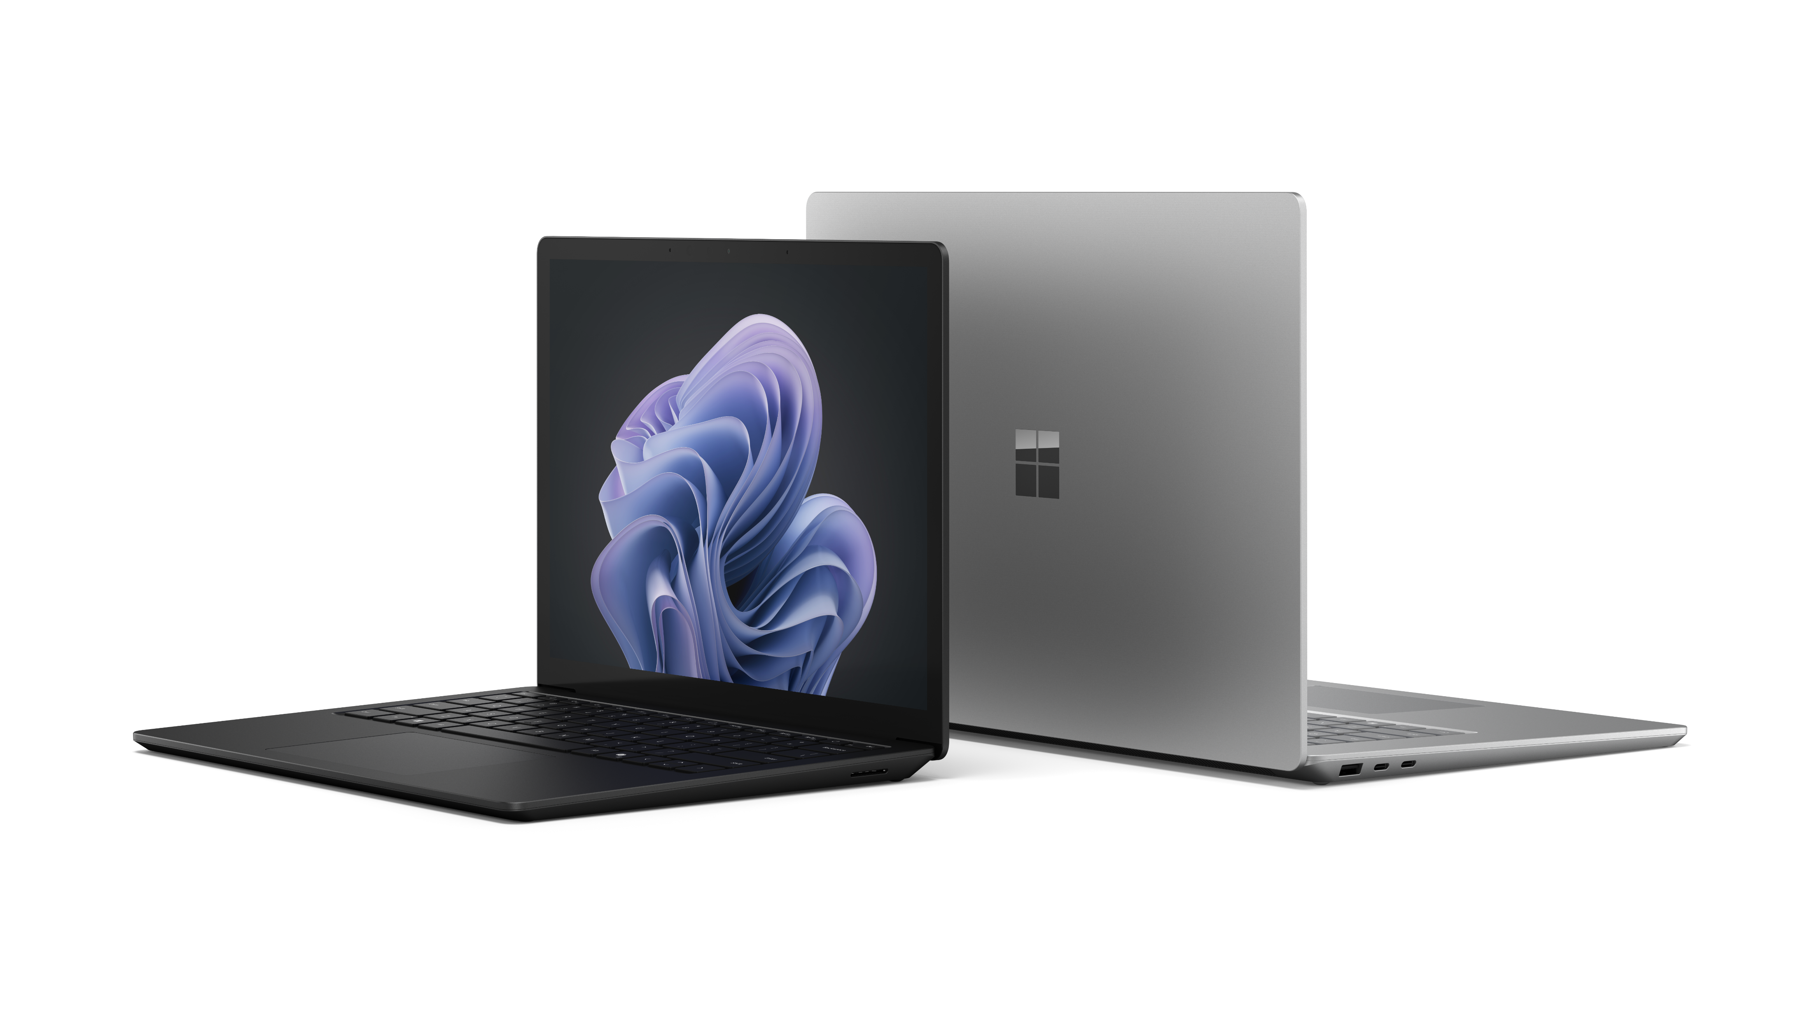
ASSETS
Surface Laptop 6 for Business
FAQ
Factsheet
Seller Slide
Laptop 6
Laptop Portfolio
Display Banners
Laptop 6
Laptop Portfolio
Laptop 6 with Copilot Key
Explore Surface
ExpertZone: Intro Surface Laptop 6
Surface Laptop 6 Collection
*renderings and contextual images in collection*
Power and design in an AI PC, ​ built for business workloads ​
Surface Laptop 6 elevates business with an elite level of performance, power, and sleek design. Built for demanding workloads, Surface Laptop 6 unleashes a new era of productivity through the power of the Intel® Core™ Ultra processor (Series H).

Slide 6
ASSETS
Microsoft Adaptive Accessories
Factsheet
Social
Display Banner
Microsoft Adaptive Accessories Collection
*renderings and contextual images in collection
Accessible by design

Slide 7
ASSETS
Designed for Surface
Blog
Discover Solutions with Designed for Surface Accessories
Overview Decks
Designed for Surface Overview
Designed for Surface Solution Areas
Industry Decks
Designed for Surface Education Industry
Designed for Surface Healthcare Industry
Designed for Surface Industry Overview
Designed for Surface Manufacturing...
Designed for Surface Public Sector Industry
Designed for Surface Retail Industry
Email Template
Infographic
Designed for Surface Collection
Explore collection of digital assets to showcase the Designed for Surface line of accessories developed by trusted manufacturers.

Slide 8
ASSETS
Surface for Business Essentials
Surface for Business Essentials
Pitch Deck
Warranty & Protection Plans Seller Guides
Americas
APAC
MEA
Expert Zone Microsoft Surface Protection Plans
Surface for Business Essentials provides the resources and options to assist in maintaining productivity, lowering IT costs and protecting a customer’s device investments.

