Slide 1
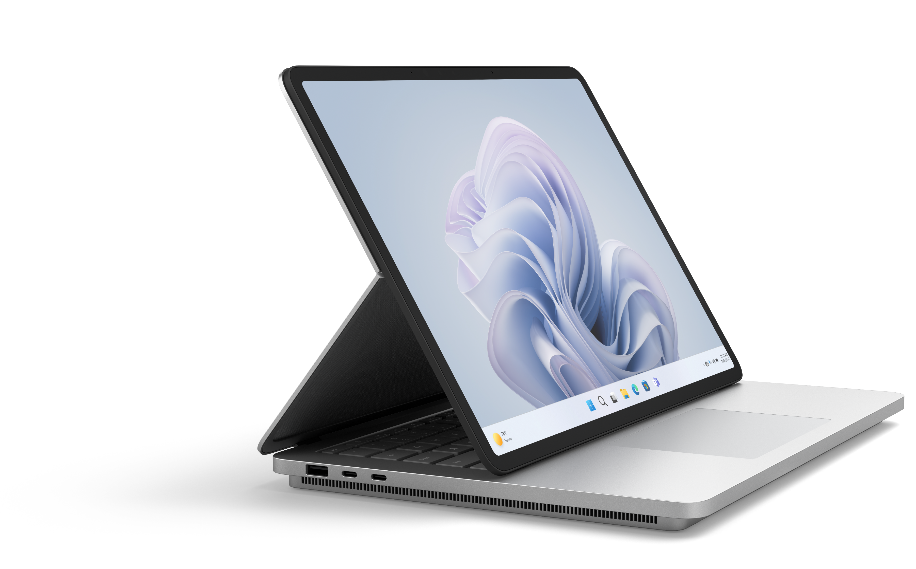
Surface for Business Essentials
Protect | Manage | Support | Repair
Business moves quickly making it essential to have a fully functioning fleet of devices. Surface for Business Essentials provides the resources and options to assist in maintaining productivity and lowering IT cost so customers can achieve more.
Investment Protection
Each Surface device comes with a one-year Microsoft Limited Hardware Warranty¹. For customers looking to extend protection coverage beyond the one-year warranty they can purchase one of the Microsoft Protection Plans² to protect their investment and extend the use of their device.
A better business experience.
Streamlined Management
Surface delivers powerful tools and centralized management solutions that help businesses easily and efficiently control the health, apps, and functionality of their organization’s devices and streamline lifecycle management.
Optimized Support
Surface provides several comprehensive resources and options to support customers. For more customized support, businesses can utilize a Surface Authorized Service Provider (ASP) to meet their needs.
Simplified Repair
Repairable Surface devices provide businesses with more control and more options. Microsoft designed a self-repair model that simplifies the process so when an incident happens, customers can bring a device back online quickly.
¹ Without prejudice to any legal (statutory) rights to which you may be entitled under your local law, Microsoft Limited Hardware Warranty covers your device or replacement component from the date of original purchase from Microsoft or an authorized reseller. Exclusions and limitations apply. Please refer to Microsoft Limited Hardware Warranty & Agreement.
² Warranty and Protection Plans vary by market. Please visit the Surface Warranty and Protection Plan page to see availability.
PARTNER
LOGO

Slide 2
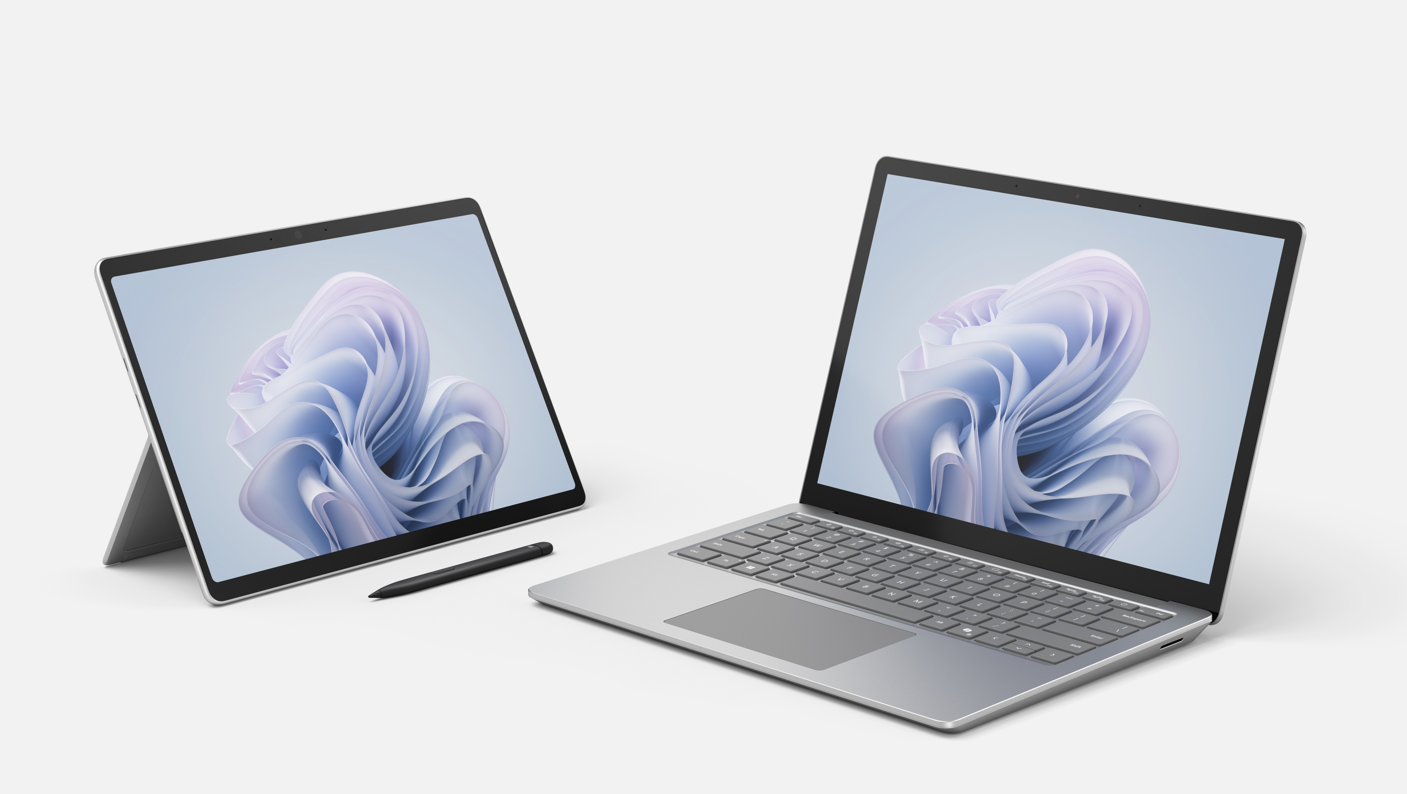
Resources
Surface provides businesses with the resources and tools to deliver a more efficient and complete lifecycle management solution.
Protect
Find the right Microsoft Surface Protection Plan to protect your investment and meet business needs.
Manage your Surface warranty and services requests.
Manage
Discover the Surface device management resources to boost your IT efficiency.
Robust and easy to use management portals for deployment, device health monitoring and tracking.
Support
Top support services for Surface devices and contact support services for businesses and education.
Locate a Surface Authorized Service Provider for commercial support services.
Repair
Visit Surface for Business service and repair for repair resources and replacement components for repairable Surface devices.
Watch the ease of repair in the latest Surface disassembly videos.
Surface for Business Essentials delivers the complete built for business experience so customers can achieve more.

