Slide 1
Value Added Distributor – Opportunity Reseller (VAD-OR) Onboarding Readiness Deck
Microsoft Commercial Devices Team

Slide 2
Objectives
In This Lesson
By the end of this lesson you will be able to:
Identify the Surface VAD-OR Program Benefits
Describe the VAD-OR pre-onboarding requirements
Outline the step-by-step process for VAD-OR onboarding
VAD-OR Program Overview
Benefits
Overall VAD-OR Flow
VAD-OR Readiness
Pre-onboarding Requirements
Step-by-Step Process for VAD-OR onboarding
FAQs
Resources & Support

Slide 3
VAD-OR Program Overview

Slide 4
Surface VAD-OR Program Benefits
Be part of the business transformation: Tap into the innovation of Microsoft devices and their role in accelerating enterprise transformation.
Increase your demand: Be one of the select qualified partners to sell the most productive devices on the planet.
Make more money: Access world-class Surface partner programs and promotions.
Enable your sales force faster: Ramp up quickly with resources like the Surface Reseller Alliance portal and high-touch Distributor enablement

Slide 5
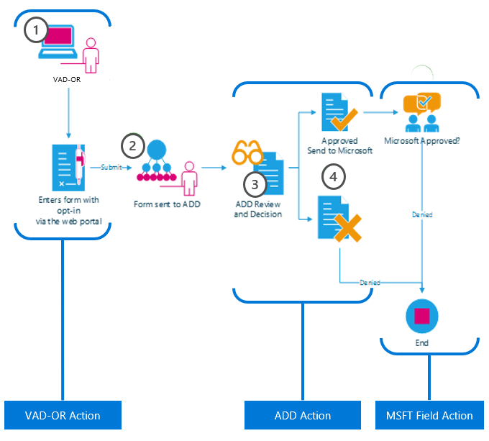
VAD-OR Onboarding Flow
1
A partner is invited to become a Value Added Distributor – Opportunity Reseller via the “Reseller Profile and Registration Portal” by completing a form online which includes the following data:
Partner Contact Details
ADD selection (multiple allowed)
Profiling Details
Opt-In legal agreement on program criteria
2
Once the form is complete, it will be sent to the ADD(s) selected.
3
The ADD partner will review the criteria in the form and determine the nomination based on fit and completeness of information.
4
Once the decision has been made, if approved, the detail is sent to Microsoft for approval.
Note: Incorrect MPN IDs will be rejected

Slide 6
Profiling Questions & Drop-down Options
What is the primary role of your organization?
SI | AV-SI | AV only | ISV | Telco | Others
.
Do you offer Surface Hub integration services?
Yes | No | Future plans
.
How many Surface Hub hardware/solution sellers do you have?
1-5 | 6-9 | 10-25 | 26-50 | 50+
.
Do you offer Surface Hub training services?
Yes | No | Future plans
How many branches/locations does your organization have?
1 | 2-5 | 6-10 | 11-25 | 25+
How many Surface Hub do you have already installed in your organization?
0 | 1-3 | 4-10 | 10+
.
Do you offer Surface Hub installation services?
Yes | No | Future plans
What is your outlook for Surface Hub sales in the next 6 months?
0-5 | 6-15 | 15-50 | 50-100 | 100+
What type of Surface Hub opportunities do you currently have?
Pending Order | Tender in Progress | None

Slide 7
VAD-OR Readiness

Slide 8
Pre-onboarding Requirements
Q: What do I need to prepare before becoming a Value Added Distributor-Opportunity Reseller (VAD-OR)?
A: Partners are required to Register using their work ID associated to their Organization ID
VAD-ORs must have an active Partner Center tenant.
Partners are required to associate with their Organization Partner ID to complete the Enrollment at Partner Center.
For instructions on how to register in Partner Center, click here.
IMPORTANT: if your Organization previously existed in the Partner Membership Center (https://partners.microsoft.com), please follow the steps here to migrate your company to the new Partner Center.
VAD-ORs must have an active Work ID (Azure AD).
If you do not have an active Work ID, please request your Organization’s Administrator to add you to the tenant.
VAD-ORs are required to provide their legal company and contact information.
Legal Business Profile- provides the Distributor with your company profile including legal company name, address, and contact information. Your Legal Company Name should match your MPN account information.
Company Tax ID- necessary to receive Channel Incentives (if applicable).
Primary Program Contact- responsible for submitting Company Information, agreeing Terms and Conditions, and receiving system notifications.
Contract Authorization Contact- responsible for reviewing Terms and Conditions.
Channel Incentives Contact - responsible for setting up Channel Incentives for the organization (if applicable).
1
3
2

Slide 9
VAD-OR Portal Registration

Slide 10
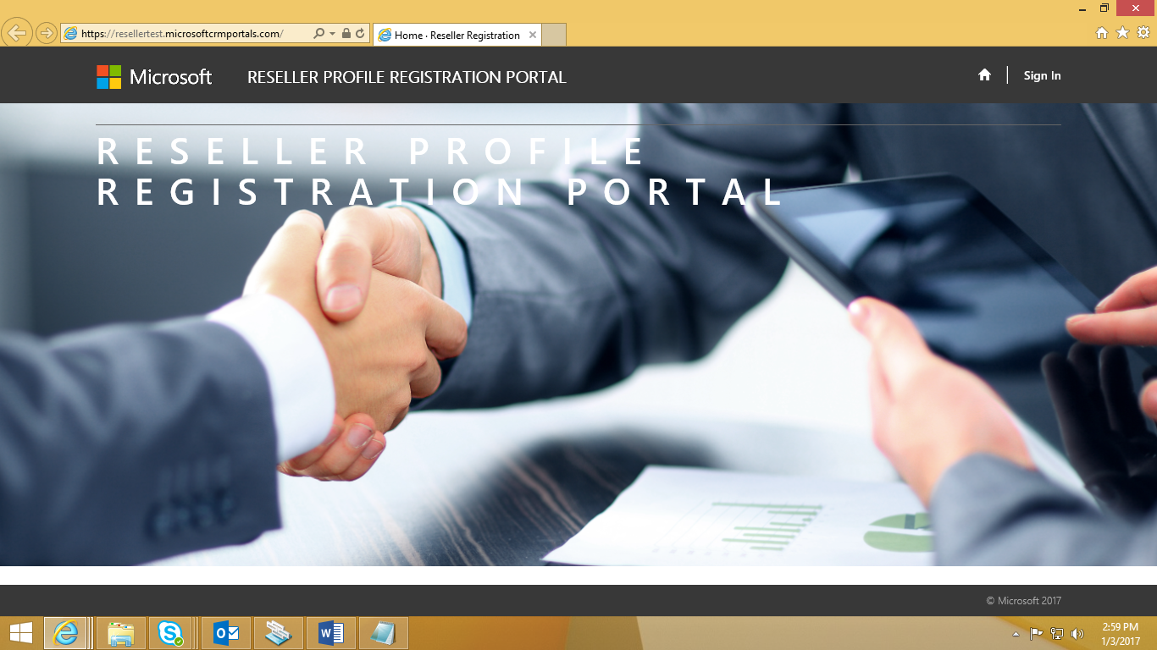
Portal Registration
Landing Page
Reseller Profile Registration Portal
Open link to the and click “Sign In”

Slide 11
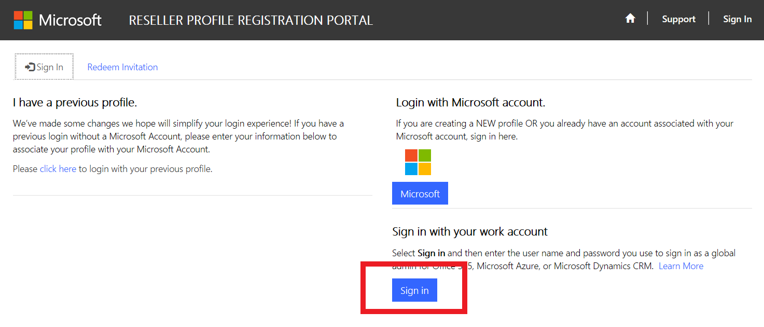
Portal Registration
Signing In
If you are a current user with a previous profile, Sign In with your User Name and Password.
For new users, Login with a Work Account by clicking on the Sign In button and entering your Work ID and Password.
Please ensure this Work ID is the same ID that is used to log into Partner Center.:\\partners.microsoft.com

Slide 12
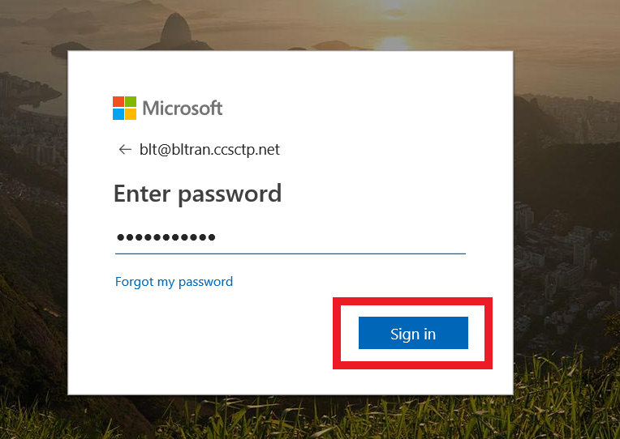
Portal Registration
Signing In
Enter your Work ID and Password. Now click on the Sign in button.

Slide 13
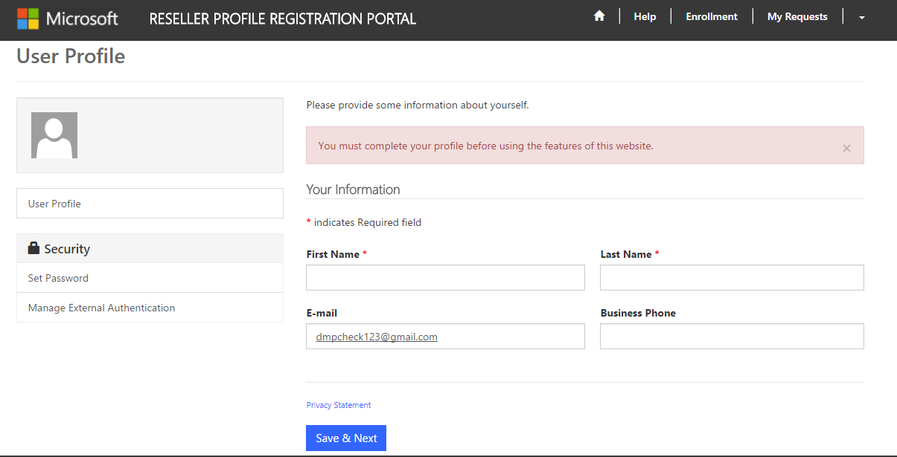
Portal Registration
User Profile
6
Upon successful sign-in, you will be redirected to User Profile page and you will be requested to complete your profile information before accessing other contents of this portal.
Enter all mandatory information and click on Save & Next button to complete your User Profile.
John
Smith
john@hotmail.com
00353 53 1234567

Slide 14
Portal Registration
Partner Enrolment List
Once you reach the Partner Enrollment List, please select “Enroll Organization” and continue with the registration.
Smith

Slide 15
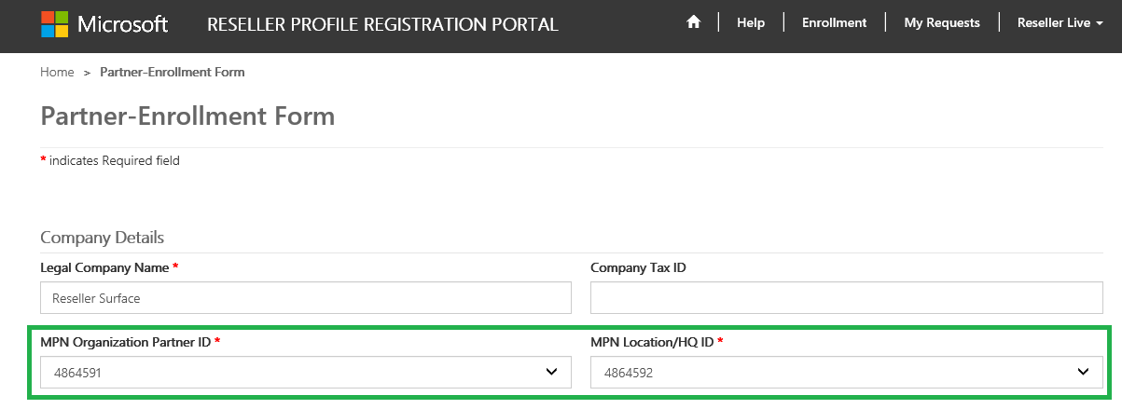
Portal Registration
Partner Enrollment Form
MPN ID’s will be pre-populated with the Work ID associations. Please select the MPN Organization ID that you would like to use and then select the appropriate MPN Location ID from the drop downs.
Your Legal Company Name will then populate, and you can type in your Company Tax ID (if available).
For Partners looking to onboard Multiple Locations:
For partners with the same MPN Organization ID, but multiple MPN Locations IDs, please select the appropriate Location ID(s) being onboarded.
What NOT to do: Do not edit the existing enrollment records MPN IDs & address. All new locations must be enrolled with the steps above.

Slide 16
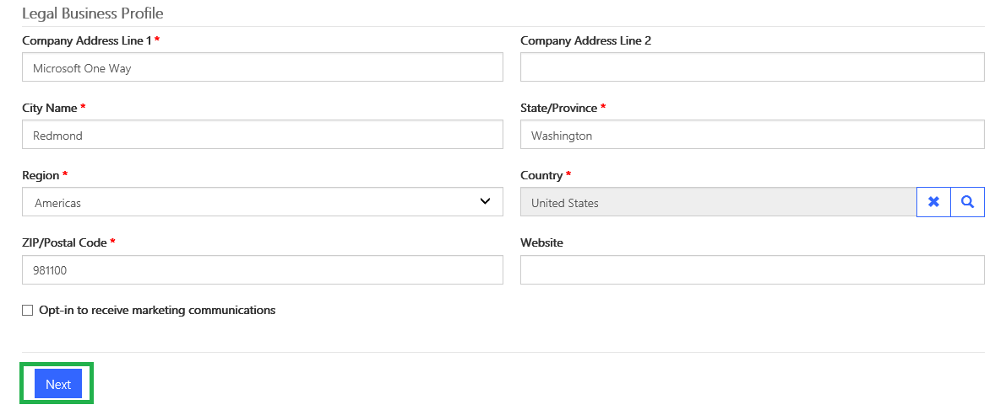
Portal Registration
Legal Business Profile
Fill up your Legal Business Profile information.
Mandatory fields are marked with an asterisk*.
Click on Next to continue.

Slide 17
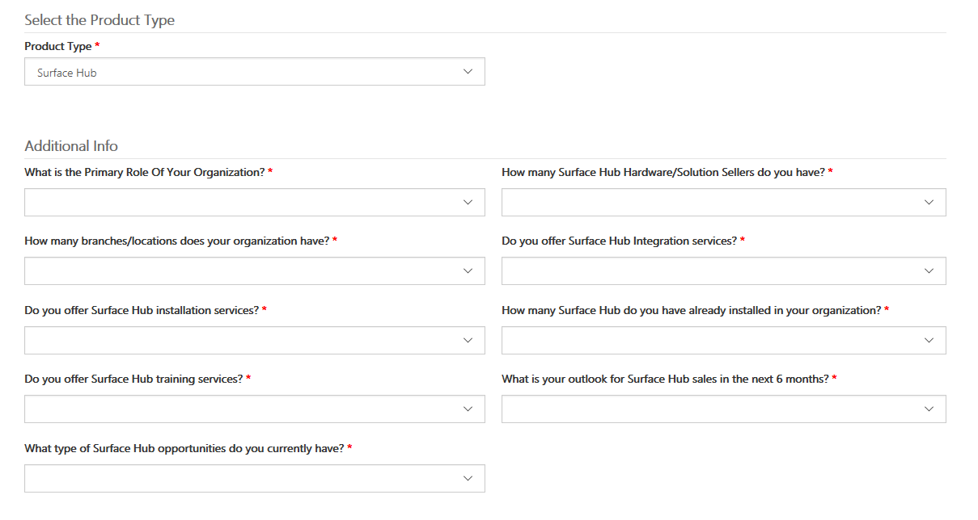
Portal Registration
Product Type & Questionnaire
Select Surface Hub as the Product Type and fill out the following questionnaire.
Proceed to the Contacts once completed.

Slide 18
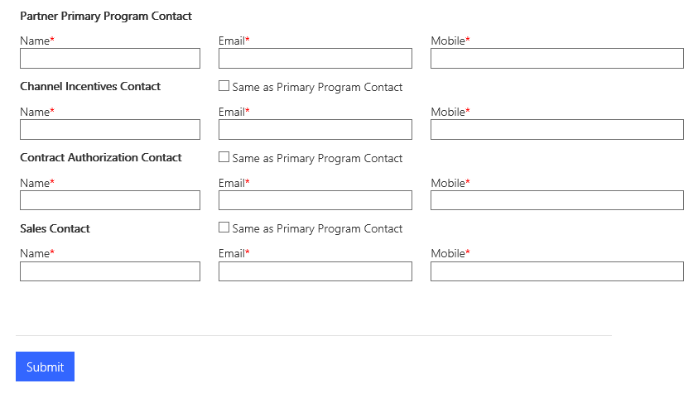
Portal Registration
Adding Contacts
Click the Add Contacts button and complete all four of the mandatory contact types.
Click Submit once finished.
If you do not complete this, you may see the error shown below:

Slide 19
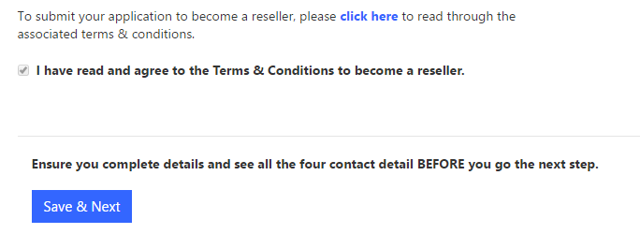
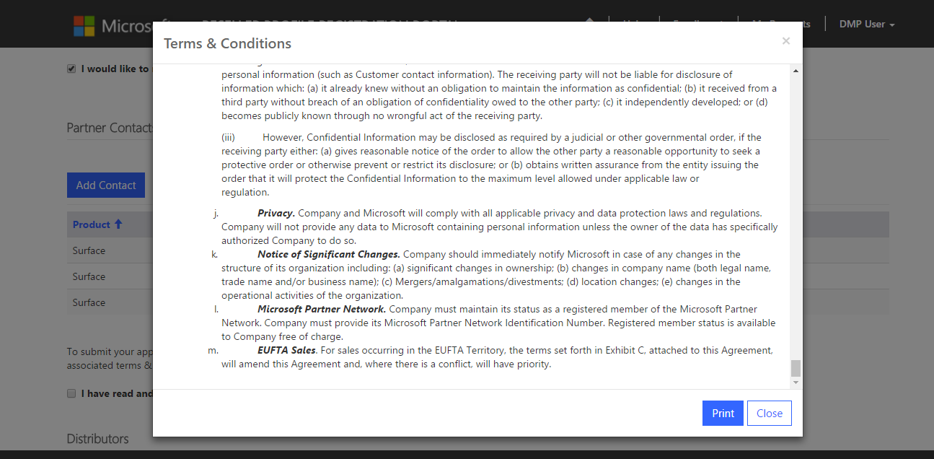
Portal Registration
Terms and Conditions
To view the Terms and Conditions, select the “click here” button as shown.
Tick the check box, which effectively confirms that you have read and agree to the terms and conditions.
Ensure you complete the details and confirm all four contact details BEFORE you click the “Save & Next” button.
Terms and Conditions
The Terms & Conditions can be printed if required once accessed as above.

Slide 20
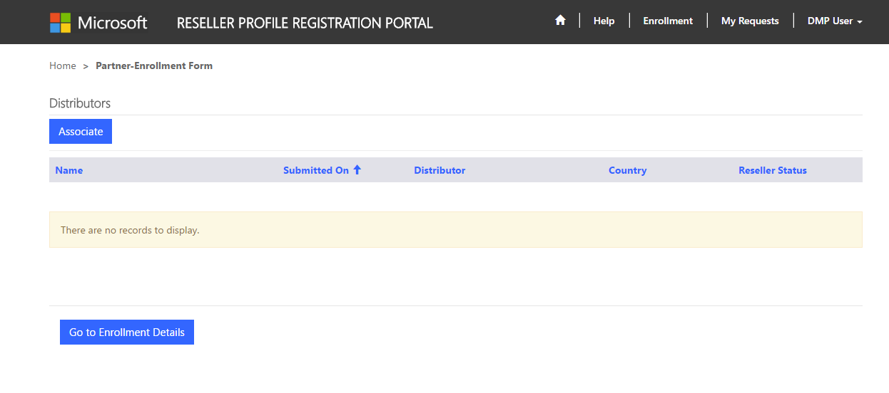
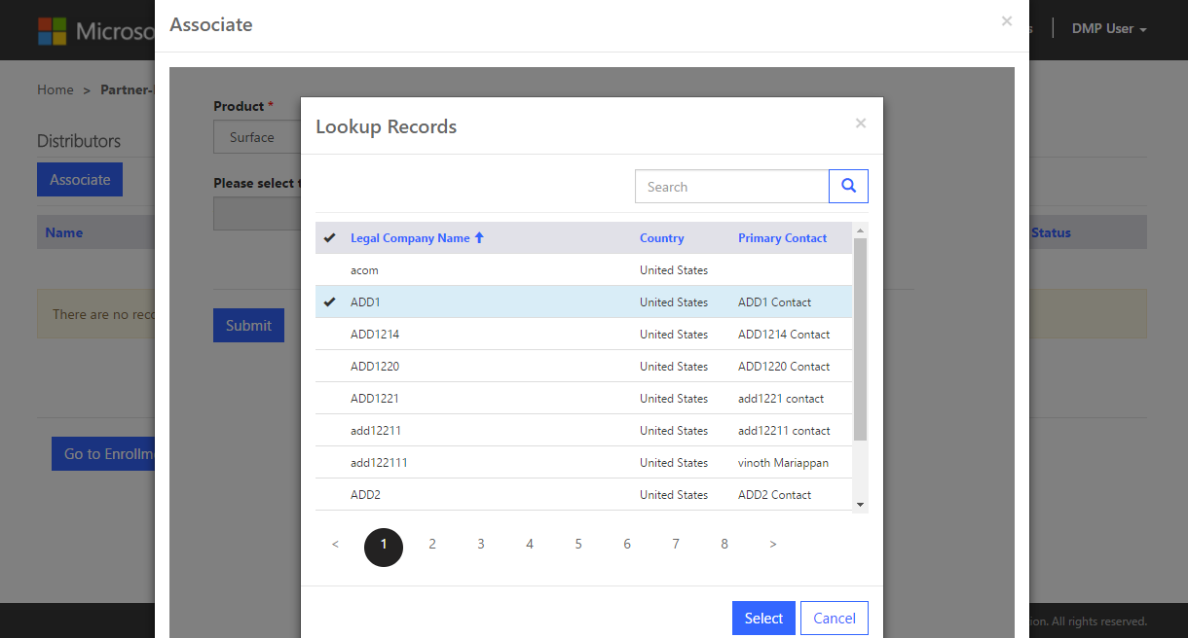
Portal Registration
Requesting VAD-OR Partnerships
Click on Associate to find a local Distributor to create a partnership with.
Select a Distributor to request VAD-OR partnership:
Click Submit.
Important: Ensure that Surface Hub is selected as the Product Type
To add more Distributors to the partnership request, click the Associate button, select and submit again.

Slide 21
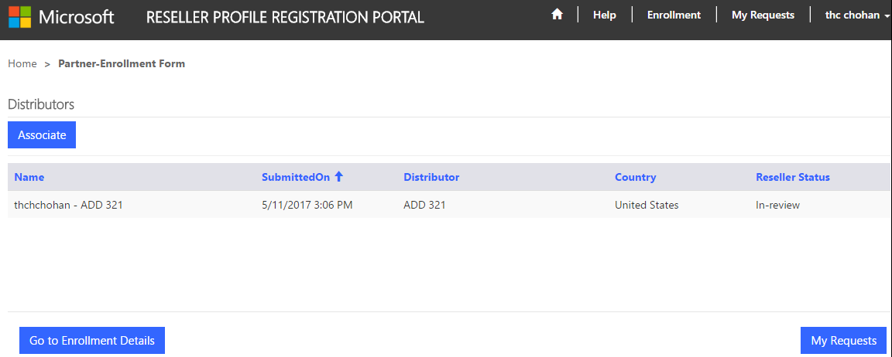
Portal Registration
Enrollment Details
Click on “Go to Enrollment Details” button to view the enrollment details.
Click on “My Requests” Button to view all the Associations.

Slide 22
Portal Registration
Approval Status
You can view the approval status on the “My Requests” landing page.
You will receive a notification email within 5-10 business days for your approval status.
If you submitted multiple partnership requests, you will receive a separate approval email from each Distributor that you have submitted a request through.
From: NoReply.rpr@microsoft.com Sent: Thursday, December 1, 2016 1:42 PM To: DMP Partner<dmppartner@test.com>; Subject: DMP Welcome Letter
Dear [Partner Company Name], MPN ID: [MPN ID],
We are extremely proud to officially welcome you to the Surface Disti Managed Program (DMP). You have been approved by [ADD Name] in [Location] to sell Surface. You will be receiving notification from the Microsoft Channel Incentives team for further instructions to onboard.
If you have any questions regarding the DMP Program, please contact [ADD Name] in [Location].
Thank you,
Microsoft Devices Team
John@contoso.com

Slide 23
Resources and Support
For access to the Reseller Registration and Profiling Tool click here.
For technical tool support for the Reseller Profile and Registration Portal, please contact dro@microsoft.com.
Please wait 1-2 business days for a response.

Slide 24
Tell us what you think.
Click the smiley face above to rate this content.
Thank you
© 2019 Microsoft Corporation. All rights reserved.

Slide 25
Appendix

Slide 26
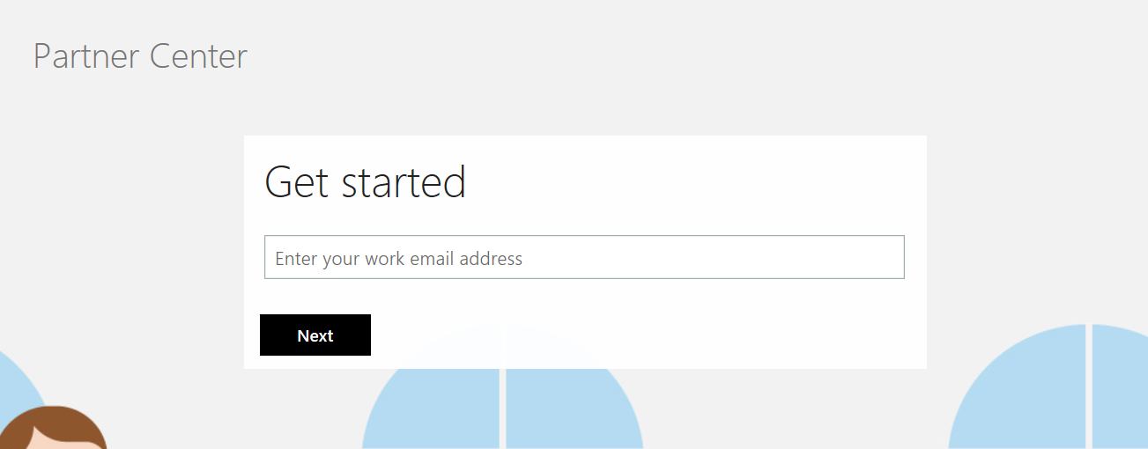
Appendix 2-1
How do I create a tenant in Partner Center?
Please click here to access the registration form shown in the screenshot below:
Type in your work email ID
Click Next
Important: if your Organization already has an existing tenant, please do not create a new tenant, as this will cause a duplicate to be created in Partner Center. Instead, if your Organization has an existing tenant, simply reach out to your Organization’s Administrator and they will add you to the tenant.

Slide 27
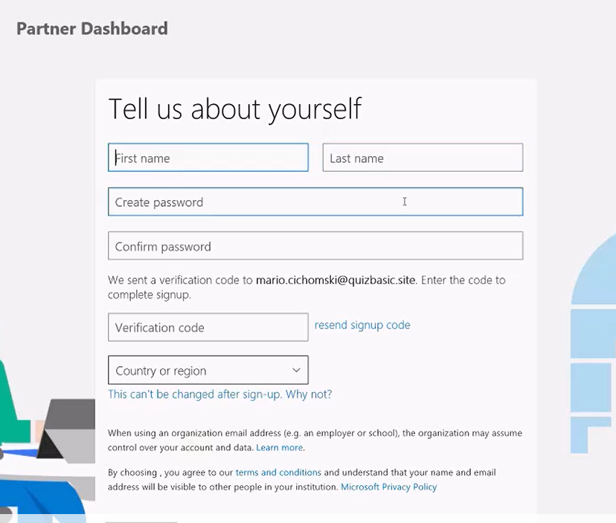
Appendix 2-2
How do I create a tenant in Partner Center?
Fill in all the required details
You will receive an email in your inbox for a Verification code
Click Next to proceed

Slide 28
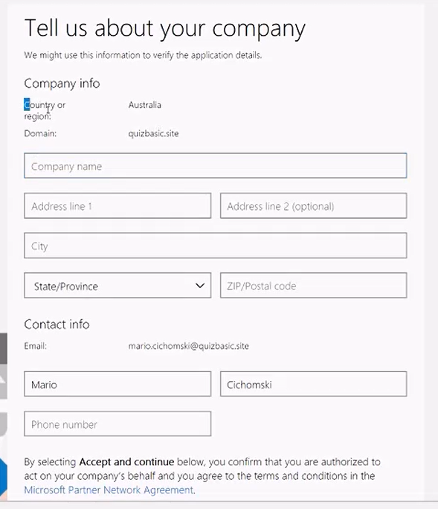
Appendix 2-3
How do I create a tenant in Partner Center?
Fill in all the details about your company
Submit the form once completed

Slide 29
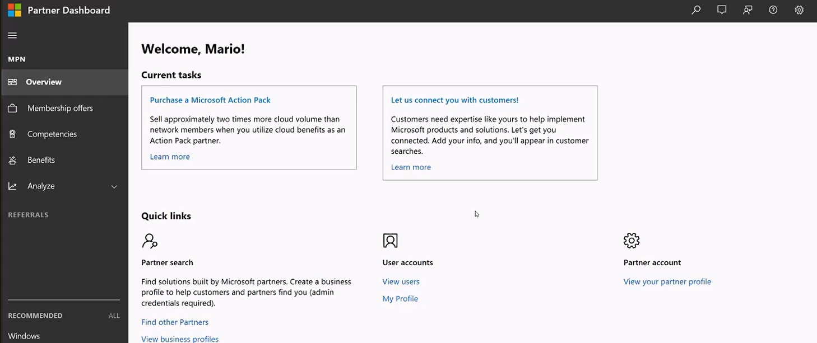
Appendix 2-4
How do I create a tenant in Partner Center?
You will land on a page similar to the one above
Partner Center registration is complete!

Slide 30
How to Contact MPN Support for Associations request.
Reach out to the Regional Support Center via this website: https://partner.microsoft.com/en-us/support or call (800) 676-7658 (US).
You should be able to scroll down and Start Chat with a support member that can help you troubleshoot your issues.
Appendix 2-5

Slide 31
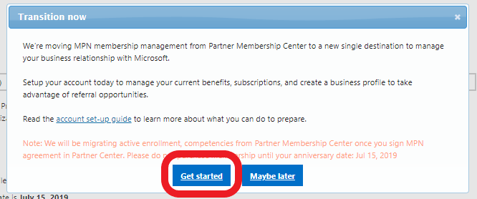
Appendix 3-1
How do I migrate to Partner Center from the Partner Membership Center?
Login to the Partner Membership Center using the ID associated with your company’s MPN ID.
If your organization has not migrated, you’ll receive the message to the right.
Select Get started to begin the migration.
https://partners.microsoft.com
This will take you to a welcome page pictured to the right.
Select Next to continue.

Slide 32
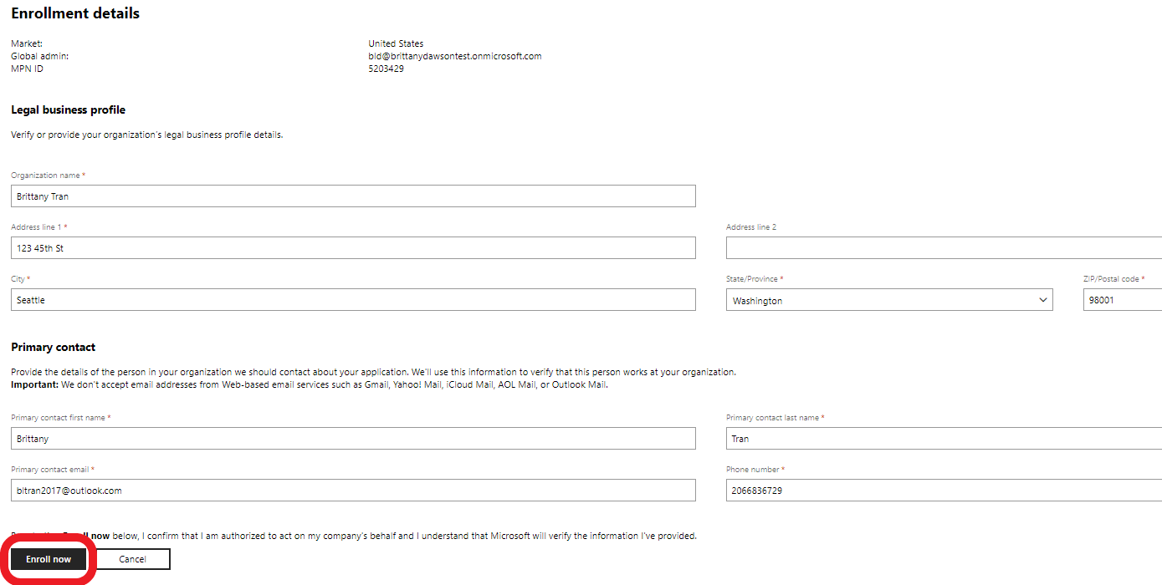
Appendix 3-2
How do I migrate to Partner Center from the Partner Membership Center?
The next page will ask you to sign in with you work account.
Note: It is very import that you sign in with the same ID you use for Office 365, Microsoft Azure, Microsoft Dynamics CRM. For further details you can Learn More here.
When ready to sign in click the Sign In option pictured to the right. migration.
If your sign is successful, you’ll be taken to an Enrollment details page.
Ensure all the details are correct and filled out.
Note: Please ensure you have access to the Primary Contact email as it will receive a verification email to validate the account.
Click Enroll now to continue.

Slide 33
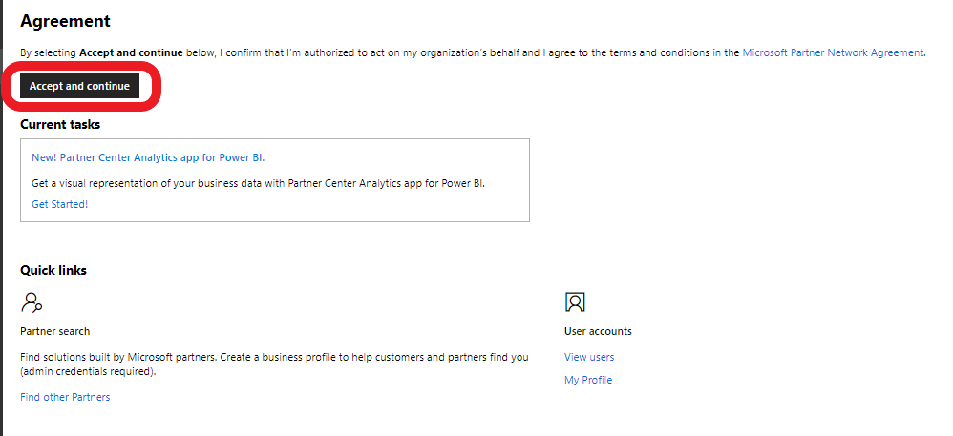
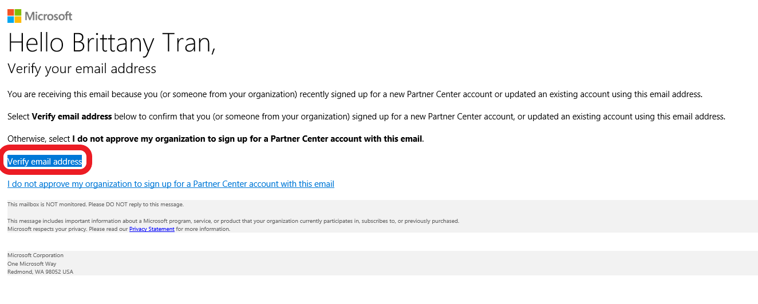
Appendix 3-3
How do I migrate to Partner Center from the Partner Membership Center?
On the next page review the terms and conditions by clicking the link Microsoft Partner Network Agreement and accept them by selecting Accept and Continue.
The last step is to have the primary contact verify their email address. They should receive an email similar to the one on the right. They can verify their account by selecting the Verify email address link.
Once complete, your migration is complete. You can now begin using Partner Center to things such as:
Setup your team (this will not be migrated over with the company migration)
Update your profile
Check your organizations competency status
Connect with customers
Purchase a Microsoft Action Pack
Note: This will now be your new site to manage your MPN ID. You will no longer need to access the Partner Membership Center.

