Slide 1
Surface Performance SKUs

Slide 2
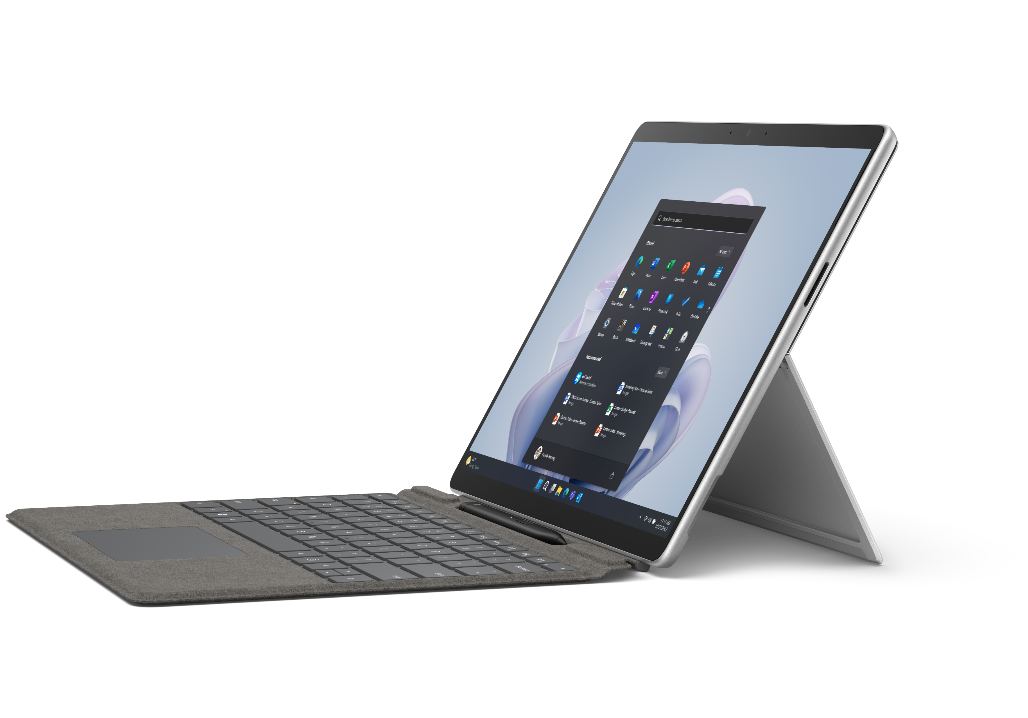
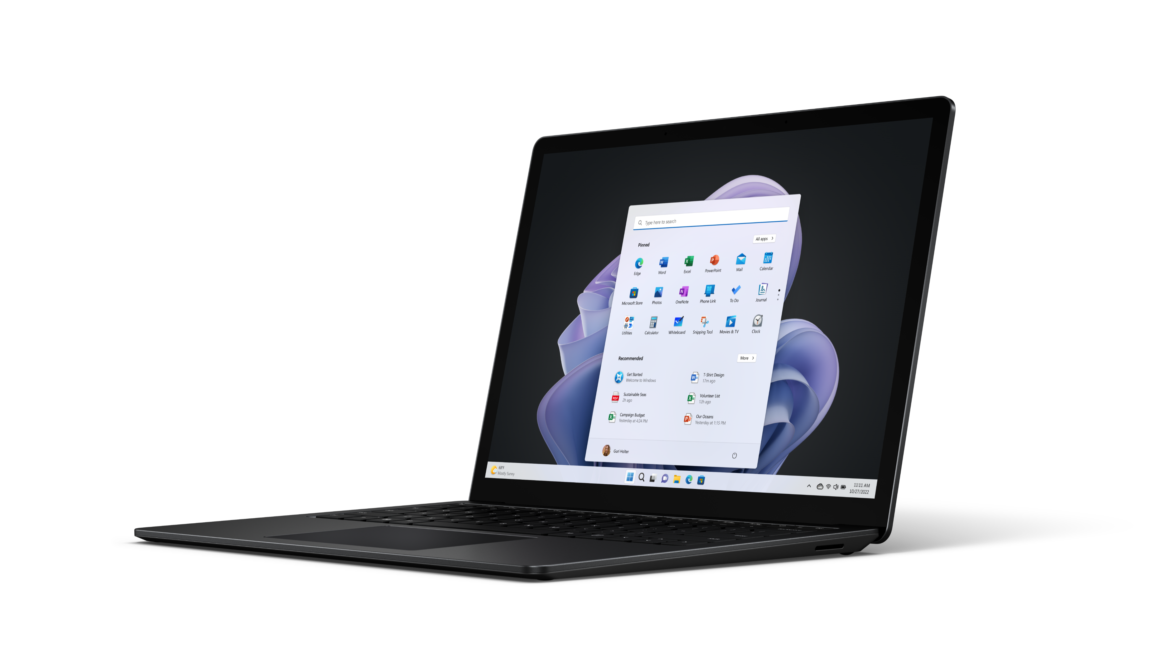
Microsoft Surface Pro 9
Surface Commercial Performance SKU’s
Microsoft Surface Laptop 5
Memory and Storage*
i5/16/256
i7/16/256
i7/16/512
Color(s)
Platinum (metal)
Operating System
OS Choice - To be confirmed by local Surface area leads
Memory and Storage*
13in i5/16/256
13in i7/16/256
13in i7/16/512
15in i7/16/256
15in i7/16/512
Color(s)
Black (metal)
Operating System
OS Choice - To be confirmed by local Surface area leads
*Does not include demo, BSKU, Bulk or EDU

Slide 3
Benefits of Positioning Performance SKU’s
Drive velocity on select Laptop 5 and Pro 9 Devices:
Customers
Partners
Premium 16GB devices built for hybrid work to optimize performance and productivity
In-Stock SKU’s – pre-positioned for supply with targeted 2-week order to ship lead time
Top selling devices with the highest profitability
All Performance SKU’s are eligible for AGI Performance Booster (effective 1/1/2023 to 6/30/2023)
Performance SKU’s are eligible for Bid Grid Booster, except i5 configurations (effective 2/3/2023 to 6/30/2023)

Slide 4
What’s new since H1 FY23
FY23 H1 | FY23 H2
Surface Hero SKU’s | Surface Commercial Performance SKU’s
6 Devices | 8 Devices - New - Pro 9 i7/16/512 and Laptop 5 15” i7/16/512
BTS – with shortest lead times | In-Stock – pre-positioned for supply with targeted 2-week order to ship lead time
OS - WIN10 and WIN11 | OS Choice – OS to be determined by your local area leads – easier to manage for faster lead times
AGI Hero Booster | AGI Performance Booster

Slide 5
FY23 H2 AGI Performance Booster
Maximizing our incentive payout opportunities for your business growth and profitability. Earn extra rebate with Performance Booster!
Overview
Details
Eligible Devices
Platinum/Gold/Silver Resellers and Distributors
Earn up to 0.5% extra rebate for Performance configuration
Eligibility Timeframe: January 1, 2023 – June 30, 2023
To focus on delivering the best in-class performance and benefitting from the In-Stock SKU supply.
Performance Booster will apply if partner meets 90% AGI attainment with additional 0.5% rebate.
Surface Laptop 5 13”
i5/16/256
i7/16/256
i7/16/512
Surface Laptop 5 15”
i7/16/256
i7/16/512
Surface Pro 9
i5/16/256
i7/16/256
i7/16/512
Performance Booster
Microsoft-Partner Confidential Information

Slide 6
FY23 H2 Bid Grid Booster – New!
For a limited time, we are doubling the Tier 3 Bid Grid discounts – Sell More, Get More !
Overview
Details
Eligible Performance SKU Devices
Doubling the Tier 3 (250+) Bid Grid discounts on select Surface Pro 9 and Surface Laptop 5 SKUs to enable partners to close larger deals
Eligibility Timeframe: February 3, 2023 – June 30, 2023
Deal Size: Bid Grid Tier 3; single PO’s of 250+ devices
Discount: 7%
Surface Laptop 5 13”
i7/16/256
i7/16/512
Surface Laptop 5 15”
i7/16/256
i7/16/512
Surface Pro 9
i7/16/256
i7/16/512
Bid Grid Booster
Microsoft-Partner Confidential Information

