Slide 1
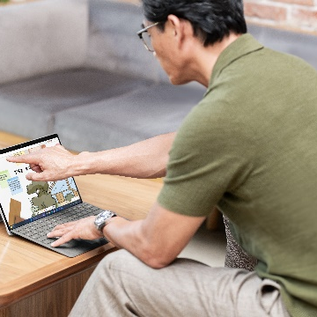
Day in the life of a K–12 educator
Mr. Kim is a geography and social studies teacher who loves to use dynamic instructional methods to ignite student engagement.
7:30 AM: Getting started
7:30 AM: First class
10:00 AM: Technology-empowered teaching
It’s a bright and early start to the school day, and Mr. Kim logs on to his
Microsoft Surface Pro 10. It’s quick, easy, and secured, thanks to Windows Hello with facial recognition. He reviews his class schedule for the day and looks over his lesson plans, typing in adjustments and notes here and there on the Surface Pro Signature Keyboard. After half an hour, the bell rings, and it’s time for his first class…
A 9th grade geography class kicks off the day in Mr. Kim’s room. The first exercise is asking students to arrange their desks into different geographical features associated with parts of the world they’re studying. With his versatile Surface Pro 10 in Tablet Mode, Mr. Kim has the freedom to roam around the room, helping students with suggestions and even documenting their work with the 10 MP Quad HD rear-facing camera. He isn’t worried about bumps or drops, because the school’s IT admin reassured him that his new Surface Pro 10 is tested for durability and has more repair options than previous 2-in-1s.
Mr. Kim’s 11th grade social studies class calls for specialized educational software—a gamified civilization simulator with a fun graphic interface. The educator’s version of the software requires extra computing power. Fortunately, Mr. Kim’s Surface Pro 10 has the latest Intel® Core™ Ultra processor with an integrated Intel® AI Boost NPU, and it’s more than a match for this
engaging edtech.
3:15 PM: School’s out
1:30 PM: Last lecture
12:00 PM: After-lunch grading
Classes are done for the day, but there’s just one more task: a district-wide town hall on some policy changes across the school board. Mr. Kim jumps into the Microsoft Teams meeting and sends friendly messages to colleagues in the chat. Everyone has a chance to speak at this meeting, and Mr. Kim decides to share his perspective. He shows up great because of how the Surface Studio Camera captures lifelike details and delivers AI-enhanced meeting features like automatic framing and background blur. Once the meeting’s resolved, it’s time to head home!
For Mr. Kim’s final class, he’ll be talking through a complex political concept with his 12th grade social studies students. At this time of day, the sun always pours in through the classroom’s big windows, and that can make it hard to see. But Surface Pro 10’s anti-reflective touchscreen display and adaptive color keep his notes at the optimal luminance level for reading. He also glances at his battery level: still plenty of power! All-day battery life¹ means Mr. Kim rarely has to plug in during the school day.
There’s a free period after lunch, so Mr. Kim takes this opportunity to do some grading. Hand-drawn corrections are very helpful in a visual subject like geography, so he tilts the screen back on Surface Pro 10’s built-in Kickstand and marks up his students’ assignments using Surface Slim Pen 2. Mr. Kim also uses voice commands to add annotations where he thinks learners need a little extra guidance.
¹Battery life varies significantly based on usage, network and feature configuration, signal strength, settings and other factors. See aka.ms/SurfaceBatteryPerformance for details.

