Slide 1
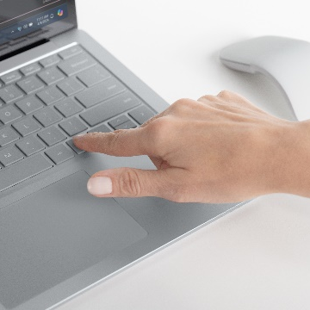
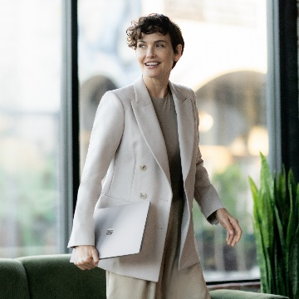
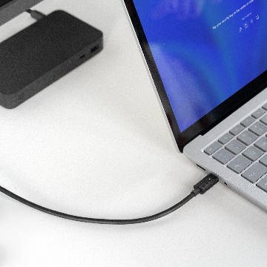
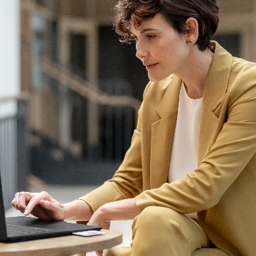
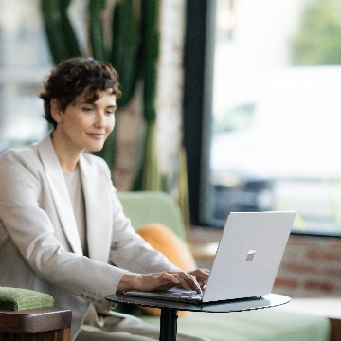
Day in the life of a higher education faculty member
Dr. Mansour is a computer science professor working on cutting-edge large language model (LLM) research, but she also has a heavy teaching load this semester.
7:30 AM: Getting started
9:00 AM: First class
11:00 AM: Crunching data
Dr. Mansour knows she has a big day ahead of her, so she decides to open her
Microsoft Surface Laptop 6 over breakfast to review her schedule. She logs on securely using Windows Hello face sign-in, then checks out her classes and meetings for the day in Outlook. While she’s there, she notices new emails from her research collaborators. Dr. Mansour asks Microsoft Copilot for Microsoft 365¹ to summarize the email thread and prompts the tool to craft a response. She reviews and sends the email, and with that, she’s off!
After heading to campus, Dr. Mansour makes her way to the head of the lecture hall and sets up her Surface Laptop 6. The device’s lightweight and durable design makes setup a breeze, and she’s not worried about knocks and bumps as she sets it on the console. She hooks up to the room’s AV system via the USB-C® port with Thunderbolt™ 4 to seamlessly project her slides onto the larger display.
Now it’s time to work on research, so
Dr. Mansour heads to her on-campus office and connects her Surface Laptop 6 to the Surface Thunderbolt™ 4 dock. That gives her the ability to run two 4K displays at once, and she spreads her work across each screen for the best visibility possible. Thanks to the latest Intel® Core™ Ultra processor with an integrated AI Boost NPU, Dr. Mansour’s Surface Laptop 6 has the power to run simulations based on her LLM training sets locally.
1:00 PM: Connected collaboration
7:00 PM: Writing time
4:30 PM: Grading papers
2:30 PM: Working from anywhere
After lunch, Dr. Mansour and her research collaborators hop on a call to discuss their latest contributions. The AI-enhanced 1080p Studio Camera with Windows Studio Effects, vivid PixelSense™ display, and Omnisonic® speakers with Dolby® Atmos® provide enhanced clarity so her team can share their ideas accurately. The dual Studio Mics ensure she gets a clear transcription. That’s important, because Dr. Mansour likes to distribute the Copilot in Microsoft Teams meeting summary to her team after they connect.
Dr. Mansour does her best writing in the evening. After dinner, she sits down in her home office to draft a section of an upcoming article. With Surface Laptop 6’s full-size keyboard, backlit keys, and perfect balance of key travel, responsiveness, and typing accuracy, she can blaze through paragraph after paragraph. With the last citation in place, Dr. Mansour logs off for the day.
Now Dr. Mansour has to switch gears and
grade some papers—she prefers to navigate her students’ writing by touch-scrolling on Surface Laptop 6’s PixelSense™ touchscreen. Gestures help her highlight key passages, and voice commands make it easy to input brief comments. Even in this public place, Dr. Mansour isn’t concerned about keeping her students’ work safe if her device gets stolen, because Surface Laptop 6 is a Secured-core PC with a TPM 2.0 chip that elevates the benefits of Windows 11 security and delivers chip-to-cloud protection.
It’s time for a mid-afternoon boost, and Dr. Mansour heads to her favorite on-campus café for an espresso and to read an article her colleague suggested. Surface Laptop 6’s sleek design makes it easy to slide in and out of her light satchel. There aren’t any outlets available, but Dr. Mansour isn’t worried. She knows that Surface Laptop 6 delivers all-day battery life,² so it still has plenty of power remaining. Dr. Mansour’s seat is right by the café’s picture window, and it’s a sunny day. But glare isn’t a problem: Surface Laptop 6’s anti-reflective touchscreen display and adaptive color provide excellent clarity and a consistent, optimal luminance level for reading and research.
¹Copilot in Windows (in preview) is available in select global markets and will be rolled out to additional markets over time. Learn more. Copilot with commercial data protection is available at no additional cost for users with an Entra ID enabled with an enabled, eligible Microsoft 365 license. Copilot for Microsoft 365 sold separately and requires a qualifying volume license or subscription - Microsoft Copilot for Microsoft 365 | Microsoft 365.
²Battery life varies significantly based on usage, network and feature configuration, signal strength, settings and other factors. See aka.ms/SurfaceBatteryPerformance for details.

