Slide 1
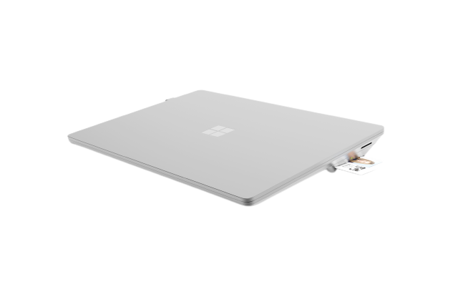
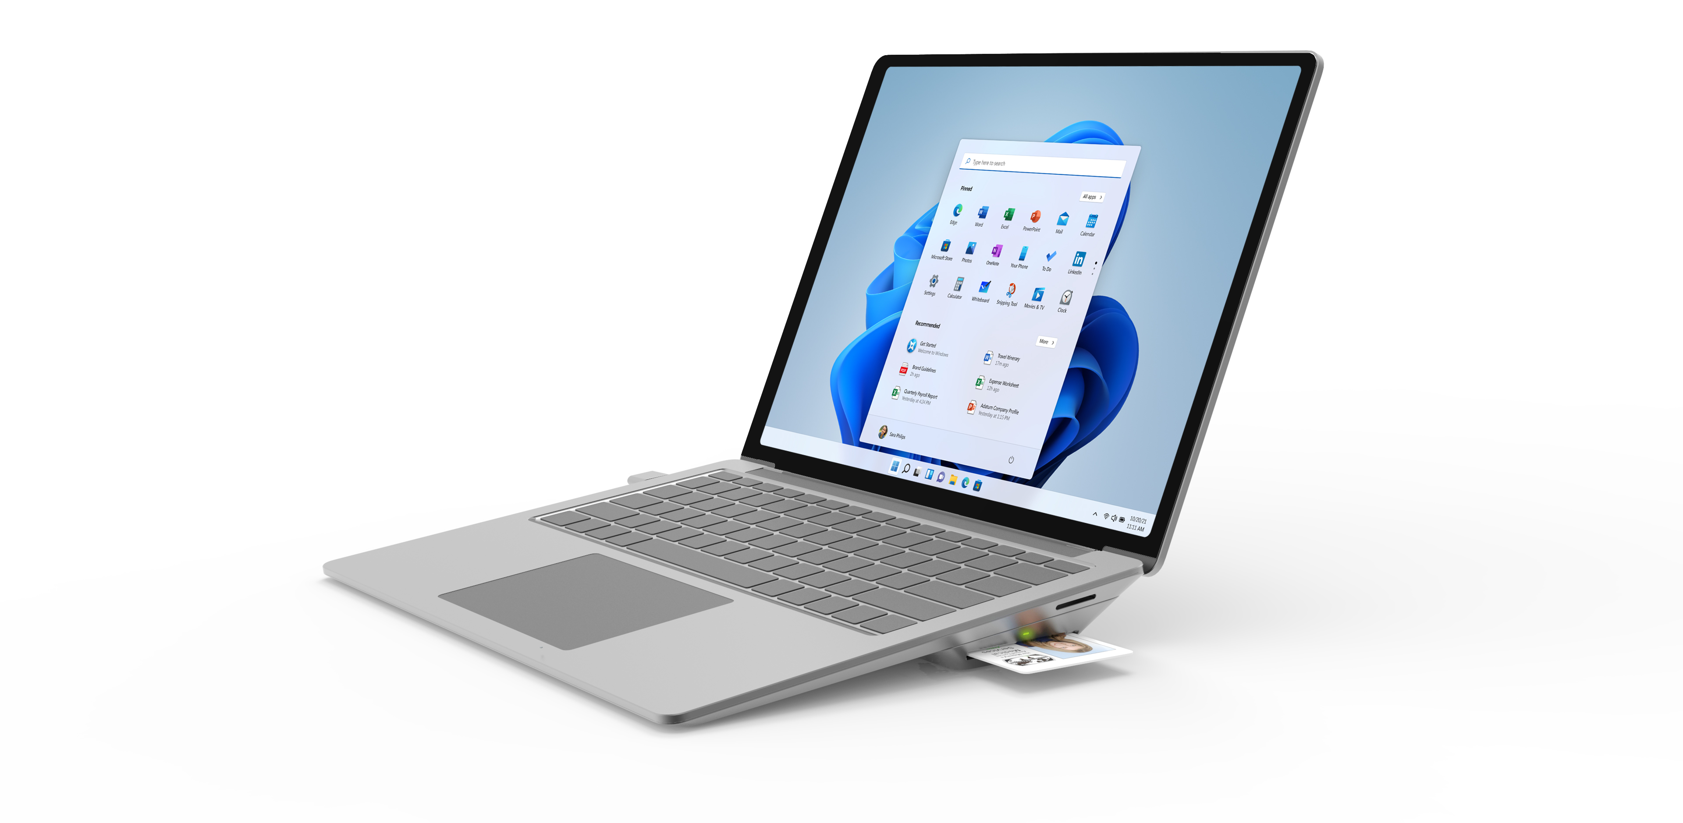
Microsoft Surface Laptop 5 SCR
Powered for secured work​
Microsoft Surface Laptop 5 SCR enables your team to deliver impact, speed and performance with the secure convenience of a FIPS 201 compliant smart card reader.
Benefits
Surface Enterprise Management Mode (SEMM) provides enterprise level UEFI management and physical disablement of cameras and radios.
Enhance your Teams meetings with a high-quality camera enhanced by Windows 11 smart features and Studio Mics
More replaceable components with 3yr next business day onsite extended hardware service through ITG. Uplifts to 4yr and 5yr service and/or accidental damage protection are available.
13.5” or 15" PixelSense™ screen for ultra-portable productivity
Secured-core PC
FIPS 201 compliant smart card reader
Removable hard drive to retain sensitive data

Slide 2
Surface Laptop 5 SCR Technical Specifications
In the Box | Surface Laptop 5 13.5” or 15” Power Supply Quick Start Guide Safety and warranty documents
Dimensions | Surface Laptop 5 13.5”: Length: 12.1 inch Width: 8.8 inch Height: .57 inch Weight: Fabric 2.80 lbs | Surface Laptop 5 15”: Length: 13.4 Width: 9.6 inch Height: .58 inch Weight: 3.44 lbs
Display | Surface Laptop 5 13.5” Screen: 13.5” PixelSense™ Resolution: 2256 x 1504 (201 PPI) Aspect ratio: 3:2 Contrast ratio 1300:1 Color profile: sRGB, Vivid Individually color-calibrated Dolby Vision IQ™³ support Touch: 10-point multi-touch Gorilla® Glass 3 display with Alcantara® palm rest Gorilla® Glass 5 with metal palm rest Brightness: 400 nits maximum (typical). 5 nits minimum | Surface Laptop 5 15” Screen: 15” PixelSense™ Resolution: 2496 x 1664 (201 PPI) Aspect ratio: 3:2 Contrast ratio 1300:1 Color profile: sRGB, Vivid Individually color-calibrated Dolby Vision IQ ™³ support Touch: 10-point multi-touch Gorilla® Glass 5 Brightness: 400 nits maximum (typical). 5 nits minimum
Memory | 8GB, 16GB, or 32GB LPDDR5x RAM Removable² solid-state drive (SSD) options: 256GB, 512GB, or 1TB
Processor | Surface Laptop 5 13.5” 12th Gen Intel® Core™ i5-1245U processor 12th Gen Intel® Core™ i7-1265U processor Built on the Intel® Evo™ platform | Surface Laptop 5 15” 12th Gen Intel® Core™ i7-1265U processor Built on the Intel® Evo™ platform
Software | Windows 11 Pro Preloaded Microsoft 365 Apps⁷ Microsoft 365 Business Standard, Microsoft 365 Business Premium, or Microsoft 365 Apps 30-day trial⁸
Wireless | Wi-Fi 6: 802.11ax compatible Bluetooth® Wireless 5.1 technology
Storage¹ | 8GB, 16GB, or 32GB LPDDR5x RAM Removable² solid-state drive (SSD) options: 256GB, 512GB, or 1TB
Keyboard Layout | Activation: Moving keys. Layout: QWERTY, full row of function keys (F1 – F12). Windows key and dedicated buttons for media controls, screen brightness. Keyboard backlight
Sensors | Ambient light sensor
Connections | 1 x USB-C® with USB 4.0/Thunderbolt™ 4 1 x USB-A 3.1 3.5 mm headphone jack 1 x Surface Connect port
Security | TPM 2.0 chip for enterprise-grade security and BitLocker support Enterprise-grade protection with Windows Hello face sign-in Windows 11 Secured-core PC
Battery life⁴ | 13.5” Up to 18 hours of typical device usage 15” Up to 17 hours of typical device usage Battery Capacity Nominal (WH) 47.4 Battery Capacity Min (WH) 45.8
Cameras, video, and audio | Windows Hello Face, 720p HD front facing authentication camera Dual far-field Studio Mics Omnisonic® Speakers with Dolby® Atmos®⁵ Intel® Iris® Xe Graphics
Accessory Compatibility | Designed for Surface Pen⁶ Supports Microsoft Pen Protocol (MPP)
Accessibility | Compatible with Surface Adaptive Kit Compatible with Surface Delray Include Windows Accessibility Feature – Learn More
Exterior | Casing: Aluminum Power and Volume buttons on keyboard Surface Laptop 5 13.5” Platinum with Alcantara® material palm rest Matte Black with metal palm rest | Surface Laptop 5 15” Platinum and Matte Black with metal palm rest Matte Black with metal palm rest
Serviceability | Replaceable components include: SSD, AB Cover module (display), C Cover, Battery + Bucket, Motherboard, Charging Port (Surflink connector),Thermal Module, Thermal pad and Desense tape, Feet
Warranty | ITG 3-Year Next Business Day Onsite Extended Hardware Service with Keep Your Hard Drive, options for 4 or 5 year coverage.
Keyboard layout | Activation: Moving keys. Layout: QWERTY, full row of function keys (F1 – F12). Windows key and dedicated buttons for media controls, screen brightness. Keyboard backlight
Eco Labels and Ratings⁹ | Meets ENERGY STAR® requirements Registered EPEAT® Gold in the US and Canada¹⁰
SCR Security Slot | K63240WW (black) K63213WW (platinum) K64036WW | HDMI 2.0 (4K/60Hz) USB-C 3.2 Gen. 2 FIPS 201 Smart Card Reader Compatible with Kensington Standard Microsaver™ /T-Bar™ locks | 13": 11.9" x 3.7in x 0.8in (301.5mm x 94.6mm x 21.0mm) 15": 13.1" x 3.7in x 0.8in (332.8mm x 94.6mm x 21.0mm) 54mm/Width: 19.5mm/Height:7mm
Disclaimers 1 System software uses significant storage space. Available storage is subject to change based on system software updates and apps usage. 1 GB = 1 billion bytes. 1 TB = 1,000 GB. See Surface.com/Storage for more details.
2 Customer Replaceable Units (CRUs) are components available for purchase through your Surface Commercial Authorized Device Reseller. Components can be replaced on-site by a skilled technician following Microsoft’s Service Guide. Opening and/or repairing your device can present electric shock, fire and personal injury risks and other hazards. Use caution if undertaking do-it-yourself repairs. Device damage caused during repair will not be covered under Microsoft’s Hardware Warranty or protection plans. Components will be available shortly after initial launch; timing of availability varies by component and market.
3 Requires Dolby Vision® encoded content and video. 4 Battery life varies significantly based on device configuration, usage, network and feature configuration, signal strength, settings and other factors. See aka.ms/SurfaceBatteryPerformance for details.
5 Requires Dolby® Atmos® encoded content/audio.
6 Sold separately
7 Sold separately. Software license required for some features.
8 Activation required. If your device is managed by your organization’s IT department, contact your IT administrator for activation. If you activate your trial outside your organization, after 30 days, you will be charged the applicable monthly or annual subscription fee. Credit card required. Cancel any time to stop future charges. See https://aka.ms/m365businesstrialinfo.
9 Download the full Eco profile see – https://aka.ms/ProX_EcoProfile 10 For more information on registration in other markets check - https://aka.ms/LaptopStudio_EPEAT.

