Slide 1
Introduction to Customer Experience
Jennifer S. Tomlinson
Sr. Manager Partner Marketing
Worldwide Channels and Programs
Jesidd@Microsoft.com

Slide 2
Table of Contents
Why Customer Experience?
Customer Experience Overview
Customer Journey Mapping
Customer Personas
Voice of the Customer Research
ROI and Quality of Experience
Next Steps

Slide 3
WHY CUSTOMER EXPERIENCE?

Slide 4
Customers today have high expectations of services they receive, service accessibility, choice, speed to resolve issues, customization, personalization and more.

Slide 5
What do we remember and share the most?
Amazing Experiences
Good Service
Great Products

Slide 6
The Need For A Focus on the Customer
Customer Retention
It is all about end-to-end experience & relationship
The customer journey (and experience) continues after acquisition and purchase
Purchase Paradigm Shift
Marketing funnels are being replaced with customer lifecycle
Fragmented path to purchases (multiple interactions and channels)
Quality of Experience
Companies must deliver relevant experiences, or lose customers
Companies must measure interaction effectiveness throughout the entire lifecycle

Slide 7
Powerful Customer Experience (CX) Statistics
70% of revenue growth is received from existing customers
7 in 10 CxO’s believe social/digital interactions is the new imperative
60% of CxO’s now look to PARTNERS who will have an equal hand in creating business value
3 out of 4 decision makers stated that top priority is enhancing customer experience
One of the top CEO’s priorities is Satisfied Customers and Brand perception
By 2018 50% of consumer product investments will go toward Customer Experience Innovation

Slide 8
Customer Experience As a Differentiator
Differentiated
Experiences
Services
Competitive Positioning
Goods
Commodities
Un-differentiated
Market $
Pricing
Premium $$$

Slide 9
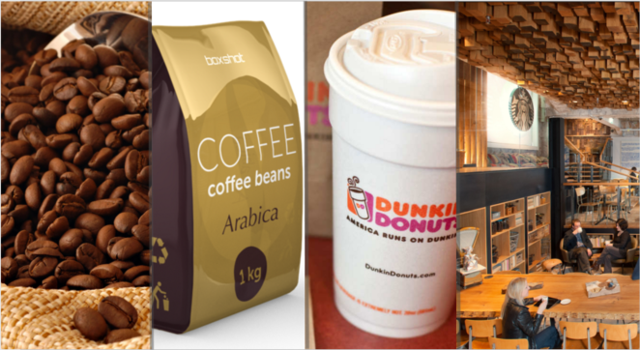
Customer Experience Example
$.01 - $.02 Per Cup
$.05 - $.25 Per Cup
$.75 - $1.50 Per Cup
$2.00 - $5.00 Per Cup
Commodities
Goods
Service
Experience

Slide 10
CUSTOMER EXPERIENCE OVERVIEW

Slide 11
Creating a world-class, end-to-end customer experience can become a key strategic differentiator. However, it requires a deep understanding of both the customers and how they interact. Plus, a commitment to change business processes based on that understanding.

Slide 12
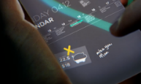
What is Customer Experience (CX)?
The sum of how customers perceive interactions with your company’s products, services and/or people...
Dynamic workplace
Merging home & work
Responsible organization
Immersive, connected experiences
THE CHALLENGE – customer experience is whatever your customer thinks it is.
Notes:
Good customer experience can be defined as the practice of building and responding to customer interactions in a way that meets or exceeds demands, expectations and satisfaction. It increases demand in the short term as well as loyalty in the long run. It leads to greater customer satisfaction, long lasting relationships and brand loyalty, encouraging repeat customers, creating a competitive advantage and boosting revenue.

Slide 13
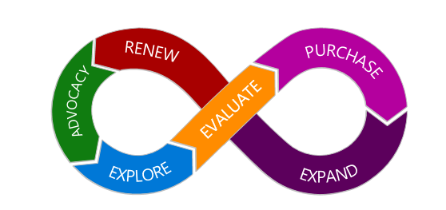
Understanding your customer
Customer Lifecycle
Notes:
Understanding your customer, where they stand and what motivates them to choose you or a competitor, is the foundation of delivering a superior customer experience

Slide 14
Four Steps to Improve Customer Experience
Identify Product or Service Journeys | Define Personas & Key Interactions | Validate Perceptions & Define CX Metrics | Calculate CX ROI & Build Experiences
Collaborate within your organization to identify most urgent product/service journeys to fix | Start with your segments and audiences in order to narrow down the persona groupings | Using voice of the customer research confirm with customers data points from your journey map. | Using industry or custom created ROI formulas prove that desired CX improvement will yield profits.
When deciding on the top journey keep in mind the business and customer metrics that you need to improve | Identify common attributes within each personas and their key interaction touchpoints. | Decide on the key metrics you want to measure. | With ROI confirmation generate the list of improvement projects that company will undertake to improve customer experiences
Journey Mapping
Voice of the Customer
Quality of Experience

Slide 15
CUSTOMER JOURNEY MAPPING

Slide 16
What do customers expect from their relationship with your company? A combination of utility, convenience, value and delight at each interaction based on their individual needs at a specific moment. Each interaction is an opportunity to strengthen or weaken the relationship with that customer.

Slide 17
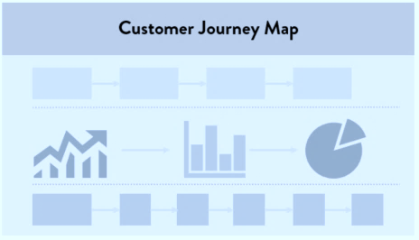
What Is a “Customer Journey Map”?
It is visual illustration of one persona’s interactions and experience, from the persona’s point of view.
Goal is to understand what “occurs” in each stage of the customer journey, and what “moves” those customers from one to the next.
While mapping the Customer Journey , you will gather and rate three categories of information:
Wants, needs, and goals of the persona
Persona’s interaction touchpoints
Persona’s pain-points
1
2
3
4
5
6

Slide 18
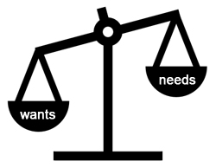
What are the Wants and Needs?
Wants – products or services that are not necessary but that we desire or wish for
Needs – products or services that are required
Wants and Needs represent personas’ expectations and perceptions at each stage of the journey.
Typical questions when discovering wants and needs:
What are customers trying to accomplish?
What’s most important to them at that stage?
How do they want to feel?
What are emotions, thoughts, feelings and reactions during experience.

Slide 19
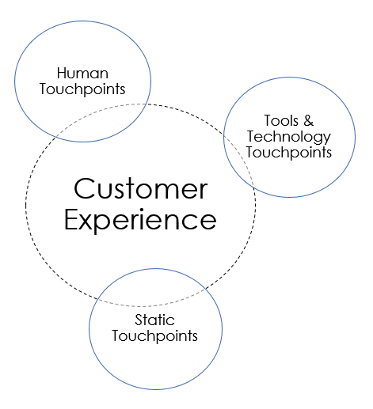
What are the Interaction Touchpoints?
Touchpoints are customer interactions with a company via any channel, at any time, for any purpose.
Your touchpoints drive customer perceptions of your brand (what you stand for) and experience (how well you meet their expectations)

Slide 20
Journey Mapping Approach Summary
Choose Key Products or Services To Fix
Create prioritized list of products/services that are not meeting customer expectations
Collaborate with other team members that are participating in selected customer journey
Identify Key Personas
Create the list of key customers grouped by common shared traits (role, needs, expectations…)
Identify and nominate the leaders for each persona (persona ownership)
Break the Silos & Map The Journey
Invite cross-team members to map together journey (end-to-end view)
Co-create journey map (hypothesis) then validate it through voice of the customer research step

Slide 21
CUSTOMER PERSONAS

Slide 22
A critical part of designing customer experiences is selecting and defining key customer personas, which represent a particular customer segment with shared traits. These behavioral archetypes are used to design specific experiences and interactions based on an understanding of the unique wants and needs of that particular segment. For example, an individual shopper visiting a web site or calling support will have different requirements and expectations than a business partner.

Slide 23
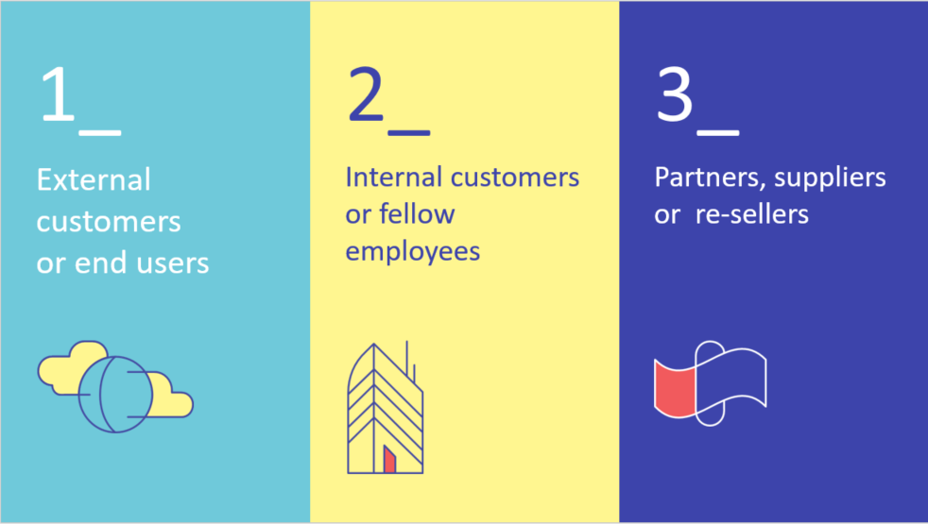
Who Is A “Customer”? Customer is whoever is taking the journey

Slide 24
How Do We Design Customer Experience?
We Can’t Treat Everyone Differently
OR
Treat Them As If They Are The Same…
We design customer experience for a persona

Slide 25
What Are Personas? A proxy for bigger group of customers with shared common traits & business goals
Common Traits: Age, Title, Attitudes, Gender, Common Interests, Location…
Business Needs: Goals, Concerns, Expectations, Perceptions, Painpoints…
Persona: Alexa

Slide 26
Persona Design Approach Summary
Who is taking a journey
Engage with broader internal teams to create list of top customer profiles
Prioritize top customers that are relevant to your journey
Define segments
Group customers by common traits & align them around business needs
Ensure a mix of personas is used to capture broad perspectives
Design your persona
Identify top wants and needs as well as top painpoints
Map key interaction touchpoints (in the context of the journey)

Slide 27
VOICE OF THE CUSTOMER RESEARCH

Slide 28
The Voice of the Customer is a market research technique that produces a detailed set of customer wants and needs, organized into a hierarchical structure, and then prioritized in terms of relative importance for customer segment(s) being researched.

Slide 29
Voice of the Customer Research Approach
GOOD: CX Qualitative Research
Small customer sample (10-15 per persona)
In person (Interviews) or Online (Discussions Boards)
BETTER: CX Quantitative Research
Large sample sizes, statistically significant numbers
Not a market research survey, rather used to validate the journey and persona interactions and perceptions
BEST: Metrics & Drivers Definitions
Define key CX metrics that you will monitor
Establish and derive key drivers of loyalty, satisfaction and behaviors

Slide 30
Validate Your Hypothesis
Qualitative research typically is used when a company has a lack of understanding about customer issues.
The objective of CX qualitative research is to provide understanding of a sample population’s issues, beliefs, and motivations.
Quantitative research is typically used when a company understands the issues, but needs greater certainty with projectable data.
The objective of CX quantitative research is to gather and organize the data and generalize, or extrapolate, the results from the sample set and apply it to the entire population of interest.

Slide 31
ROI AND QUALITY OF EXPERIENCE

Slide 32
A critical part of CX improvements is to have clear ROI method and well defined CX metrics which provide monitoring and validation of customer experience improvements In order to justify the investment required for CX improvement projects, a common framework/index can be used to measure the CX impact on business. Successful measurement frameworks always include multiple data sources (i.e. perception data, behavior data and telemetry data).

Slide 33
Quality of Experience
Create Business Case – CX ROI
Using voice of the customer research establish key CX metrics
Using industry ROI formulas try to calculate CX ROI
Build Experience Metrics
Collect and create list of most common used metrics
Group them by categories that help you build better business cases
Implement CX Index
Create a comprehensive CX index (multi-part)
Example: employee satisfactions, customer perceptions, customer behaviors, brand perceptions

Slide 34
CX ROI – Example Primer
1. A company with $100 Millions in revenue has current Satisfaction distribution as following:
- 50% of customers are very satisfied - 34% are somewhat satisfied - 16% are not satisfied
2. From their perception survey, company learned that the likelihood to re-purchase is as following:
- For very satisfied customers is 81% - For somewhat satisfied is 44% - For not satisfied is 16%
3. If company is able to convert just 1% of not satisfied to very satisfied their ROI could be approximately $1.12 M
Current Revenue Index (CRI)
50% x 81%= 40.50
34% x 44%= 14.96
16% x 16%= 2.56
CRI= 58.02
Future Revenue Index (FRI)
51% x 81%= 41.31
34% x 44%= 14.96
15% x 16%= 2.40
FRI= 58.67
58.67-58.02
ROI=
X $100M
58.02
ROI= $1,120,303.34
Notes:
Above is a simple ROI calculator – please note that for each industry segment, service and products there could be one or more appropriate ROI calculators. This example is provided for simple and educational purposes.

Slide 35
Example: Useful CX Related Metrics
Customer Loyalty | Success Metrics | Revenue | Satisfaction | Employee | Marketing
Retention Rate | Customer acquisition cost/rate | Revenue Per User | Overall Satisfaction | Revenue Per Employee | Market Growth Rate
Renewal Rate | Reliability (as vendor/ or business partner) | Conversion Rate | Stars in Reviews | Employee Satisfaction | Market Share
Buy More | Advocacy (recommend to others) | Customer Lifetime Value | Compete Score (versus others) | Average Employee Tenure | Brand Equity
Customer Effort Score | First Contact Resolution | Share of Wallet | Trust (level of organization trust with vendors) | Employee Churn Rate | Cost per Lead

Slide 36
Example: Components of CX Index Score
CX Score
25%
15%
47%
13%
Employee Satisfaction
Customer Perceptions
Customer Behaviors
Brand Experience
- Long term satisfaction is our top priority - I have tools and resources I need to deliver excellent services - Processes an procedures allow me to effectively meet my customer needs
- Overall Satisfaction - Likelihood to recommend - Likelihood to continue - Easy to do business with us - Enjoyable to do business with us - Increase Share of Wallet
- Conversion Rate - Renewal Rate - Retention/Churn Rate - Buy More - Revenue Per User
- Company Innovation - Brand Awareness - Brand Engagement - Brand Perception - Marketing Communications - Social Sentiment
NOTE
The presented CX Index components and their metrics should be adjusted based on the industry, service and customer types. Having a compound index helps organizations to bring balanced view and bring together disconnected siloed.

Slide 37
NEXT STEPS

Slide 38
To Learn More
The Truth About Customer Experience (HBR): https://hbr.org/2013/09/the-truth-about-customer-experience
Visit Smart Partner Marketing on: http://smartpartnermarketing.microsoft.com
Start your CX self-assessment: http://www.indigoslate.com/cx-self-assessment

