Slide 1
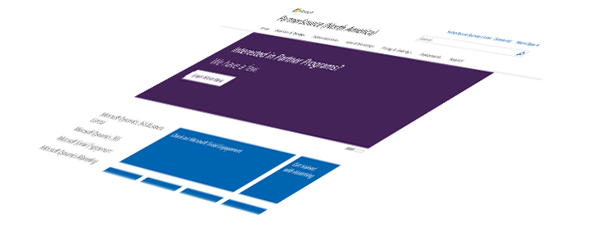
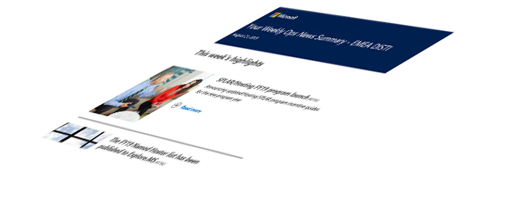
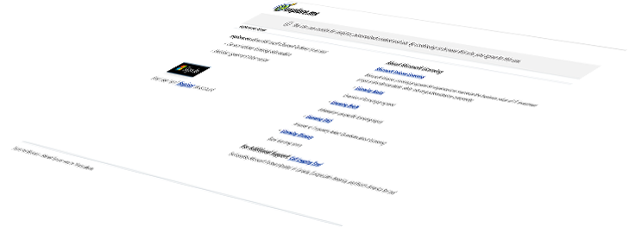
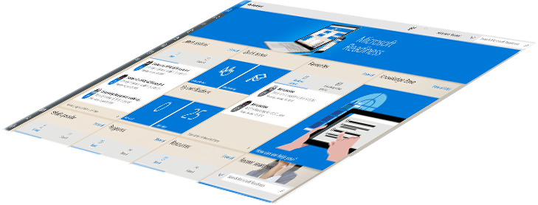
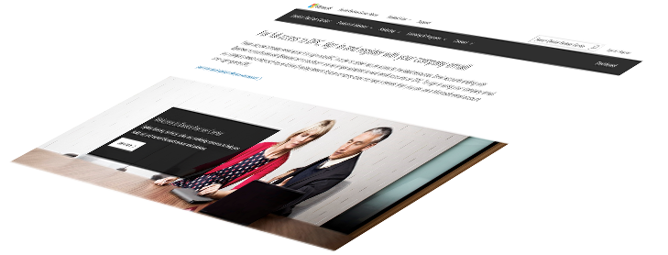
Distributor-Managed Partner (DMP) Onboarding Readiness Deck
Microsoft Commercial Devices Team

Slide 2
Our objective
In this Lesson
DMP Program Overview
Benefits
Overall DMP Flow
By the end of this lesson you will be able to:
Identify the Surface DMP Program Benefits
Describe the DMP pre-onboarding requirements
Outline the step-by-step process for DMP onboarding
DMP Readiness
Pre-onboarding Requirements
Step by Step Process for DMP onboarding
FAQs
Resources & Support

Slide 3
DMP Program Overview

Slide 4
Surface DMP Program Benefits
Be part of the business transformation: Tap into the innovation of Microsoft devices and their role in accelerating enterprise transformation.
Increase your demand: Be one of the select qualified partners to sell the most productive devices on the planet.
Make more money: Access world-class Surface partner programs and promotions.
Enable your sales force faster: Ramp up quickly with resources like the Surface Reseller Alliance portal and high-touch Distributor enablement
DMP
DMP refers to Disti Managed Partner.

Slide 5
DMP On-boarding Readiness

Slide 6
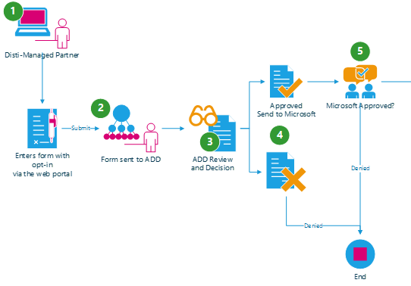
DMP Onboarding Flow
1
1
A partner is invited to become a Disti Managed Partner via the “Reseller Profile and Registration Portal” by completing a form online which includes the following data:
Partner Contact Details
ADD selection (multiple allowed)
Profiling Details
Opt-In legal agreement on program criteria
2
3
4
2
Once the form is complete, it will be sent to the ADD(s) selected.
The ADD partner will review the criteria in the form and determine the nomination based on fit and completeness of information.
3
4
Once the decision has been made, if approved, the detail is sent to Microsoft for approval.
**Incorrect MPN IDs will be rejected.
DMP Action
ADD Action
MSFT Field Action

Slide 7
Pre-onboarding Requirements
What do I need to prepare before becoming a Disti-Managed Partner (DMP)?
1. DMPs must have an active Partner Center tenant.
Partners are required to associate with their Organization Partner ID to complete the Enrollment at Partner Center.
For instructions on how to register in Partner Center, see here.
IMPORTANT: if your Organization previously existed in the Partner Membership Center (https://partners.microsoft.com), please follow the steps here to migrate your existing company to the new Partner Center.
2. DMPs must have an active Work ID (Azure AD).
If you do not have an active Work ID, please request your Organization’s Administrator to add you to the tenant.
3. DMPs are required to provide their legal company and contact information.
Legal Business Profile- provides the Distributor with your company profile including legal company name, address, and contact information. Your Legal Company Name should match your MPN account information.
Company Tax ID- necessary to receive Channel Incentives (if applicable).
Primary Program Contact- responsible for submitting Company Information, agreeing Terms and Conditions, and receiving system notifications.
Contract Authorization Contact- responsible for reviewing Terms and Conditions.
Channel Incentives Contact - responsible for setting up Channel Incentives for the organization (if applicable).

Slide 8
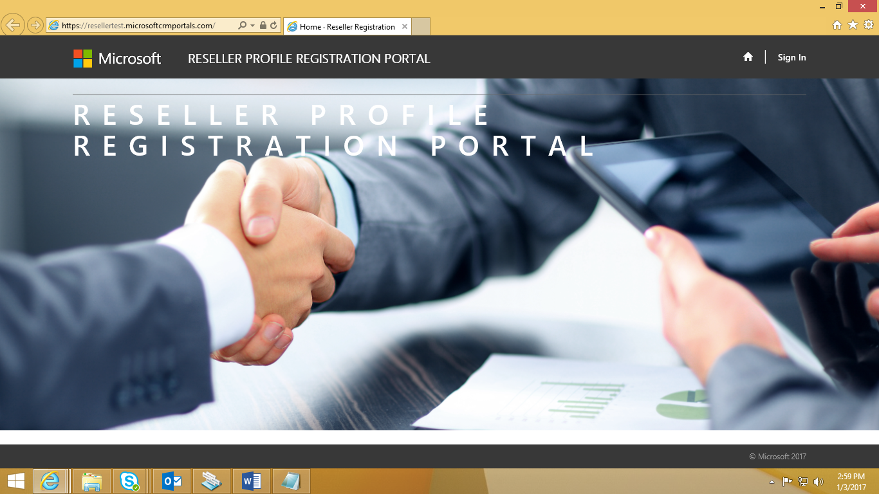
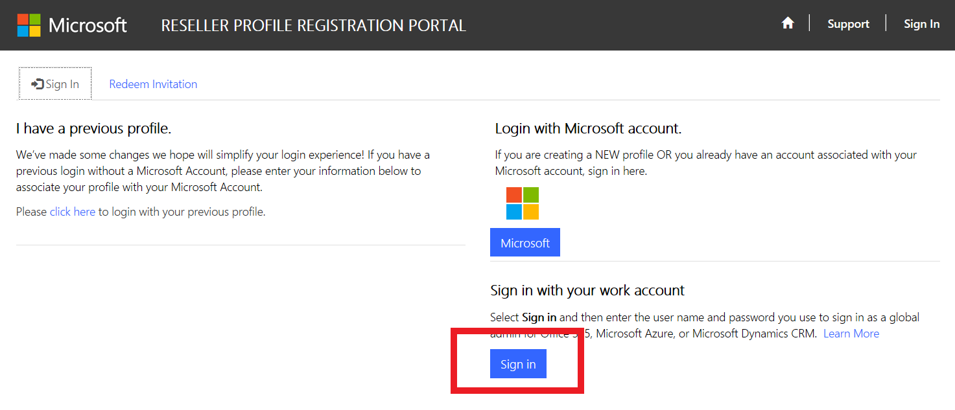
DMP: Portal Registration Step by Step
Open link to Reseller Profile Registration Portal and click “Sign In” at the top right corner.
https://reseller.microsoftcrmportals.com/
For a new user, Login with a Work account by clicking on the “Sign in” button and enter you work account and Password.
*Please ensure that this is the same Work ID that was created for you by your Organization’s Administrator

Slide 9
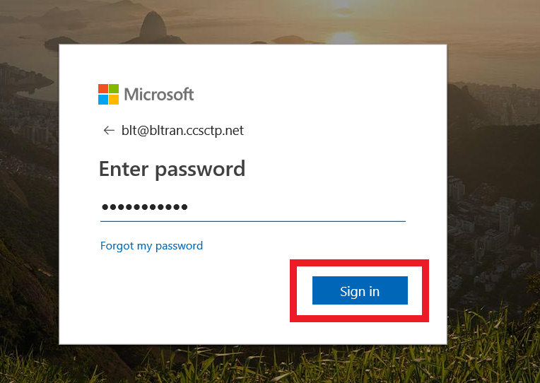
DMP: Portal Registration Step by Step
Enter your Work ID and Password.
Click on Sign in button.
If you do NOT have a Work ID, please request your Organization’s Administrator to create one for you.

Slide 10
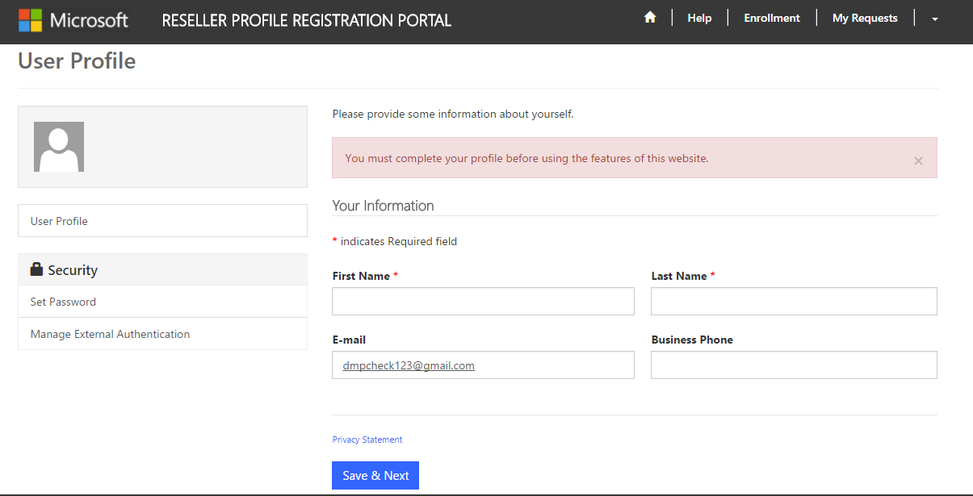
DMP: Portal Registration Step by Step
On successful Sign-in, you will be redirected to User Profile page and you will be requested to complete your profile information before accessing other contents of this portal.
Enter all mandatory information and click on Save & Next button to complete your User Profile.

Slide 11
DMP: Portal Registration Step by Step
1st Partnership
Once you reach the Partner Enrollment List, please select “Enroll Organization” and continue with the registration.
Additional Partnerships w/ Existing Account
If you have already completed a registration and would like to submit additional Partnership requests, then please select the appropriate Organization in the list.
Select Save & Next on the bottom until you reach the Distributors page.
Submit the desired ADD Partnership request(s) by selecting the Associate button.

Slide 12
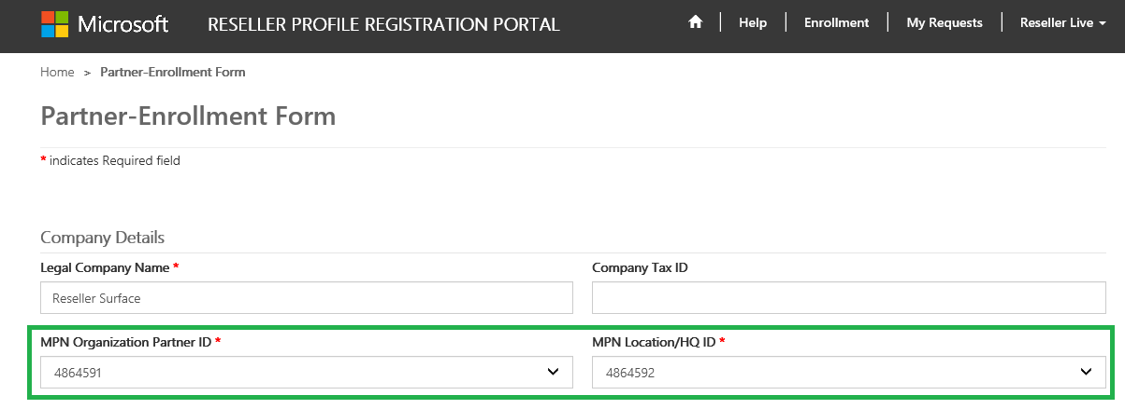
DMP: Portal Registration Step by Step
MPN ID’s will be pre-populated with the Work Account associations. Please select the MPN Organization ID that you want to use and then select the appropriate MPN Location ID from the drop downs.
Once you select the appropriate MPN Location ID, your Legal Company Name will automatically pre-populate.
For Partners looking to onboard Multiple Locations:
For partners with the same MPN Organization ID, but multiple MPN Locations IDs, please select the appropriate Location ID(s) being onboarded.
What NOT to do: Do not edit the existing enrollment records MPN IDs & address. All new locations must be enrolled with the steps above.

Slide 13
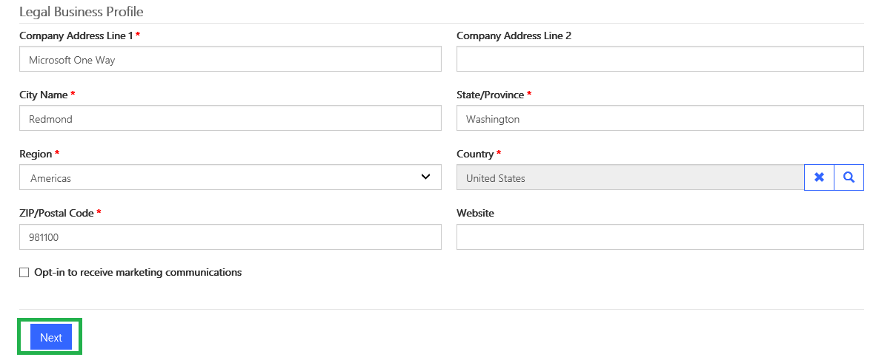
DMP: Portal Registration Step by Step
Fill out your Legal Business Profile information.
Opt-in for Surface communications (optional).
Click on Next.

Slide 14
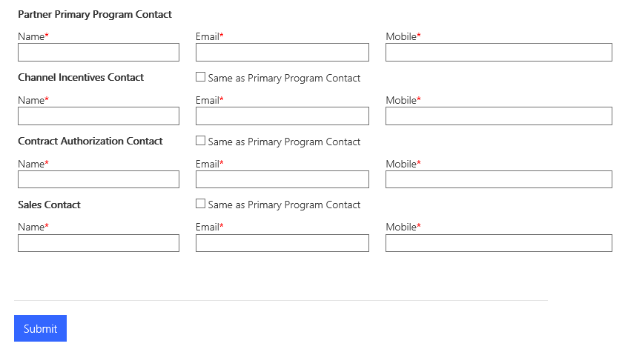
DMP: Portal Registration Step by Step
Click on Add Contact button.
Complete the Contact Details for each Contact Type by:
Click Add Contact button and complete all the 4 types of contact details required, click Submit.
If you do not complete all of the contacts, then you may see the error as follows:

Slide 15
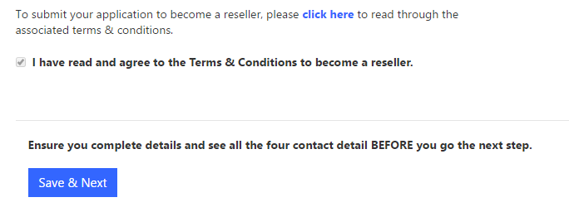
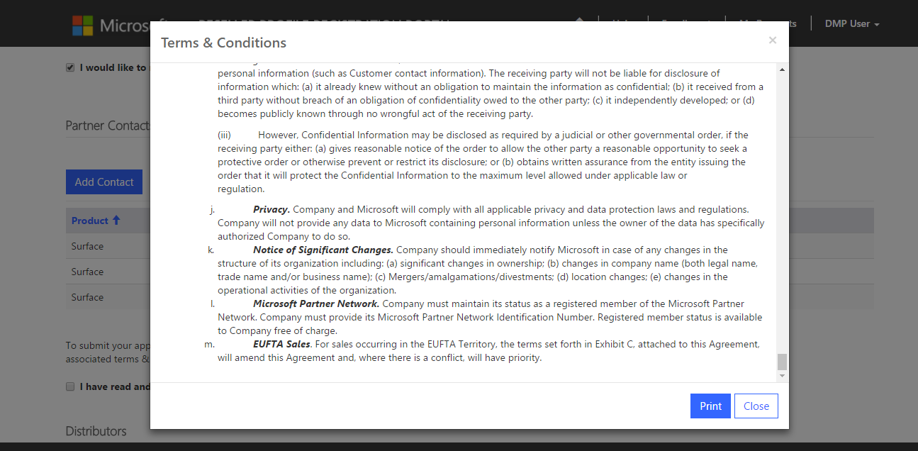
DMP: Portal Registration Step by Step
Select the “click here” button, as shown to the left, to view the Terms and Conditions.
Read through the Terms & Conditions and click Close or Print.
Upon closing, you will be able to confirm that you have read and agree to the Terms & Conditions.
If you would like to accept, select the check box for Terms and Conditions.
Click on the Save & Next button.

Slide 16
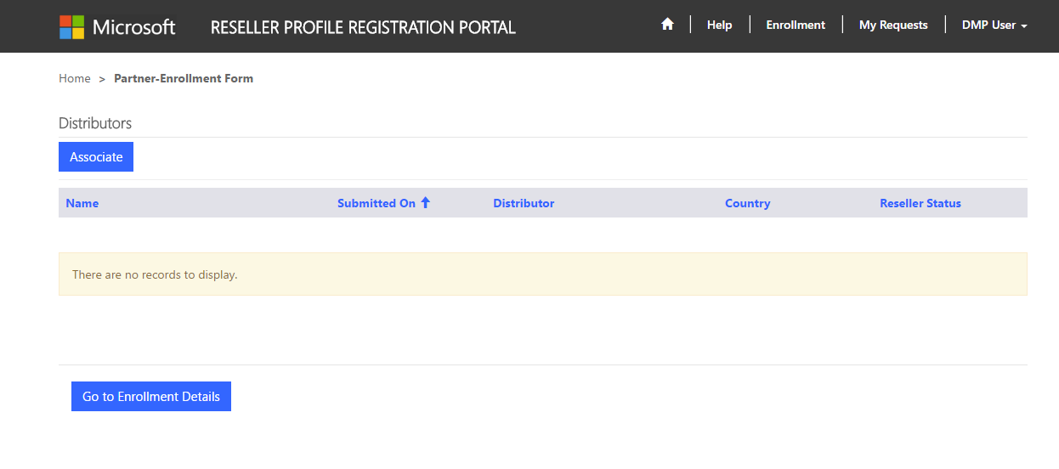
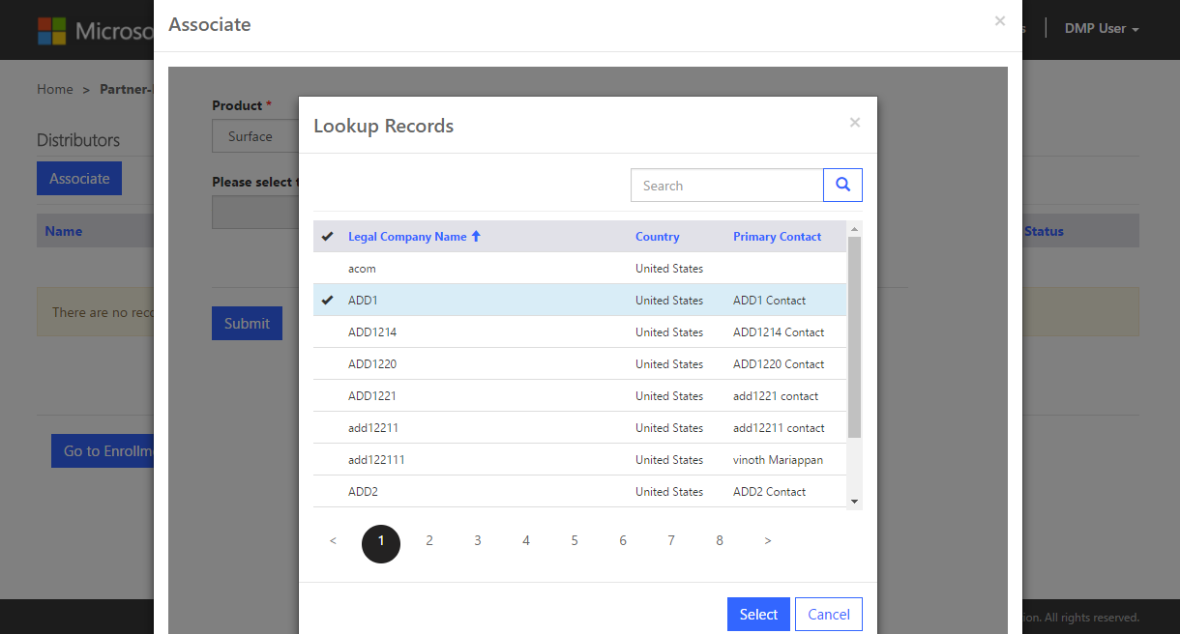
DMP: Portal Registration Step by Step
Click on the “Associate” button to find a local Distributor to create a partnership with.
Select a Distributor to request DMP partnership:
Click Submit;
To add more Distributors to the partnership request, click Associate button, select and submit again.

Slide 17
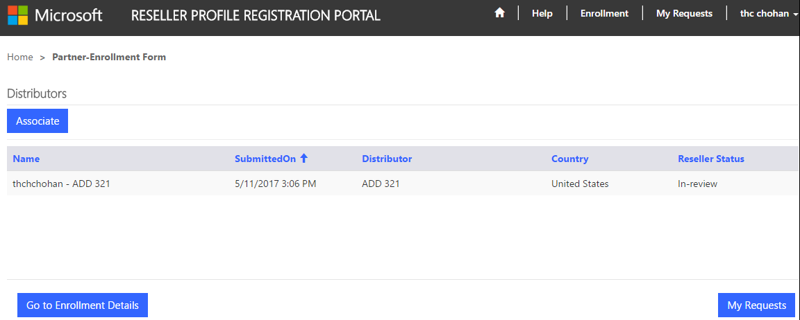
DMP: Portal Registration Step by Step
Click on “Go to Enrollment Details” button to view the enrollment details.
Click on “My Requests” Button to view all the Associations.

Slide 18
DMP: Portal Registration Step by Step
View approval status and in the “My Requests” landing page.
From: NoReply.rpr@microsoft.com Sent: Thursday, December 1, 2016 1:42 PM To: DMP Partner<dmppartner@test.com>; Subject: DMP Welcome Letter
Dear [Partner Company Name], MPN ID: [MPN ID],
We are extremely proud to officially welcome you to the Surface Disti Managed Program (DMP). You have been approved by [ADD Name] in [Location] to sell Surface. You will be receiving notification from the Microsoft Channel Incentives team for further instructions to onboard.
If you have any questions regarding the DMP Program, please contact [ADD Name] in [Location].
Thank you,
Microsoft Devices Team
Expect a notification email within 5-10 business days for your approval status. You will receive a separate approval email from each Distributor you have submitted a request through.

Slide 19
Support

Slide 20
Support
For access to the Reseller Registration and Profiling Tool click here.
If this does not cover your needs and/or technical tool support is required on the Reseller Profile and Registration Portal, please contact partnerlifecycle@microsoft.com.
*Please wait 1-2 business days for a response.

Slide 21
Partner Center Troubleshooting
Common Troubleshooting Issues

Slide 22
Partner Center Login
Troubleshooting
“Sign In” screen does NOT appear
Cause
This happens when you have another Microsoft Account cached in your IE Browser cookie history.
Solution 1
Try to open an InPrivate Browsing Window (Ctrl-Shift-P)
Go into https://partner.microsoft.com/
Solution 2
Open in regular browser window
Delete the “cookies and website data” in browser history
Open new browser and go to into https://partner.microsoft.com/
If you still don’t have access, please contact your local Regional Service Center agent for support and go to into https://partner.microsoft.com/
If you still have problems log into https://partner.microsoft.com/ and send a screen shot of the page you see to your Subsidiary Contact for assistance.

Slide 23
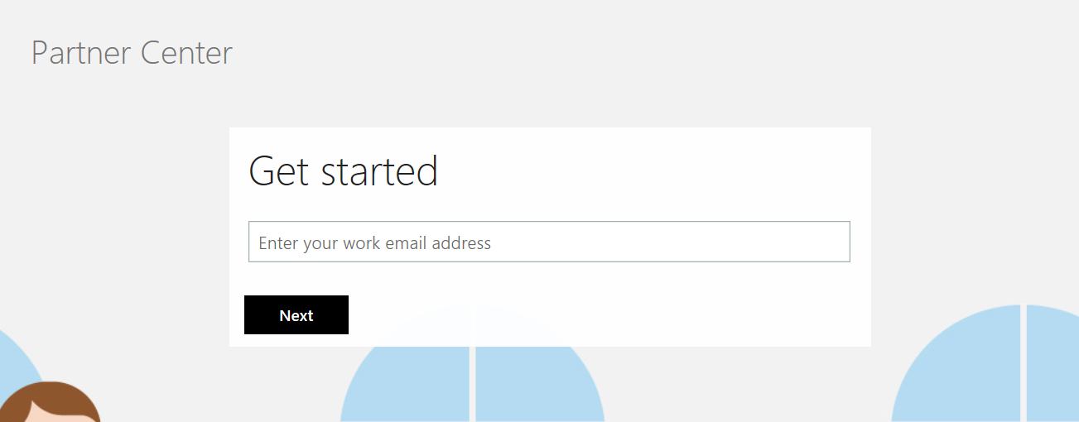
Create a Tenant: Step 1
How do I create a tenant in Partner Center?
Visit https://signup.microsoft.com/signup?sku=StoreForBusinessIW&origin=partnerdashboard&culture=en-us&ru=https://partner.microsoft.com/dashboard/account/v3/xpu/onboard?ru=/en-us/dashboard/account/v3/enrollment/companyprofile/basicpartnernetwork/new
Type in your work email ID
Click Next
Important: if your Organization already has an existing tenant, please do not create a new tenant, as this will cause a duplicate to be created in Partner Center. Instead, if your Organization has an existing tenant, simply reach out to your Organization’s Administrator and they will add you to the tenant.

Slide 24
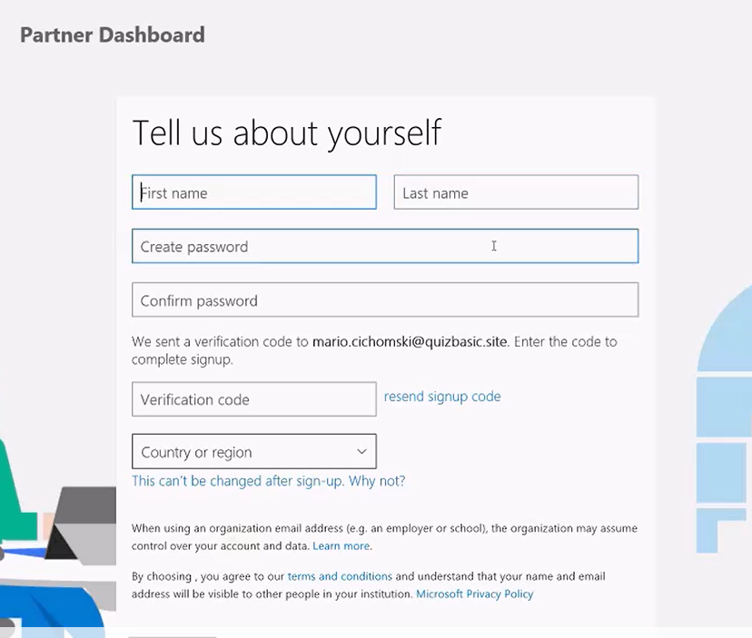
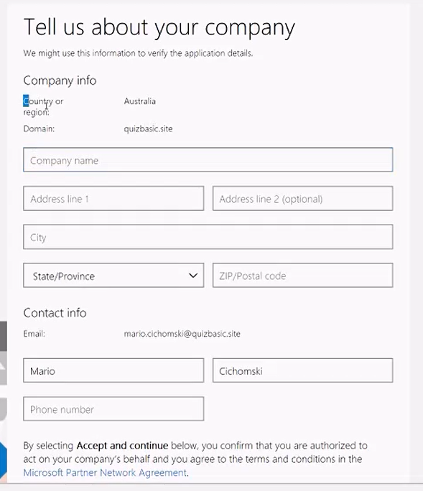
Create a Tenant: Step 2
How do I create a tenant in Partner Center?
Fill in all the details about your company
Submit the form once completed
Fill in all the required details
You will receive an email in your inbox for a Verification code
Click Next to proceed

Slide 25
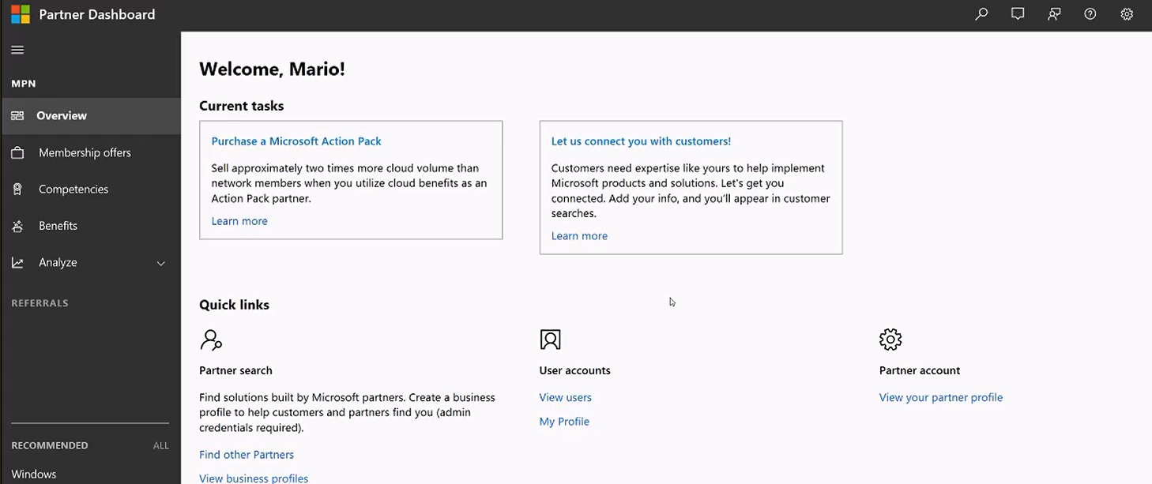
Create a Tenant: Step 3
How do I create a tenant in Partner Center?
You will land on a page similar to the one above
Partner Center registration is complete!

Slide 26
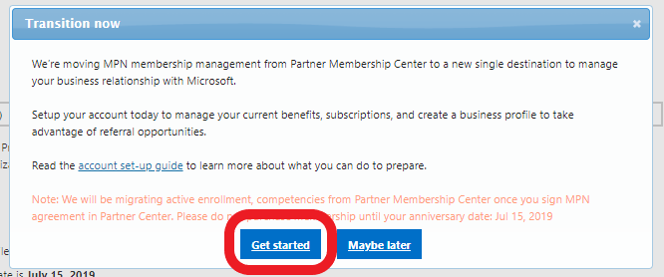
Migrate Membership: Step 1
How do I migrate to Partner Center from the Partner Membership Center?
Login to the Partner Membership Center using the ID associated with your company’s MPN ID.
If your organization has not migrated, you’ll receive the message to the right.
Select Get started to begin the migration.
https://partners.microsoft.com
This will take you to a welcome page pictured to the right.
Select Next to continue.

Slide 27
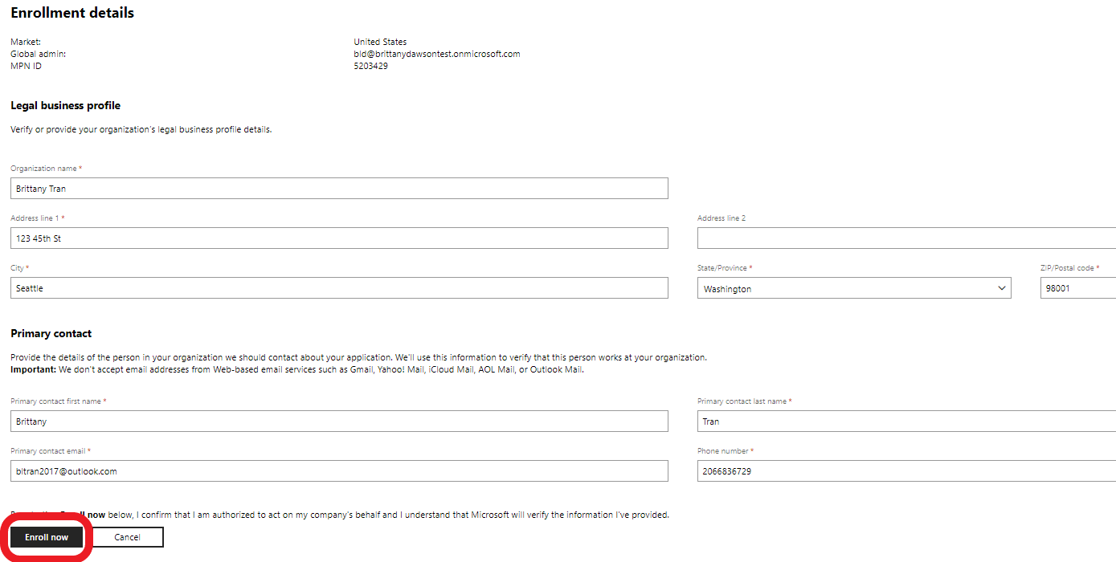
Migrate Membership: Step 2
How do I migrate to Partner Center from the Partner Membership Center?
The next page will ask you to sign in with you work account.
Note: It is very import that you sign in with the same ID you use for Office 365, Microsoft Azure, Microsoft Dynamics CRM. For further details you can Learn More here.
When ready to sign in click the Sign In option pictured to the right. migration.
If your sign is successful, you’ll be taken to an Enrollment details page.
Ensure all the details are correct and filled out.
Note: Please ensure you have access to the Primary Contact email as it will receive a verification email to validate the account.
Click Enroll now to continue.

Slide 28
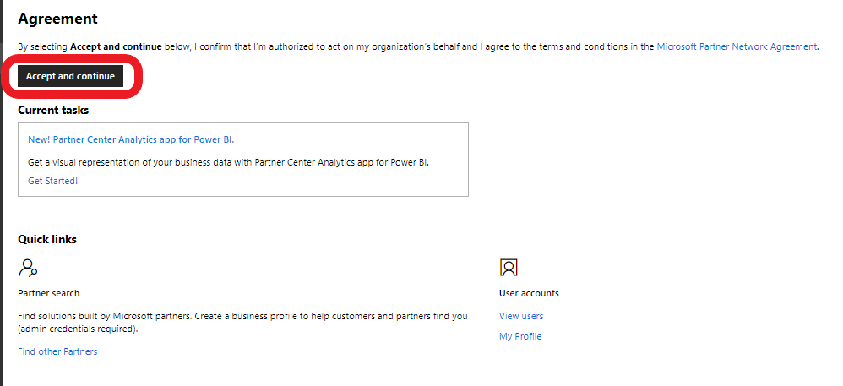
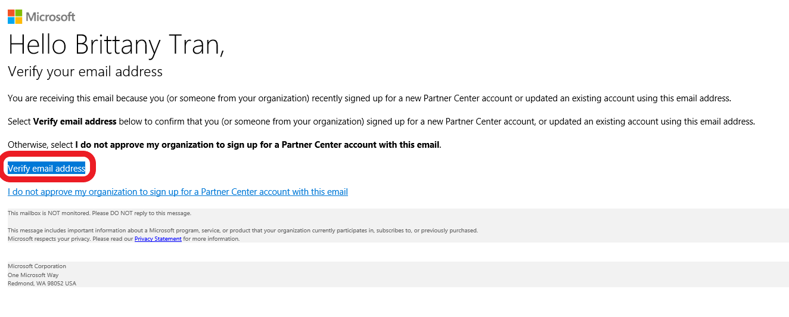
Migrate Membership: Step 3
How do I migrate to Partner Center from the Partner Membership Center?
On the next page review the terms and conditions by clicking the link Microsoft Partner Network Agreement and accept them by selecting Accept and Continue.
The last step is to have the primary contact verify their email address. They should receive an email similar to the one on the right. They can verify their account by selecting the Verify email address link.
Once complete, your migration is complete. You can now begin using Partner Center to things such as:
Setup your team (this will not be migrated over with the company migration)
Update your profile
Check your organizations competency status
Connect with customers
Purchase a Microsoft Action Pack
Note: This will now be your new site to manage your MPN ID. You will no longer need to access the Partner Membership Center.

