Slide 1
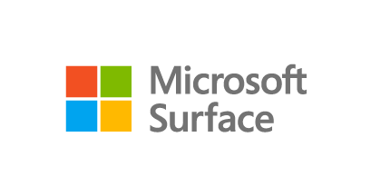
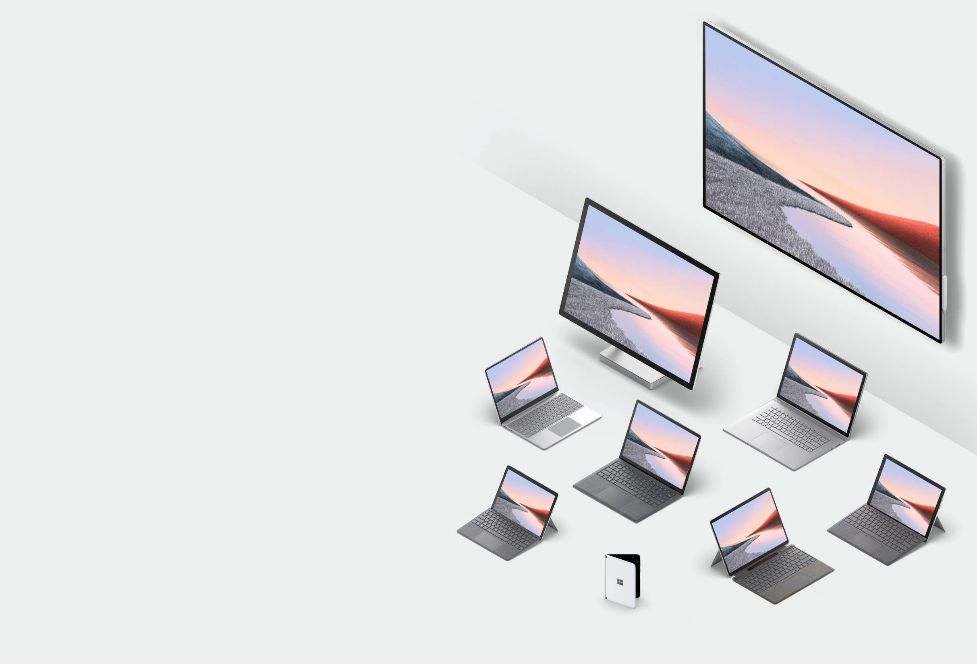
Microsoft Surface Security |
Built-in, fully integrated, chip to cloud protection
Speaker/ Presenter name
Notes:
DAVID
With the shift to remote work, while enabling your entire team work remotely, you can enjoy the confidence that your data, devices and users’ identities are protected with todays secure PCs.
It seems that with each passing week, more stories of security breaches and data leaks hit the news cycle, with each incident affecting more and more people than before. Certain industries such as healthcare, financial services, and government are especially vulnerable as they deal with personal, confidential information on the scale of tens of millions of people.
As a result, software solutions and applications for security are top considerations for IT decision-makers. These considerations include the deployment of solutions to address specific concerns including endpoint protection and data loss prevention.
Modern evolving cyberthreats leverage a variety of attack vectors, most of which can be prevented at the software layer. However, today’s software solutions have reached a limitation for comprehensive security and can’t adequately resolve vulnerabilities. Known major cyberthreats are increasingly targeting the firmware and pre-OS layers of computer systems, precisely because anti-malware software isn’t running yet. The National Institute of Standards and Technology’s (NIST) National Vulnerability Database has seen a five-fold increase in the number of firmware vulnerabilities. The crucial moments before the operating system and its protections are loaded present a tremendous risk and opportunity for malware to strike, and hackers are knowingly designing malware to leverage this attack vector. While software solution limitations are known, and hardware solutions may indeed help, the need for a holistic, integrated “out of the box” solution cannot be understated. Hardware and software working together to create a strong security posture may be the only proactive way forward, given the scope and risks of modern cyberthreats.

Slide 2

Today’s workplace needs an integrated security solution
Organizations are pivoting to remote work
Current network infrastructures were not built with today’s security in mind
Increasingly sophisticated and targeted attacks
Customers need an added layer of security to ensure comprehensive protection as adapting to remote work.
Organizations are pivoting to remote work
Current network infrastructures were not built with today’s security in mind
Increasingly sophisticated and targeted attacks, specifically at a firmware level
Customers need an added layer of security to ensure comprehensive protection as they adapt to remote work
Notes:
With the shift to remote work, while enabling your entire team work remotely, you can enjoy the confidence that your data, devices and users’ identities are protected with todays secure PCs.
It seems that with each passing week, more stories of security breaches and data leaks hit the news cycle, with each incident affecting more and more people than before. Certain industries such as healthcare, financial services, and government are especially vulnerable as they deal with personal, confidential information on the scale of tens of millions of people.
As a result, software solutions and applications for security are top considerations for IT decision-makers. These considerations include the deployment of solutions to address specific concerns including endpoint protection and data loss prevention.
Modern evolving cyberthreats leverage a variety of attack vectors, most of which can be prevented at the software layer. However, today’s software solutions have reached a limitation for comprehensive security and can’t adequately resolve vulnerabilities. Known major cyberthreats are increasingly targeting the firmware and pre-OS layers of computer systems, precisely because anti-malware software isn’t running yet. The National Institute of Standards and Technology’s (NIST) National Vulnerability Database has seen a five-fold increase in the number of firmware vulnerabilities. The crucial moments before the operating system and its protections are loaded present a tremendous risk and opportunity for malware to strike, and hackers are knowingly designing malware to leverage this attack vector. While software solution limitations are known, and hardware solutions may indeed help, the need for a holistic, integrated “out of the box” solution cannot be understated. Hardware and software working together to create a strong security posture may be the only proactive way forward, given the scope and risks of modern cyberthreats.

Slide 3
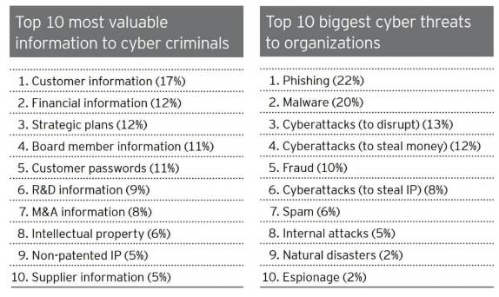
The increasing costs of data breaches
$3.86M USD
$123B
USD
190
DAYS
$10B
USD
average total cost of data breach to companies worldwide, +6.4% from 2017 ¹
was spent worldwide for information security in 2020 ²
average mean time it takes to identify a data breach ¹
will be spent globally on security awareness training for employees in 2027 ³
¹NASCIO, Ponemon Institute’s 2018 Cost of a Data Breach Study, September 2018. . ²Gartner Forecasts Worldwide Security and Risk Management Spending Growth to Slow but Remain Positive in 2020, June 17, 2020 ³https://www.cpomagazine.com/cyber-security/11-eye-opening-cyber-security-statistics-for-2019, June 2019.
Notes:
It’s no secret that security is expensive. And the costs keep going up, whether you’re responding to a data breach or trying to ensure that your systems and employees are protected:
Data shows that in the 190 days that it takes, on average, to identify a data breach. The total cost to companies worldwide in 2018 was nearly 4 million dollars.
Meanwhile, companies are spending over $124 billion to keep their systems and infrastructure secure in 2019 alone and by 2027 are expected to spend another $10 billion on security awareness training for their employees.

Slide 4




Did you know? Security effects more than just IT
C-Suite &
Finance
Product Development
HR & Operations
Legal
40%
96%
24x
LAWSUITS & FINES
Three years after an attack, breached companies underperform the index by a margin of over 40%. ⁴
96% of cybercriminals attack to gather intelligence such as proprietary IP. ⁴
The average cost of downtime is 24 times higher than the average ransom amount. ⁴
Companies can be sued by customers whose PII has been stolen; and fined by regulatory agencies. ¹¹
¹ 300+ Terrifying Cybercrime and Cybersecurity Statistics & Trends [2020] EDITION] – Comparitech, July 2020, https://www.comparitech.com/vpn/cybersecurity-cyber-crime-statistics-facts-trends/
² https://www.blackstratus.com/risk-liability-assessment/
Notes:
IT isn’t the only department to suffer when security is breached.
Breached companies recover to NASDAQ’s pre-breach performance level after 38 days on average, but three years after the breach they still underperform the index by a margin of over 40% (4)
The most likely reason for an organization to experience a targeted attack was intelligence gathering, which is the motive for 96 percent of groups. (4)
The average cost of downtime is 24 times higher than the average ransom amount. (4)
On top of the immediate costs of a cyber attack, the legal costs can be even more concerning. Companies can be sued by customers whose personal information has been stolen, and many businesses are fined by regulatory agencies if a breach is determined to have happened due to negligence. (11)
REFERENCES
300+ Terrifying Cybercrime and Cybersecurity Statistics & Trends [2020] EDITION] – Comparitech, July 2020, https://www.comparitech.com/vpn/cybersecurity-cyber-crime-statistics-facts-trends/
https://www.blackstratus.com/risk-liability-assessment/

Slide 5



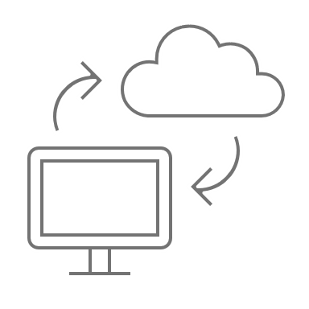
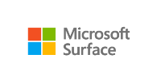
There is a clear need for device protection.
Conditional Access
Windows Update for Business
Microsoft Defender ATP
MDM UEFI Management
Cloud
Remotely monitor, control, & respond.
The answer? Layered security with Microsoft Surface.
Microsoft-designed & built components
+
Factory-level security protocols & inspection
+
Advanced Windows Security factory enabled
+
Ultimate control via remote device management
=
Highly Secure Surface PC
Every layer of Surface from chip to cloud is developed and maintained by Microsoft, giving you ultimate control, proactive protection, and peace of mind wherever and however work gets done.
Click each circle to expand
Notes:
We build our devices from the ground up to be the most secure device and keep them up to date to ensure you are protected for the lifetime of the device, not just the day you buy it.
We make sure our hardware, firmware, drivers and Operating System undergo thorough security design and inspection before shipping them to you.
We then utilize Windows update to make sure you are up to date from any new emerging threats.
Our cloud managed Device Firmware Configuration Interface gives you comfort that you can manage your enterprise in today’s world where many of your employees are remote and not directly on your network.

Slide 6
There is a clear need for device protection.
Conditional Access
Windows Update for Business
Microsoft Defender ATP
MDM UEFI Management
Cloud
Remotely monitor, control, & respond.
The answer? Layered security with Microsoft Surface.
Microsoft built UEFI for Boot Security and Firmware Management
TPM 2.0 Security Processor to ensure data protection
Microsoft-designed & built components
Highly Secure Surface PC
Windows 10 and Microsoft 365 Defender enterprise defense suite, built-in is better than bolt-on
Every layer of Surface from chip to cloud is developed and maintained by Microsoft, giving you ultimate control, proactive protection, and peace of mind wherever and however work gets done.
Notes:
We build our devices from the ground up to be the most secure device and keep them up to date to ensure you are protected for the lifetime of the device, not just the day you buy it.
We make sure our hardware, firmware, drivers and Operating System undergo thorough security design and inspection before shipping them to you.
We then utilize Windows update to make sure you are up to date from any new emerging threats.
Our cloud managed Device Firmware Configuration Interface gives you comfort that you can manage your enterprise in today’s world where many of your employees are remote and not directly on your network.

Slide 7
There is a clear need for device protection.
Conditional Access
Windows Update for Business
Microsoft Defender ATP
MDM UEFI Management
Cloud
Remotely monitor, control, & respond.
The answer? Layered security with Microsoft Surface.
Component inspection and testing at final assembly locations
Use of Microsoft developed & maintained firmware, drivers and OS
Factory-level security protocols & inspection
Highly Secure Surface PC
Secure logistics to Microsoft resellers
Every layer of Surface from chip to cloud is developed and maintained by Microsoft, giving you ultimate control, proactive protection, and peace of mind wherever and however work gets done.
Notes:
We build our devices from the ground up to be the most secure device and keep them up to date to ensure you are protected for the lifetime of the device, not just the day you buy it.
We make sure our hardware, firmware, drivers and Operating System undergo thorough security design and inspection before shipping them to you.
We then utilize Windows update to make sure you are up to date from any new emerging threats.
Our cloud managed Device Firmware Configuration Interface gives you comfort that you can manage your enterprise in today’s world where many of your employees are remote and not directly on your network.

Slide 8
There is a clear need for device protection.
Conditional Access
Windows Update for Business
Microsoft Defender ATP
MDM UEFI Management
Cloud
Remotely monitor, control, & respond.
The answer? Layered security with Microsoft Surface.
Virtualization-based security (VBS) to separate applications and data from the core of Windows 10
Secure Boot and Boot Guard to ensure Windows 10 is authentic
Advanced Windows Security factory enabled
Highly Secure Surface PC
Bitlocker to secure and encrypt your data and Windows Hello to enable password-less login
Every layer of Surface from chip to cloud is developed and maintained by Microsoft, giving you ultimate control, proactive protection, and peace of mind wherever and however work gets done.
Notes:
We build our devices from the ground up to be the most secure device and keep them up to date to ensure you are protected for the lifetime of the device, not just the day you buy it.
We make sure our hardware, firmware, drivers and Operating System undergo thorough security design and inspection before shipping them to you.
We then utilize Windows update to make sure you are up to date from any new emerging threats.
Our cloud managed Device Firmware Configuration Interface gives you comfort that you can manage your enterprise in today’s world where many of your employees are remote and not directly on your network.

Slide 9
There is a clear need for device protection.
Conditional Access
Windows Update for Business
Microsoft Defender ATP
MDM UEFI Management
Cloud
Remotely monitor, control, & respond.
The answer? Layered security with Microsoft Surface.
Complete device management through the cloud via Microsoft Endpoint Manager (MEM)
Automatic Updates from Windows Update for Business
Ultimate control via remote device management
Highly Secure Surface PC
Granular firmware management to disable components pre-boot via MEM
Every layer of Surface from chip to cloud is developed and maintained by Microsoft, giving you ultimate control, proactive protection, and peace of mind wherever and however work gets done.
Notes:
We build our devices from the ground up to be the most secure device and keep them up to date to ensure you are protected for the lifetime of the device, not just the day you buy it.
We make sure our hardware, firmware, drivers and Operating System undergo thorough security design and inspection before shipping them to you.
We then utilize Windows update to make sure you are up to date from any new emerging threats.
Our cloud managed Device Firmware Configuration Interface gives you comfort that you can manage your enterprise in today’s world where many of your employees are remote and not directly on your network.

Slide 10
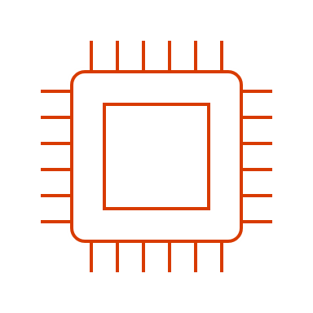





Why firmware defense matters
!
Jan 2018
Spectre & Meltdown vulnerability at processor level of all x86, PowerPC and select ARM devices.
!
Jan 2019
ShadowHammer supply chain attack against ASUS firmware infecting > 1M devices.
!
Sept 2020
Does your organization have a firmware defense strategy in place?
MosaicRegressor is identified as a bootkit that over-writes the UEFI and is used for espionage and data exfiltration.
!
Sept 2020
US National Security Agency (NSA) issues technical report recommending Secure Boot and protections for UEFI/Firmware.
!
Dec 2020
Trickbot malware begins to target UEFI vulnerabilities to overwrite firmware and takeover OS as a bootkit.
Notes:
MARK
In the Microsoft devices group security is built into our DNA.
We build our devices from the ground up to be the most secure device and keep them up to date to ensure you are protected for the lifetime of the device, not just the day you buy it. We make sure our hardware, firmware, drivers and Operating System undergo thorough security design and inspection before shipping them to you.
We then utilize Windows update to make sure you are up to date from any new emerging threats.
We are continuously working with our friends in David’s Operating System group, and our silicon and hardware partners, to innovate and raise the bar on security.
Back when we shipped Surface Pro4 we had a fantastic on-prem device management solution called SEMM (which is still available today) but over the last few years we have built our cloud managed Device Firmware Configuration Interface. This gives you comfort that you can manage your enterprise in today’s world where many of your employees are remote and not directly on your network.

Slide 11

Chip to cloud security is built-in to Surface DNA
Hardware
Defend against hardware & supply chain attacks
Firmware
Ensure each stage in the boot cycle launches authentic code
Operating System
Protect identities & defend against malicious drivers
Cloud
Remotely prevent, detect & respond
TPM 2.0
BitLocker
Windows Hello
Microsoft UEFI*
Surface Enterprise Mgmt Mode (SEMM)* Intune (DFCI)*
Advanced Windows
Security Features (HVCI/VBS)
Secure Boot enabled by default
Microsoft 365 Defender
Windows Update for Business
Conditional Access
MDM UEFI Management*
*Exclusive to Surface
Notes:
With Microsoft devices, security is built into our DNA. Microsoft Defender for Endpoint (Microsoft 365 Defender)
It all starts with the hardware and understanding if someone has tampered with the device, then the firmware or bios all the way through to the cloud tools that can help you protect the endpoint from potential vulnerabilities. This is what we mean when we refer to ‘chip to cloud security my Microsoft’. It’s Microsoft DNA from the components all the way through to the cloud management tools.
First of all, we start with the…
TPM (Trusted Platform Module): Available on Surface - Protecting the hardware from being tampered with. Quickly and easily encrypt your data, enabling access only by authorized individuals, with a physical Trusted Platform Module (TPM)² on Surface devices, or for the Surface Go
UEFI (Unified Extensible Firmware Interface): Available on Surface - (https://support.microsoft.com/en-gb/help/4023531/surface-how-to-use-surface-uefi) Protecting the firmware from malicious attacks. Maintained by Microsoft,¹ so that from the time the power button is pressed to the time that the operating system boots, organizations can avoid a critical vulnerability point and be assured that the latest UEFI updates are pushed out.
DFCI (Device Firmware Configuration Interface): Exclusively with Surface (https://docs.microsoft.com/en-us/surface/surface-manage-dfci-guide). This is important to note that this is exclusive ‘with Surface’ because this solution is born from the Microsoft cloud offerings and enabled fast cloud deployment and management down to the firmware and component level. Benefit for those using AutoPilot via InTune, perfect for cloud first deployment, management and end of user decommission from your IT admin. There is an on prem offering, SEMM = Physically needs to be done for deployment, traditional deployment – gives slightly more control over what can be disabled. Preferred by some more secure environment.
*SEMM – Preferred by local administration organisations. Functionally the same (UEFI management), turn the driver off (before it boots.
SOURCE/Notations:
¹ Surface Pro X uses a firmware TPM.
² Surface Go and Surface Go 2 use a third-party UEFI and do not support DFCI. DFCI is currently available for Surface Book 3, Surface Laptop 3, Surface Pro 7, and Surface Pro X. Find out more about managing Surface UEFI settings.
BACK UP:
In contrast to other Windows 10 devices available in the market today, Surface provides IT admins with the ability to configure and manage firmware through a rich set of UEFI configuration settings. This provides a layer of hardware control on top of software-based policy management as implemented via mobile device management (MDM) policies, Configuration Manager or Group Policy. For example, organizations deploying devices in highly secure areas with sensitive information can prevent camera use by removing functionality at the hardware level. From a device standpoint, turning the camera off via a firmware setting is equivalent to physically removing the camera. Compare the added security of managing at the firmware level to relying only on operating system software settings. For example, if you disable the Windows audio service via a policy setting in a domain environment, a local admin could still re-enable the service.

Slide 12
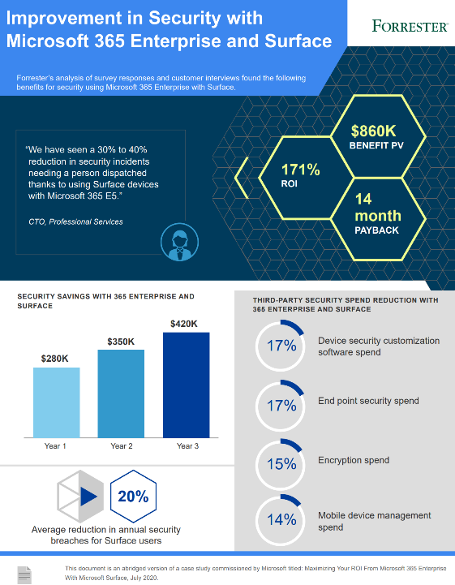





Reduce risk and lower costs with Microsoft 365–powered Surface devices
20%
reduction
in security breaches
for Surface users
17%
reduction
in endpoint security
spend
14%
reduction
in mobile device
management spend
Source: A commissioned Total Economic Impact™ study conducted by Forrester Consulting on behalf of Microsoft, July 2020. “Maximizing Your ROI from Microsoft 365 Enterprise With Microsoft Surface.”
Notes:
Choose proof points, play them back to the customer for the ones that suit their needs
NEXT SLIDES: Internal case studies (don’t share these externally). New external case studies coming soon.
Source:
Forrester Consulting Total Economic Impact™ Study: Maximizing your ROI from Microsoft 365 Enterprise with Microsoft Surface, 2020
https://opdhsblobprod04.blob.core.windows.net/contents/c431470c962e48af91a266cb2568e19a/212ed46cc3ed4343cab7522d671efdfc?sv=2018-03-28&sr=b&si=ReadPolicy&sig=bdSGonaSINWsEgCIJDdFhQcmkCetXfBordmE7qcBTx8%3D&st=2020-10-05T15%3A55%3A55Z&se=2020-10-06T16%3A05%3A55Z

Slide 13

Surface Secure: the gold standard in endpoint security
Windows Enhanced Hardware Security features enabled out of the box to protect against malicious code
Complete Cloud-based device management and updates from OS to firmware to reduce IT complexity
Security processor protections; BitLocker to secure & encrypt your data and Windows Hello for password-less login
Microsoft written, open source UEFI (BIOS) to ensure authenticity of firmware and Windows 10
Notes:
To address the need for strong security for industries handling Personal Identifiable Information (PII) and confidential data, Microsoft has created highly secure Surface PCs, and has partnered with leading PC manufacturers to innovate a new class of secured devices (secured-core PCs) to counter security challenges for industries requiring mission-critical data protection right out of the box.
Unlike software-only security solutions, both Surface devices and secured-core PCs are designed to prevent attacks, rather than simply detecting them, and are resistant to future attacks by utilizing a comprehensive and hardware-integrated security solution.
By leveraging advanced hardware security capabilities and reducing the firmware attack surface, Microsoft has helped enable device to cloud security which extends the identity and security protections like BitLocker and Windows Defender Antivirus that businesses have come to expect from Windows 10 Professional—all while enabling a great breadth of device choices.
Both Surface PCs provide the highest level of end-point security through integrated hardware, firmware, software, and identity protection.
BACKUP:
Secured Core PC is a response to the build out of partner OEM devices that implement heterogeneous solutions across multiple vendors; UEFI (BIOS) from third parties such as AMI, processors from multiple vendors and operating systems from Microsoft. To ensure the root of trust in these solutions processors safeguard at a hardware level that legitimate code is booted.
Surface accomplishes an equal level of trust by providing an integrated UEFI firmware and Windows operating system stack, all from Microsoft, that can be managed and updated through the cloud from the first moment the device is turned on and deployed through modern tools such as Autopilot.
Both Surface and Secured Core PCs provide the highest level of end-point security through integrated hardware, firmware, software, and identity protection.

Slide 14


 | Surface Devices | Secured Core PCs
Protect with hardware root of trust
Defend against firmware level attack
Prevent access to unverified code
Protect identities from external threats
Microsoft Surface & Secured Core PCs
Different approaches but the same result: best-in-class endpoint security from Microsoft.
Notes:
Surface Secure & Secured Core PCs
Secured Core PC is a response to the build out of partner OEM devices that implement heterogeneous solutions across multiple vendors; UEFI (BIOS) from third parties such as AMI, processors from multiple vendors and operating systems from Microsoft. To ensure the root of trust in these solutions processors safeguard at a hardware level that legitimate code is booted.
Surface accomplishes an equal level of trust by providing an integrated UEFI firmware and Windows operating system stack, all from Microsoft, that can be managed and updated through the cloud from the first moment the device is turned on and deployed through modern tools such as Autopilot.
Both Surface and Secured Core PCs provide the highest level of end-point security through integrated hardware, firmware, software, and identity protection.

Slide 15


Microsoft Surface & Secured Core PCs
Different approaches but the same result: best-in-class endpoint security from Microsoft.
Protect with hardware root of trust
Defend against firmware level attack
Prevent access to unverified code
Protect identities from external threats
Surface Devices
Surface’s Root of Trust checks signatures and measurements at each stage to tightly ensure each stage is secure and authentic before allowing the next phase of boot to proceed.
Microsoft builds its own firmware from the ground up, rather than relying on 3rd party source code. This allows Microsoft to continuously provides updates, down to the firmware level to protect against the latest threats.
With Hypervisor Code Integrity (HVCI), Windows 10 devices are protected from running any unverified code. Code running within the trusted computing base runs with integrity and is not subject to exploits or attacks.
Protect Identities from external threats with Windows Hello². Credential Guard ensures that identity and domain credentials are isolated and protected in a secure environment.
Secured Core PCs
Partnering with leading PC manufacturers and silicon vendors, secured-core PCs use industry standard hardware root of trust coupled with security capabilities built into today’s modern CPUs.
Secured-core PCs use hardware rooted security in the modern CPU to launch the system into a trusted state, preventing advanced malware from tampering with the system and attacking at the firmware level.
Notes:
² To use Windows Hello with biometrics specialized hardware, including fingerprint reader, illuminated IR sensor, or other biometric sensors is required. Hardware based protection of the Windows Hello credential/keys requires TPM 1.2 or greater; if no TPM exists or is configured, credentials/keys protection will be software-based.

Slide 16
Surface Security Specifications
Security Feature | W10 O/S Feature | Surface + OEMs | Surface only | What does it mean?
Custom Built UEFI |  |  | Yes ¹ | Replaces the standard basic input/output system (BIOS) with new features including faster startup and improved security. The Unified Extensible Firmware Interface (UEFI) — built by Microsoft without third-party involvement — ensures significantly more control over the hardware of a device and speedier react times. ¹
DCFI (Device Firmware Configuration Interface) |  |  | Yes ² | Delivers cloud-scale remote firmware management with zero-touch device provisioning. Microsoft’s own UEFI allows stronger DCFI implementation, enabling organizations to disable hardware elements and remotely lock UEFI using Intune. ¹
Protected DMA Access |  |  | Yes | Mitigates potential security vulnerabilities associated with using removable SSDs or external storage devices. Newer Surface devices come with DMA Protection enabled by default.
Surface Data Eraser |  |  | Yes | Provides a bootable USB tool to securely wipe data from your Surface devices.
SEMM (Surface Enterprise Management Mode) |  |  | Yes | Enables centralized enterprise engagement of UEFI firmware settings across on-premises, hybrid, and cloud environments.¹
Removable SSD |  | Yes | Yes ³ | Helps organizations protect their data and comply with data retention policies.
Physical TPM 2.0 |  | Yes |  | Uses a physical, discrete TPM 2.0 chip, implementing a secure and sandboxed environment for storing passwords, PIN numbers, and certificates.
BitLocker | Yes | Yes | Yes | Combined with physical TPM and UEFI, provides a significantly improved and integrated encryption solution.
[1] Surface Go and Surface Go 2 use a third party UEFI and do not support DFCI. DFCI is currently available for Surface Laptop Go, Surface Book 3, Surface Laptop 3, Surface Pro 7, and Surface Pro X. about managing Surface UEFI settings.
[2] DFCI is currently available for Surface Laptop Go, Surface Book 3, Surface Laptop 3, Surface Pro 7, and Surface Pro X. about managing Surface UEFI settings.
[3] Removable SSD available on Surface Laptop 3, Surface Laptop Go, and Surface Pro X. Hard drive is only removable by skilled technicians following Microsoft instructions. Hard drive replacement may cause damage or safety risk and is not recommended.

Slide 17
Surface Security Specifications (contd)
Security Feature | W10 O/S Feature | Surface + OEMs | Surface only | What does it mean?
Windows Hello for Business | Yes | Yes | Yes | Replaces passwords with strong two-factor authentication on PCs and mobile devices. This authentication consists of a new type of user credential that is tied to a device and uses a biometric or PIN.
Secure Boot | Yes | Yes | Yes | Enabled by UEFI and TPM 2.0, ensures that only code signed, measured, and correctly implemented code can execute on a Surface device.
Microsoft Defender with Endpoint | Yes | Yes | Ships Enabled | Provides an enterprise endpoint security platform designed to help enterprise networks prevent, detect, investigate, and respond to advanced threats.
Windows Defender Credential Guard | Yes | Yes | Ships Enabled | Isolates and hardens key systems and user secrets, making an attack against user credentials much harder to perform.
Windows Defender Application Control | Yes | Yes | Ships Enabled | Hardens computers against malware and prevents malicious code. If code is not previously confirmed as secure, it cannot run.
[1] Surface Go and Surface Go 2 use a third party UEFI and do not support DFCI. DFCI is currently available for Surface Laptop Go, Surface Book 3, Surface Laptop 3, Surface Pro 7, and Surface Pro X. about managing Surface UEFI settings.
[2] DFCI is currently available for Surface Laptop Go, Surface Book 3, Surface Laptop 3, Surface Pro 7, and Surface Pro X. about managing Surface UEFI settings.
[3] Removable SSD available on Surface Laptop 3, Surface Laptop Go, and Surface Pro X. Hard drive is only removable by skilled technicians following Microsoft instructions. Hard drive replacement may cause damage or safety risk and is not recommended.

