Slide 1
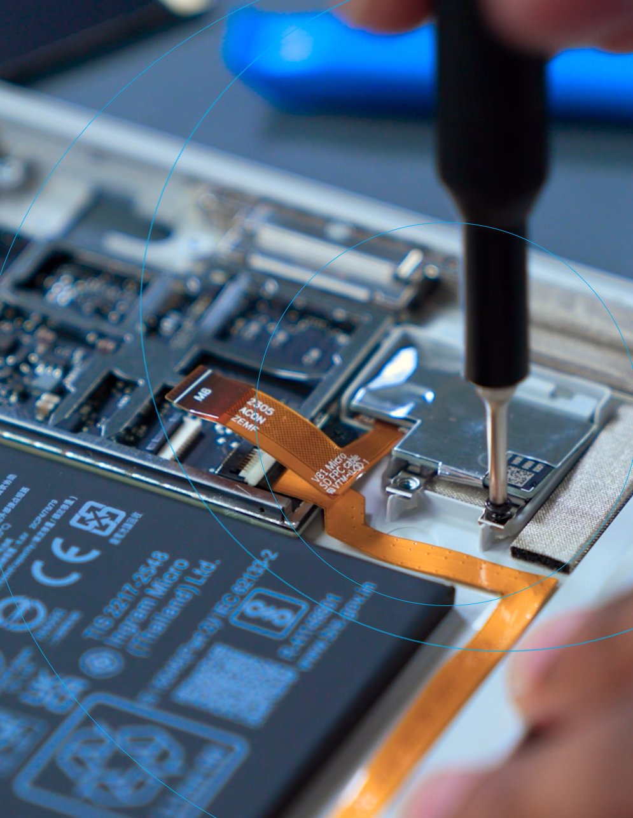
Surface Replacement Components
SKU Guide (Canada)

Slide 2
Contents
Replacement component SKUs and pricing ……..…………. 3 – 19
Surface Laptop Studio devices ……..…………. 3 – 4
Surface PRO devices ……..…………. 5 – 9
Surface Laptop Go devices .…..…………. 10 – 11
Surface Laptop devices …..…………. 12 – 17
Surface Go and other models …..…………. 18 – 19
Estimated lead times…….....…………………………………………. 20 – 22
Device repair resources
Service Guides for each repairable Surface device.
Follow expert guidance with device specific disassembly and repair videos.
Useful self-repair information and resources on Microsoft Learn.
Surface repair tools are available through iFixit.
Surface Diagnostic Toolkit for Business.
Install Surface Diagnostic Toolkit for Business.

Slide 3
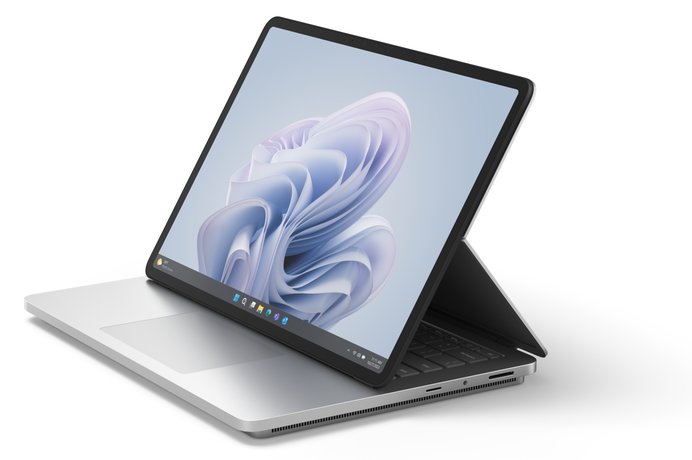
Surface Laptop Studio 2
Model 2029
Please read service guides to identify all parts needed for the repair
Replacement Component | SKU | Description | Price | Box contents
Display Assembly | Z6B-00001 | Platinum Display | $ 739.00 | Includes 1 display, TIM, cosmetic plate, adhesive, foam, and screws
rSSD | Z8F-00001 | 1TB | $ 369.00 | Includes 1 rSSD, TIM, cosmetic plate, adhesive, and screws
 | Z8H-00001 | 2TB | $ 699.00 | Includes 1 rSSD, TIM, cosmetic plate, adhesive, and screws
 | Z7N-00001 | 512GB | $ 189.00 | Includes 1 rSSD, TIM, cosmetic plate, adhesive, and screws
Feet | Z6F-00001 | Platinum Feet | $ 18.00 | Includes 2 feet
Ports & Connectors | ZNM-00002 | USB-A and USB-C | $ 52.00 | Includes 1 USB-A/USB-C module, TIM, cosmetic plate, adhesive, and screws
 | ZNM-00001 | USB-C | $ 52.00 | Includes 1 USB-C module, TIM, vanity shim, adhesive, and screws
 | Z7D-00001 | Surface Connect Charging Port | $ 52.00 | Includes 1 surface connect charging port, TIM, cosmetic plate, adhesive, and screws
 | Z6S-00001 | Audio Jack | $ 35.00 | Includes 1 audio jack, TIM, cosmetic plate, adhesive, and screws
Battery and Bucket | ZNL-00002 | Battery | $ 339.00 | Includes 1 back cover with battery, TIM, cosmetic plate, adhesive, and screws
Keyboard | Z6J-00024 | US Keyboard | $ 295.00 | 1 keyset, Cosmetic plate, TIM, adhesive, and screws
 | Z6J-00027 | Canada | $ 295.00 | 1 keyset, Cosmetic plate, TIM, adhesive, and screws
Motherboard | ZML-00002 | SrfLS2 i7/16/4050 dGPU | $ 1,459.00 | 1 Motherboard, cosmetic plate, TIM, adhesive, and screws
 | ZTP-00002 | SrfLS2 i7/16/iGPU | $ 1,459.00
 | ZMN-00002 | SrfLS2 i7/32/2000 dGPU | $ 1,769.00
 | ZMM-00002 | SrfLS2 i7/32/4050 dGPU | $ 1,769.00
 | ZCL-00002 | SrfLS2 i7/64/2000 dGPU | $ 2,079.00
 | ZCJ-00002 | SrfLS2 i7/64/4060 dGPU | $ 2,079.00
Other | ZNJ-00001 | mSD Reader | $ 69.00 | 1 SD card reader, TIM, cosmetic plate, adhesive, and screws
 | Z6H-00001 | Cosmetic Plate | $ 35.00 | 1 cosmetic plate
Device damage caused during a repair will not be covered under Microsoft’s Limited Hardware Warranty or extended protection plans.
Replacement components have a 90-day limited warranty unless the accompanying written warranty gives a longer time. Replacement components are currently only available for purchase separately, independent of the warranty status of your device. To order, see Customer self-serve repair. Replacement components may be refurbished.

Slide 4
Surface Laptop Studio
Model 1964
Please read service guides to identify all parts needed for the repair
Replacement Component | SKU | Description | Price | Box contents
Display Assembly | I85-00001 | Platinum | $ 699.00 | 1 Display and screws
rSSD | 8LV-00007 | 256GB | $ 111.99 | 1 rSSD and screws
 | 8LX-00007 | 512GB | $ 174.99 | 1 rSSD and screws
 | 8LU-00003 | 1TB | $ 332.99 | 1 rSSD and screws
 | I89-00001 | 2TB | $ 649.00 | 1 rSSD and screws
Feet | CK1-00001 | Feet | $ 17.00 | Includes 2 feet
Ports & Connectors | I8G-00001 | Charging Port | $ 49.00 | 1 surface connect charging Port and screws
 | I8D-00001 | Audio Jack | $ 33.00 | audio jack and screws
 | I8B-00001 | USB-C | $ 49.00 | 1 USB-C port and screws
Battery and Enclosure | I8K-00001 | Battery | $ 319.00 | 1 battery and screws
Keyboard | I87-00005 | Platinum | $ 270.00 | 1 Keyboard and Screws
 | I87-00008 | Platinum | $ 270.00 | 1 Keyboard and Screws
Cosmetic Plate | I8I-00001 | Cosmetic Plate | $ 17.00 | 1 Cosmetic Plate.
Device damage caused during a repair will not be covered under Microsoft’s Limited Hardware Warranty or extended protection plans.
Replacement components have a 90-day limited warranty unless the accompanying written warranty gives a longer time. Replacement components are currently only available for purchase separately, independent of the warranty status of your device. To order, see Customer self-serve repair. Replacement components may be refurbished.

Slide 5
Surface Pro 10 for Business
Please read service guides to identify all parts needed for the repair
Replacement Component | SKU | Description | Price | Box contents
Kickstand | 40V-00002 | Black | $89.00 | 1 kickstand and screws
 | 40V-00001 | Platinum | $89.00 | 1 kickstand and screws
SSD Door | 40G-00002 | Black | $49.00 | 1 door
 | 40G-00001 | Platinum | $49.00 | 1 door
rSSD | 30M-00001 | 1TB | $589.00 | 1 rSSD and screws
 | 30L-00001 | 512GB | $295.00 | 1 rSSD and screws
 | 30K-00001 | 256GB | $175.00 | 1 rSSD and screws
Display Module | 40U-00002 | Display | $589.00 | 1 display module, foam, screws, and adhesive
Cameras | 40X-00001 | Front Facing Camera | $89.00 | 1 front facing camera, foam, screws, and adhesive
 | 40Y-00001 | Rear Facing Camera | $89.00 | 1 rear facing camera, foam, screws, and adhesive
Buttons (Power&Volume) | F2O-00002 | Black | $69.00 | 1 set of power and volume buttons, button PCB, foam, screws, and adhesive.
 | F2O-00001 | Platinum | $69.00 | 1 set of power and volume buttons, foam, screws, and adhesive.
Ports and Connectors | 50B-00001 | Surface Connect Charge Port | $55.00 | 1 surface connect charge port, foam, screws, and adhesive
Motherboards | 50F-00001 | i5/16 GB | $1,199.00 | 1 motherboard, foam, screws, and adhesive
 | 50G-00001 | i5/32 GB | $1,865.00 | 1 motherboard, foam, screws, and adhesive
 | 50D-00001 | i5/8 GB | $885.00 | 1 motherboard, foam, screws, and adhesive
 | 50H-00001 | i7/16 GB | $1,525.00 | 1 motherboard, foam, screws, and adhesive
 | 50I-00001 | i7/32 GB | $2,189.00 | 1 motherboard, foam, screws, and adhesive
 | 50J-00001 | i7/64 GB | $2,835.00 | 1 motherboard, foam, screws, and adhesive
Battery | 50C-00001 | Battery | $295.00 | 1 battery, foam, screws, and adhesive
Enclosure | 50A-00002 | Black | $379.00 | 1 enclosure, foam, screws, and adhesive
 | 50A-00001 | Platinum | $379.00 | 1 enclosure, foam, screws, and adhesive
Speakers | 30S-00001 | Speakers | $55.00 | 1 right and one left speaker, foam, screws, and adhesive
Other | GOH-00001 | Device Entry Kit | $65.00 | All foam, adhesive and screws needed to gain entry into the device
 | 40Z-00001 | Microphone Module | $89.00 | 1 Microphone Module, foam, screws, and adhesive
 | 50K-00001 | Thermal Module | $89.00 | 1 thermal module, foam, screws, and adhesive
Device damage caused during a repair will not be covered under Microsoft’s Limited Hardware Warranty or extended protection plans.
Replacement components have a 90-day limited warranty unless the accompanying written warranty gives a longer time. Replacement components are currently only available for purchase separately, independent of the warranty status of your device. To order, see Customer self-serve repair. Replacement components may be refurbished.

Slide 6
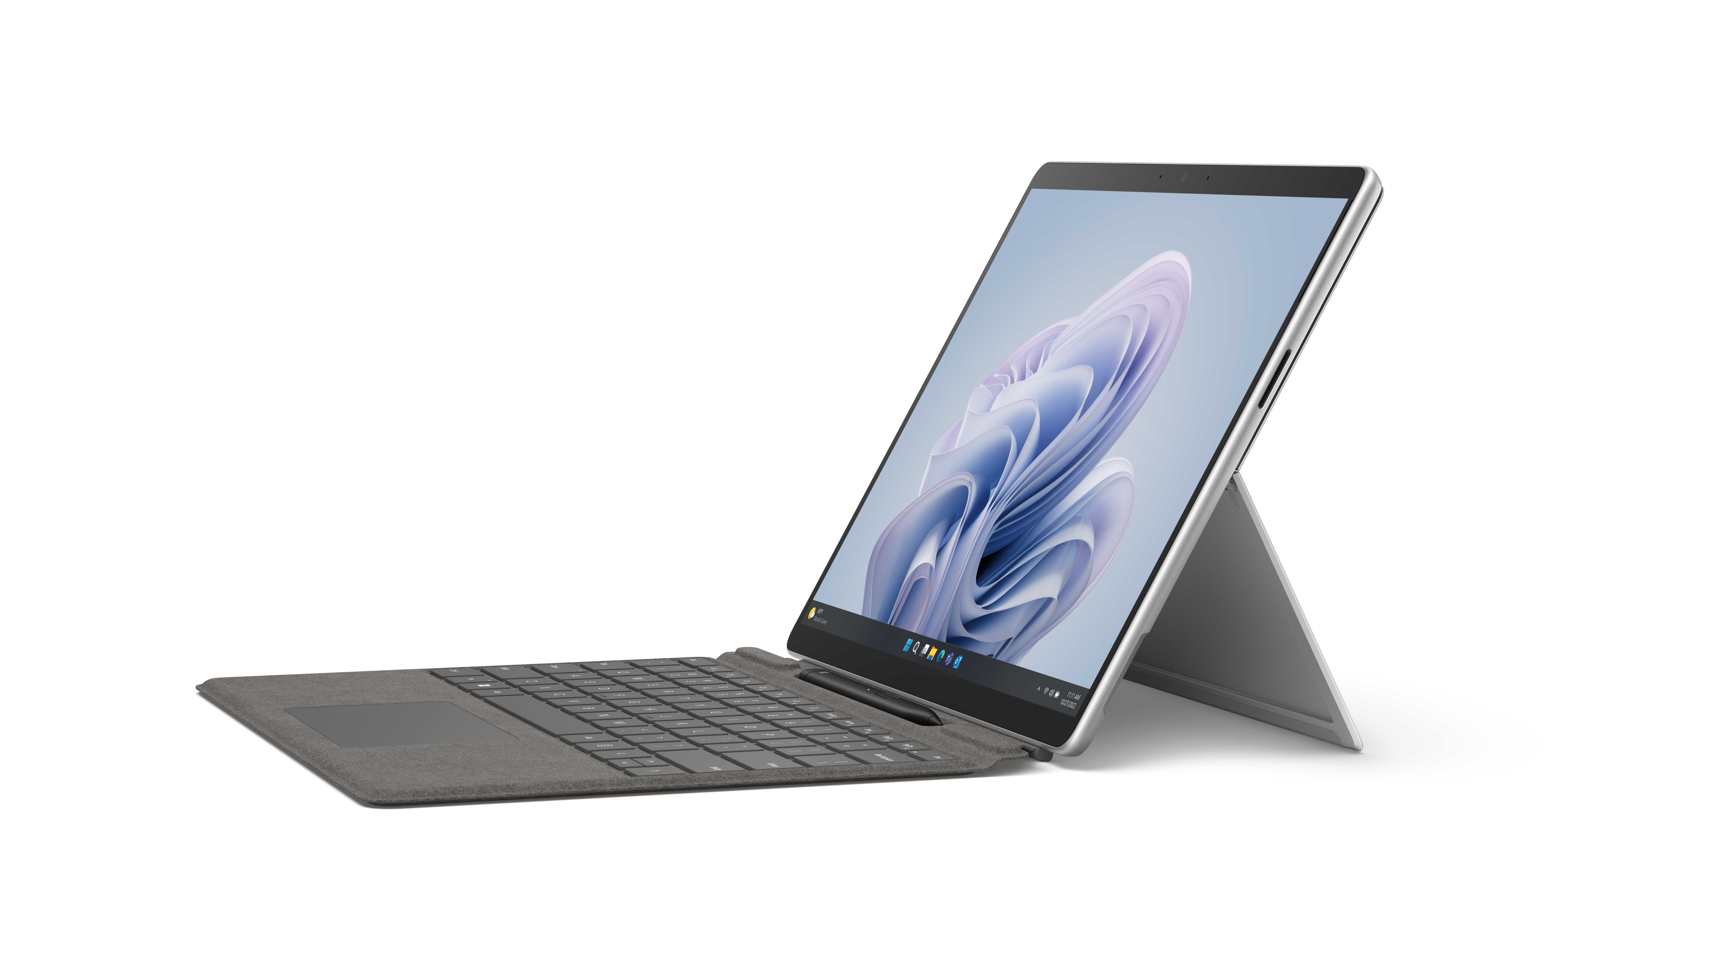
Surface Pro 9
Model 2038
Please read service guides to identify all parts needed for the repair
Replacement Component | SKU | Description | Price | Box contents
Kickstand | TIB-00001 | Platinum | $74.99 | 1 kickstand and screws.
 | TIB-00002 | Graphite | $74.99 | 1 kickstand and screws.
 | TIB-00003 | Sapphire | $74.99 | 1 kickstand and screws.
 | TIB-00004 | Forest | $74.99 | 1 kickstand and screws.
SSD Door | TIH-00001 | Platinum | $41.99 | 1 SSD Door.
 | TIH-00002 | Graphite | $41.99 | 1 SSD Door.
 | TIH-00003 | Sapphire | $41.99 | 1 SSD Door.
 | TIH-00004 | Forest | $41.99 | 1 SSD Door.
rSSD | TIC-00001 | 128GB | $106.99 | 1 rSSD and screws.
 | TID-00001 | 265GB | $122.99 | 1 rSSD and screws.
 | TIF-00001 | 512GB | $162.99 | 1 rSSD and screws.
 | TIG-00001 | 1TB | $302.99 | 1 rSSD and screws.
Display Module | TI6-00001 | Display | $459.00 | 1 Display and screws and adhesive
Cameras | WGR-00001 | Rear Camera | $162.99 | 1 rear camera, 1 thermal module, adhesive, and screws
 | WGQ-00001 | Front Camera | $162.99 | 1 front camera, 1 thermal module, adhesive, and screws
Buttons (Power&Volume) | TIM-00001 | Platinum | $65.99 | 1 set of power and volume buttons, screws, and adhesive.
 | TIM-00002 | Graphite | $65.99 | 1 set of power and volume buttons, screws, and adhesive.
 | TIM-00003 | Sapphire | $65.99 | 1 set of power and volume buttons, screws, and adhesive.
 | TIM-00004 | Forest | $65.99 | 1 set of power and volume buttons, screws, and adhesive.
Ports and Connectors | TI7-00001 | Surface Connect Charging Port | $82.99 | 1 Surface Connect Charging Port, screws and adhesive
Device damage caused during a repair will not be covered under Microsoft’s Limited Hardware Warranty or extended protection plans.
Replacement components have a 90-day limited warranty unless the accompanying written warranty gives a longer time. Replacement components are currently only available for purchase separately, independent of the warranty status of your device. To order, see Customer self-serve repair. Replacement components may be refurbished.

Slide 7
Surface Pro 9 (continued)
Model 2038
Please read service guides to identify all parts needed for the repair
Replacement Component | SKU | Description | Price | Box contents
Enclosure | WGU-00001 | Platinum | $521.99 | 1 enclosure, 1 thermal module, 1 battery, adhesive, and screws.
 | WGU-00002 | Graphite | $521.99 | 1 enclosure, 1 thermal module, 1 battery, adhesive, and screws.
 | WGU-00003 | Sapphire | $521.99 | 1 enclosure, 1 thermal module, 1 battery, adhesive, and screws.
 | WGU-00004 | Forest | $521.99 | 1 enclosure, 1 thermal module, 1 battery, adhesive, and screws.
Battery | WGN-00001 | Battery | $309.99 | 1 battery, 1 thermal module, adhesive and screws.
Speakers | TIL-00001 | Left Speaker | $65.99 | 1 left speaker, adhesive and screws
 | WGT-00001 | Left and Right Speaer | $130.99 | 1 right speaker and 1 thermal module, adhesive and screws
Other | TIA-00001 | Thermal Module+Fan | $65.99 | 1 kickstand, screws and adhesive
 | WGS-00001 | Wi-Fi and Camera Deck | $195.99 | 1 Wi-Fi and camera deck module, thermal module, screws and adhesive
Motherboard | WGP-00001 | i5 8GB | $909.99 | 1 Motherboard, 1 thermal module, adhesive and screws
 | WGP-00004 | i5 16GB | $1,171.99 | 1 Motherboard, 1 thermal module, adhesive and screws
 | WGP-00009 | i7 32GB | $1,561.99 | 1 Motherboard, 1 thermal module, adhesive and screws
 | WGP-00012 | i7 16GB | $1,299.99 | 1 Motherboard, 1 thermal module, adhesive and screws
Device damage caused during a repair will not be covered under Microsoft’s Limited Hardware Warranty or extended protection plans.
Replacement components have a 90-day limited warranty unless the accompanying written warranty gives a longer time. Replacement components are currently only available for purchase separately, independent of the warranty status of your device. To order, see Customer self-serve repair. Replacement components may be refurbished.

Slide 8
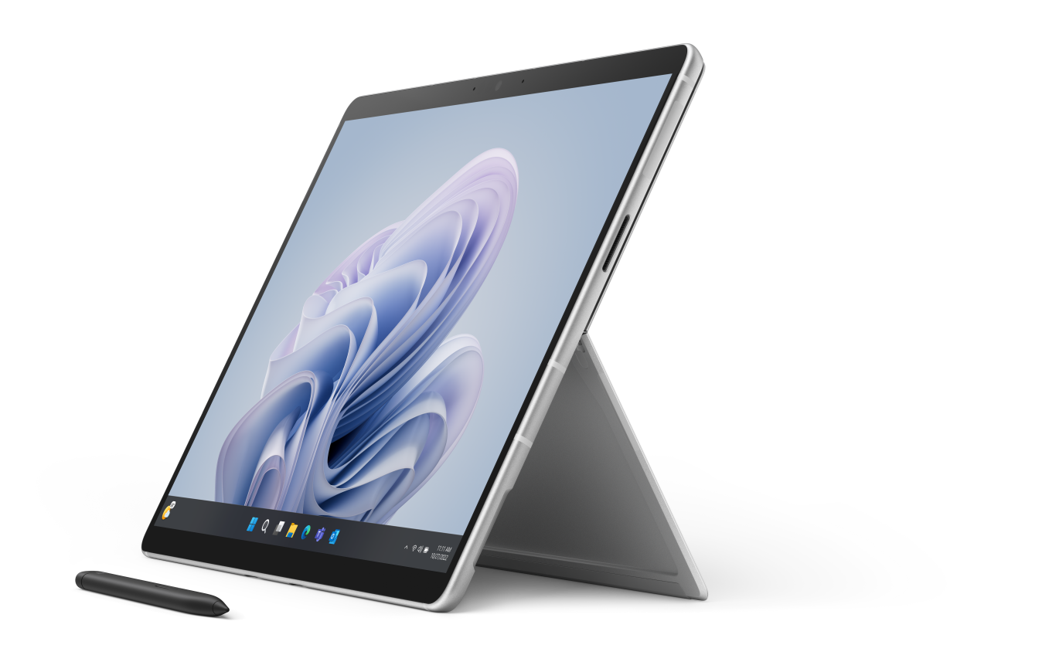
Surface Pro 9 5G
Model 1996 (Sub6), 1997 (mmWave)
Please read service guides to identify all parts needed for the repair
Replacement Component | SKU | Description | Price | Box contents
Kickstand | TLB-00001 (ROW) | Platinum | $ 114.99 | 1 Kickstand and screws
SSD Door | TM8-00001 | Platinum | $ 41.99 | 1 SSD Door.
rSSD | TLI-00001 | 128GB | $ 106.99 | 1 rSSD and screws.
 | TM1-00001 | 256GB | $ 122.99 | 1 rSSD and screws.
 | TM6-00001 | 512GB | $ 162.99 | 1 rSSD and screws.
Display Module | TK8-00001 | Display | $ 473.99 | 1 Display, adhesive, and screws.
Cameras | TMI-00001 | Rear | $ 65.99 | 1 rear camera, adhesive, and screws.
 | TMB-00001 | Front | $ 65.99 | 1 front camera, adhesive, and screws.
Buttons | TN8-00001 | Platinum | $ 65.99 | 1 set Power and volume buttons, screws, and adhesive.
Ports and Connectors | TKB-00001 | Surflink Port | $ 49.99 | 1 Surflink Assembly, screws, and adhesive.
Enclosure | WID-00001 | Platinum | $ 650.99 | Enclosure, thermal module, battery, screws and adhesive
Battery | WIA-00001 | Battery | $ 309.99 | 1 battery, 1 thermal module, adhesive and screws.
Speakers | TN1-00001 | Speakers | $ 49.99 | 1 left and 1 right speaker, screws and adhesive
Other | TL8-00001 | Thermal Module | $ 65.99 | 1 thermal module, 1 fan, adhesive, and screws.
 | TMM-00001 | Camera Deck | $ 114.99 | 1 camera deck, adhesive, and screws.
Motherboard | WIC-00003 | SQ3, 16GB | $ 459.00 | 1 Motherboard, thermal module, adhesive and screws
 | WIC-00004 | SQ3, 8GB | $ 363.99 | 1 Motherboard, thermal module, adhesive and screws
Device damage caused during a repair will not be covered under Microsoft’s Limited Hardware Warranty or extended protection plans.
Replacement components have a 90-day limited warranty unless the accompanying written warranty gives a longer time. Replacement components are currently only available for purchase separately, independent of the warranty status of your device. To order, see Customer self-serve repair. Replacement components may be refurbished.

Slide 9
Surface Pro 8 and Pro 7+
Please read service guides to identify all parts needed for the repair
Replacement Component | SKU | Description | Price | Box contents
Surface Pro 8 Model 1982 – LTE and Model 1983 - Wi-Fi
Kickstand | I61-00002 | Graphine | $ 65.00 | 1 kickstand and screws.
 | I61-00001 | Platinum (Model 1983-Wifi) | $ 65.00 | 1 kickstand and screws.
 | I61-00003 | Platinum (Model 1982-LTE) | $ 65.00 | 1 kickstand and screws.
SSD Door | DCI-00002 | Graphine | $ 20.00 | 1 SSD Door.
 | DCI-00001 | Platinum | $ 20.00 | 1 SSD Door.
rSSD | DFB-00001 | 128GB | $ 79.99 | 1 rSSD and screws.
 | DFI-00001 | 256GB | $ 94.99 | 1 rSSD and screws.
 | DGB-00001 | 512GB | $ 158.99 | 1 rSSD and screws.
 | DGI-00001 | 1TB | $ 294.99 | 1 rSSD and screws.
Display Module | I62-00001 | Display | $ 385.00 | 1 Display, FPC Cable, and adhesive.
Surface Pro 7+ Model 1960 - Wi-Fi and Model 1961 - LTE
Kickstand | I5A-00002 | Black | $ 65.00 | 1 kickstand and screws
 | I5A-00001 | Platinum (Model 1960-Wi-Fi) | $ 65.00 | 1 Kickstand and screws
 | I5A-00003 | Platinum (Model 1961-LTE) | $ 65.00
SSD Door | 8LS-00002 | Black | $ 20.00 | 1 SSD Door
 | 8LS-00001 | Platinum | $ 20.00 | 1 SSD Door
rSSD | 8LT-00001 | 128GB | $ 79.99 | 1 rSSD and Screws
 | 8LV-00001 | 256GB | $ 94.99 | 1 rSSD and Screws
 | 8LX-00001 | 512GB | $ 158.99 | 1 rSSD and Screws
 | 8LU-00001 | 1TB | $ 294.99 | 1 rSSD and Screws
Device damage caused during a repair will not be covered under Microsoft’s Limited Hardware Warranty or extended protection plans.
Replacement components have a 90-day limited warranty unless the accompanying written warranty gives a longer time. Replacement components are currently only available for purchase separately, independent of the warranty status of your device. To order, see Customer self-serve repair. Replacement components may be refurbished.

Slide 10
Surface Pro 7 and Pro X
Please read service guides to identify all parts needed for the repair
Replacement Component | SKU | Description | Price | Box contents
Surface Pro 7 Model 1866
Kickstand | I5B-00001 | Platinum | $ 65.00 | 1 kickstand and screws
 | I5B-00002 | Black | $ 65.00 | 1 kickstand and screws
Surface Pro X Model 1876-SQ1
Kickstand | I5C-00004 | Black | $ 65.00 | 1 kickstand and screws.
SSD Door | I5D-00001 | Black | $ 20.00 | 1 SSD Door.
rSSD | 8LT-00004 | 128GB | $ 79.99 | 1 rSSD and screws.
 | 8LV-00005 | 256GB | $ 94.99 | 1 rSSD and screws.
 | 8LX-00006 | 512GB | $ 158.99 | 1 rSSD and screws.
Surface Pro X Model 1876-SQ2
Kickstand | I5C-00001 | Black | $ 65.00 | 1 kickstand and screws
 | I5C-00002 | Platinum | $ 65.00 | 1 kickstand and screws.
SSD Door | I5D-00001 | Black | $ 20.00 | 1 SSD Door.
 | I5D-00002 | Platinum | $ 20.00 | 1 SSD Door.
Display Module | I5Z-00001 | Display | $ 385.00 | 1 Display and adhesive
rSSD | 8LV-00005 | 256GB | $ 94.99 | 1 rSSD and screws.
 | 8LX-00005 | 512GB | $ 158.99 | 1 rSSD and screws.
Surface Pro X Model 2010
Kickstand | I5C-00003 | Platinum | $ 65.00 | 1 kickstand and screws.
SSD Door | I5D-00002 | Platinum | $ 20.00 | 1 SSD Door.
Display Module | I5Z-00001 | Display | $ 385.00 | 1 screen and adhesive
rSSD | 8LT-00003 | 128GB | $ 79.99 | 1 rSSD and screws.
 | 8LV-00004 | 256GB | $ 94.99 | 1 rSSD and screws.
 | 8LX-00004 | 512GB | $ 158.99 | 1 rSSD and screws.
Device damage caused during a repair will not be covered under Microsoft’s Limited Hardware Warranty or extended protection plans.
Replacement components have a 90-day limited warranty unless the accompanying written warranty gives a longer time. Replacement components are currently only available for purchase separately, independent of the warranty status of your device. To order, see Customer self-serve repair. Replacement components may be refurbished.

Slide 11
Surface Laptop Go 2
Model 2013
Please read service guides to identify all parts needed for the repair
Replacement Component | SKU | Description | Price | Box contents
Display Assembly | N1W-00001 | SrfcLptp Go2 AB Cover CRU | $ 355.00 | 1 Display, thermal module, and screws
 | N1W-00002 | SrfcLptp Go2 AB Cover CRU | $ 355.00
 | N1W-00003 | SrfcLptp Go2 AB Cover CRU | $ 355.00
 | N1W-00004 | SrfcLptp Go2 AB Cover CRU | $ 355.00
rSSD | N2B-00001 | 128GB | $ 79.99 | 1 rSSD and screws
 | N2I-00001 | 256GB | $ 94.99 | 1 rSSD and screws
Feet | N1V-00001 | SrfcLptp Go2 Feet CRU | $ 16.00 | 2 feet
 | N1V-00002 | SrfcLptp Go2 Feet CRU | $ 16.00 | 2 feet
 | N1V-00003 | SrfcLptp Go2 Feet CRU | $ 16.00 | 2 feet
 | N1V-00004 | SrfcLptp Go2 Feet CRU | $ 16.00 | 2 feet
Ports & Connectors | N1U-00001 | SrfcLptp Go2 Surflink CRU | $ 39.00 | 1 Surface Connect Charging Port and screws
 | N1U-00002 | SrfcLptp Go2 Surflink CRU | $ 39.00 | 1 Surface Connect Charging Port and screws
 | N1U-00003 | SrfcLptp Go2 Surflink CRU | $ 39.00 | 1 Surface Connect Charging Port and screws
 | N1U-00004 | SrfcLptp Go2 Surflink CRU | $ 39.00 | 1 Surface Connect Charging Port and screws
Battery | N3I-00001 | Battery | $ 155.00 | 1 battery and screws
Keyboards (FPR – Fingerprint Reader) | N1X-00006 | AMER/ASIA Sage with FPR | $ 169.00 | 1 keyboard, and screws
 | N1X-00014 | AMER/ASIA Ice Blue with FPR | $ 169.00 | 1 keyboard, and screws
 | N1X-00018 | AMER/ASIA Platinum with FPR | $ 169.00 | 1 keyboard, and screws
 | N1X-00035 | AMER/ASIA Platinum No FPR | $ 135.00 | 1 keyboard, and screws
 | N1X-00058 | AMER/ASIA Sandstone with FPR | $ 169.00 | 1 keyboard, and screws
 | N1X-00012 | Canadian, Bilingual Ice Blue FPR | $ 169.00 | 1 keyboard and screws.
 | N1X-00031 | Canadian, Bilingual Platinum FPR | $ 169.00 | 1 keyboard and screws.
 | N1X-00004 | Canadian, Bilingual Sage FPR | $ 169.00 | 1 keyboard and screws.
 | N1X-00056 | Canadian, Bilingual Sandstone FPR | $ 169.00 | 1 keyboard and screws.
 | N1X-00036 | Canadian, Bilingual Platinum No FPR | $ 135.00 | 1 keyboard and screws.
Device damage caused during a repair will not be covered under Microsoft’s Limited Hardware Warranty or extended protection plans.
Replacement components have a 90-day limited warranty unless the accompanying written warranty gives a longer time. Replacement components are currently only available for purchase separately, independent of the warranty status of your device. To order, see Customer self-serve repair. Replacement components may be refurbished.

Slide 12
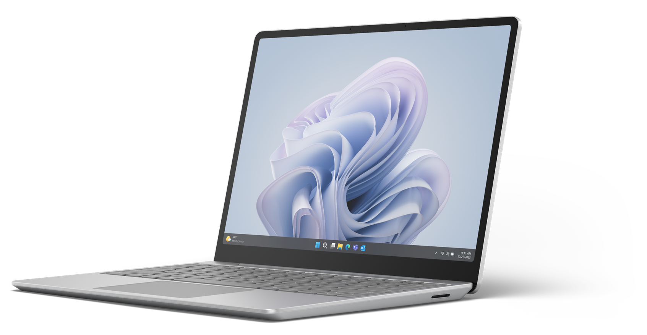
Surface Laptop Go 3
Model 2013
Please read service guides to identify all parts needed for the repair
Replacement Component | SKU | Description | Price | Box contents
Display Assembly | XT9-00001 | Sage | $ 399.00 | 1 Display, thermal module, TIM, Protective components and screws
 | XT9-00002 | Ice Blue | $ 399.00
 | XT9-00003 | Platinum | $ 399.00
 | XT9-00004 | Sandstone | $ 399.00
rSSD | XTD-00001 | 128GB | $ 89.00 | 1 rSSD, protective components, screws
 | XTC-00001 | 256GB | $ 105.00 | 1 rSSD, protective components, screws
 | XTB-00001 | 512GB | $ 169.00 | 1 rSSD, protective components, screws
Feet | N1V-00001 | Sage | $ 16.00 | 2 feet
 | N1V-00002 | Ice Blue | $ 16.00 | 2 feet
 | N1V-00003 | Platinum | $ 16.00 | 2 feet
 | N1V-00004 | Sandstone | $ 16.00 | 2 feet
Ports & Connectors | ZNH-00001 | Sage Surflink | $ 52.00 | 1 surface connect charging port, TIM, adhesive, and screws
 | ZNH-00002 | Ice Blue Surflink | $ 52.00 | 1 surface connect charging port, TIM, adhesive, and screws
 | ZNH-00003 | Platinum Surflink | $ 52.00 | 1 surface connect charging port, TIM, adhesive, and screws
 | ZNH-00004 | Sandstone Surflink | $ 52.00 | 1 surface connect charging port, TIM, adhesive, and screws
Battery | ZNI-00001 | Battery | $ 169.00 | 1 battery, TIM, and screws
Motherboard | XT5-00001 | i5, 8GB RAM, NUV NVMe | $ 1,009.00 | 1 motherboard, TIM, adhesive, and screws
 | XT5-00002 | i5, 8GB RAM, NUV UFS | $ 1,009.00 | 1 motherboard, TIM, adhesive, and screws
 | XT7-00001 | i5, 16GB RAM, NUV NVMe | $ 1,319.00 | 1 motherboard, TIM, adhesive, and screws
Keyboards (FPR – Fingerprint Reader) | ZNG-00006 | AMER/ASIA Sage with FPR | $ 169.00 | 1 keyboard, screws, TIM
 | ZNG-00014 | AMER/ASIA Ice Blue with FPR | $ 169.00 | 1 keyboard, screws, TIM
 | ZNG-00018 | AMER/ASIA Platinum with FPR | $ 169.00 | 1 keyboard, screws, TIM
 | ZTV-00018 | AMER/ASIA Platinum No FPR | $ 149.00 | 1 keyboard, screws, TIM
 | ZNG-00039 | AMER/ASIA Sandstone with FPR | $ 169.00 | 1 keyboard, screws, TIM
 | ZTV-00030 | Canadian, Bilingual Platinum No FPR | $ 149.00 | 1 keyboard, screws, TIM
 | ZNG-00012 | Canadian, Bilingual Ice Blue FPR | $ 169.00 | 1 keyboard, screws, TIM
 | ZNG-00030 | Canadian, Bilingual Platinum FPR | $ 169.00 | 1 keyboard, screws, TIM
 | ZNG-00004 | Canadian, Bilingual Sage FPR | $ 169.00 | 1 keyboard, screws, TIM
 | ZNG-00037 | Canadian, Bilingual Sandstone FPR | $ 169.00 | 1 keyboard, screws, TIM
Device damage caused during a repair will not be covered under Microsoft’s Limited Hardware Warranty or extended protection plans.
Replacement components have a 90-day limited warranty unless the accompanying written warranty gives a longer time. Replacement components are currently only available for purchase separately, independent of the warranty status of your device. To order, see Customer self-serve repair. Replacement components may be refurbished.

Slide 13
Surface Laptop 6 For Business – Intel 13”
Please read service guides to identify all parts needed for the repair
Replacement Component | SKU | Description | Price | Box contents
Display Assembly | D0I-00001 | Black | $619.00 | 1 display assembly, 4 black, 4 silver feet, screws, and adhesive
 | D0I-00002 | Platinum | $619.00 | 1 display assembly, 4 black, 4 silver feet, screws, and adhesive
Battery | B0Y-00001 | Battery | $249.00 | 1 battery, 4 black, 4 silver feet, screws, and adhesive
rSSD | E0R-00001 | 1TB | $589.00 | 1 rSSD, 4 black, 4silver feet, screws, and adhesive
 | E0Q-00001 | 512GB | $295.00 | 1 rSSD, 4 black, 4silver feet, screws, and adhesive
 | E0P-00001 | 256GB | $175.00 | 1 rSSD, 4 black, 4silver feet, screws, and adhesive
Feet | D0V-00001 | Black | $19.00 | 4 feet
 | D0V-00002 | Platinum | $19.00 | 4 feet
Ports and Connectors | D0S-00001 | Audio Jack | $49.00 | 1 audio jack, 4 black, 4 silver feet, screws, and adhesive
 | D0W-00001 | Surface Connect Port | $55.00 | 1 Surface Connect Port, 4 black and 4 silver feet, screws, and adhesive
Enclosure | C0V-00001 | Black | $205.00 | 1 Enclosure, 4 black, 4 silver feet, screws, and adhesive
 | C0V-00002 | Platinum | $205.00 | 1 Enclosure, 4 black, 4 silver feet, screws, and adhesive
Other | D0X-00001 | Thermal Module | $89.00 | 1 thermal module, 4 black, 4 silver feet, screws, and adhesive
Speakers | D0Y-00001 | Speaker | $69.00 | 1 speaker, 4 black, 4silver feet, screws, and adhesive
Motherboard | C0I-00001 | i7/64 GB | $2,835.00 | 1 Motherboard, 4 black, 4 silver feet, screws, and adhesive
 | C0D-00001 | i5/16GB | $1,199.00 | 1 Motherboard, 4 black, 4 silver feet, screws, and adhesive
 | C0F-00001 | i5/32GB | $1,865.00 | 1 Motherboard, 4 black, 4 silver feet, screws, and adhesive
 | C0C-00001 | i5/8GB | $885.00 | 1 Motherboard, 4 black, 4 silver feet, screws, and adhesive
 | C0G-00001 | i7/16GB | $1,525.00 | 1 Motherboard, 4 black, 4 silver feet, screws, and adhesive
 | C0H-00001 | i7/32GB | $2,189.00 | 1 Motherboard, 4 black, 4 silver feet, screws, and adhesive
Keyboards | D0M-00001 | AMER/ASIA Black | $229.00 | 1 keyboard, 4 black, 4 silver feet, screws, and adhesive
 | D0M-00019 | AMER/ASIA Platinum | $229.00 | 1 keyboard, 4 black, 4 silver feet, screws, and adhesive
 | D0M-00002 | Canada Black | $229.00 | 1 keyboard, 4 black, 4 silver feet, screws, and adhesive
 | D0M-00020 | Canada Platinum | $229.00 | 1 keyboard, 4 black, 4 silver feet, screws, and adhesive
Device damage caused during a repair will not be covered under Microsoft’s Limited Hardware Warranty or extended protection plans.
Replacement components have a 90-day limited warranty unless the accompanying written warranty gives a longer time. Replacement components are currently only available for purchase separately, independent of the warranty status of your device. To order, see Customer self-serve repair. Replacement components may be refurbished.

Slide 14
Surface Laptop 6 For Business – Intel 15”
Please read service guides to identify all parts needed for the repair
Replacement Component | SKU | Description | Price | Box contents
Display Assembly | D0J-00001 | Black | $665.00 | 1 display assembly, 4 black, 4 silver feet, screws, and adhesive
 | D0J-00002 | Platinum | $665.00 | 1 display assembly, 4 black, 4 silver feet, screws, and adhesive
Battery | B0Z-00001 | Battery | $249.00 | 1 battery, 4 black, 4 silver feet, screws, and adhesive
rSSD | E0R-00002 | 1TB | $589.00 | 1 rSSD, 4 black, 4silver feet, screws, and adhesive
 | E0Q-00002 | 512GB | $295.00 | 1 rSSD, 4 black, 4silver feet, screws, and adhesive
 | E0P-00002 | 256GB | $175.00 | 1 rSSD, 4 black, 4silver feet, screws, and adhesive
Feet | D0V-00001 | Black | $19.00 | 4 feet
 | D0V-00002 | Platinum | $19.00 | 4 feet
Ports and Connectors | D0W-00002 | Surface Connect Port | $55.00 | 1 Surface Connect Port, 4 black and 4 silver feet, screws, and adhesive
 | D0U-00001 | Audio Jack | $49.00 | 1 audio jack, 4 black, 4 silver feet, screws, and adhesive
Enclosure | C0W-00001 | Black | $205.00 | 1 Enclosure, 4 black, 4 silver feet, screws, and adhesive
 | C0W-00003 | Platinum | $205.00 | 1 Enclosure, 4 black, 4 silver feet, screws, and adhesive
Other | D0X-00002 | Thermal Module | $89.00 | 1 thermal module, 4 black, 4 silver feet, screws, and adhesive
Speakers | D0Y-00002 | Speaker | $69.00 | 1 speaker, 4 black, 4silver feet, screws, and adhesive
Motherboard | C0K-00001 | i5/16GB | $1,199.00 | 1 Motherboard, 4 black, 4 silver feet, screws, and adhesive
 | C0J-00001 | i5/8GB | $885.00 | 1 Motherboard, 4 black, 4 silver feet, screws, and adhesive
 | C0L-00001 | i7/16GB | $1,525.00 | 1 Motherboard, 4 black, 4 silver feet, screws, and adhesive
 | C0M-00001 | i7/32GB | $2,189.00 | 1 Motherboard, 4 black, 4 silver feet, screws, and adhesive
 | C0N-00001 | i7/64 GB | $2,835.00 | 1 Motherboard, 4 black, 4 silver feet, screws, and adhesive
Keyboards | D0N-00002 | AMER/ASIA Black | $229.00 | 1 keyboard, 4 black, 4 silver feet, screws, and adhesive
 | D0N-00020 | AMER/ASIA Platinum | $229.00 | 1 keyboard, 4 black, 4 silver feet, screws, and adhesive
 | D0N-00003 | Canada Black | $229.00 | 1 keyboard, 4 black, 4 silver feet, screws, and adhesive
 | D0N-00021 | Canada Platinum | $229.00 | 1 keyboard, 4 black, 4 silver feet, screws, and adhesive
Device damage caused during a repair will not be covered under Microsoft’s Limited Hardware Warranty or extended protection plans.
Replacement components have a 90-day limited warranty unless the accompanying written warranty gives a longer time. Replacement components are currently only available for purchase separately, independent of the warranty status of your device. To order, see Customer self-serve repair. Replacement components may be refurbished.

Slide 15
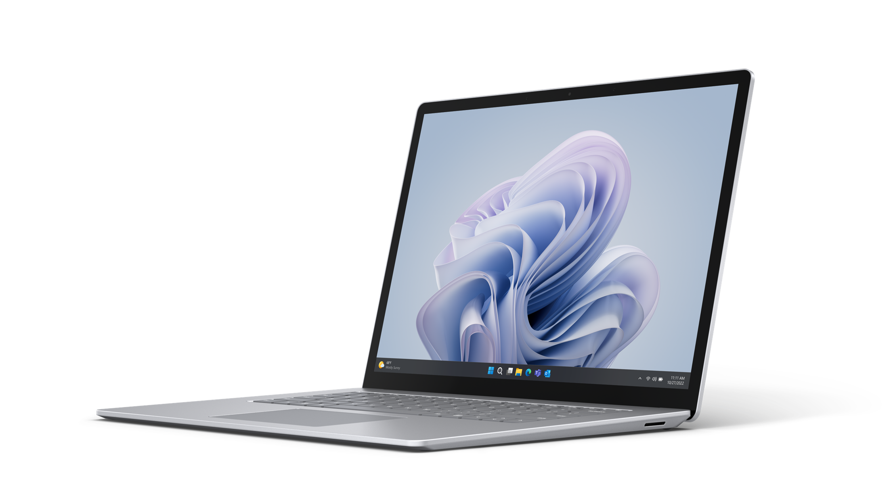
Surface Laptop 5 – Intel 13”
Model 1950/1951
Please read service guides to identify all parts needed for the repair
Replacement Component | SKU | Description | Price | Box contents
Display Assembly | U2I-00001 | Platinum | $ 521.99 | 1 Display, 4 feet, TIM and screws
 | U2I-00003 | Sage | $ 521.99 | 1 Display, 4 feet, TIM and screws
 | U2I-00004 | Sandstone | $ 521.99 | 1 Display, 4 feet, TIM and screws
 | CIB-00001 | Black | $ 429.00 | 1 Display, 4 feet, TIM and screws
rSSD | U1Y-00001 | 256GB | $ 122.99 | 1 rSSD, 4 feet, TIM, and screws
 | U1Z-00001 | 512GB | $ 162.99 | 1 rSSD, 4 feet, TIM, and screws
Feet | CIG-00002 | Platinum | $ 17.00 | 4 feet
 | CIG-00006 | Sage | $ 17.00 | 4 feet
 | CIG-00004 | Sandstone | $ 17.00 | 4 feet
 | CIG-00001 | Black | $ 17.00 | 4 feet
Ports and Connectors | U1U-00001 | Surface Connect Charging port | $ 49.99 | 1 Surface Connect Charging Port, 4 feet, TIM and screws
Battery and Enclosure | U1V-00001 | Platinum | $ 294.99 | 1 battery and enclosure, 4 Feet, TIM and screws
 | U1V-00002 | Black | $ 294.99 | 1 battery and enclosure, 4 Feet, TIM and screws
 | U1V-00003 | Sage | $ 294.99 | 1 battery and enclosure, 4 Feet, TIM and screws
 | U1V-00004 | Sandstone | $ 294.99 | 1 battery and enclosure, 4 Feet, TIM and screws
Other | U1X-00001 | Thermal Module | $ 82.99 | 1 thermal module, 4 feet, TIM, and screws
Motherboard | U1W-00002 | i5, 8GB | $ 910.99 | 1 Motherboard, 4 feet, TIM, thermal module, and screws
 | U1W-00006 | i5, 16GB | $ 1,174.99 | 1 Motherboard, 4 feet, TIM, thermal module, and screws
 | U1W-00010 | i7, 16GB | $ 1,302.99 | 1 Motherboard, 4 feet, TIM, thermal module, and screws
 | U1W-00020 | i7, 32GB | $ 1,565.99 | 1 Motherboard, 4 feet, TIM, thermal module, and screws
Keyboards | U3B-00019 | AMER/ASIA Black | $ 179.99 | 1 keyboard, 4 feet, TIM and screws
 | U3B-00001 | AMER/ASIA Platinum | $ 114.99 | 1 keyboard, 4 feet, TIM and screws
 | U3B-00037 | AMER/ASIA Sage | $ 179.99 | 1 keyboard, 4 feet, TIM and screws
 | U3B-00045 | AMER/ASIA Sandstone | $ 179.99 | 1 keyboard, 4 feet, TIM and screws
 | U3B-00020 | English/French (Canada) Black | $ 179.99 | 1 keyboard, 4 feet, TIM and screws
 | U3B-00002 | English/French (Canada) Platinum | $ 114.99 | 1 keyboard, 4 feet, TIM and screws
 | U3B-00038 | English/French (Canada) Sage | $ 179.99 | 1 keyboard, 4 feet, TIM and screws
 | U3B-00046 | English/French (Canada) Sandstone | $ 179.99 | 1 keyboard, 4 feet, TIM and screws
Device damage caused during a repair will not be covered under Microsoft’s Limited Hardware Warranty or extended protection plans.
Replacement components have a 90-day limited warranty unless the accompanying written warranty gives a longer time. Replacement components are currently only available for purchase separately, independent of the warranty status of your device. To order, see Customer self-serve repair. Replacement components may be refurbished.

Slide 16
Surface Laptop 5 – Intel 15”
Model 1979
Please read service guides to identify all parts needed for the repair
Replacement Component | SKU | Description | Price | Box contents
Display Assembly | U7I-00001 | Platinum | $ 602.99 | 1 Display, 4 feet, TIM and screws
 | U7I-00002 | Black | $ 602.99 | 1 Display, 4 feet, TIM and screws
rSSD | U1Y-00001 | 256GB | $ 122.99 | 1 rSSD, 4 feet, TIM, and screws
 | U1Z-00001 | 512GB | $ 162.99 | 1 rSSD, 4 feet, TIM, and screws
 | U7B-00001 | 1TB | $ 302.99 | 1 rSSD, 4 feet, TIM, and screws
Feet | CIG-00002 | Platinum | $ 17.00 | 4 feet
 | CIG-00001 | Black | $ 17.00 | 4 feet
Ports and Connectors | U1U-00002 | Surface Connect Charging port | $ 49.99 | 1 Surface Connect Charging Port, 4 feet, TIM and screws
Battery and Enclosure | U6B-00001 | Platinum | $ 294.99 | 1 battery and enclosure, 4 Feet, TIM and screws
 | U6B-00002 | Black | $ 294.99 | 1 battery and enclosure, 4 Feet, TIM and screws
Other | U1X-00002 | Thermal Module | $ 82.99 | 1 thermal module, 4 feet, TIM, and screws
Motherboard | U6I-00002 | i7, 8GB | $ 1,105.99 | 1 Motherboard, 4 feet, TIM, thermal module, and screws
 | U6I-00006 | i7, 16GB | $ 1,302.99 | 1 Motherboard, 4 feet, TIM, thermal module, and screws
 | U6I-00010 | i7, 32GB | $ 1,565.99 | 1 Motherboard, 4 feet, TIM, thermal module, and screws
Keyboards | U83-00019 | AMER/ASIA Black | $ 179.99 | 1 keyboard, 4 feet, TIM and screws
 | U83-00001 | AMER/ASIA Platinum | $ 179.99 | 1 keyboard, 4 feet, TIM and screws
 | U83-00019 | English/French (Canada) Black | $ 179.99 | 1 keyboard, 4 feet, TIM and screws
 | U83-00001 | English/French (Canada) Platinum | $ 179.99 | 1 keyboard, 4 feet, TIM and screws
Device damage caused during a repair will not be covered under Microsoft’s Limited Hardware Warranty or extended protection plans.
Replacement components have a 90-day limited warranty unless the accompanying written warranty gives a longer time. Replacement components are currently only available for purchase separately, independent of the warranty status of your device. To order, see Customer self-serve repair. Replacement components may be refurbished.

Slide 17
Surface Laptop 3 – 13”
Please read service guides to identify all parts needed for the repair
Replacement Component | SKU | Description | Price | Box contents
Display Assembly | RPN-00001 | Black | $ 429.00 | 1 Display, 4 feet, and screws.
 | CIB-00004 | Sandstone | $ 429.00 | 1 Display, 4 feet, and screws.
 | CIB-00005 | Cobalt Blue | $ 429.00 | 1 Display, 4 feet, and screws.
 | CIB-00002 | Platinum | $ 429.00 | 1 Display, 4 feet, and screws.
rSSD | 8LT-00006 | 128GB | $ 79.99 | 1 rSSD and screws
 | 8LV-00009 | 256GB | $ 94.99 | 1 rSSD and screws
 | 8LX-00009 | 512GB | $ 158.99 | 1 rSSD and screws
 | 8LU-00005 | 1TB | $ 294.99 | 1 rSSD and screws
Feet | CIG-00001 | Black | $ 17.00 | 4 feet
 | CIG-00004 | Sandstone | $ 17.00 | 4 feet
 | CIG-00005 | Cobalt Blue | $ 17.00 | 4 feet
 | CIG-00002 | Platinum | $ 17.00 | 4 feet
Other | CII-00001 | SSD Screws | $ 1.29 | 1 screw
 | CIH-00001 | C-Cover Screws | $ 1.29 | 4 screws
Keyboard | IDX-00001 | AMER/ASIA Black | $ 209.00 | 1 keyboard, 4 feet, and screws
 | IDX-00019 | AMER/ASIA Sandstone | $ 209.00 | 1 keyboard, 4 feet, and screws
 | IDW-00001 | AMER/ASIA Cobalt Blue (Fabric) | $ 149.00 | 1 keyboard, 4 feet, and screws
 | IDW-00002 | AMER/ASIA Platinum (Fabric) | $ 149.00 | 1 keyboard, 4 feet, and screws
 | IDX-00002 | French Canadian Black | $ 209.00 | 1 keyboard, 4 feet, and screws
 | IDX-00020 | French Canadian Sandstone | $ 209.00 | 1 keyboard, 4 feet, and screws
 | IDW-00020 | French Canadian Cobalt Blue | $ 149.00 | 1 keyboard, 4 feet, and screws
 | IDW-00003 | French Canadian Platinum | $ 149.00 | 1 keyboard, 4 feet, and screws
Device damage caused during a repair will not be covered under Microsoft’s Limited Hardware Warranty or extended protection plans.
Replacement components have a 90-day limited warranty unless the accompanying written warranty gives a longer time. Replacement components are currently only available for purchase separately, independent of the warranty status of your device. To order, see Customer self-serve repair. Replacement components may be refurbished.

Slide 18
Surface Laptop 3 – 15”
Please read service guides to identify all parts needed for the repair
Replacement Component | SKU | Description | Price | Box contents
Model 1872 and 1873
Display Assembly | CIC-00001 | Black | $ 549.00 | 1 Display, 4 feet, and screws.
 | CIC-00002 | Platinum | $ 549.00 | 1 Display, 4 feet, and screws.
Feet | CIG-00001 | Black | $ 17.00 | 4 feet
 | CIG-00002 | Platinum | $ 17.00 | 4 feet
Other | CII-00001 | SSD Screws | $ 1.29 | 1 screw
 | CIH-00001 | C-Cover Screws | $ 1.29 | 4 screws
Keyboard | IDY-00019 | AMER/ASIA Black | $ 219.00 | 1 keyboard, 4 feet, and screws
 | IDY-00001 | AMER/ASIA Platinum | $ 219.00 | 1 keyboard, 4 feet, and screws
 | IDY-00020 | French Canadian Black | $ 219.00 | 1 keyboard, 4 feet, and screws
 | IDY-00002 | French Canadian Platinum | $ 219.00 | 1 keyboard, 4 feet, and screws
rSSD Dependent on Model
Replacement Component | SKU | Description | Price | Box contents
Model 1872 – Intel 15”
rSSD | 8LT-00006 | 128GB | $ 79.99 | 1 rSSD and screws
 | 8LV-00009 | 256GB | $ 94.99 | 1 rSSD and screws
 | 8LX-00009 | 512GB | $ 158.99 | 1 rSSD and screws
 | 8LU-00005 | 1TB | $ 294.99 | 1 rSSD and screws
Model 1873 – AMD 15”
rSSD | 8LT-00005 | 128GB | $ 79.99 | 1 rSSD and screws
 | 8LV-00008 | 256GB | $ 94.99 | 1 rSSD and screws
 | 8LX-00008 | 512GB | $ 158.99 | 1 rSSD and screws
 | 8LU-00004 | 1TB | $ 294.99 | 1 rSSD and screws
Device damage caused during a repair will not be covered under Microsoft’s Limited Hardware Warranty or extended protection plans.
Replacement components have a 90-day limited warranty unless the accompanying written warranty gives a longer time. Replacement components are currently only available for purchase separately, independent of the warranty status of your device. To order, see Customer self-serve repair. Replacement components may be refurbished.

Slide 19
Surface Laptop 4 –13”
Please read service guides to identify all parts needed for the repair
Replacement Component | SKU | Description | Price | Box contents
All Models
Display Assembly | RPN-00001 | Black | $ 429.00 | 1 Display, 4 feet, and screws | 1 Display, 4 feet, and screws
 | CIB-00004 | Sandstone | $ 429.00 | 1 Display, 4 feet, and screws | 1 Display, 4 feet, and screws
 | CIB-00003 | Ice Blue | $ 429.00 | 1 Display, 4 feet, and screws | 1 Display, 4 feet, and screws
 | CIB-00002 | Platinum | $ 429.00 | 1 Display, 4 feet, and screws | 1 Display, 4 feet, and screws
Feet | CIG-00001 | Black | $ 17.00 | 4 feet | 4 feet
 | CIG-00004 | Sandstone | $ 17.00 | 4 feet | 4 feet
 | CIG-00003 | Ice Blue | $ 17.00 | 4 feet | 4 feet
 | CIG-00002 | Platinum | $ 17.00 | 4 feet | 4 feet
Other | CII-00001 | SSD Screws | $ 1.29 | 1 screw | 1 screw
 | CIH-00001 | C-Cover Screws | $ 1.29 | 4 screws | 4 screws
Keyboard | CID-00019 | AMER/ASIA Ice Blue | $ 149.00 | 1 keyboard, 4 feet, and screws | 1 keyboard, 4 feet, and screws
 | CID-00001 | AMER/ASIA Platinum | $ 149.00 | 1 keyboard, 4 feet, and screws | 1 keyboard, 4 feet, and screws
 | I3P-00001 | AMER/ASIA Black | $ 209.00 | 1 keyboard, 4 feet, and screws | 1 keyboard, 4 feet, and screws
 | I3P-00019 | AMER/ASIA Sandstone | $ 209.00 | 1 keyboard, 4 feet, and screws | 1 keyboard, 4 feet, and screws
 | CID-00020 | French Canadian Ice Blue | $ 149.00 | 1 keyboard, 4 feet, and screws | 1 keyboard, 4 feet, and screws
 | CID-00002 | French Canadian Platinum | $ 149.00 | 1 keyboard, 4 feet, and screws | 1 keyboard, 4 feet, and screws
 | I3P-00002 | French Canadian Black | $ 209.00 | 1 keyboard, 4 feet, and screws | 1 keyboard, 4 feet, and screws
 | I3P-00020 | French Canadian Sandstone | $ 209.00 | 1 keyboard, 4 feet, and screws | 1 keyboard, 4 feet, and screws
rSSD Dependent on Model
Replacement Component | SKU | Description | Price | Box contents
Model 1950/1951 – Intel 13”
rSSD | 8LU-00002 | 1TB | $ 294.99 | 1 rSSD and screws
 | 8LV-00002 | 256GB | $ 94.99 | 1 rSSD and screws
 | 8LX-00002 | 512GB | $ 158.99 | 1 rSSD and screws
Model 1958/1959 – AMD 13”
rSSD | 8LT-00002 | 128GB | $ 79.99 | 1 rSSD and screws
 | 8LV-00003 | 256GB | $ 94.99 | 1 rSSD and screws
 | 8LX-00003 | 512GB | $158.99 | 1 rSSD and screws
Device damage caused during a repair will not be covered under Microsoft’s Limited Hardware Warranty or extended protection plans.
Replacement components have a 90-day limited warranty unless the accompanying written warranty gives a longer time. Replacement components are currently only available for purchase separately, independent of the warranty status of your device. To order, see Customer self-serve repair. Replacement components may be refurbished.

Slide 20
Surface Laptop 4 – 15”
Please read service guides to identify all parts needed for the repair
Replacement Component | SKU | Description | Price | Box contents
All Models
Display Assembly | CIC-00001 | Black | $ 549.00 | 1 Display, 4 feet, and screws.
 | CIC-00002 | Platinum | $ 549.00 | 1 Display, 4 feet, and screws.
Feet | CIG-00001 | Black | $ 17.00 | 4 feet
 | CIG-00002 | Platinum | $ 17.00 | 4 feet
Other | CII-00001 | SSD Screws | $ 1.29 | 1 screw
 | CIH-00001 | C-Cover Screws | $ 1.29 | 4 screws
Keyboard | CIF-00001 | AMER/ASIA Black | $ 219.00 | 1 keyboard, 4 feet, and screws
 | CIF-00019 | AMER/ASIA Platinum | $ 219.00 | 1 keyboard, 4 feet, and screws
 | CIF-00002 | French Canadian Black | $ 219.00 | 1 keyboard, 4 feet and screws
 | CIF-00020 | French Canadian Platinum | $ 219.00 | 1 keyboard, 4 feet and screws
rSSD Dependent on Model
Replacement Component | SKU | Description | Price | Box contents
Model 1979 – Intel 15”
rSSD | 8LU-00002 | 1TB | $ 294.99 | 1 rSSD and screws
 | 8LV-00002 | 256GB | $ 94.99 | 1 rSSD and screws
 | 8LX-00002 | 512GB | $ 158.99 | 1 rSSD and screws
Model 1953 – AMD 15”
rSSD | 8LT-00002 | 128GB | $ 79.99 | 1 rSSD and screws
 | 8LV-00003 | 256GB | $ 94.99 | 1 rSSD and screws
 | 8LX-00003 | 512GB | $ 158.99 | 1 rSSD and screws
Device damage caused during a repair will not be covered under Microsoft’s Limited Hardware Warranty or extended protection plans.
Replacement components have a 90-day limited warranty unless the accompanying written warranty gives a longer time. Replacement components are currently only available for purchase separately, independent of the warranty status of your device. To order, see Customer self-serve repair. Replacement components may be refurbished.

Slide 21
Surface Go 3 and Go 4
Please read service guides to identify all parts needed for the repair
Replacement Component | SKU | Description | Price | Box contents
Surface Go 3 Model 1926
Kickstand | I64-00005 | Black | $ 65.00 | 1 kickstand and screws.
 | I64-00002 | Platinum | $ 65.00 | 1 kickstand and screws.
Surface Go 3 Model 2022
Kickstand | I64-00006 | Black | $ 65.00 | 1 kickstand and screws.
 | I64-00003 | Platinum | $ 65.00 | 1 kickstand and screws.
Replacement Component | SKU | Description | Price
Surface Go 4 Model 2067
Kickstand | XSK-00001 | Platinum | $ 79.00 | 1 kickstand and screws.
SD Slot | XSC-00001 | SD Slot | $ 69.00 | 1 SD Slot, Connector cable, antenna deck, screws, and adhesive
Display | XS6-00001 | Display | $ 309.00 | 1 Dispay, antenna deck, and screws
Rear Camera | XSG-00001 | Camera | $ 89.00 | 1 Rear camera, antenna deck, screws, and adhesive
Front Camera | XSF-00001 | Camera | $ 69.00 | 1 Front camera, antenna deck, screws, and adhesive
Windows hello Camera | XSH-00001 | Camera | $ 69.00 | 1 Windows hello Camera, antenna deck, screws, and adhesive
Battery & Enclosure | XS5-00001 | Battery | $ 969.00 | 1 Battery and attached Enclosure, antenna deck, screws, and adhesive
Hinges | XSJ-00001 | Hinges | $ 1,289.00 | 2 Hinges, antenna deck, screws, and adhesive
Speakers | XSI-00001 | Left and Right | $ 789.00 | 2 attached Speakers, antenna deck, screws, and adhesive
Type cover Connector | XSD-00001 | Connector | $ 309.00 | 1 Type cover Connector, antenna deck, screws, and adhesive
Motherboard | XS8-00001 | N200 / 8GB / 128GB | $ 89.00 | 1 Motherboard, antenna deck, screws, and adhesive
 | XS9-00001 | N200 / 8GB / 256GB | $ 69.00 | 1 Motherboard, antenna deck, screws, and adhesive
 | XS7-00001 | N200 / 8GB / 64GB | $ 69.00 | 1 Motherboard, antenna deck, screws, and adhesive
Device damage caused during a repair will not be covered under Microsoft’s Limited Hardware Warranty or extended protection plans.
Replacement components have a 90-day limited warranty unless the accompanying written warranty gives a longer time. Replacement components are currently only available for purchase separately, independent of the warranty status of your device. To order, see Customer self-serve repair. Replacement components may be refurbished.

Slide 22
Other Surface Models
Please read service guides to identify all parts needed for the repair
Replacement Component | SKU | Description | Price | Box contents
Surface Laptop SE Model 2016
Display Assembly | IL1-00001 | Display | $ 158.99 |  | 1 Display and screws
Feet | IL8-00001 | Feet | $ 17.00 |  | Includes 4 feet
Ports & Connectors | TBM-00001 | Power Port | $ 36.99 |  | 1 power connector module and screws
Battery and Enclosure | IL3-00001 | Battery | N/A |  | 1 battery and screws
 | IL7-00001 | Enclosure | $ 49.00 |  | 1 Enclosure and screws
Other | IL6-00001 | Wi-Fi Module | $ 33.00 |  | 1 wifi module and screws
 | IL5-00001 | Speaker | $ 33.00 |  | 1 speaker and screws
Keyboard | IL2-00001 | US Keyboard | $ 79.99 |  | 1 Keyboard and Screws
 | IL2-00002 | Canadian, Bilingual | $ 79.99 |  | 1 Keyboard and Screws
Motherboard | IL4-00001 | 2 core CPU / 4GB RAM / 64GB Storage | $ 268.99 |  | 1 Motherboard and Screws
 | IL4-00002 | 4 core CPU / 8GB RAM / 128GB Storage | $ 280.99 |  | 1 Motherboard and Screws
Please read service guides to identify all parts needed for the repair
Replacement Component | SKU | Price | Box contents
Surface Studio 2+ Model 2028
Feet | VDB-00001 | $ 29.99 | 4 feet
rSSD | VEB-00001 | $ 309.99 | 1 rSSD and screws
Display | VE1-00001 | $ 2,271.99 | 1 Display and screws
Power Supply Unit | VNB-00001 | $ 147.99 | 1 Power Supply Unit (PSU) and screws
Thermal Module | VF1-00001 | $ 82.99 | 1 thermal module, 1 fan and screws
Motherboard | VFB-00002 (US/CAN) | $ 1,689.99 | 1 Motherboard, cables, feet, and screws
 | VFB-00001 (ROW) | $ 1,689.99 | 1 Motherboard, cables, feet, and screws
Device damage caused during a repair will not be covered under Microsoft’s Limited Hardware Warranty or extended protection plans.
Replacement components have a 90-day limited warranty unless the accompanying written warranty gives a longer time. Replacement components are currently only available for purchase separately, independent of the warranty status of your device. To order, see Customer self-serve repair. Replacement components may be refurbished.

Slide 23
Replacement components estimated lead times
Device | Replacement Components | Bulk Order Range | Current Supply Status | Lead Time for Small Orders (<5 Units) | Bulk Order LT | Outside of Bulk Order Range
Laptop 3 | Surface Display | 5 to 50 | DC and Channel Inventory Only (Contact for Bulk Order Solution) | <3 weeks if stock available WW | N/A (Contact for Bulk Order Solution) | N/A (Contact for Bulk Order Solution)
Laptop 3 | Surface Feet | 5 to 300
Laptop 3 | Surface Keyset | 5 to 50
Laptop 3 | Surface Misc Parts | 5 to 100
Laptop 3 | Surface Storage | 5 to 100
Laptop 4 | Surface Display | 5 to 50 | DC and Channel Inventory Only (Contact for Bulk Order Solution) | <3 weeks if stock available WW | N/A (Contact for Bulk Order Solution) | N/A (Contact for Bulk Order Solution)
Laptop 4 | Surface Feet | 5 to 300
Laptop 4 | Surface Keyset | 5 to 50
Laptop 4 | Surface Misc Parts | 5 to 100
Laptop 4 | Surface Storage | 5 to 100
Surface Laptop 5 | Surface Battery | 5 to 100 | No Constraint | <3 weeks if stock available WW | 4-6 weeks | 6-8 weeks
Surface Laptop 5 | Surface Display | 5 to 100
Surface Laptop 5 | Surface Feet | 5 to 300
Surface Laptop 5 | Surface Keyset | 5 to 100
Surface Laptop 5 | Surface Misc Parts | 5 to 100
Surface Laptop 5 | Surface PCBA | 5 to 100
Surface Laptop 5 | Surface Storage | 5 to 100
Surface Laptop 5 | Surface Surflink | 5 to 100
Surface Laptop Go 2 | Surface Battery | 5 to 100 | No Constraint | <3 weeks if stock available WW | 6-8 weeks | TBD MS inform ETA
Surface Laptop Go 2 | Surface Display | 5 to 100
Surface Laptop Go 2 | Surface Feet | 5 to 300
Surface Laptop Go 2 | Surface Keyset | 5 to 100
Surface Laptop Go 2 | Surface Storage | 5 to 100
Surface Laptop Go 2 | Surface Surflink | 5 to 100
Surface Laptop SE | Surface Base | 5 to 100 | No Constraint | <3 weeks if stock available WW | 6-8 weeks | TBD MS inform ETA
Surface Laptop SE | Surface Battery | 5 to 100
Surface Laptop SE | Surface Display | 5 to 100
Surface Laptop SE | Surface Feet | 5 to 300
Surface Laptop SE | Surface Keyset | 5 to 100
Surface Laptop SE | Surface Misc Parts | 5 to 100
Surface Laptop SE | Surface PCBA | 5 to 100
Surface Laptop SE | Surface Speakers | 5 to 100
Surface Laptop Studio | Surface Audio Jack | 5 to 100 | DC and Channel Inventory Only (Contact for Bulk Order Solution) | <3 weeks if stock available WW | N/A (Contact for Bulk Order Solution) | N/A (Contact for Bulk Order Solution)
Surface Laptop Studio | Surface Battery | 5 to 30
Surface Laptop Studio | Surface Display | 5 to 30
Surface Laptop Studio | Surface Feet | 5 to 300
Surface Laptop Studio | Surface Keyset | 5 to 50
Surface Laptop Studio | Surface Misc Parts | 5 to 100
Surface Laptop Studio | Surface Storage | 5 to 100

Slide 24
Replacement components estimated lead times
Device | Replacement Components | Bulk Order Range | Current Supply Status | Lead Time for Small Orders (<5 Units) | Bulk Order LT | Outside of Bulk Order Range
Surface Pro 7 | Surface Kickstand | 5 to 100 | DC and Channel Inventory Only (Contact for Bulk Order Solution) | <3 weeks if stock available WW | N/A (Contact for Bulk Order Solution) | N/A (Contact for Bulk Order Solution)
Surface Pro 7+ | Surface Display | 5 to 50 | DC and Channel Inventory Only (Contact for Bulk Order Solution) | <3 weeks if stock available WW | N/A (Contact for Bulk Order Solution) | N/A (Contact for Bulk Order Solution)
Surface Pro 7+ | Surface Kickstand | 5 to 100
Surface Pro 7+ | Surface Memory Door
Surface Pro 7+ | Surface Storage
Surface Pro 8 | Surface Battery | 5 to 100 | No Constraint | <3 weeks if stock available WW | 4-6 weeks | 6-8 weeks
Surface Pro 8 | Surface Display
Surface Pro 8 | Surface Kickstand
Surface Pro 8 | Surface Memory Door
Surface Pro 8 | Surface Misc Parts
Surface Pro 8 | Surface Storage
Surface Pro 8 | Surface Surflink
Surface Pro 9 | Surface Base | 5 to 100 | No Constraint | <3 weeks if stock available WW | 4-6 weeks | 6-8 weeks
Surface Pro 9 | Surface Battery
Surface Pro 9 | Surface Display
Surface Pro 9 | Surface Kickstand
Surface Pro 9 | Surface Memory Door
Surface Pro 9 | Surface Misc. Parts
Surface Pro 9 | Surface PCBA
Surface Pro 9 | Surface Speakers
Surface Pro 9 | Surface Storage
Surface Pro 9 | Surface Surflink
Surface Pro 9 | Surface Camera Parts
Surface Pro 9 5G | Surface Base | 5 to 100 | No Constraint | <3 weeks if stock available WW | 4-6 weeks | 6-8 weeks
Surface Pro 9 5G | Surface Battery
Surface Pro 9 5G | Surface Display
Surface Pro 9 5G | Surface Kickstand
Surface Pro 9 5G | Surface Memory Door
Surface Pro 9 5G | Surface Misc. Parts
Surface Pro 9 5G | Surface PCBA
Surface Pro 9 5G | Surface Speakers
Surface Pro 9 5G | Surface Storage
Surface Pro 9 5G | Surface Surflink
Surface Pro 9 5G | Surface Camera Parts

Slide 25
Replacement components estimated lead times
Device | Replacement Components | Bulk Order Range | Current Supply Status | Lead Time for Small Orders (<5 Units) | Bulk Order LT | Outside of Bulk Order Range
Surface Pro X | Surface Display | 5 to 50 | DC and Channel Inventory Only (Contact for Bulk Order Solution) | <3 weeks if stock available WW | N/A (Contact for Bulk Order Solution) | N/A (Contact for Bulk Order Solution)
Surface Pro X | Surface Kickstand
Surface Pro X | Surface Storage
Surface Pro X LTE | Surface Display | 5 to 50 | DC and Channel Inventory Only (Contact for Bulk Order Solution) | <3 weeks if stock available WW | N/A (Contact for Bulk Order Solution) | N/A (Contact for Bulk Order Solution)
Surface Pro X LTE | Surface Kickstand | 5 to 100
Surface Pro X LTE | Surface Memory Door
Surface Pro X LTE | Surface Storage
Surface Pro X SQ2 | Surface Kickstand | 5 to 50 | DC and Channel Inventory Only (Contact for Bulk Order Solution) | <3 weeks if stock available WW | N/A (Contact for Bulk Order Solution) | N/A (Contact for Bulk Order Solution)
Surface Pro X SQ2 | Surface Memory Door | 5 to 100
Surface Pro X SQ2 | Surface Storage
Surface Studio 2+ | Surface Display | 5 to 50 | No Constraint | <3 weeks if stock available WW | 4-6 weeks | 6-8 weeks
Surface Studio 2+ | Surface Feet | 5 to 300
Surface Studio 2+ | Surface Misc Parts | 5 to 50
Surface Studio 2+ | Surface PCBA
Surface Studio 2+ | Surface Storage
Surface Studio 2+ | Surface PSU
Surface Laptop 6 for Business | Surface Battery | 5 to 100 | No Constraint | <3 weeks if stock available WW | 12 weeks | 12 weeks
 | Surface Display | 5 to 100 | No Constraint | <3 weeks if stock available WW | 4-6 weeks | 6-8 weeks
 | Surface Feet | 5 to 300
 | Surface Keyset | 5 to 100
 | Surface Misc Parts | 5 to 100
 | Surface PCBA | 5 to 100
 | Surface Storage | 5 to 100
 | Surface Surflink | 5 to 100
 | Surface Speakers | 5 to 100
Surface Pro 10 for Business | Surface Base | 5 to 100 | No Constraint | <3 weeks if stock available WW | 4-6 weeks | 6-8 weeks
 | Surface Battery | 5 to 100
 | Surface Display | 5 to 100
 | Surface Kickstand | 5 to 100
 | Surface Memory Door | 5 to 100
 | Surface Misc Parts | 5 to 100
 | Surface PCBA | 5 to 100
 | Surface Speakers | 5 to 100
 | Surface Storage | 5 to 100
 | Surface Surflink | 5 to 100
 | Surface Camera Parts | 5 to 100

