Slide 1
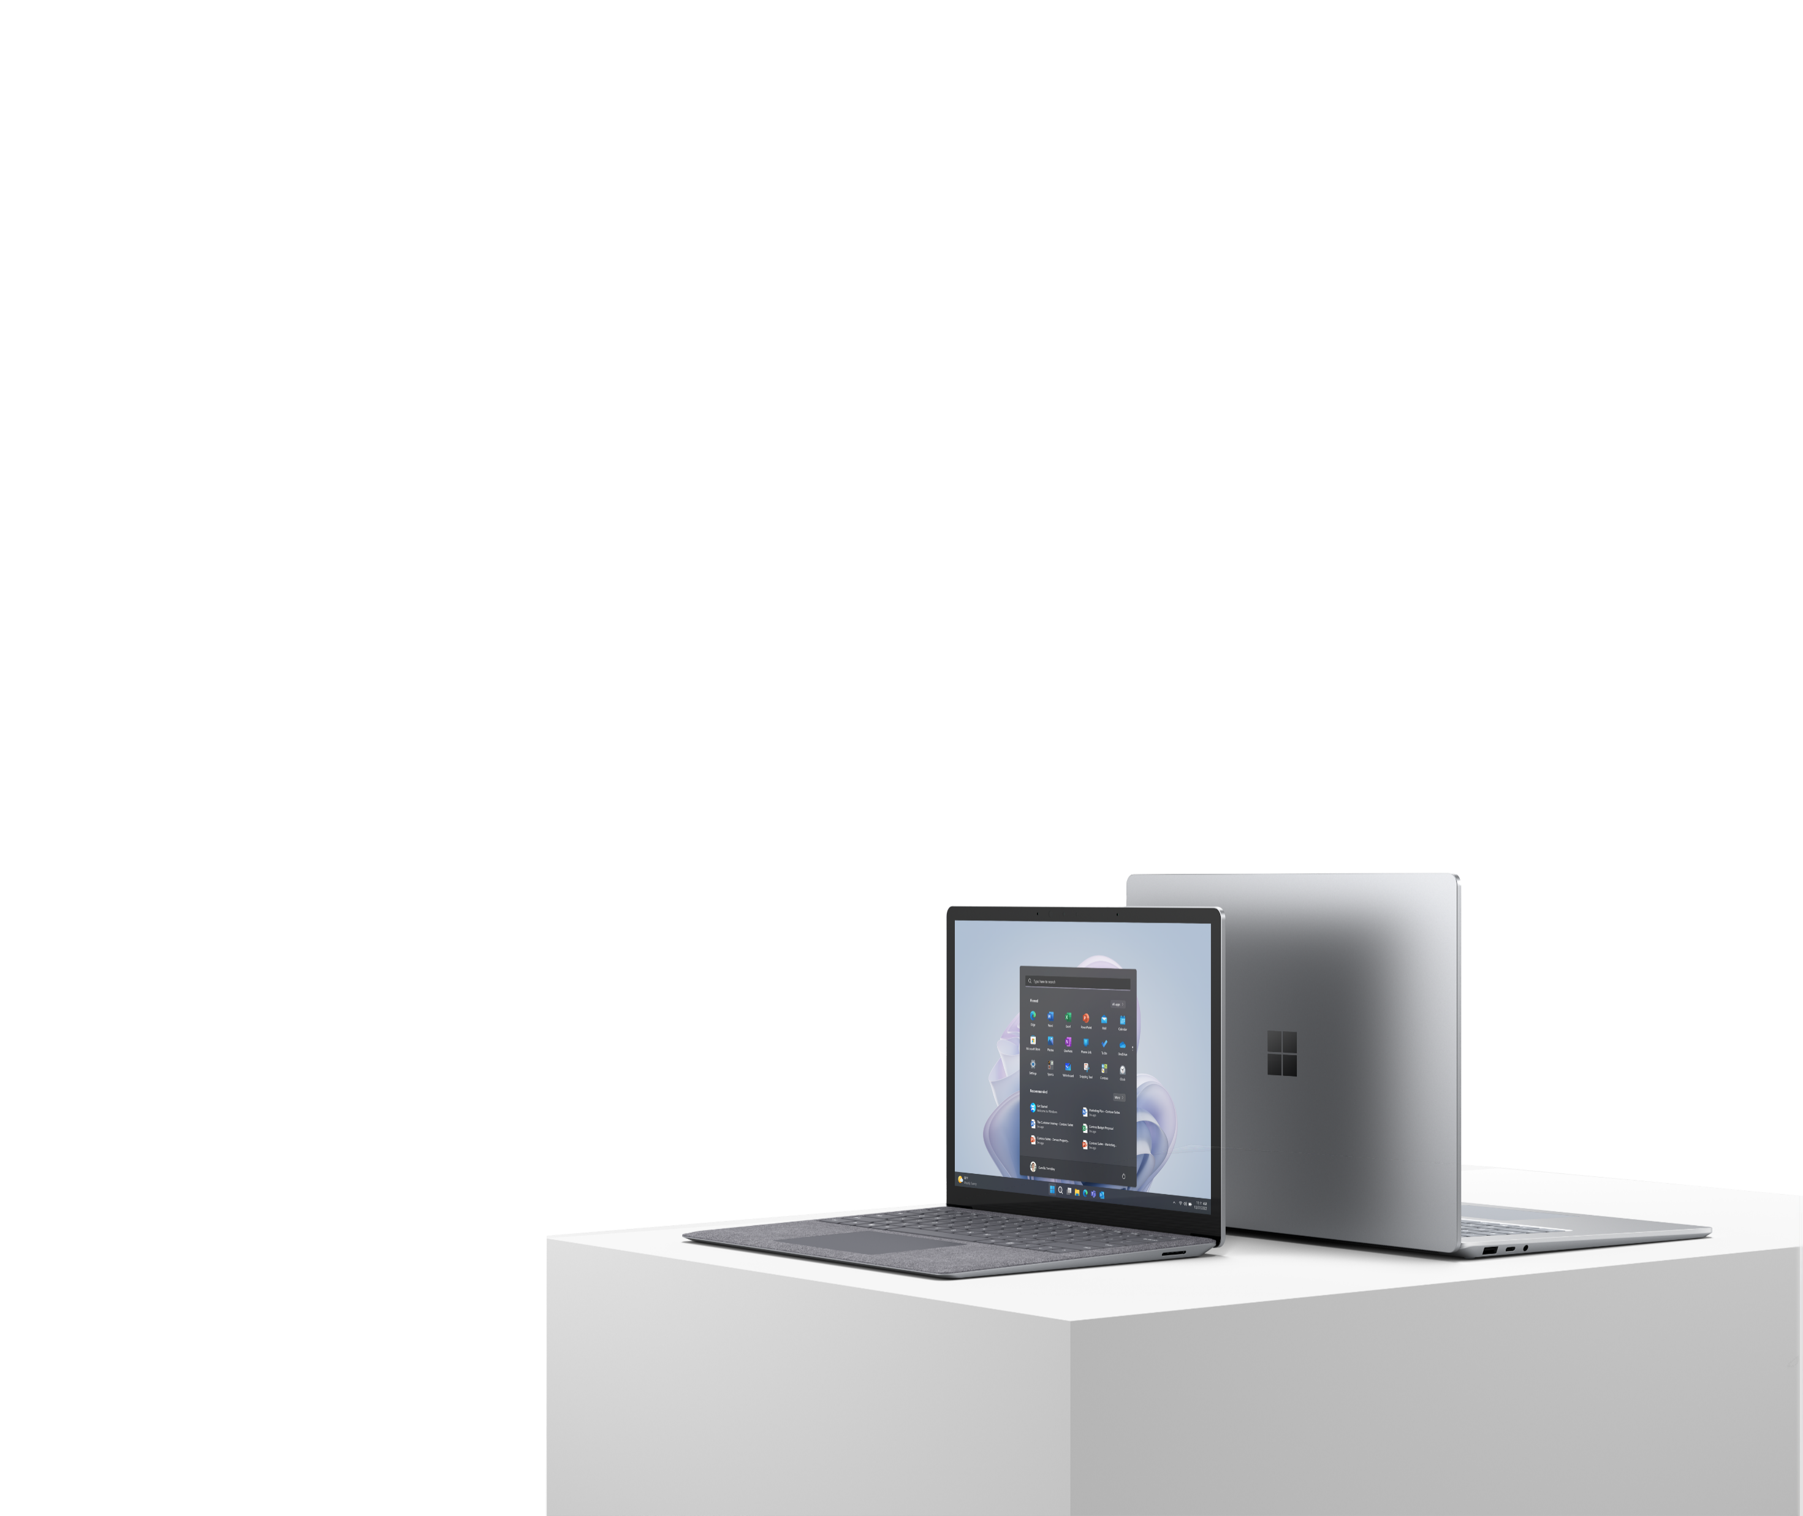
Explore ways to modernize your workplace with Microsoft Surface
In the new era of modern work, flexibility, empowerment, and resilience are the paths to success.
A modern device strategy prioritizes the employee experience to deliver better business outcomes with hardware built for flexible and productive environments.
Join us for the Modernize with Surface Workshop to meet the challenges of modern business head-on.
See what Surface can do for your business
For the Modernize with Surface Workshop, [PARTNER NAME] consultants' partner with you to identify challenges, pain points, and opportunities. We’ll develop an actionable plan to propel your organization into the future of work and set the stage for resilience and innovation in a changing world.
Workshop highlights
We’ll work with you to:
Assess your needs and challenges through a customized workshop
Explore ways that Microsoft Surface can support your goals to improve business outcomes
Inform how Surface can help reduce costs and improve business agility
Build a plan tailored to your business with concrete next steps that work for you
Who should attend
The workshop is intended for:
IT decision makers
Business decision makers
Chief Information Officer (CIO)
IT Operations
Business Architects
Solution Architects

Slide 2
FPO - Partner Logo
Modernize your business. Empower your workforce.
Discover the advantages of Microsoft Surface.
Unlock powerful productivity
Empower a productive everyday experience for employees by capturing the best of Microsoft on devices with the power, battery life, and connectivity they need to thrive.
Industry-leading security
Protect your business and your customers with chip-to-cloud security, protection down to the firmware layer, and complete control through remote device management.
Versatile and adaptable
Give your people the benefits of versatile form factors, premium inking and touch, high-quality displays, mics, and cameras, and an adaptable ecosystem of flexible accessories.
Maximize your technology investment
Extend your total cost of ownership with devices built around quality craftsmanship, accessible design, and sustainability.
Why [PARTNER NAME]?
With extensive solution development experience, [PARTNER NAME] can help you bridge the gap between your employees’ day-to-day realities and your organization’s future opportunities. Our industry and technology experience makes us a trusted partner in our customers’ transformation journeys. We’ll work with you to understand your environment and identify opportunities to help you modernize your organization through technology.
Contact us today to get started
[PARTNER NAME]
[PARTNER EMAIL]
[PARTNER PHONE]
[PARTNER ADDRESS]
Explore Microsoft Surface for Business solutions >

