Slide 1
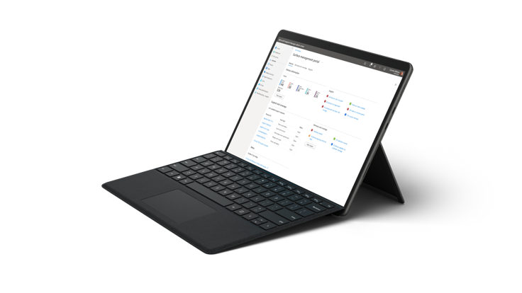
[Partner logo]
Live online event
Surface Modern
Workshop
Sponsored by
Partnering with Microsoft, we are proud to invite you to our Surface Modern Workshop event. We know customers are searching for modern solutions to today’s technology challenges. [Partner Company] is inviting select customers to learn how Surface and Microsoft 365 address these challenges and provide an integrated hardware and software experience.
During our time together, you’ll be briefed on the Surface device family, new approaches to modern management with Windows Autopilot, and how [Partner Company] can bring it all together for you.
Workshop agenda
Surface and the Modern Workplace
Surface Portfolio Updates
Remote Work with Microsoft Teams
Modern Management in Microsoft 365
Zero-Touch Deployment with Windows Autopilot
Surface Device-as-a-Service
Live Q&A
[Month] [day], [year]
[time]
Join us for the live event!
Register now

