Slide 1
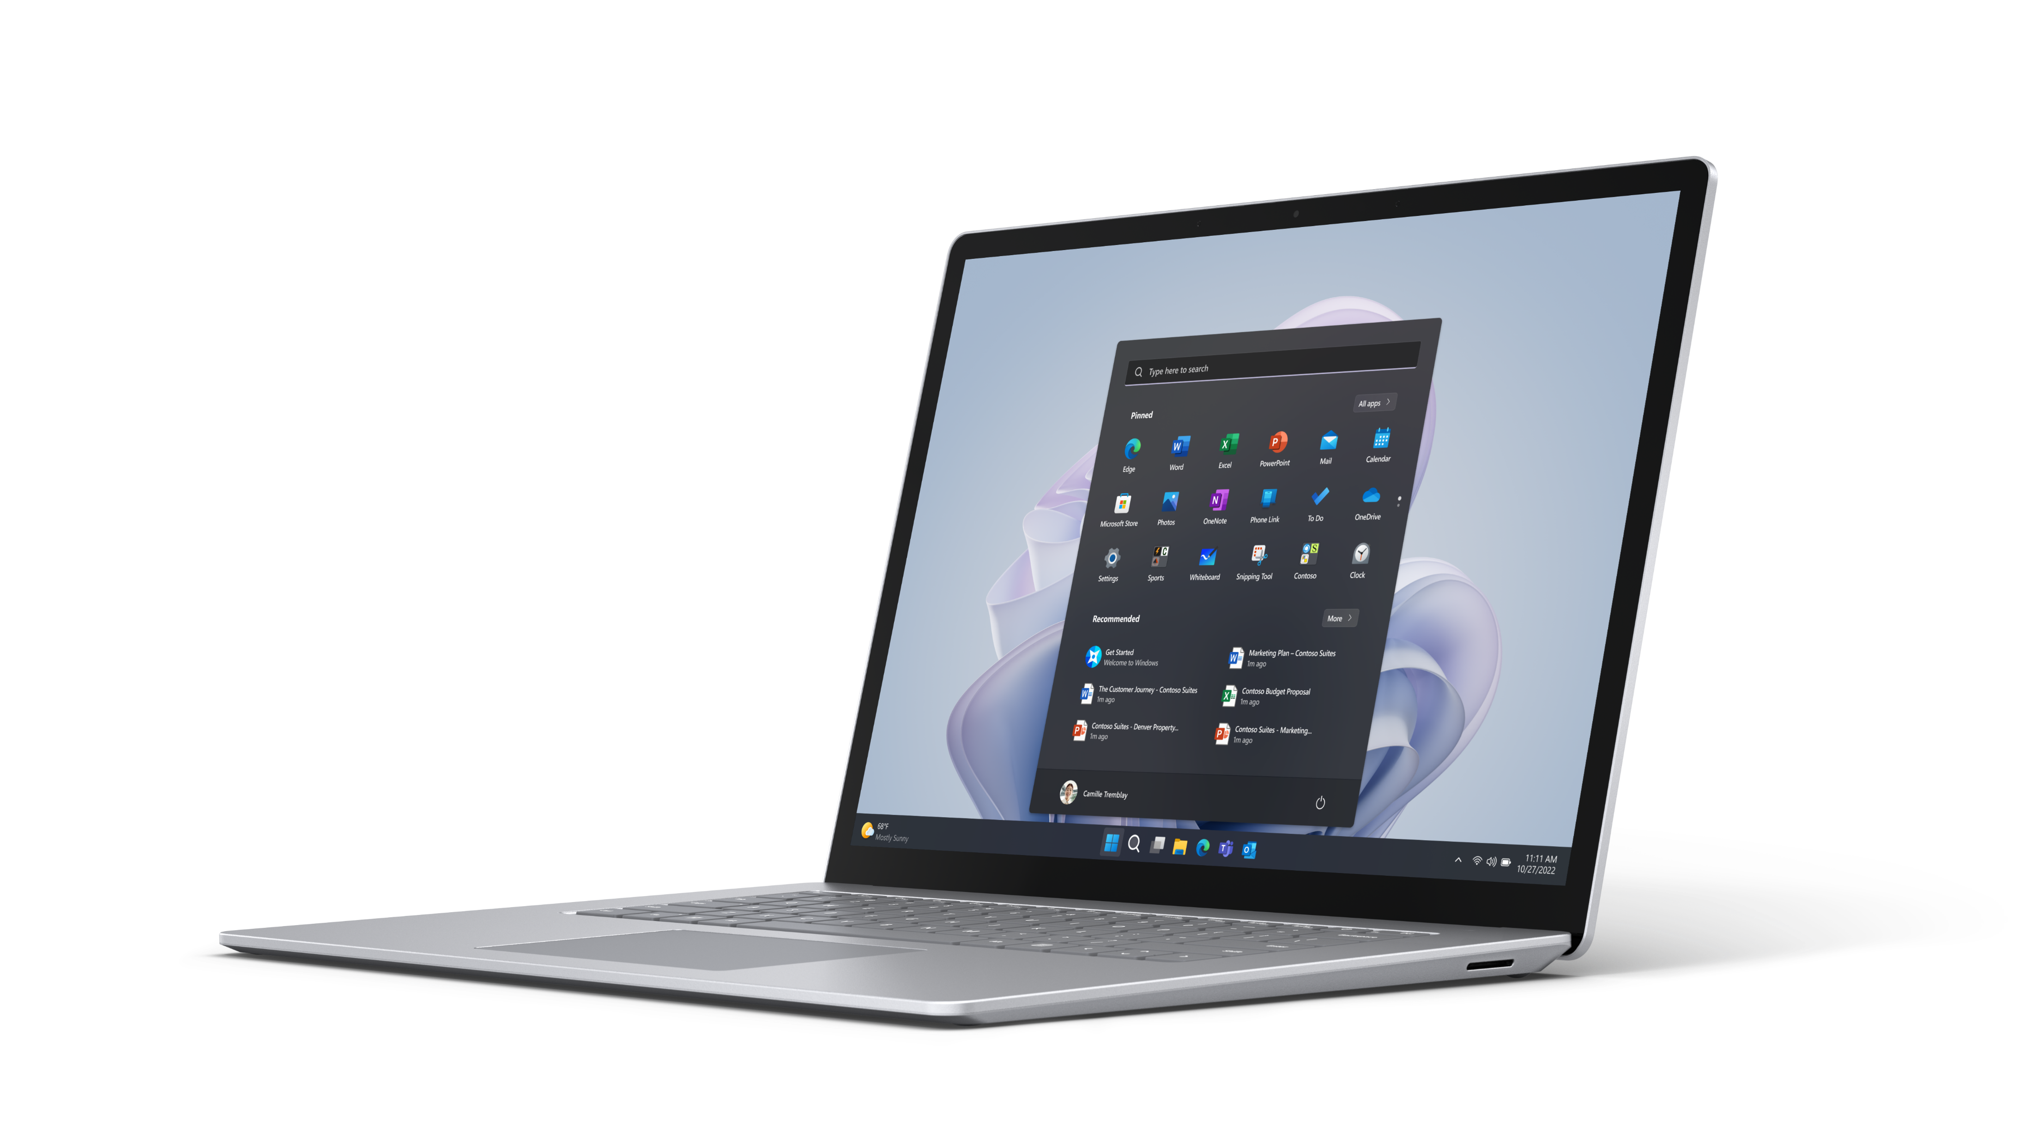
Save up to $100¹ on Surface Laptop 5
Explore Limited-Time Savings on Surface
Surface Laptop 5 for Business
Take advantage of limited time savings on Surface Laptop 5 and experience lightning-fast productivity, sleek portability, an enhanced camera for more engaging video calls, and built-in security.
Save up to
$100¹
Reach out to your Surface specialist or partner rep today! This offer is good for commercial customers from April 1 – June 30, 2024.¹
¹Savings based on US MSRP. Contact your partner for full details including SKU level eligibility. Final discounts determined by authorized reseller. Valid from 04/01/24 – 06/30/24 only through participating Surface Commercial Authorized Resellers in the 50 United States and the District of Columbia.
²ERP listed is for Windows 11 and Windows 10 SKUs
Notes:
Source 2: A Business Value White Paper, commissioned by Microsoft September 2022 (IDC)
Source 3: A commissioned Total Economic Impact™ study conducted by Forrester Consulting on behalf of Microsoft, July 2020. “Maximizing Your ROI from Microsoft 365 Enterprise With Microsoft Surface.”; Evaluating the Business Case of Microsoft Surface-IDC

Slide 2
Save up to $100¹ on Surface Laptop 5
Explore Limited-Time Savings on Surface
Surface Laptop 5 Win 11 | Estimated Retail Price² | Discount $¹
SrfcLpt5 13in i5/8/256 CM W11 | $1,099.99 | $75.00
SrfcLpt5 13in i5/8/512 CM W11 | $1,399.99 | $75.00
SrfcLpt5 13in i5/16/256 CM W11 | $1,499.99 | $100.00
SrfcLpt5 13in i5/16/512 CM W11 | $1,599.99 | $100.00
SrfcLpt5 13in i7/16/256 CM W11 | $1,699.99 | $100.00
SrfcLpt5 13in i7/16/512 CM W11 | $1,799.99 | $100.00
SrfcLpt5 13in i7/32/512 W11 | $2,199.99 | $100.00
SrfcLpt5 13in i7/32/1TB CM W11 | $2,399.99 | $100.00
SrfcLpt5 15in i7/8/256 CM W11 | $1,399.99 | $75.00
SrfcLpt5 15in i7/8/512 CM W11 | $1,599.99 | $75.00
SrfcLpt5 15in i7/16/256 CM W11 | $1,799.99 | $100.00
SrfcLpt5 15in i7/16/512 CM W11 | $1,899.99 | $100.00
SrfcLpt5 15in i7/32/1TB CM W11 | $2,499.99 | $100.00
Surface Laptop 5 Win 10 | Estimated Retail Price² | Discount $¹
SrfcLpt5 13in i5/8/256 CM W10 | $1,149.99 | $75.00
SrfcLpt5 13in i5/8/512 CM W10 | $1,449.99 | $75.00
SrfcLpt5 13in i5/16/256 CM W10 | $1,549.99 | $100.00
SrfcLpt5 13in i5/16/512 CM W10 | $1,649.99 | $100.00
SrfcLpt5 13in i7/16/256 CM W10 | $1,749.99 | $100.00
SrfcLpt5 13in i7/16/512 CM W10 | $1,849.99 | $100.00
SrfcLpt5 13in i7/32/512 CM W10 | $2,249.99 | $100.00
SrfcLpt5 13in i7/32/1TB CM W10 | $2,449.99 | $100.00
SrfcLpt5 15in i7/8/256 CM W10 | $1,449.99 | $75.00
SrfcLpt5 15in i7/8/512 CM W10 | $1,649.99 | $75.00
SrfcLpt5 15in i7/16/256 CM W10 | $1,849.99 | $100.00
SrfcLpt5 15in i7/16/512 CM W10 | $1,949.99 | $100.00
SrfcLpt5 15in i7/32/1TB CM W10 | $2,549.99 | $100.00
¹Savings based on US MSRP. Contact your partner for full details including SKU level eligibility. Final discounts determined by authorized reseller. Valid from 04/01/24 – 06/30/24 only through participating Surface Commercial Authorized Resellers in the 50 United States and the District of Columbia.
²ERP listed is for Windows 11 and Windows 10 SKUs
Notes:
Source 2: A Business Value White Paper, commissioned by Microsoft September 2022 (IDC)
Source 3: A commissioned Total Economic Impact™ study conducted by Forrester Consulting on behalf of Microsoft, July 2020. “Maximizing Your ROI from Microsoft 365 Enterprise With Microsoft Surface.”; Evaluating the Business Case of Microsoft Surface-IDC

