Slide 1
FY24 Surface ECIF 101
For Microsoft Partners

Slide 2
10 things to know about ECIF
ECIF – End Customer Investment Funds
Funding is paid to the ECIF approved partner, never to the customer
ECIF re-certification occurs annually.
ECIF work cannot be started by the partner until the ECIF PO is approved & issued.
ECIF funds are use it or lose it. Funds cannot be earmarked nor rollover.
Projects should be completed within 90 days.
Multiple milestones are required in project crosses quarters or $50K+. Milestones need to be a minimum of 10 days apart.
Each milestone requires the submission of an invoice, and the customer will receive a POE (Proof of Execution) for each as well.
Funding requested should be based on cost of technical services. Not to buy down equipment, “promised” funding or matching a competitor.
Microsoft’s Fiscal Year runs July 1 thru June 30. H1 is July 1 – December 31. H2 is January 1 – June 30.
MS Finance asks that all projects complete by the 15th of the last day of the quarter to ensure invoicing can be completed on/before close of the quarter.

Slide 3
FY24 Surface ECIF Program
What is Surface ECIF?
Investment funds to provide services to customers in order to help close sales.
What can Surface ECIF be used towards?
PRE-SALES
Proof of Concept (POC) to showcase value Surface devices and Hub
Customer assessments of Surface devices and Hub
Pre-sales architecture
POST-SALES
White-Glove deployment & migration services including Surface + Autopilot/Intune/MDM
Windows 10 and Windows 11 Surface device Imaging
Customer end user/power user/IT training & adoption
How do I request funding?
Connect with your SSP, verify you are ECIF Approved
Provide SSP with ECIF Work Scope via approved ECIF template
Ask your SSP for the MSX Opp ID(s) associated with the opportunity
SSP will submit the request via OneAsk.
Revenue Requirements
FY24 Products Supported:
Surface Pro 8 LTE, Surface Pro 9 & Laptop 5 with Core i5/16/256 or above
Surface Hub with minimum opportunity of 5 or more units. - revised for FY24H1, effective 7/21/23
Minimum ROI
Laptop, Pro: Max ECIF $30/device
Hub: 20X ROI
Maximum funding up to $30K for PoC/ACM type non-production service (pre-sales)
Maximum funding up to $249K for post-sales services contingent on winning the deal
​​​​​All ECIF requests between $250K-$500K must go thru the MW Sales program for funding.

Slide 5
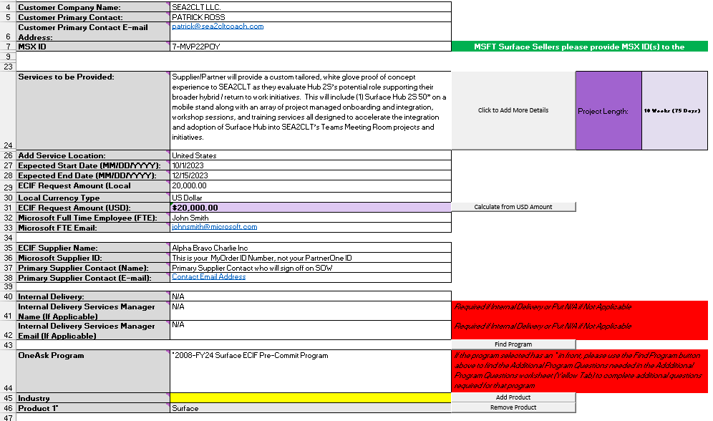
ECIF Work Scope – it’s all about the details
Reminders:
Approved ECIF Work Scope template required with submission
“Services to be Provided” section needs to include a brief yet detailed overview of the work occurring.

Slide 6
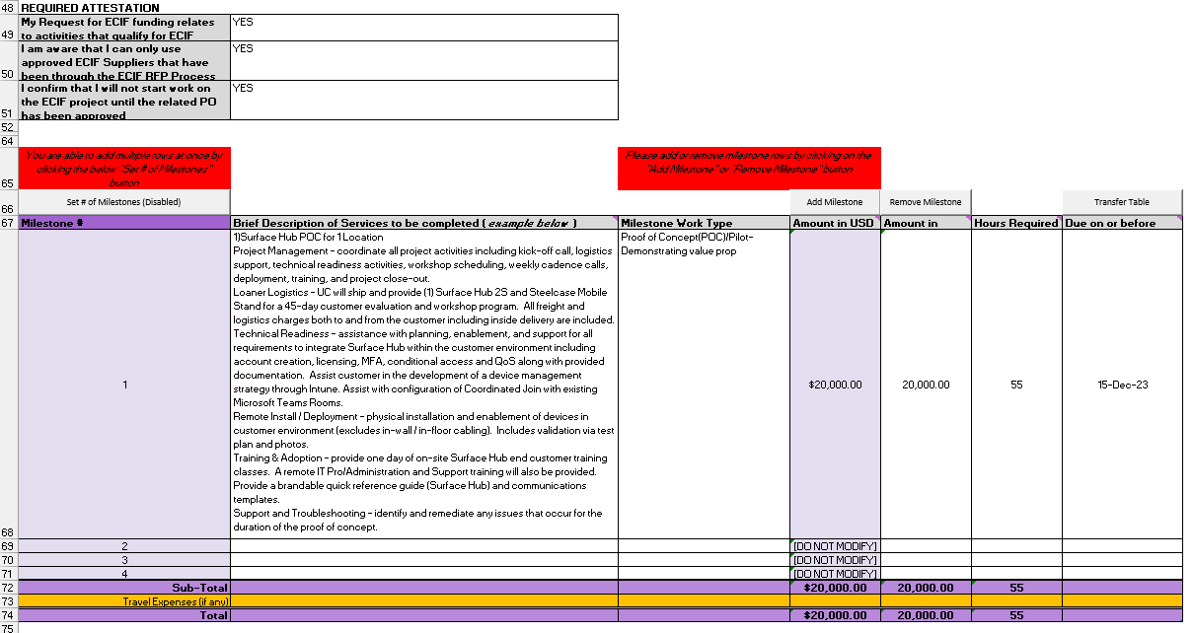
ECIF Work Scope – it’s all about the details
Reminders:
If project is $50K+ or crosses quarters, a minimum of (2) milestones are required.
Milestones need to provide detailed breakdown of the work that is happening. BE SPECIFIC yet brief.
“Hours Required” – this is amount of time it takes to complete that milestone. If you have 4 people working 8 hours that would be 32 hours required.

Slide 7
Submission to PO to Invoice
Submit request via OneAsk
US Local & Time zone review/approve request
(1-2 business days)
Program Owner review/approve request
(1-2 business days)
(if over $100K it will go to Program Owner’s manager for approval)
Finance review/ approval + IO Issued
(1-2 business days)
US Finance
FOR PUBLIC SECTOR ONLY
N&C sent via DocuSign to Customer POC & Microsoft SAFE approver
(1-2 business days)
SOW sent via DocuSign to Partner and Microsoft SAFE approver
(1-3 business days)
PO is raised and sent for approval to SAFE approver
(1-3 business days)
Approved PO communication sent to Requestor & Partner
Work can begin
Partner completes work within 90 days or by End Date
Partner submits Invoice to eInvoice (MSInvoice) tool
Proof of Execution (POE) template is sent to Customer POC to complete & return
Invoice & POE Review and Approved. Partner is paid.
Project Status updated to Closed & Completed

Slide 8
Thank you, Partners/Suppliers!

