Slide 1
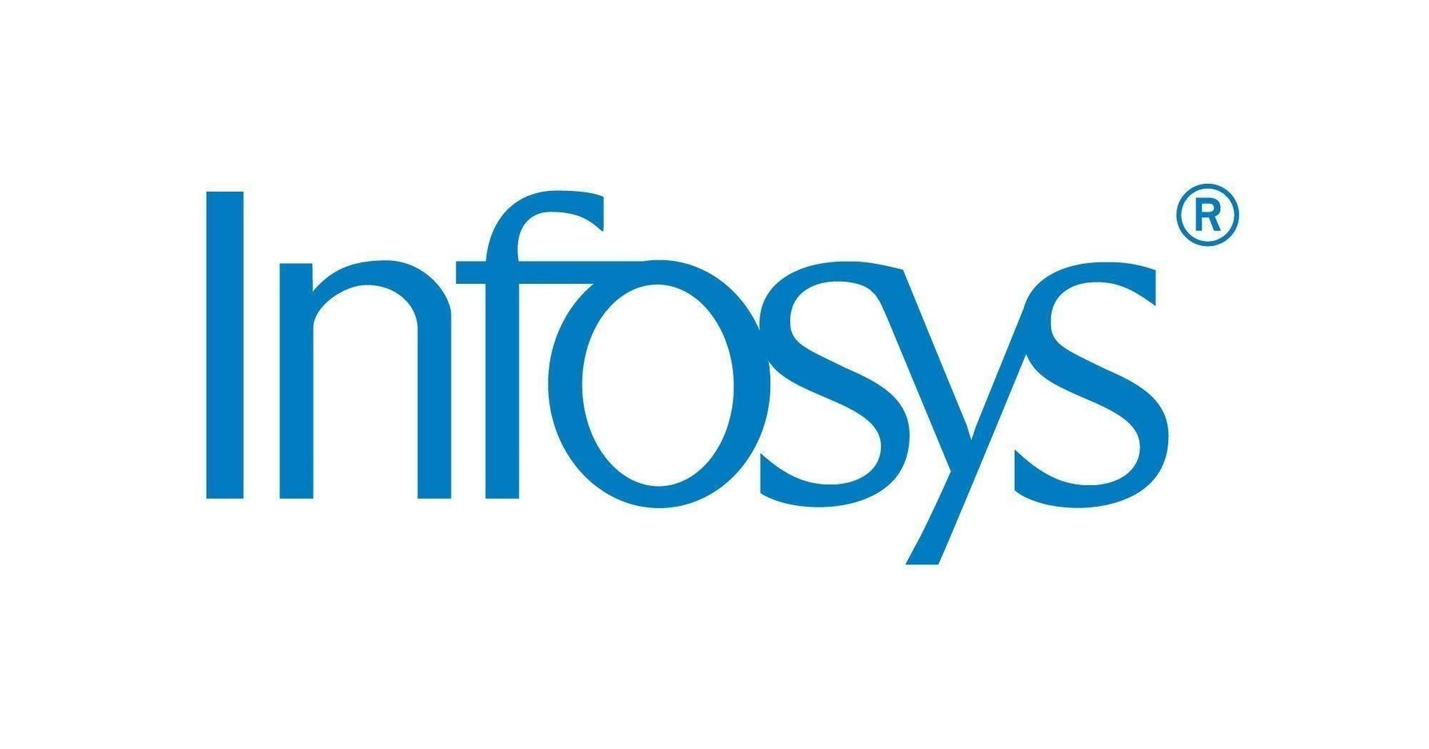
Infosys helps customers gain competitive advantage with Azure AI
Infosys is a global leader in next-generation digital services and consulting with over 30 years of experience managing global enterprise systems. The firm works to empower businesses with agile digital scale and helps customers in over 50 countries navigate digital transformation.
Infosys is an AI thought leader with an analytics and AI-powered core competency that prioritizes value realization and business transformation. The firm has worked with customers across multiple industries, including manufacturing, retail, healthcare, finance, oil and gas, and more to uncover how analytics, AI, and machine learning (ML) can solve specific business challenges.
A close collaborator with Microsoft for 25 years, Infosys is a recognized global leader in implementing Microsoft cloud technologies powered by Infosys Cobalt. Infosys relies on the Microsoft Azure cloud platform for its marquee AI and ML use cases. Microsoft offerings in this space represent a strategic edge for Infosys customers.
Using Azure services to change the game
Infosys created a transformative solution to help a leading global food and beverage company determine competitor product recipes, a key part of competitive intelligence. Traditionally, the customer relied on food labs to determine the makeup of competitor products, an expensive and time-consuming process. Using Azure ML, Infosys developed ML models that automatically reverse-engineer product formulations using publicly available information, such as nutrition data and labels.
Searching for actionable intelligence
Customers across industries need cloud-based AI and analytics services to transform and grow their business.
Using Azure services to change the game
Infosys implements Microsoft Azure cloud technologies to give businesses a strategic edge.
Anticipating an innovative future
With Infosys solutions on Azure, customers are gaining competitive intelligence and automating key business processes.
“Azure has completely changed the game for data analysts because an analyst with some training can build models, deploy them, and make them available for the end users, all inside this cloud framework.”
— Srujan Darsi, Lead Consultant, Analytics at Infosys

Slide 2
Infosys also integrated market-share information in the framework to prioritize data on competitors’ products. The model shows which recipes the company should make a priority, based on the impact of recipe changes or new recipe releases.
This solution was built on Azure Machine Learning, which simplifies and automates ML management. The Azure service enables Infosys to try several different models, keep track of successes and failures, and find patterns across various experiments.
Azure ML provides libraries that helped Infosys build, train, refresh, and publish the ML models. These libraries feature out-of-the-box functionality, cutting down on the amount of code that the Infosys team needed to write.
Infosys also used Azure data solutions for this project, including Data Lake Storage. Infosys was able to load huge datasets using ML workspaces, increasing confidence in the results.
Infosys deployed Azure Data Factories (ADF) for serverless data integration and to move data between the original source and ML workspaces. This allowed business users to schedule the ML process through a simple file drop operation into a network-shared folder, without the need to rely on data scientists or analysts.
The customer realized several immediate benefits from the Infosys solution. Now it can:
Track competitors on a near real-time basis in terms of cost, product composition, and variety of recipes
Complete investigations in hours, at 80 percent
accuracy, versus six months previously
Continuously benchmark against more than 200 competitors, versus only a few top competitors previously
The customer has also expanded the consumption of insights to other groups across the company and is looking to grow this capability in other regions in addition to the U.S.
The Infosys solution has the potential to disrupt food testing R&D globally, with wide applicability across product categories in the packaged food industry.
Helping a customer win with automated pricing
Infosys helped a major U.S. transportation company surge ahead in the digital brokerage market with a pricing solution leveraging Azure AI and ML. Previously, the customer used manual methods and simple models to generate price quotes, resulting in overbidding that squeezed profit margins.
Infosys built ML models that automatically generate accurate price quotes using the company’s historical data and third-party data, allowing the company to submit winning bids while increasing margins. This solution is built on Azure Databricks analytics architecture, which was used to develop the model. Running Databricks, Infosys could try more than 20 ML models until it found the right ones.
“We were able to do a lot of experimentation, and this was possible only due to the infrastructure offered by Microsoft Azure, as well as the fact that build times and runtimes are much shorter in the Azure environment compared to native
“We were able to do a lot of experimentation, and this was possible only due to the infrastructure offered by Microsoft Azure.”
— Thilak Kumar, Manager, Analytics Technology at Infosys
This case study is for informational purposes only. MICROSOFT MAKES NO WARRANTIES, EXPRESS OR IMPLIED, IN THIS SUMMARY. Document published September 2021.

Slide 3
environments,” says Thilak Kumar, Manager, Analytics Technology at Infosys.
The Log Analytics tool in the Azure portal helped the team scrutinize the intermediate results and swiftly change code to arrive at an optimal solution. Infosys also used Azure SQL Database to save the model’s outputs, which are conveniently accessed by end users via a web browser. Infosys stored and processed the raw data in an Azure data lake.
After the price quote solution was implemented, the Infosys team needed to find a secure way for many more users to access it. With Azure Key Vault, they saved user IDs and passwords, allowing access to the solution while keeping personal data confidential.
The model is now in production and the results look promising. With the solution, the company can:
Increase savings
Process more requests in less time
Improve bid win rate
Increase cost margin per employee per day
Make higher quality formulation decisions
Allocate resources to higher value activities
Because few companies in the space have this capability, the customer has gained a competitive advantage and now aims to double its revenues. The company is working on expanding the program this year.
Leveraging a powerful platform and deep experience
Azure enables Infosys to accelerate customers’ digital journey with AI and ML, harnessing the power of Microsoft technologies to deliver innovation, agility, and scale. Azure’s flexibility and automation allow Infosys problem solvers to focus on customer challenges, not infrastructure.
“Azure has completely changed the game for data analysts because an analyst with some training
can build models, deploy them, and make them available for the end users, all inside this cloud framework,” says Srujan Darsi, Lead Consultant, Analytics at Infosys.
Infosys has also found Microsoft to be exceptionally responsive, offering hands-on help to solve problems. For the food and beverage customer, for example, Microsoft experts supported Infosys in resolving problems of how to scale infrastructure and store data. Similarly, Microsoft helped Infosys overcome hiccups during the development process on the transportation solution and worked closely with the team to quickly resolve the issues.
“Data is the most strategic asset for every business. Together with Infosys, we are empowering organizations to realize superior business value through the power of analytics and AI,” says Simran Sachar, Microsoft Director of Analytics, AI & Industry, Global Partner Solutions. “We are co-innovating with Infosys on exciting new analytics and AI solutions across industries to help customers achieve their business goals.”
Anticipating an innovative future
For the teams working on the solutions for the transportation company and the food and beverage enterprise, the collaboration with Microsoft allowed the Infosys team to successfully show its capabilities. The success and positive feedback on these projects empower Infosys to approach other clients with greater confidence.
Infosys will continue to build on its collaboration with Microsoft to grow its practices in analytics, AI, ML, and data engineering, pursuing its mission to deliver business value by making these technologies pervasive in enterprises. It will execute cutting-edge use cases that blend seamlessly into customers’ technology implementations.
With Microsoft’s industry-leading engineering and Infosys’ solution delivery capabilities, the two companies will help organizations lean into transformation, elevate their business functions, and leap ahead of the competition.
This case study is for informational purposes only. MICROSOFT MAKES NO WARRANTIES, EXPRESS OR IMPLIED, IN THIS SUMMARY. Document published September 2021.

