Slide 1
How to use this deck
To-Customer Surface Modern Workshop – Social media guide
This deck is your social media guide that includes ready-made imagery and suggested copy to evangelize the Surface Modern Workshops.
Each section is divided by focus area. Slides are set to a standard LinkedIn shared image size for compatibility and can be easily added or exported as individual images easily through PowerPoint.
To save as images go to File > Save as > Select “PNG Portable Network Graphics Format” (.png)” as the file type > Save > When asked what slides you want to export choose “All slides”
Once saving is complete, navigate to the folder where you saved them, and you’ll find a new folder with each slide as its own .PNG
Speaker notes contain the suggested copy for each post with placeholders for the date and time. Feel free to copy and paste or modify as needed.
Highlights have been added to the Partner branding and date/time placeholders for the partner company. Feel free to edit accordingly.
Only Microsoft Partners participating in the Surface Modern Workshop Program are authorized to use this content.
For any more information contact:
SWIF-SMW Team
swif@microsoft.com

Slide 2
Surface Modern Workshop
Discover the magic of Zero-touch deployment
REGISTER NOW
Date/Time
Sponsored by
Partner Logo
Notes:
COPY 1: Zero-touch deployment means one less thing to touch. Equip your team with the latest Surface devices, handsfree. Join us on [DATE] to find out how.
COPY 2: Mix-and-match works for socks and ice cream; not for system deployments. Having a single, streamlined, device deployment strategy saves time and money. Let us show you how on [DATE]

Slide 3
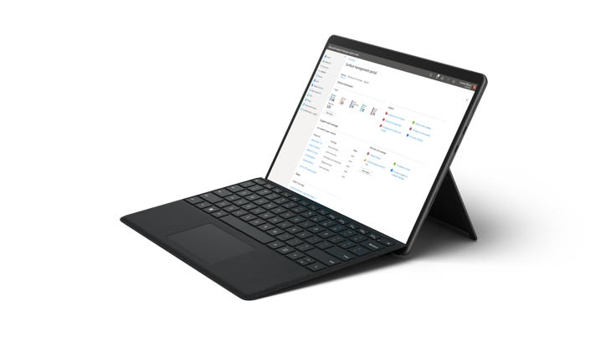
Surface Modern Workshop
Device deployment made easy. No touching required.
Find out how on our live online event
Date/Time
Sponsored by
Partner Logo
Notes:
COPY 1: Zero-touch deployment means one less thing to touch. Equip your team with the latest Surface devices, handsfree. Join us on [DATE] to find out how.
COPY 2: Mix-and-match works for socks and ice cream; not for system deployments. Having a single, streamlined, device deployment strategy saves time and money. Let us show you how on [DATE]

Slide 4
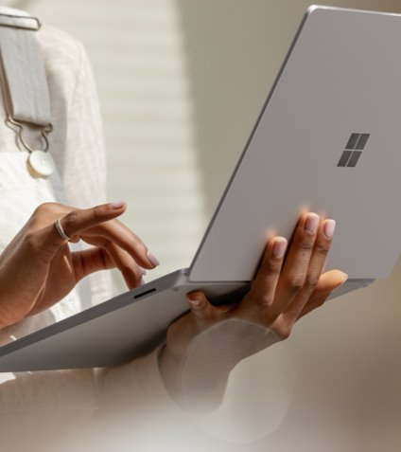
Surface Modern Workshop
Discover Surface Devices-as-a-Service
REGISTER NOW
Date/Time
Sponsored by
Partner Logo
Notes:
COPY 1: Using an emoji, how different would your life be if you didn't have to buy all your devices outright? On [DATE], find out how Surface Devices-as-a-Service lets you scale quickly without the overhead:
COPY 2: Steps to upgrade to Surface: 1. pick a device 2. pay monthly 3. scale fast. …That's pretty much it! Surface Devices-as-a-Service frees you from one-time expenses and keeps you current. Find out how on [DATE]:

Slide 5
Surface Modern
Workshop
Date/Time
Surface Devices-as-a-Service
Step 1: Pick a device
Step 2: Pay monthly
Step 3: Scale fast
REGISTER NOW
Sponsored by
Partner Logo
Notes:
COPY 1: Using an emoji, how different would your life be if you didn't have to buy all your devices outright? On [DATE], find out how Surface Devices-as-a-Service lets you scale quickly without the overhead:
COPY 2: Steps to upgrade to Surface: 1. pick a device 2. pay monthly 3. scale fast. …That's pretty much it! Surface Devices-as-a-Service frees you from one-time expenses and keeps you current. Find out how on [DATE]:

Slide 6
Surface Modern Workshop
Date/Time
Register now for the live online event
Sponsored by
Partner Logo
Notes:
COPY 1: Working remotely can be full of distractions. Don't let your devices become one of them. Surface fades into the background so you can stay on task. Find out how on [DATE]:
COPY 2: Whether you're working from your bed, the kitchen, a home office, or the roof, Surface is the ultimate device for work from wherever. Join us on [DATE] to discover why:

Slide 7
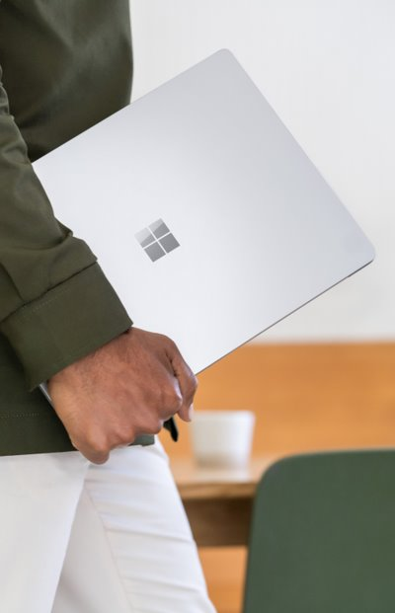
Surface Modern Workshop
Join us for the live online event
Date/Time
Work from:
Bed
Kitchen
Office
Basement
Anywhere
REGISTER NOW
Sponsored by
Partner Logo
Notes:
COPY 1: Working remotely can be full of distractions. Don't let your devices become one of them. Surface fades into the background so you can stay on task. Find out how on [DATE]:
COPY 2: Whether you're working from your bed, the kitchen, a home office, or the roof, Surface is the ultimate device for work from wherever. Join us on [DATE] to discover why:

Slide 8
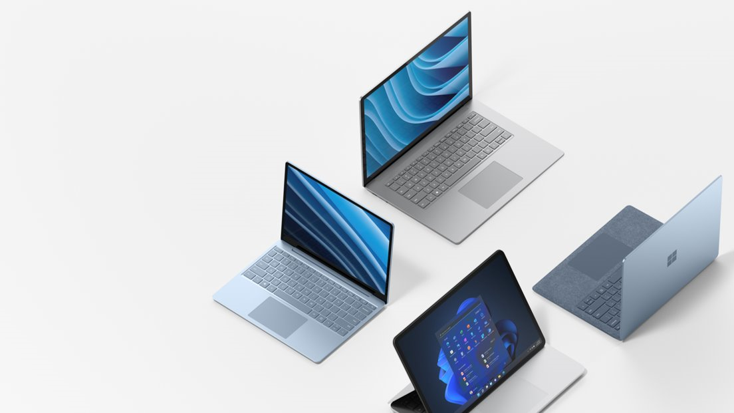
Date/Time
Surface Modern Workshop
Join us for the live event!
Sponsored by
Partner Logo
Notes:
COPY 1: You deserve devices that aren't one-size-fits-all. You deserve devices that work the way you do. On [DATE], learn how Surface for Business is different.
COPY 2: Experience the luxury of choice with Surface for Business. Join us on [DATE] and meet the device family for your work family.

Slide 9
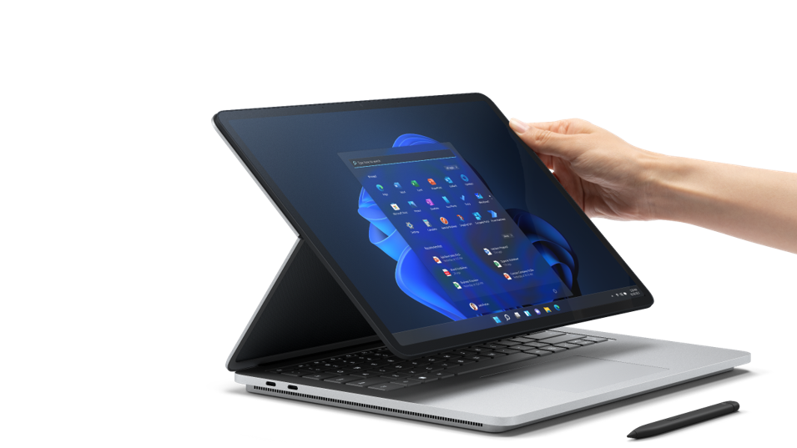
Join us for the Surface Modern Workshop
Partner Logo
80%
agree that Surface devices help position their organization as a top employer
Date/Time
Sponsored by
Notes:
COPY 1: You deserve devices that are just as good as you are. On [DATE], learn how Surface for Business is different.
COPY 2: Experience the luxury of choice with Surface for Business. Join us on [DATE] and meet the device family for your work family.

