Slide 1
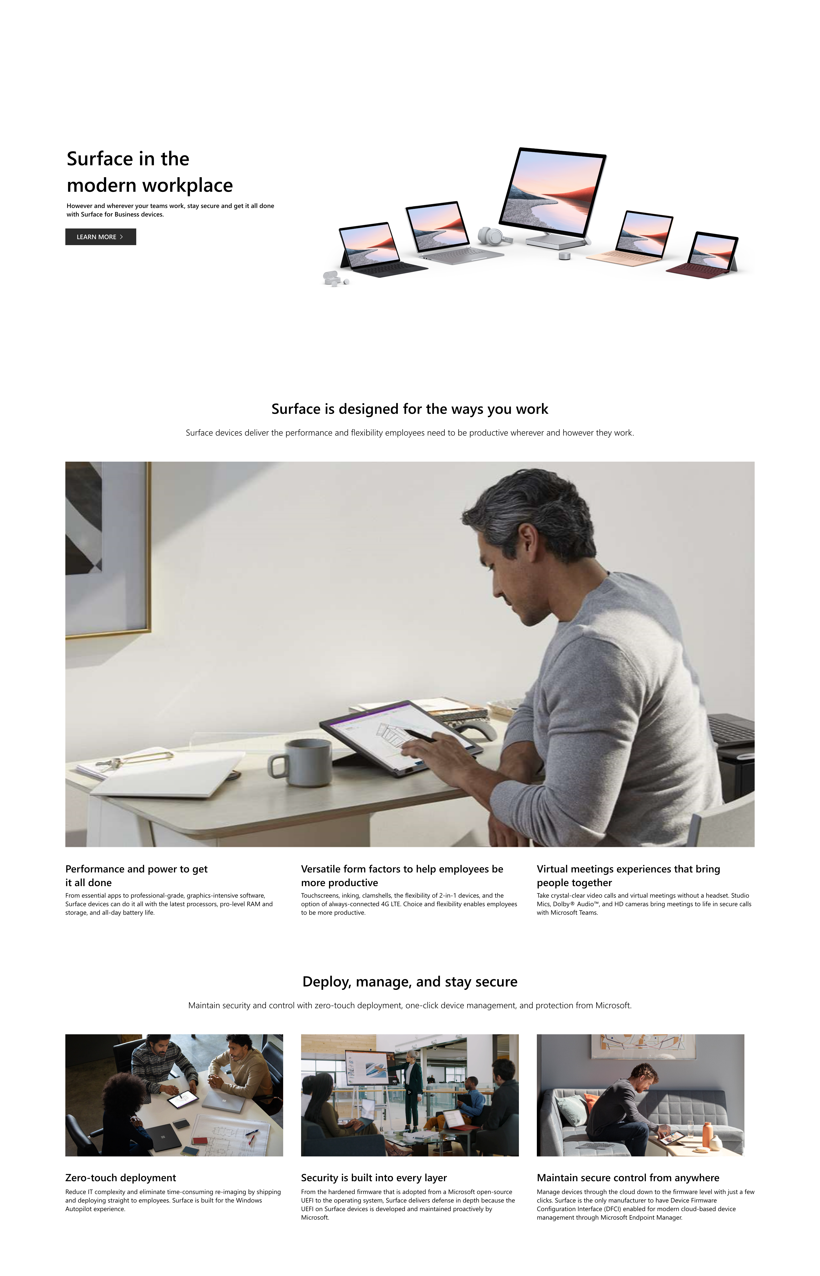
PARTNER WEB COMP

Slide 2
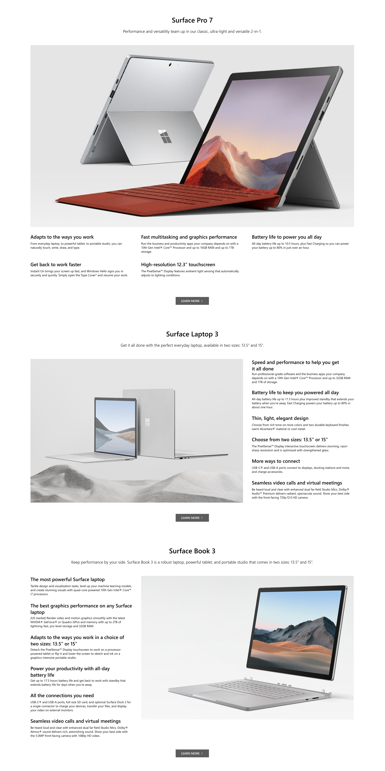
PARTNER WEB COMP

Slide 3
PARTNER WEB COMP

Slide 4
PARTNER WEB COMP

Slide 5
PARTNER WEB COMP

Slide 6
PARTNER WEB COMP

Slide 7
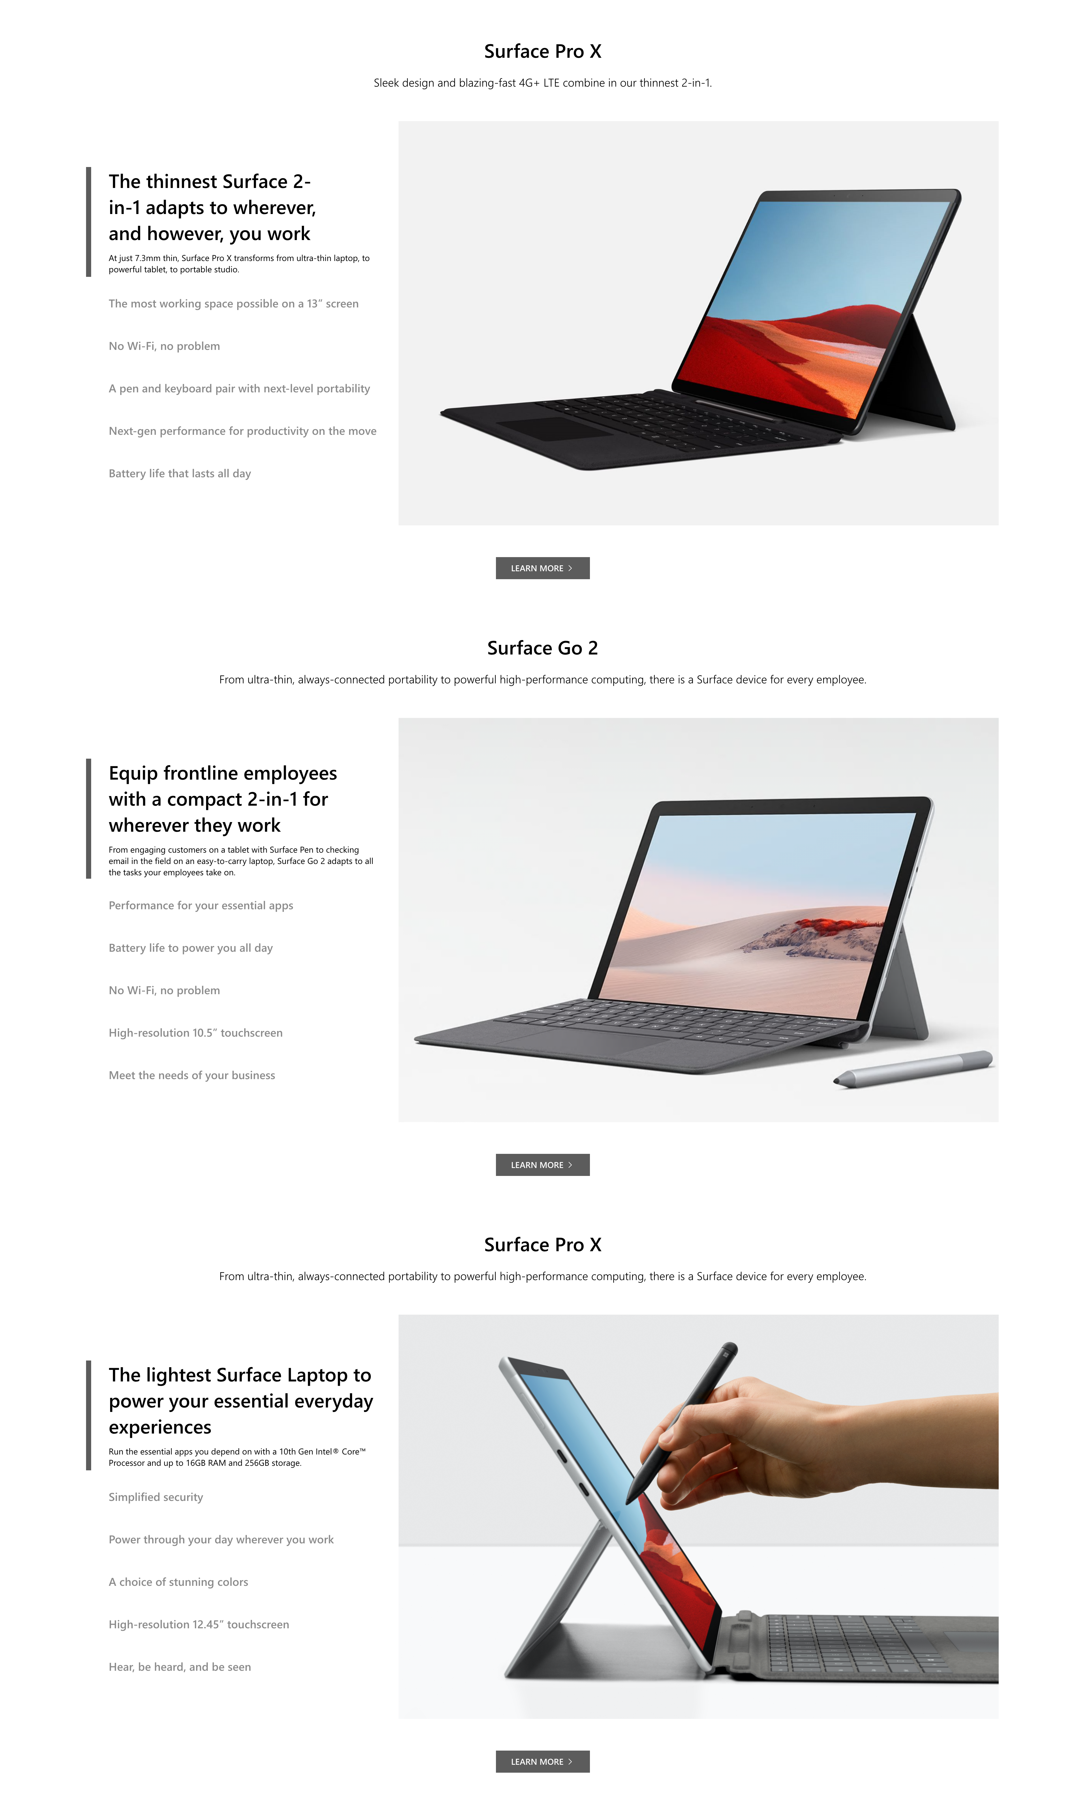
PARTNER WEB COMP

Slide 8
PARTNER WEB COMP

Slide 9
PARTNER WEB COMP

Slide 10
PARTNER WEB COMP

Slide 11
PARTNER WEB COMP

Slide 12
PARTNER WEB COMP

Slide 13
PARTNER WEB COMP

Slide 14
PARTNER WEB COMP

