Slide 1
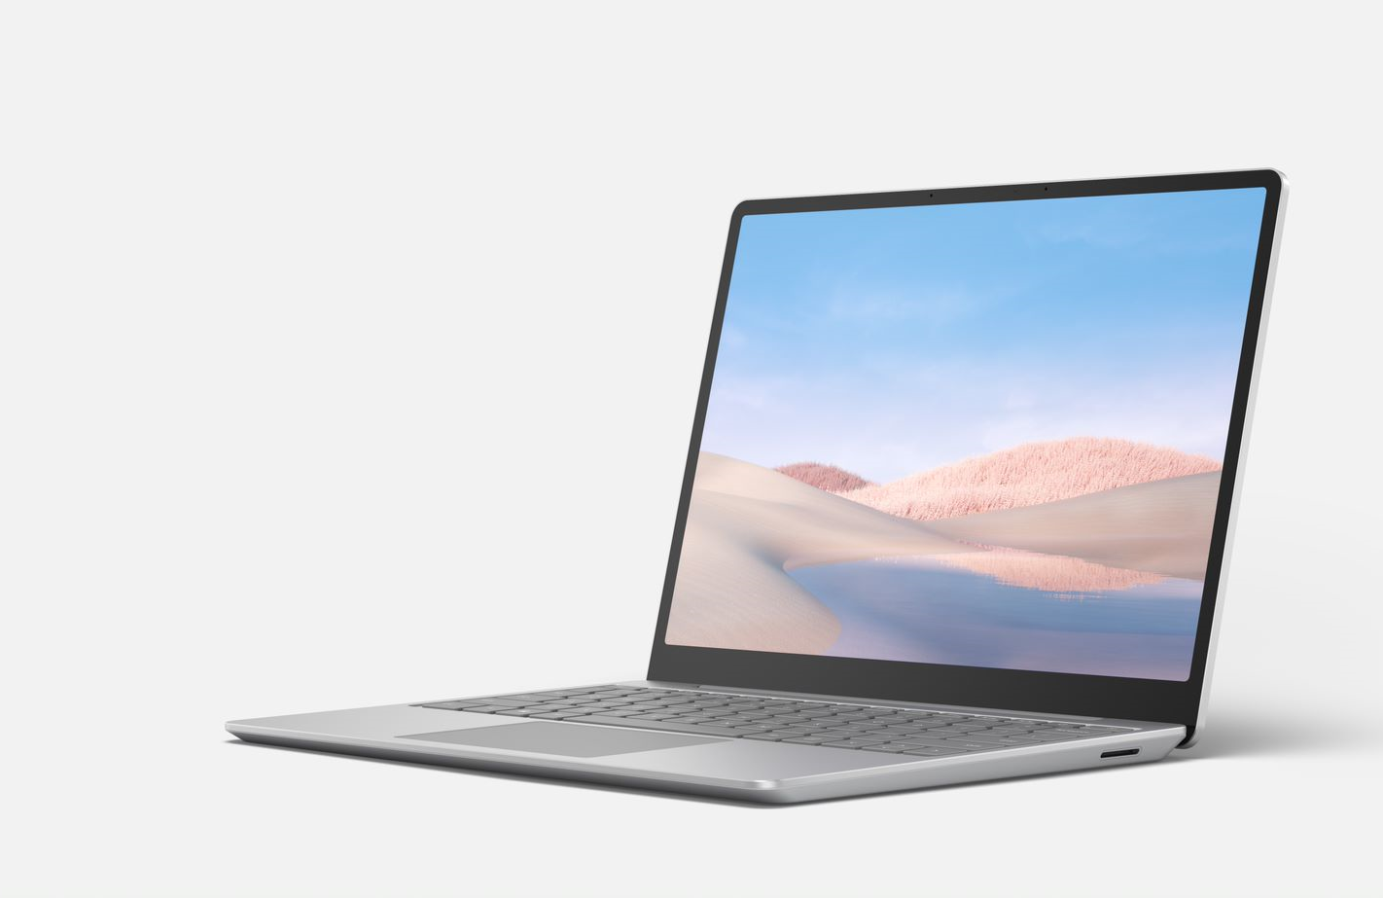
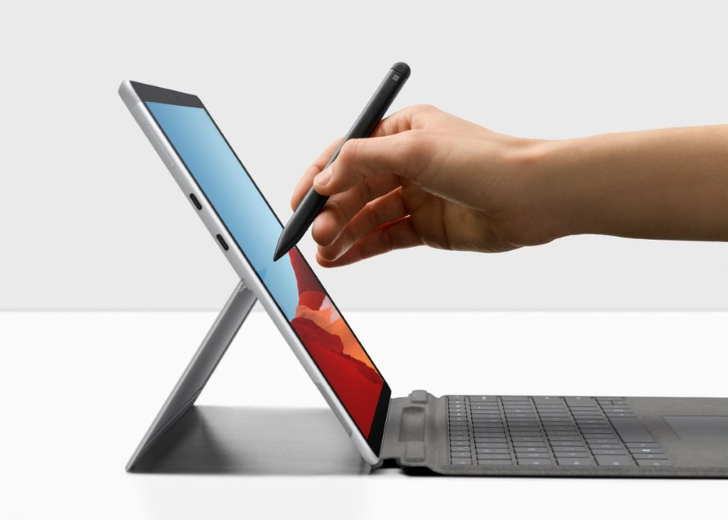
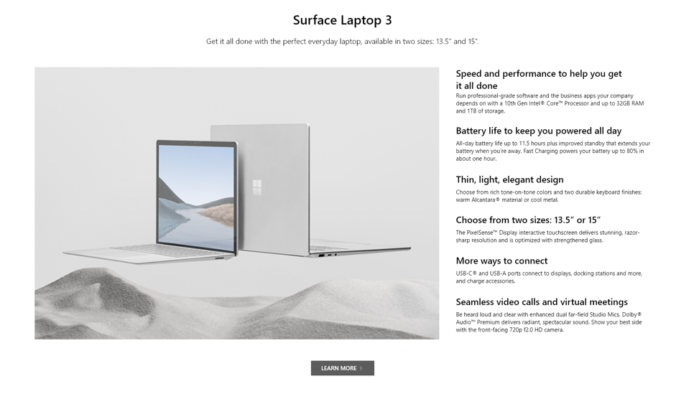
Partner web comp guidance
Considerations when using the Partner web comps
We want to ensure all Microsoft Partners are equipped with guidance for showcasing Microsoft Surface assets on their websites. We’ve created this two-part kit containing those assets, along with links to additional resources you may need.
This READ ME FIRST Guidance doc provides direct links to Surface image assets and Surface messaging developed for enterprise customers.
Web comps are in a separate downloadable PowerPoint file. These designs can be used as inspiration when considering what, where, and how to add Surface to your site. You can use these when working directly with a web developer or agency to make changes to your site.
Both assets listed above can be accessed on the SRA portal digital assets page under the web section.
Please note: the web comps are not intended to be prescriptive for your website’s look or feel, and you are not required to use any part of these web designs or assets. They are intended to serve as a place to start when considering the experience you want your customers to have when seeking Microsoft Surface information on your website.
How to use the Partner web comps:
After downloading the web comp PowerPoint deck, you will see the full web design in a long column on the right. Slides 2 through 14 show highlighted segments of the web design.
Each slide shows various web treatments that can be used to display Surface on your website in a manner that has proven to engage customers.
Figure 1:
Example of slide 6 shows a panel that you can add to an existing webpage. You can use the panel on the left to place a static image, motion graphic, or live action video. Each headline on the right highlights a benefit of the specific device with even more specific features noted in the text below it.
What copy can be used? Copy has bee provided within the web comps that can be used for specific Surface for Business devices, Surface accessories, and for the themes of Security and Remote Work.
What imagery can be used? Within the web comps are suggested images that relate to the messaging. You can also access Surface device only renders and Surface Commercial contextual imagery on the SRA portal imagery page. Access imagery on remote work, security, or education on the SRA portal.
Lastly, call to actions (CTAs) are included throughout the web comps. These are suggested for each section but can be altered to fit your site’s user journey, specifications, and customer needs.
Thank you for your partnership and including Microsoft Surface on your website. If you have questions about locating Surface assets or how to get started showcasing Surface on your website, please reach out to your Microsoft contact for support.
© 2020 Microsoft Corporation. All rights reserved. This document is provided “as-is.” Information and views expressed in this document, including URL and other Internet Web site references, may change without notice. You bear the risk of using it.
This document does not provide you with any legal rights to any intellectual property in any Microsoft product. You may copy and use this document for your internal, reference purposes.
https://www.microsoft.com/en-us/surface/business

